Slide 1
SMARTBUDGET

Slide 2
INTRODUCTION
We are building a web-based personal budget tracker that allows users to record income and expenses, analyze their financial habits, and plan ahead using visual reports.
Team members: Omer Rohina, Josef Chicas, Ryan Redderman, David Carter

Slide 3
TARGET AUDIENCE & COMPETITOR BACKGROUND
Target Users:
Students
Freelancers
Young professionals
Anyone who wants a simple way to track spending
Competitors:
Mint
PocketGuard
Excel sheets

Slide 4
UNIQUE ASPECTS OF THE PROJECT
Clean and responsive UI using Material-UI
Charts that show real-time spending trends
JWT-based authentication for secure multi-user use
Hosted on free platforms
Works on desktop and mobile browsers

Slide 5
MAJOR GOALS OF THE PROJECT
Create a user registration and login system
Allow users to add income and expenses with categories
Show total income, expenses, and balance at a glance
Visualize data with pie charts and bar graphs
Allow filtering by date and category
Fully deploy app so it’s accessible to anyone

Slide 6
PROJECT TIMELINE
Set up repo, install dependencies, assign roles – Already done
Backend: Auth, MongoDB models, transaction API – By August of 2025
Frontend: Login, dashboard, form UI – By ending of September
Analytics: Chart.js graphs, filters - By November of 2025
Deployment, testing, polish, documentation – By December of 2025

Slide 7
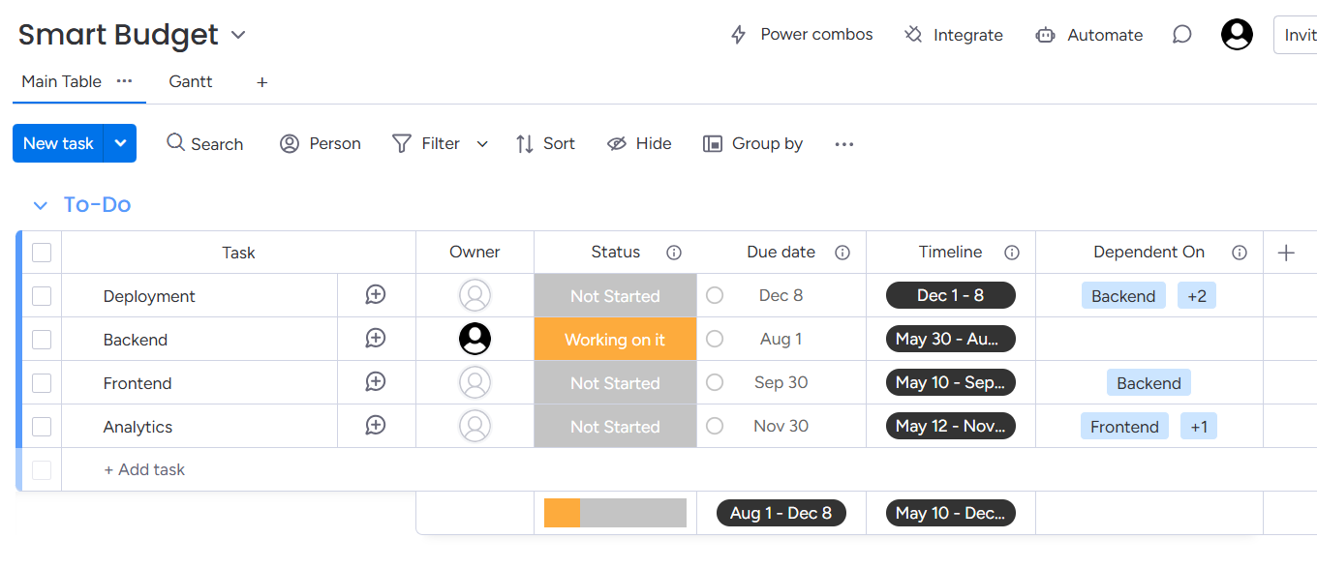
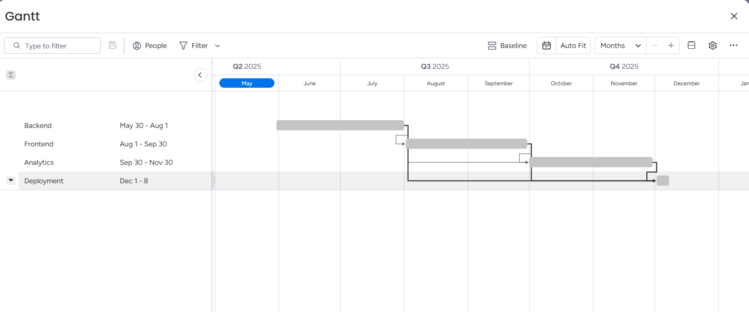
Gannt Chart

Slide 8
TECHNOLOGIES TO BE USED
Layer | Technology | Purpose
Frontend | React.js | SPA frontend with components
 | Material-UI (MUI) | UI components (buttons, forms, layout)
 | Chart.js | Pie and bar charts for analytics
Backend | Express.js | REST API handling and routing
 | Node.js | JavaScript runtime for server
Database | MongoDB Atlas | Stores users and transactions
 | Mongoose | Schema and model creation

Slide 9
TECHNOLOGIES TO BE USED
Layer` | Technology | Purpose
Auth | JWT+bcryptjs | Secure login with token-based auth

Slide 10
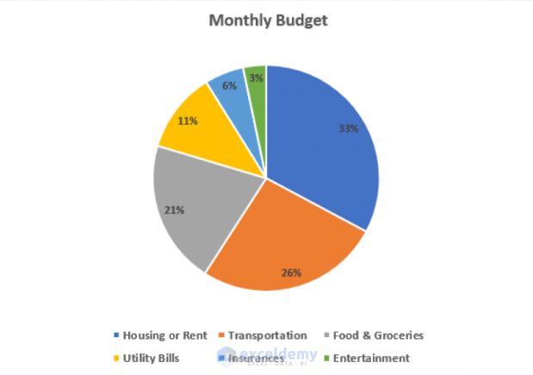
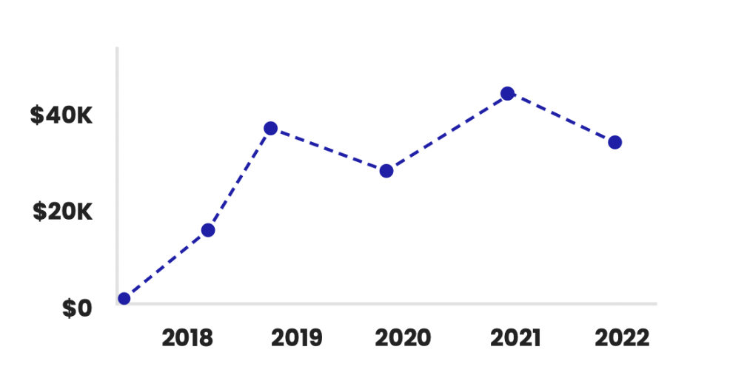
CHART EXAMPLES
Pie Chart used for tracking expenses by
category
Line Chart used for tracking expenses over
time

Slide 11
INDIVIDUAL CONTRIBUTIONS
Backend + Auth + API (Omer Rohina, David Carter)
Frontend UI + Forms + Routing + Dashboard + Analytics (Josef Chicas, Ryan Reddemann)
Deployment + Docs (Everyone)

Slide 12

Any Questions? Comments?

