Slide 1


Slide 2


9
9
9

Slide 3


999
NUMBERS

Slide 4

999
NUMBERS

Slide 5
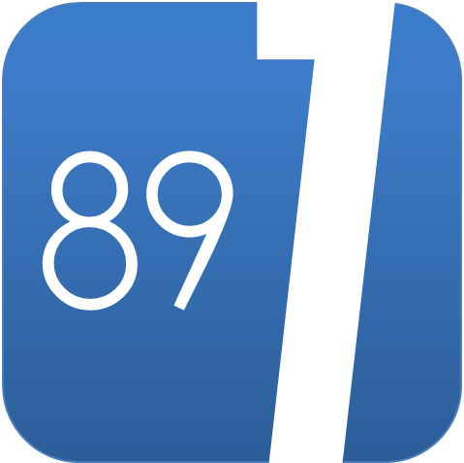
7
89

