Slide 1
Effective GIT
Marius Gundersen & Terje Aasgaard

Slide 2
Distribuert vs Sentralt
Kari
Ola
Sentral repo

Slide 3
Branch
dfbdc2f
Branch A
dfbdc2f

Slide 4
Branch
dfbdc2f
Branch B
dfbdc2f
dfbdc2f
Branch A
dfbdc2f

Slide 5
Branch
dfbdc2f
Branch B
Branch A
dfbdc2f
dfbdc2f
dfbdc2f

Slide 6
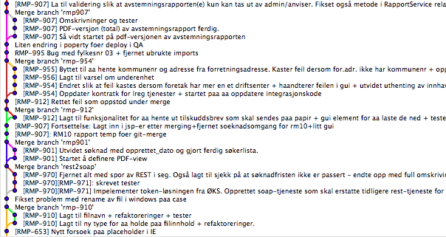
Kontroll over historikken

Slide 7
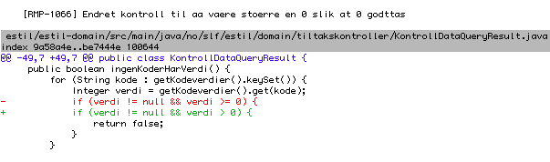
Historikken som verktøy for code review

Slide 8
Demo

Slide 9
Master branch

Slide 10
Master branch

Slide 11
Master branch

Slide 12
Master branch

Slide 13
Master branch

Slide 14
Release branch
1.1
1.0

Slide 15
Bugfix
1.2
1.1
1.0

Slide 16
Bugfix
1.2
1.1
1.0

Slide 17
Deployment
1.2
1.1
1.0

Slide 18
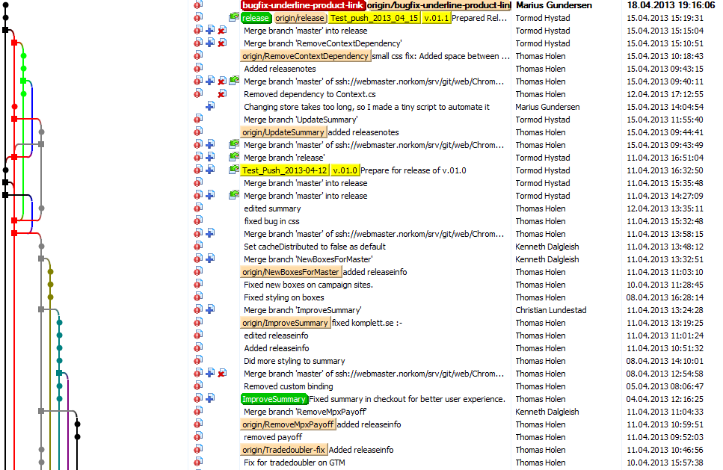
Git historikk

Slide 19
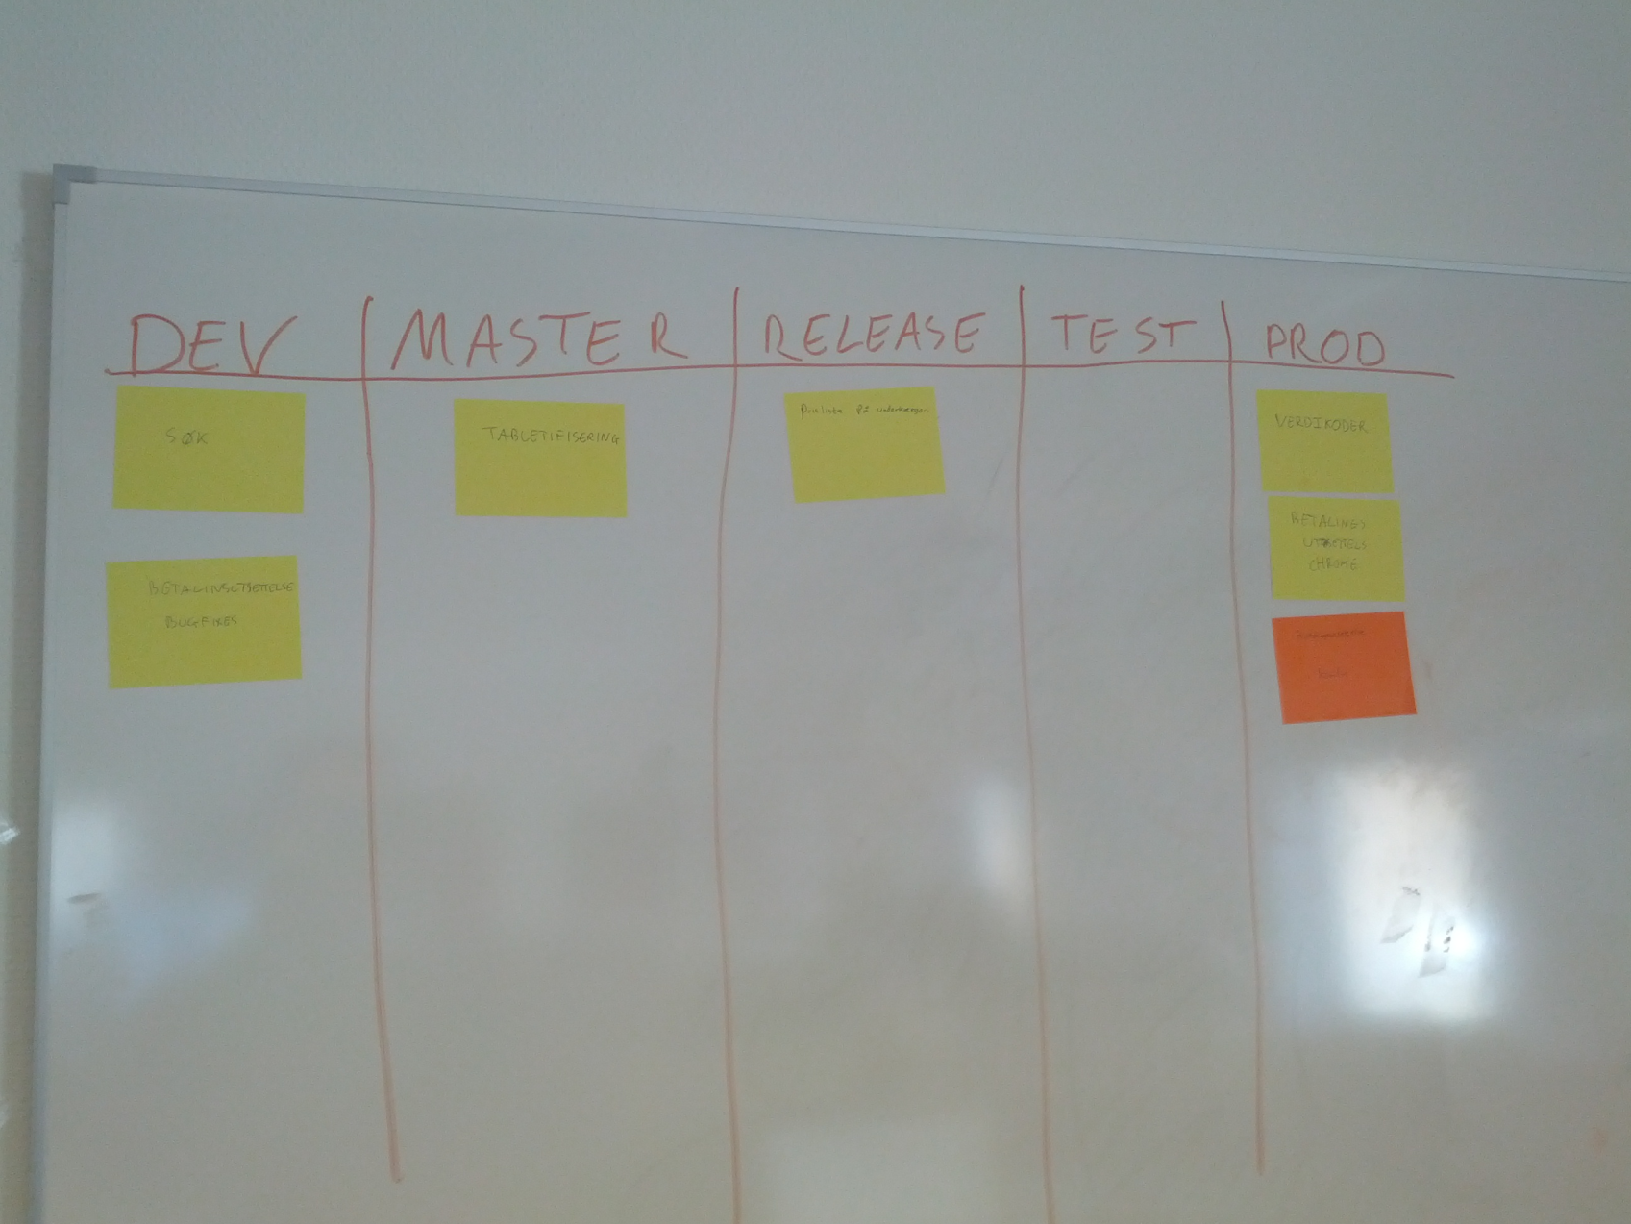
Deployment Tavle

Slide 20
Hva nå?
Advanced Git: http://vimeo.com/49444883
Successful Git branching strategy: http://nvie.com/posts/a-successful-git-branching-model/

