Slide 1
Inteligent and Mobile Robotics - 1st project
Development of a reactive agent for a simulated robot
that solves labyrinths
Vedran Semenski, Aveiro, October 2014.

Slide 2


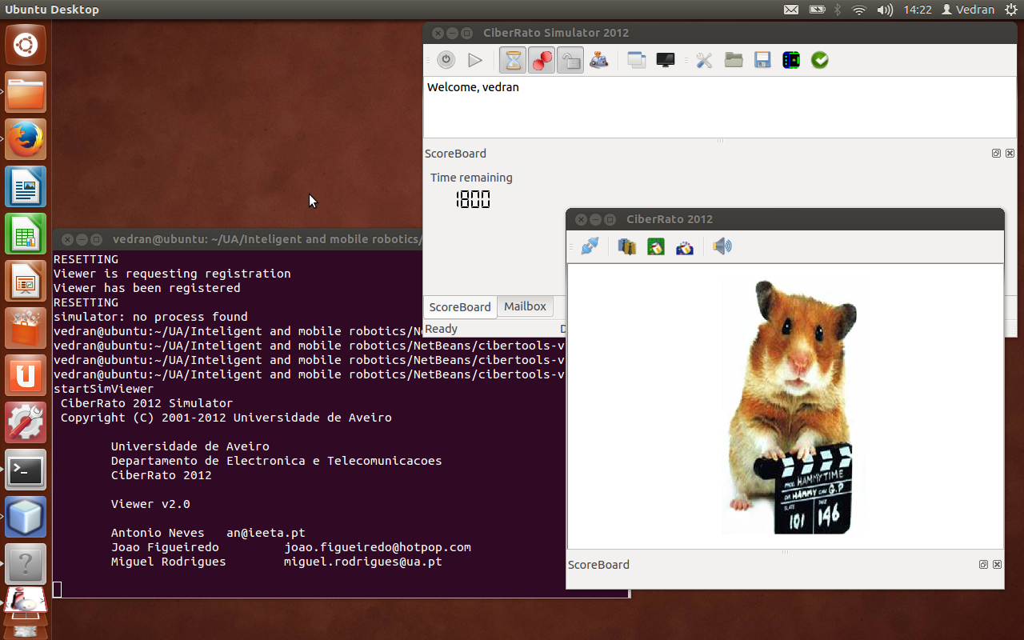
Intro
Java
NetBeans
Simulator
CiberIF
University of Aveiro, October 2014.

Slide 3
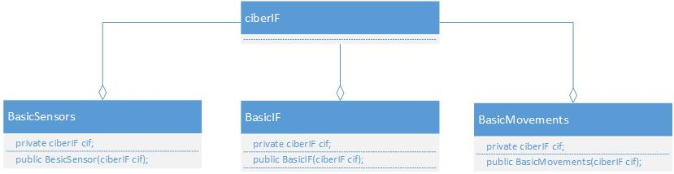
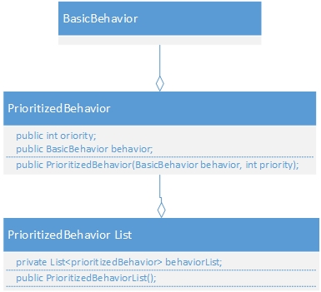
Basic concept
Abstracting the CiberIF
  Movements
  Sensors
  Interface
Robotic Agent (Factory)
Subsumption Architecture
  Prioritized list of behaviors
Behaviors
University of Aveiro, October 2014.

Slide 4
Behaviors
Avoid colision
Finish
Follow the beacon
Follow beacons approximate location
Follow the wall
Wander
University of Aveiro, October 2014.

Slide 5
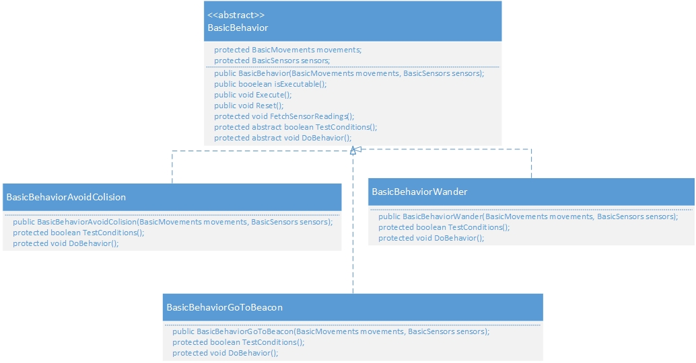
Behaviors
University of Aveiro, October 2014.

Slide 6
Workflow
BasicWorkflow:
Main function creates an Agent using AgentFactiory
Initialisation
Start loop
  Refreshing sensor readings
  Testing behaviors
  Execution of behavior with highest priority
  Check if the agent finished
End
University of Aveiro, October 2014.

Slide 7
Conclusion
Advantages:
Limitations
Simple
Good results
Flexible
Fast
Set and forget
  learning
  adaptability
Limited improvement options
University of Aveiro, October 2014.

