Slide 1
Development of an agent for a robot that solves labyrinths
Intelligent and Mobile Robotics - 2nd project
Vedran Semenski, Aveiro, November 2014.

Slide 2
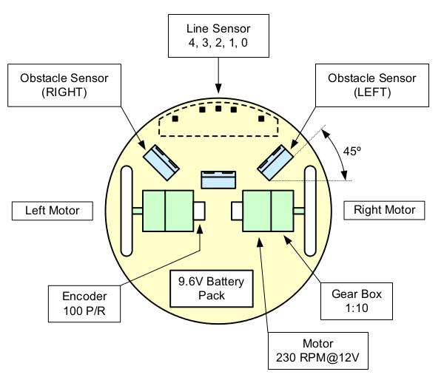
Intro
C
Basic text editor
Robot
pcompile
University of Aveiro, November 2014.

Slide 3
Basic concept
Abstracting the robot
  Movements
  Sensors
Subsumption Architecture
  Prioritized list of behaviors (dinamic)
Behaviors
University of Aveiro, November 2014.

Slide 4
Behaviors
Stop at beacon
Avoid collision
Follow the beacon
Follow the wall
Wander
Stop at starting position
Return to starting position (avoid loops)
Beacon sensor servo
University of Aveiro, November 2014.

Slide 5
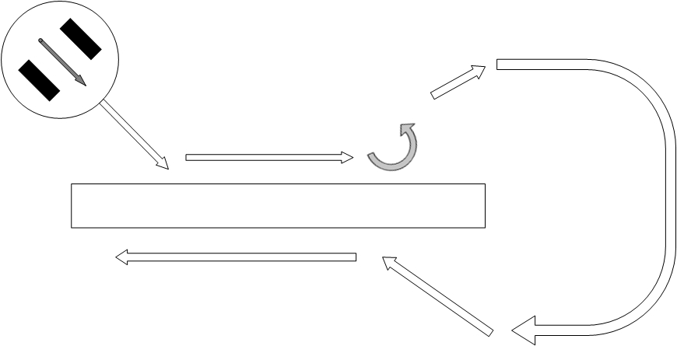
Behaviors – follow the wall
University of Aveiro, November 2014.

Slide 6
Dinamic proprity list 1
Default (starting) list
Stop at beacon
Avoid colision
Follow the beacon
Follow the wall
Wander
University of Aveiro, November 2014.

Slide 7
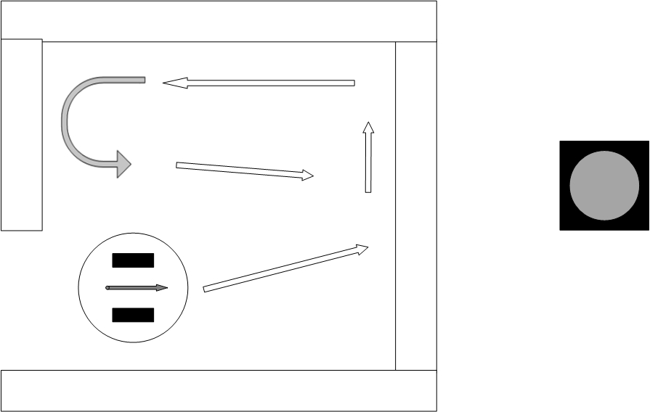
Problem
University of Aveiro, November 2014.

Slide 8
Dinamic proprity list 2
After promoting
Stop at beacon
Avoid collision
Follow the wall
Follow the beacon
Wander
University of Aveiro, November 2014.

Slide 9
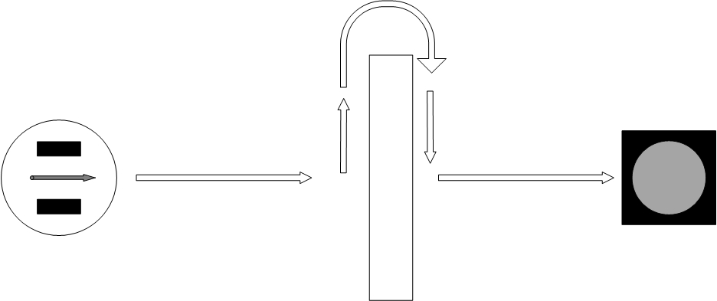
Result
University of Aveiro, November 2014.

Slide 10
Dinamic proprity list 3
Returning priority list(s)
Stop at starting position
Avoid collision
Return to starting position
Follow the wall
Wander
Stop at starting position
Avoid collision
Follow the wall
Return to starting position
Wander
University of Aveiro, November 2014.

Slide 11
Workflow
BasicWorkflow:
Initialisation
Start loop
  Refreshing sensor readings
  Testing behaviors
  Execution of behavior with highest priority
    Update priority list/promote behavior/ demote behavior
  Check if finished
End
University of Aveiro, November 2014.

Slide 12
Conclusion
Advantages:
Limitations
Simple
Good results
Flexible
Fast
Set and forget
  learning
  adaptability
Limited improvement options
University of Aveiro, November 2014.

