Slide 1

Introduction to
Windows 10 IoT core
ANURAJ P
www.dotnetthoughts.net

Slide 2
Agenda
Introduction to IoT
Rasberry PI 2
Installing Windows IoT core to Rasberry PI
Connecting to Rasberry PI
Develop application with VS2015 for IoT
Questions

Slide 3
Internet of Things (IoT)
The Internet of Things (IoT) is a scenario in which objects, animals or people are provided with unique identifiers and the ability to transfer data over a network without requiring human-to-human or human-to-computer interaction.

Slide 4
According to Gartner, Inc. (a technology research and advisory corporation), there will be nearly 26 billion devices on the Internet of Things by 2020.
ABI Research estimates that more than 30 billion devices will be wirelessly connected to the Internet of Things by 2020

Slide 5
Where we can use IoT?
Media
Environmental monitoring
Infrastructure management
Manufacturing
Energy management
Medical and healthcare systems
Building and home automation
Transportation

Slide 6
Raspberry Pi
The Raspberry Pi is a low cost, credit-card sized computer that plugs into a computer monitor or TV, and uses a standard keyboard and mouse. It’s capable of doing everything you’d expect a desktop computer to do, from browsing the internet and playing video, to word-processing, and playing games.

Slide 7
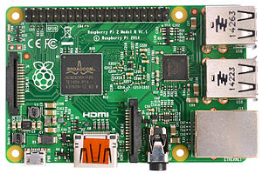
Raspberry Pi 2
CPU | 900 MHz quad-core ARM Cortex-A7
Memory | 1 GB RAM
Storage | MicroSDHC slot
Graphics | Broadcom Video Core IV
Power | 4.0 W

Slide 8
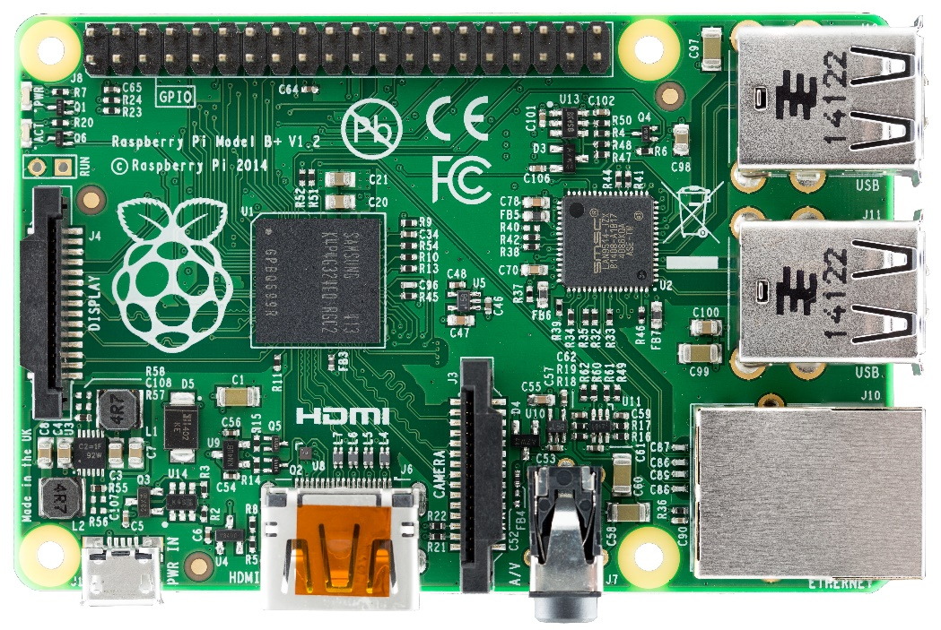
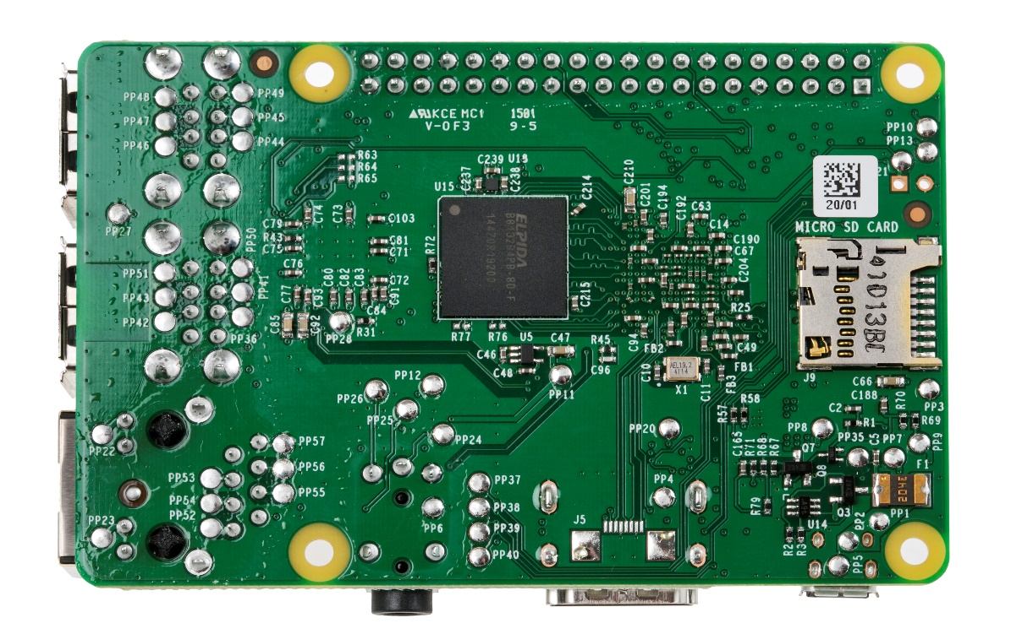
Raspberry Pi 2
USB Ports
SD Card
HDMI output
Network Cable
Audio
Power

Slide 9
Window10 + Raspberry Pi
At //Build 2015, Microsoft demonstrated a version of
Windows running on a Raspberry Pi 2 board.

Slide 10
Installing Window10 IoT core to
Raspberry Pi
1. Download Windows 10 IoT core –
http://go.microsoft.com/fwlink/?LinkId=616847
2. Mount ISO and Install Windows_10_IoT_Core_RPi2.msi
3. Insert a micro SD card into your SD card reader.
4. Use IoTCoreImageHelper.exe to flash the SD card.

Slide 11
Installing Window10 IoT core to
Raspberry Pi
5. The tool will enumerate devices as shown. Select the
SD card you want to flash and then provide the location
of the ffu and flash the image.
6. Click on the Safely Remove Hardware icon in your task
tray and select your USB SD card reader to safely remove
it from the system.
Failing to do this can cause corruption of the image.

Slide 12
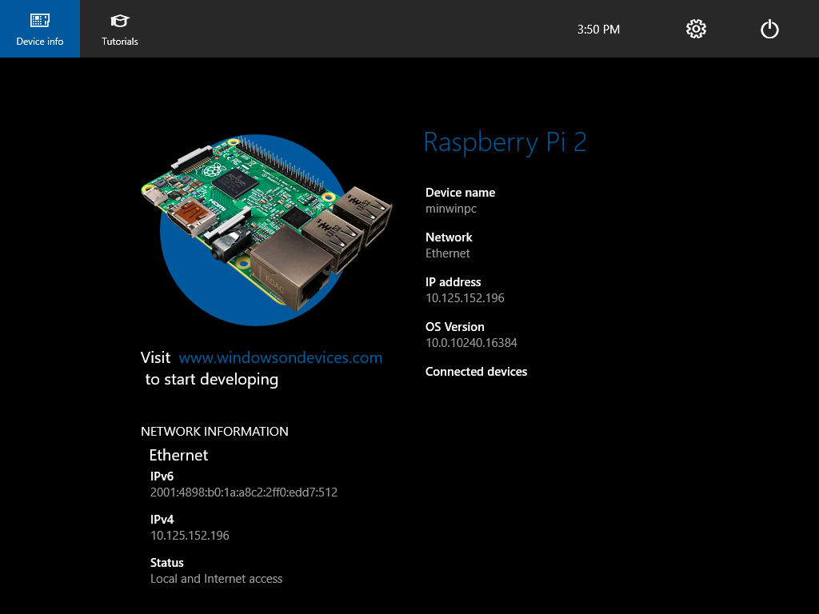
Boot Windows 10 IoT core
Windows 10 IoT Core will boot automatically after connecting the power supply. This process will take a few minutes.
Once the device has booted, the DefaultApp will launch and display the IP address of your RPi2.

Slide 13
Connecting to Raspberry Pi 2
Using Windows IoT Core Watcher.
Using PowerShell
Using FTP.
Default credentials
Username : administrator
Password : p@ssw0rd

Slide 14
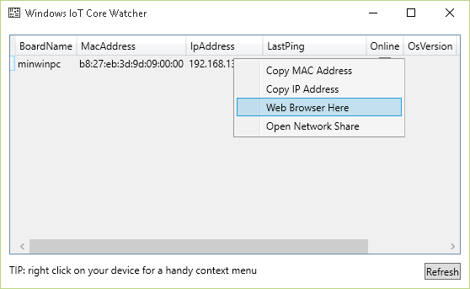
Using Windows IoT Core Watcher

Slide 15
Using PowerShell
1. To start “Windows PowerShell” entry and
select “Run as administrator”
2. Execute following commands
1. net start WinRM
2. Set-Item WSMan:\localhost\Client\TrustedHosts -Value <machine-name or IP Address>
3. Enter-PSSession -ComputerName <IP Address> -Credential <IP Address or localhost>\Administrator

Slide 16
Using PowerShell
How change password
net user Administrator [new password]

Slide 17
Using FTP
1. Verify FTP service is running – netstat –a –n –o.
2. Connect using any FTP client

Slide 18
Develop application with VS2015 for IoT
1. Enable Developer mode in Windows 10
2. Install Universal Application Development tools and SDKs.

Slide 19
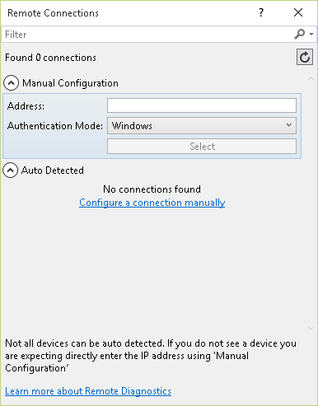
Develop application with VS2015 for IoT

Slide 20
Develop application with VS2015 for IoT
1. Change target platform to ARM
2. Change the deployment target to remote machine.
3. In the remote connections window – Provide the IP address and change authentication mode to None.
4. Run the application

Slide 21
Questions?

