Slide 1

ASP.NET 5 development with yeoman tools
ANURAJ
@anuraj
www.dotnetthoughts.net

Slide 2
What is Yeoman
Yeoman helps you to kick-start new projects, prescribing best practices and tools to help you stay productive. Yeoman provide a generator ecosystem. A generator is basically a plugin that can be run with the `yo` command to scaffold complete projects or useful parts.

Slide 3
Yeoman tools
The Yeoman workflow comprises three types of tools for improving your productivity and satisfaction when building a web app: the scaffolding tool (yo), the build tool (Grunt, Gulp, etc) and the package manager (like Bower and npm).

Slide 4
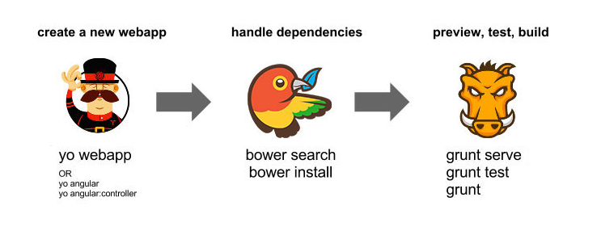
Yeoman tools

Slide 5
Installing yo and some generators
First, you'll need to install yo and other required tools
npm install -g yo bower grunt-cli gulp
Installing ASP.NET 5 generator
npm install -g generator-aspnet

Slide 6
Basic scaffolding
To scaffold a web application, you'll need to install the generator-webapp generator. To scaffold ASP.NET 5 application, execute.
yo aspnet
https://github.com/OmniSharp/generator-aspnet

Slide 7
Basic scaffolding – ASPNET 5

Slide 8
Demo
ASP.NET Web Application with yeoman
ASP.NET Unit Test project with yeoman

Slide 9
Resources
http://yeoman.io/
https://github.com/OmniSharp/generator-aspnet
http://yeoman.io/generators/

Slide 10
Questions?

