Slide 1
Developing a Reference Framework for Typical Development in the Young Pig
Abstract Presentation Number: OR06-01-21 Oral Session Title: Challenges to Development from Perinatal Nutrition (Oral 6)

Slide 2
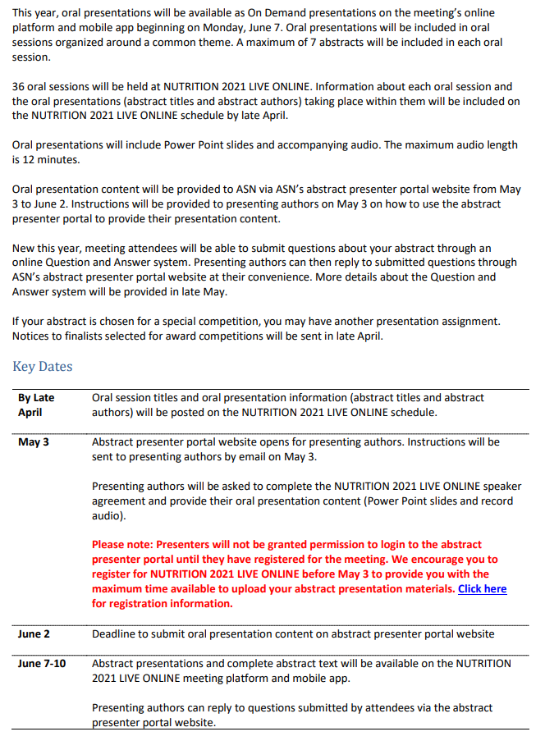
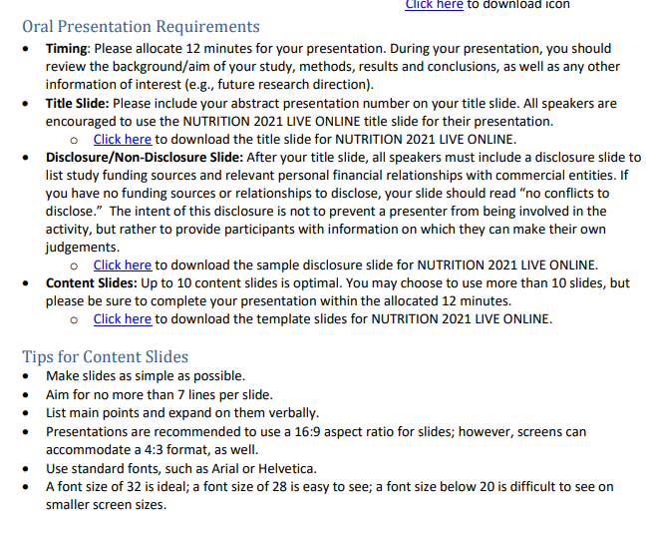

Slide 3
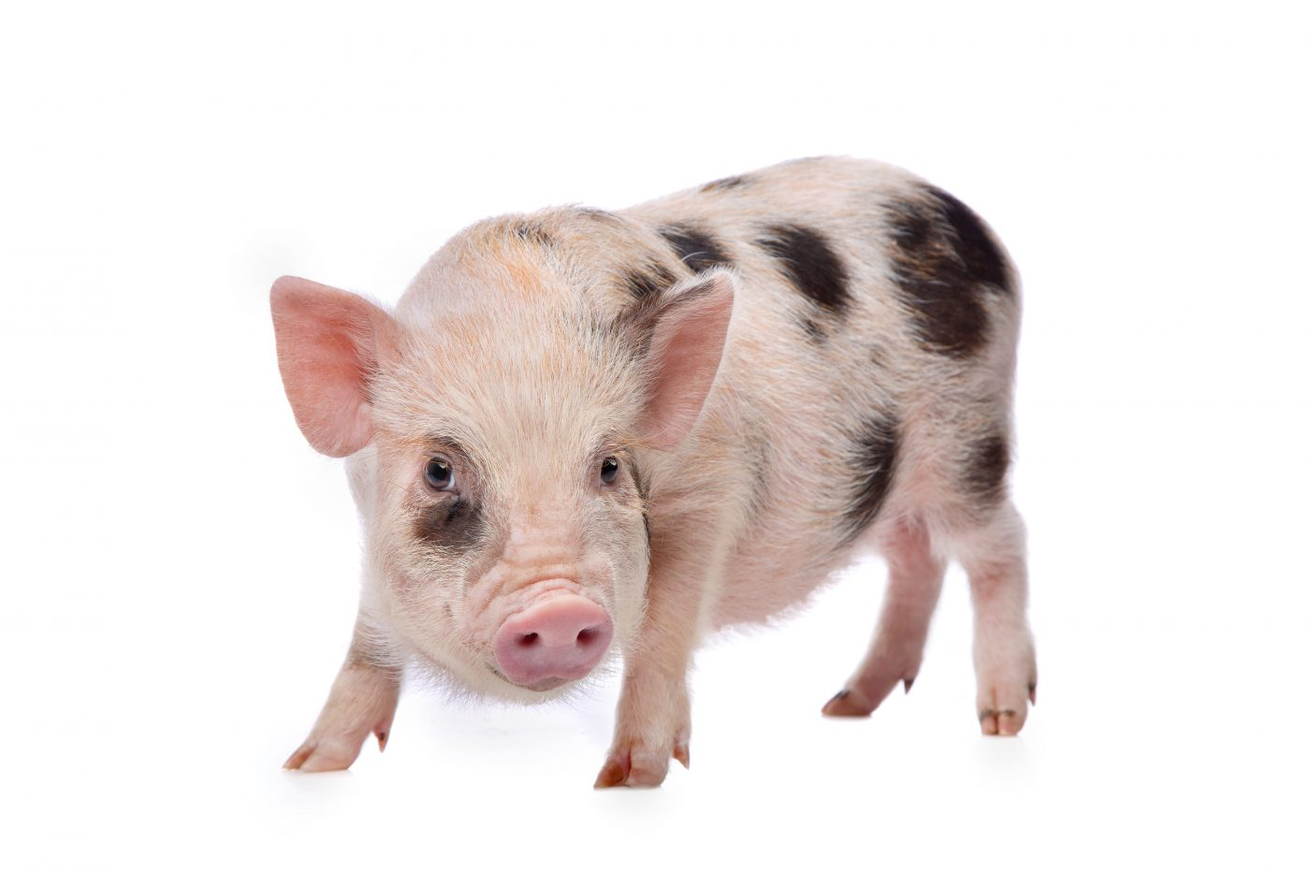
Background information
The National Academy of Medicine recommends nonhuman primates and young pigs as alternative developmental models to rodents given the difficulty of feeding preweaning rodents
Use of the pig model for biomedical research is well described and this model provide high translational power.

Slide 4
Preclinical assessments of pediatric products
The pig model allows for great experimental control and precision, but appreciating the differences between artificially- and sow reared pigs is critical.
Artificially reared pigs are raised in absence of maternal care, do not consume porcine milk, and have minimal interaction with littermates
Despite these differences, growth has been shown to be equivalent between artificially-and sow-reared pigs¹
Motivation
Clinical trials investigating novel formulas rely on standardized growth charts in order to assess growth and tolerance.
Reference ranges are currently not available for young pigs which may lead to misinterpretation of data.
9) Fil JE, Joung S, Hayes CA, Dilger RN. Influence of Rearing Environment on Longitudinal Brain Development, Object Recognition Memory, and Exploratory Behaviors in the Domestic Pig (Sus scrofa). Frontiers in Neuroscience. 2021;15:649536. doi:10.3389/fnins.2021.649536

Slide 5





Solution – Creation of Historical Standards for Normative Development
We propose a creation of a living database containing raw data on pig body and organ growth values.
This initial step will be accomplished by compiling raw data on body and organ weights from birth to 30 days postnatal (PND) along with metadata from rearing conditions across a decade of research
Import
Data management and
storage
Tidy
Transform
Visualize
Model
Modelling, visualization, and manuscript writing
Communicate
Ultimately, we call for a collaboration across public and private organization to contribute to this database to achieve this common goal

Slide 6
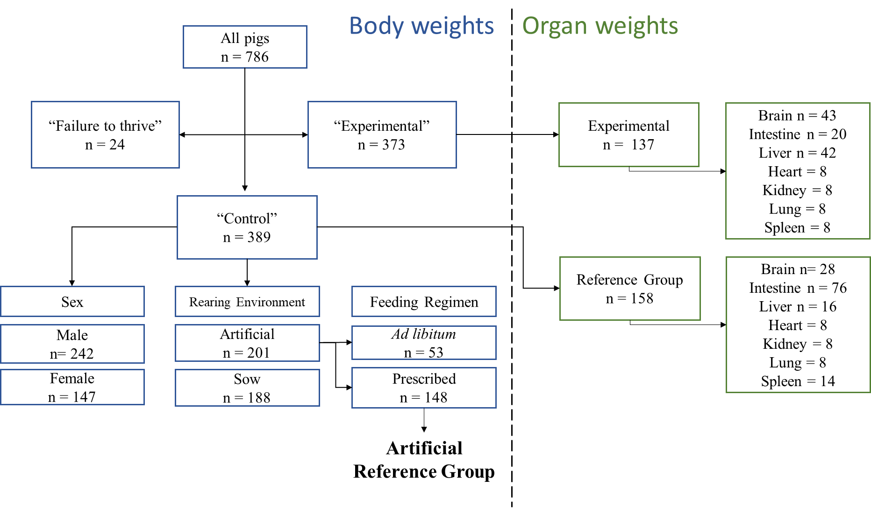
Schematic for the different inclusion and exclusion categories

Slide 7
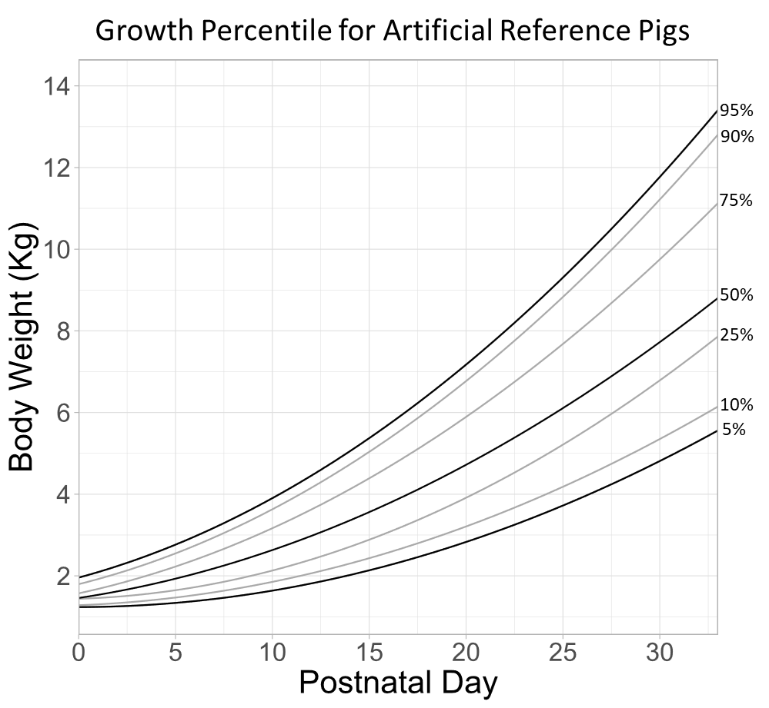
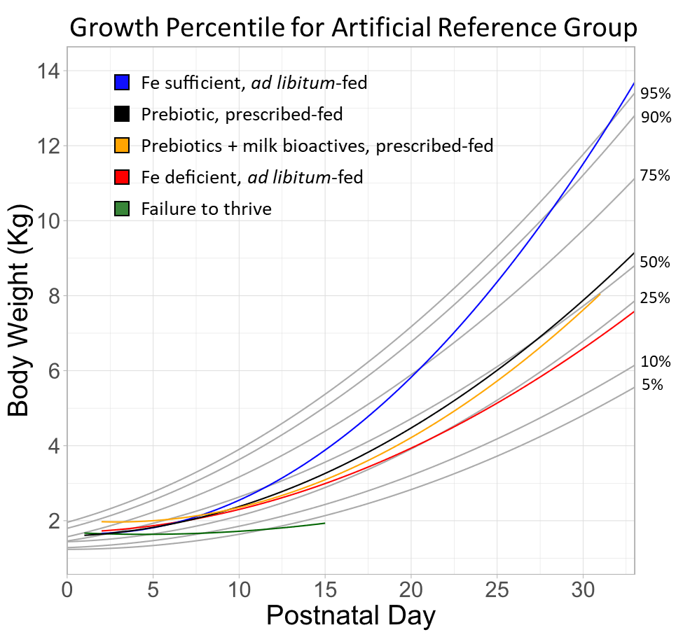
Growth Percentile Plots Depicting Typical Growth

Slide 8
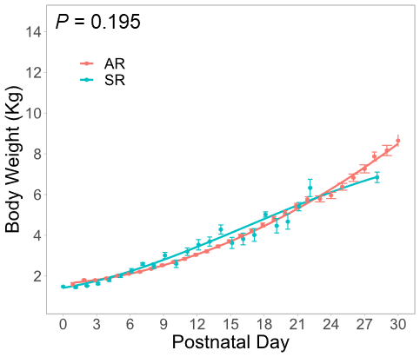
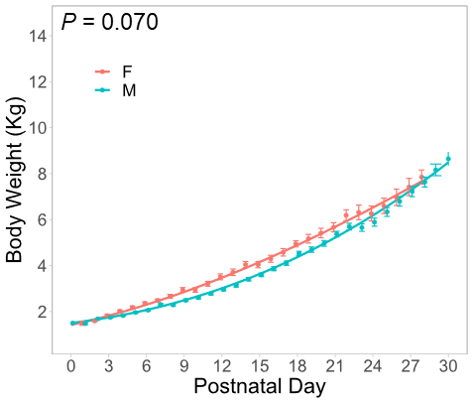
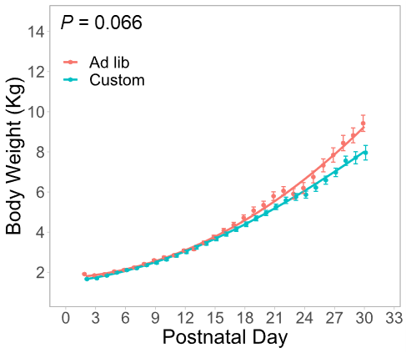
Rearing, Sex, and Feeding Style Differences does not Affect Growth Rate of Pigs PND 0-30

Slide 9
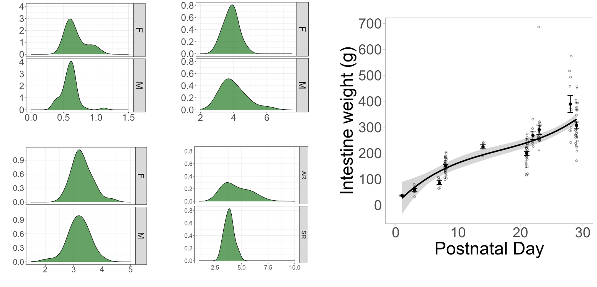
Rearing, Sex, and Feeding Style Differences does not Affect Growth Rate of Pigs PND 0-30

Slide 10
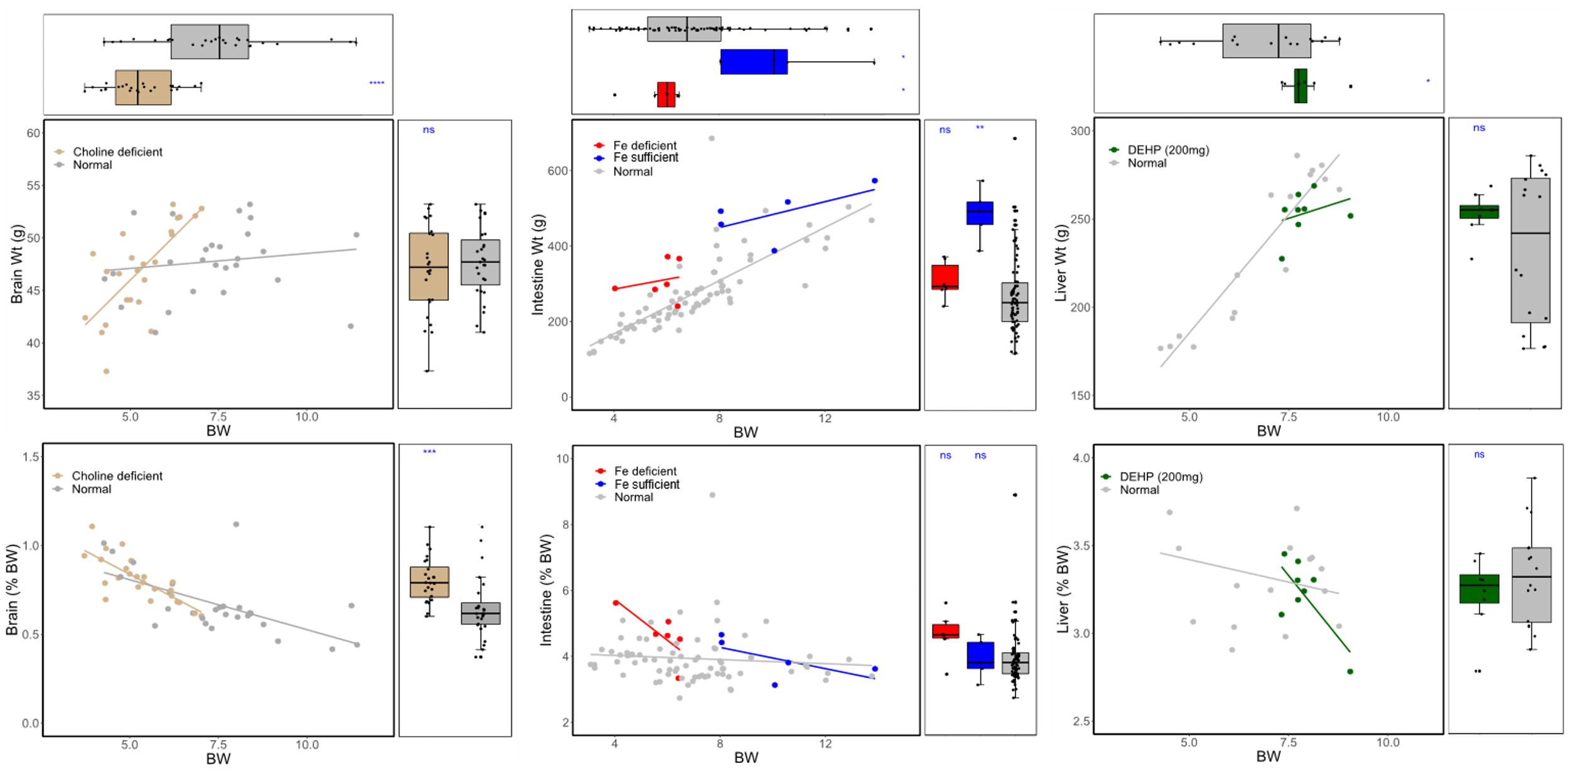
Rearing, Sex, and Feeding Style Differences does not Affect Growth Rate of Pigs PND 0-30
Reference
Reference
Reference
Reference
Reference
Reference

Slide 11
Conclusion
Table 2. Studies included
Study | Description | Rearing environment | Sex | Feeding regimen | Organs available | Reference
1 | Feeding trial on arginine supplementation | Sow-reared | MF | NA | - | ²³
2 | Feeding trial on perinatal choline deficiency and metabolomics | Sow-reared | MF | NA | Brain, liver | ²¹
3 | Feeding trial on perinatal choline deficiency and brain development | Sow-reared | MF | NA | Brain, liver | ³⁷
4 | Feeding trial on prebiotics and milk bioactives | Artificial | M | Prescribed | Brain, intestines | ¹⁶
5 | Study on choline deficiency and porcine milk composition | Sow-reared | MF | NA | - | ²²
6 | Development of behavioral testing methods | Artificial | F | Prescribed | - | Unpublished
7 | Feeding trial on alpha-lipoic acid | Artificial | M | Prescribed | Brain, intestine | ¹³
8 | Feeding trial on sialyllactose | Artificial | M | Prescribed | Intestine | ¹⁷
9 | Internal study comparing commercial milk replacers | Artificial | F | Prescribed | - | Unpublished
10 | Feeding trial on pectin | Artificial | MF | Prescribed | - | ¹⁴
11 | Feeding trial on polydextrose and galactooligosaccharide | Artificial | M | Prescribed | Intestine | ¹⁵
12 | Internal study assessing growth | Artificial | M | Prescribed | - | Unpublished
13 | Feeding trial on iron deficiency | Artificial | M | Ad libitum | Brain, intestine, liver | ²⁰
14 | Internal study testing behavioral paradigms with sow-reared pigs | Sow-reared | MF | NA | - | Unpublished
15 | Feeding trial on sialyllactose | Artificial | M | Ad libitum | - | ²⁴
16 | Study on brain development | Artificial and Sow-reared | M | Ad libitum | Brain | ³⁸
17 | Feeding trial on milk fat globule membrane | Artificial | M | Ad libitum | - | ¹⁸
18 | Internal study on maternal egg intake and offspring behavior | Sow-reared | MF | NA | - | Unpublished
19 | Feeding trial on polydextrose and galactooligosaccharide | Artificial | Not specified | Prescribed | Intestine | ¹¹
20 | Feeding trial on phthalate exposure using DEHP | Artificial | MF | NA | Brain, intestine, liver, lung, heart, kidney, spleen | Unpublished
21 | Feeding trial on polydextrose and galactooligosaccharide | Artificial | MF | Prescribed | Intestine | ¹²
22 | Study on immune system development in sow-reared pigs | Sow-reared | MF | NA | Intestine | Unpublished
We compiled growth data on body and organ weights from a decade of studies using young pig as a biomedical model
This database is a first step toward defining biological normal during critical developmental periods.
Our references standards can be used as a tool for the assessment of the safety and efficacy in the development of novel ingredients used in infant nutrition

Slide 12

Limitations of Data
Given the dynamic nature of scientific objectives over a decade, this database was highly imbalanced with respect to the study designs, sampling frequencies, and sample sizes between studies
These factors, however, may have minimal effect on the interpretation of data within a study as all subjects were treated similarly.
The data reported were chosen as they were all from studies conducted by and owned by the authors, who had access to the raw data.
Future opportunities
This database serve as a first step towards organizing research from multiple institutions, which will allow far greater power to understand biological development.
For safety and efficacy assessments of infant formula, it will provide needed background for assessing the relative risk-to-benefit ratio for novel ingredients.

Slide 13
Funding and Disclosure

