Slide 1
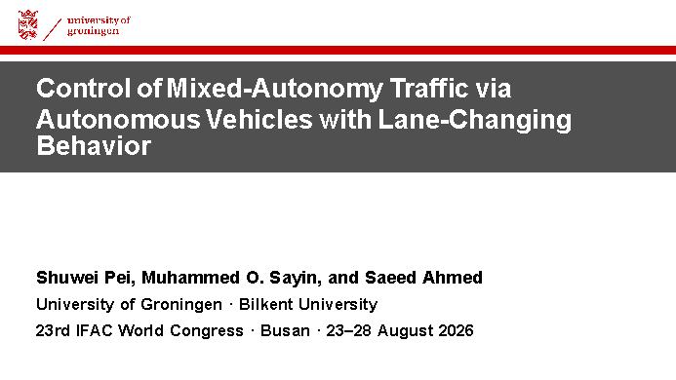
Notes:
Timing: 0:30
Opening: Good morning. I am Shuwei Pei from the University of Groningen. This is joint work with Muhammed O. Sayin from Bilkent University and Saeed Ahmed from the University of Groningen.
Main explanation: We study how human lane-changing changes the classical traffic-stabilization problem. The focus of this talk is the methodological derivation: from problem formulation, through reinforcement learning, to an interpretable rule-based controller.
Scientific interpretation: The final controller is not introduced as an isolated heuristic. It is derived from a sequence of controlled learning experiments.
Transition: I will begin with why lane-changing changes the nature of the control problem.
Likely question: Is the final controller learned? No. RL is used as a design instrument; the deployed PARC controller is rule-based.
[Sources] Docs/ifacconf8pages.tex, title and author block; official IFAC 2026 congress information; UoG-Wide.pptx.

Slide 2
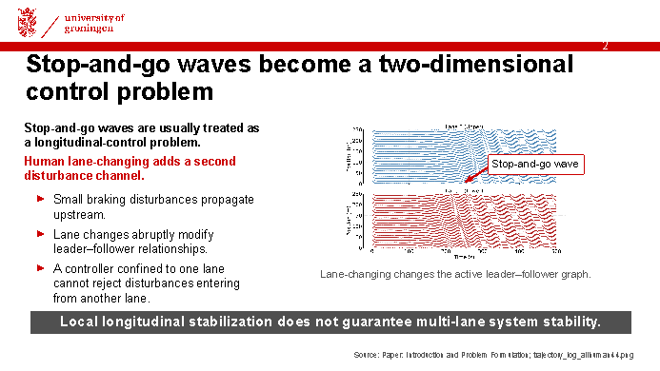
Notes:
Timing: 0:50
Opening: Stop-and-go oscillations are repeated vehicle deceleration and acceleration rather than steady motion.
Main explanation: A braking disturbance propagates upstream through car-following interactions. A lane change does more than move one vehicle laterally: it changes which vehicles interact longitudinally. This creates a hybrid, cross-lane disturbance channel.
Scientific interpretation: A controller may stabilize its own local platoon while the complete two-lane system remains unstable. Local longitudinal stabilization is therefore not equivalent to multi-lane system stability.
Transition: This limitation becomes clearer when we compare the main control paradigms used in traffic research.
Likely question: Are all lane changes undesirable? No. The controlled ring isolates unnecessary, destabilizing lane changes in dense traffic; necessary route-following lane changes remain a separate problem.
[Sources] Docs/ifacconf8pages.tex, Introduction and Problem Formulation; Docs/trajectory_log_allhuman44.png.

Slide 3
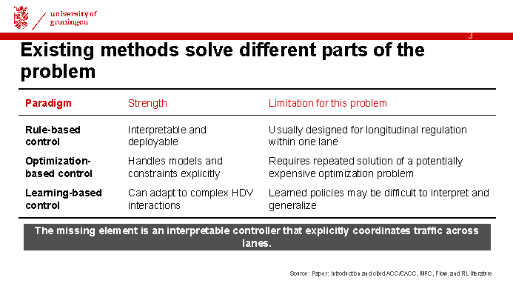
Notes:
Timing: 1:00
Opening: The paper positions the problem across three established traffic-control paradigms.
Main explanation: Rule-based methods such as ACC and CACC are attractive because they are interpretable and deployable. Optimization-based approaches, including MPC and robust control, can explicitly handle objectives and constraints but introduce computational and modeling requirements. Learning-based approaches can adapt to complex HDV interactions, although the resulting policies may be difficult to interpret.
Scientific interpretation: We use RL as a scientific policy-search and mechanism-discovery tool. The missing element is an interpretable controller that coordinates traffic explicitly across lanes.
Transition: This leads to three methodological questions that organize the complete study.
Likely question: Why not start directly with MPC? The purpose of this paper is to identify a useful coordination structure experimentally before constructing a transparent rule-based controller.
[Sources] Docs/ifacconf8pages.tex, Introduction and cited literature.

Slide 4
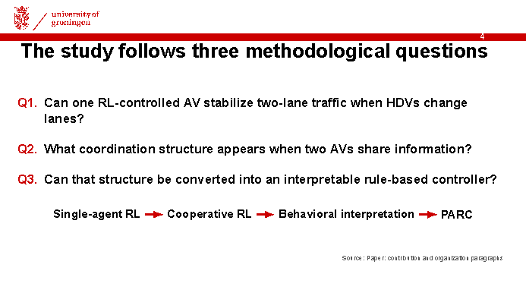
Notes:
Timing: 0:45
Opening: The paper does not begin by assuming PARC is the correct controller.
Main explanation: The first experiment tests whether the classical single-AV result generalizes to lane-changing traffic. The second changes the information and control architecture by introducing two coordinated AVs. The third interprets the learned behavior and converts it into a transparent controller.
Scientific interpretation: The sequence separates failure diagnosis, behavior discovery, and controller design. The final controller does not require RL inference at runtime.
Transition: To answer these questions, we first construct a controlled two-lane testbed.
Likely question: Was pairing specified from the beginning? Pairing is encouraged by the cooperative reward, but the rule-based controller is constructed only after interpreting the trained policy behavior.
[Sources] Docs/ifacconf8pages.tex, contribution and organization paragraphs.

Slide 5
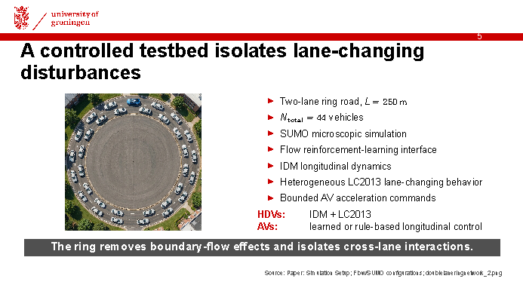
Notes:
Timing: 1:00
Opening: The ring maintains a controlled traffic density and removes inflow and outflow boundary effects.
Main explanation: The network has two 250-metre lanes and 44 vehicles in total. SUMO supplies microscopic traffic dynamics and Flow connects the RL policy. HDVs use longitudinal car-following behavior and LC2013 lane-changing. Randomized driver parameters create heterogeneous behavior.
Scientific interpretation: Oscillations are established before active controller performance is evaluated. I avoid stating one common warm-up duration because the rule-based configurations use 5000 steps at 0.1 seconds while some RL configurations use 2000 steps at 0.1 seconds.
Transition: We represent the resulting sequential decision problem as a Markov decision process.
Likely question: Are there exactly 22 vehicles in each lane? The study uses 44 vehicles on two lanes, but the configurations do not support that wording uniformly across every run.
[Sources] Docs/ifacconf8pages.tex, Simulation Setup; paired_ring.py; singleagent_ring.py; singleagent_ring2AV.py; Docs/doublelaneringnetwork_2.png.

Slide 6
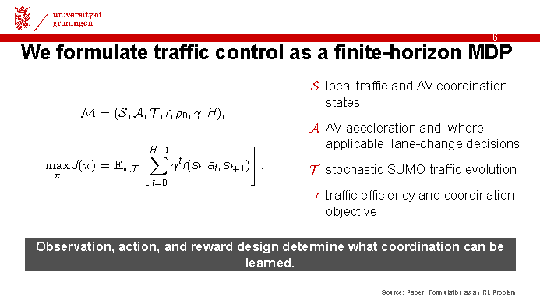
Notes:
Timing: 0:50
Opening: I will not give a general reinforcement-learning tutorial; I will map the MDP directly to this traffic problem.
Main explanation: The state contains local traffic variables and, later, AV coordination variables. The action controls AV acceleration and, in the single-agent formulation, a lane-change decision. SUMO determines the stochastic state transition. The reward specifies traffic efficiency and coordination objectives.
Scientific interpretation: The important design choices are observation, action, and reward. These choices determine both the information available to the policy and the coordination structures it can learn.
Transition: The first formulation gives one AV information about both lanes but only one local actuator.
Likely question: Is the problem actually infinite horizon? Conceptually yes; the implementation approximates it with a large finite horizon.
[Sources] Docs/ifacconf8pages.tex, Formulation as an RL Problem.

Slide 7
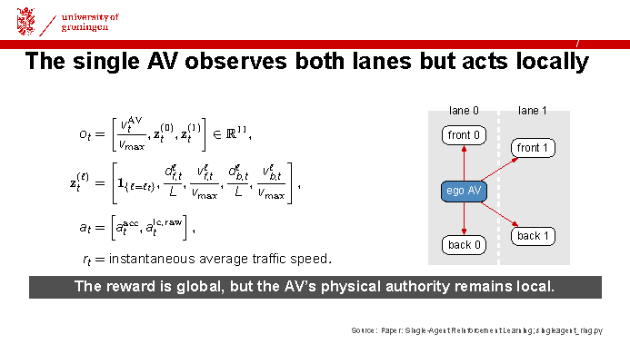
Notes:
Timing: 1:10
Opening: The single AV observes both lanes but still acts as one local vehicle.
Main explanation: The observation has dimension 11. The first element is normalized ego speed. Each lane contributes a lane indicator and normalized front and back distance and speed. The action contains continuous acceleration and a continuous lane-change intention that is mapped to a discrete lane command. The reward is the instantaneous average speed of all vehicles.
Scientific interpretation: Although the reward is global, the AV's physical authority remains local. Richer information does not create a second actuator in the adjacent lane.
Transition: Under these constraints, the learned policy adopts a rational local strategy.
Likely question: Why include adjacent-lane observations? They allow the policy to anticipate nearby traffic and lane-change opportunities, but they cannot overcome the actuation limitation.
[Sources] Docs/ifacconf8pages.tex, Single-Agent Reinforcement Learning; examples/exp_configs/rl/singleagent/singleagent_ring.py.

Slide 8
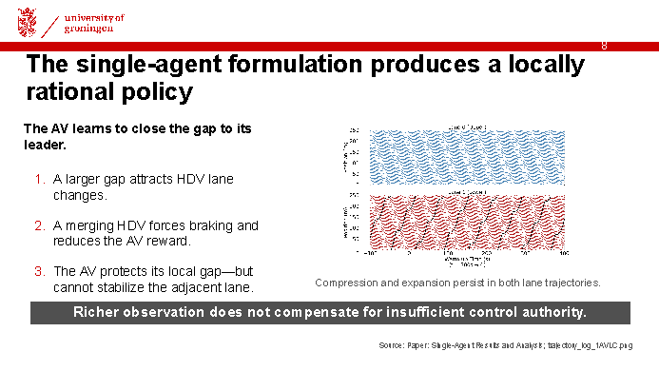
Notes:
Timing: 0:50
Opening: The result should not be interpreted simply as failed optimization.
Main explanation: Close-following is a reasonable response to the reward and the risk of another vehicle merging into the AV gap. The AV reduces some merge opportunities around itself. However, disturbances from the adjacent lane continue to propagate.
Scientific interpretation: The limitation is structural: one actuator cannot coordinate two moving lane boundaries. This diagnosis motivates a new architecture rather than merely longer training.
Transition: We therefore introduce a second AV and make cross-lane coordination explicit.
Likely question: Did the single AV have a lane-change action? Yes, but close-following becomes the dominant learned response and the complete system remains unstable.
[Sources] Docs/ifacconf8pages.tex, Single-Agent Results and Analysis; Docs/trajectory_log_1AVLC.png.

Slide 9
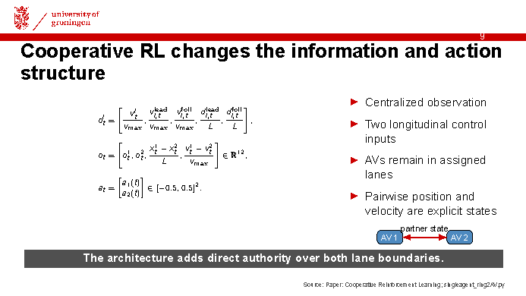
Notes:
Timing: 1:10
Opening: The cooperative formulation changes both information and action structure.
Main explanation: Each AV contributes a five-dimensional lane-local observation. Two additional states represent normalized relative position and relative velocity. The full observation is 12-dimensional. Both AVs remain in assigned lanes and control only longitudinal acceleration.
Scientific interpretation: The controller now has one actuator in each lane and can directly coordinate both moving lane boundaries. The observation is centralized and assumes access to partner state.
Transition: The reward then determines which form of cooperation is encouraged.
Likely question: Is the design decentralized? No. Decentralized sensing, communication delay, and packet loss remain future work.
[Sources] Docs/ifacconf8pages.tex, Cooperative Reinforcement Learning; examples/exp_configs/rl/singleagent/singleagent_ring2AV.py.

Slide 10
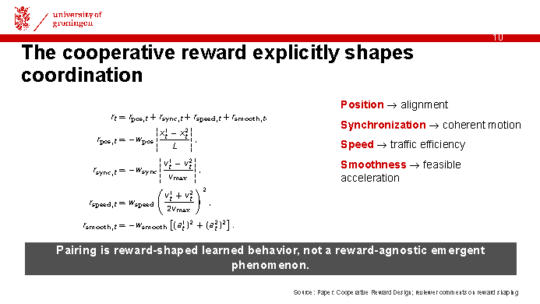
Notes:
Timing: 1:15
Opening: The cooperative reward explicitly determines the desired form of coordination.
Main explanation: The position term favors longitudinal alignment. The synchronization term favors matched velocities. The speed term prevents the pair from optimizing alignment alone, and the smoothness term discourages aggressive acceleration.
Scientific interpretation: The paired structure is encouraged by the reward and should not be described as reward-agnostic emergence. The current weights are empirically selected. The scientific value lies in using the trained policy to expose a controller structure that can be distilled.
Transition: The learned behavior suggests a simple geometric mechanism.
Likely question: Are the reward weights justified by ablation? Not in the current study. Reward ablation and sensitivity analysis are important next experiments.
[Sources] Docs/ifacconf8pages.tex, Cooperative Reward Design; Docs/reviewer_comments_summary.md, Reviewer 6 and Reviewer 8 concerns.

Slide 11
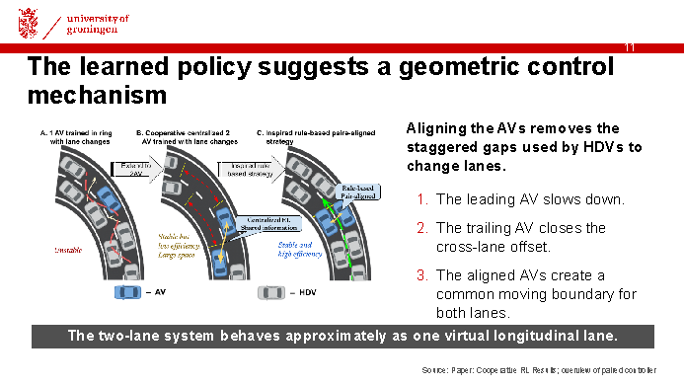
Notes:
Timing: 0:50
Opening: The trained cooperative policy suggests a geometric control mechanism.
Main explanation: The leading AV initially reduces speed so the trailing AV can close the longitudinal offset. Once aligned, the two AVs remove the staggered cross-lane gap. HDVs then see a common moving boundary rather than two independent gaps.
Scientific interpretation: The virtual-lane description refers to coupled longitudinal evolution. It does not mean the physical lanes disappear or that every lane change is undesirable.
Transition: PARC encodes this geometric mechanism as three explicit control modes.
Likely question: Could the same mechanism generalize to more lanes? Possibly, but the current evidence covers only two lanes and two AVs.
[Sources] Docs/ifacconf8pages.tex, Cooperative RL Results and Analysis; Docs/The overview of paired controller for stabilizing flow.png.

Slide 12
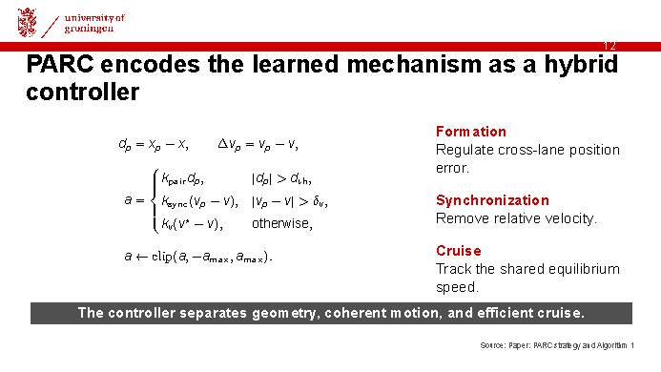
Notes:
Timing: 1:20
Opening: PARC converts the learned behavior into three explicit control modes.
Main explanation: Define d-p as the signed periodic longitudinal displacement to the designated partner. During formation, proportional feedback reduces cross-lane position error. During synchronization, relative velocity is removed after positional alignment. During cruise, both AVs track a common equilibrium speed. All commands are clipped to physical acceleration limits.
Scientific interpretation: The hierarchy makes the mechanism inspectable and separates three tasks that the learned policy blends together. The paper reports simulation evidence rather than a formal hybrid-system stability proof.
Transition: The final control mode requires a traffic-consistent target speed.
Likely question: How are gains and thresholds selected? They are design parameters in the present study; a systematic sensitivity analysis is future work.
[Sources] Docs/ifacconf8pages.tex, Rule-Based Pair-Aligned Control Strategy and Algorithm 1.

Slide 13
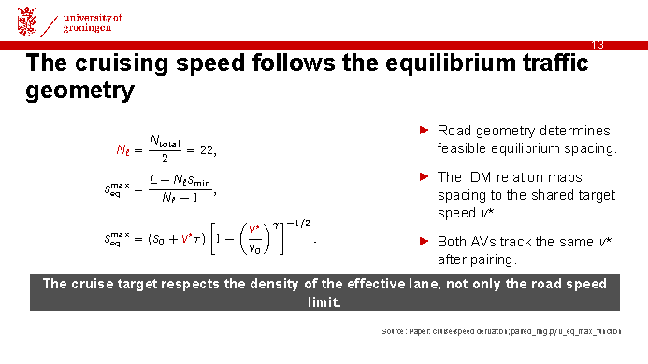
Notes:
Timing: 0:50
Opening: The target speed is not simply set to the road speed limit.
Main explanation: Dense traffic restricts the speed compatible with uniform equilibrium spacing. The implementation computes the equilibrium speed using the effective number of vehicles per lane. With 44 total vehicles and two lanes, it uses N-l equal to 22. The nonlinear IDM relation is then solved numerically for v-star.
Scientific interpretation: This links network geometry and car-following equilibrium directly to the rule-based cruise mode.
Transition: We now compare methods chosen to isolate the value of each methodological step.
Likely question: Why use a per-lane count? The implementation evaluates the equilibrium of the virtual longitudinal lane using TOTAL_VEH divided by LANES.
[Sources] Docs/ifacconf8pages.tex, PARC cruise-speed derivation; examples/exp_configs/non_rl/paired_ring.py, num_per_lane and v_eq_max_function.

Slide 14
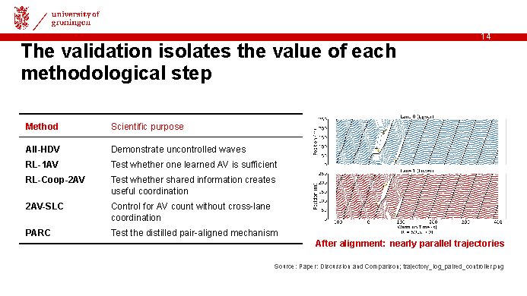
Notes:
Timing: 0:55
Opening: Each baseline answers a separate methodological question.
Main explanation: All-HDV demonstrates the uncontrolled phenomenon. RL-1AV tests the classical single-actuator extension. RL-Coop-2AV tests whether shared information enables coordination. 2AV-SLC is the most important fair baseline because it uses the same number of AVs as PARC without partner coordination. PARC tests whether the distilled mechanism is sufficient.
Scientific interpretation: Nearly parallel time-space trajectories indicate steady motion. The comparison separates the effect of adding AVs from the effect of coordinating them.
Transition: The comparison shows that coordination, rather than AV count alone, produces the improvement.
Likely question: Why is 1AV-SLC not the primary baseline? It does not stabilize the adjacent lane, so it does not solve the complete two-lane problem.
[Sources] Docs/ifacconf8pages.tex, Discussion and Comparison; Docs/trajectory_log_paired_controller.png.

Slide 15
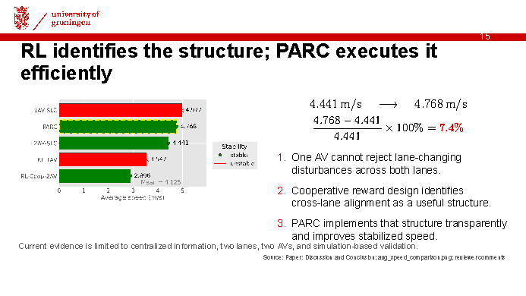
Notes:
Timing: 0:45
Opening: The fair quantitative comparison is PARC versus 2AV-SLC.
Main explanation: Both methods use two AVs and address both lanes. PARC increases stabilized average speed from 4.441 to 4.768 metres per second, corresponding to approximately 7.4 percent. 1AV-SLC reports 4.972 metres per second, but it does not stabilize the adjacent lane. Cooperative RL stabilizes both lanes but operates conservatively because of reward weighting.
Scientific interpretation: RL serves as a design instrument, and PARC becomes the interpretable runtime controller. The current evidence is limited to centralized information, two lanes, two AVs, no optimality proof, and no explicit energy, safety, or comfort evaluation.
Transition: Before questions, I would like to highlight the next IFAC World Congress.
Likely question: Is PARC optimal? No. The result demonstrates relative improvement over selected baselines, not system optimality.
[Sources] Docs/ifacconf8pages.tex, Discussion, Comparison, and Conclusion; Docs/avg_speed_comparison.png; Docs/reviewer_comments_summary.md.

Slide 16
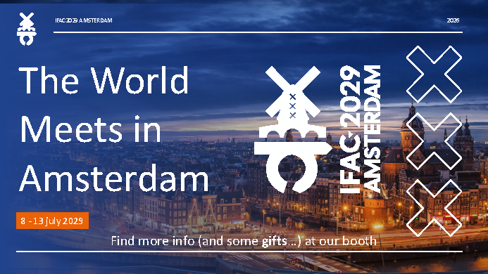
Notes:
Timing: 0:20
Opening: The next IFAC World Congress will take place in Amsterdam from 8 to 13 July 2029.
Main explanation: We look forward to welcoming the IFAC community to the Netherlands. Please visit the IFAC 2029 booth for further information.
Scientific interpretation: This is the official supplied IFAC 2029 advertisement and is intentionally shown unchanged.
Transition: Thank you. I welcome your questions.
Likely question: Where can I find more information? At the IFAC 2029 booth and through future official congress announcements.
[Sources] IFAC29.Advertising.pdf.

