Slide 1
Group 1
Bubbles for Brews
Travis Molnoskey, Gage Stout, Cindy Ngo, Juneelyn Bacaltos, & Tigist Keneni

Slide 2
Overview
Comprehensive summary of all brewery production and locations within the United States
Data collected for production includes 2008 to 2019
D3.js force diagram
Line Graph
Brewery information
Leaflet map
Bar graph

Slide 3

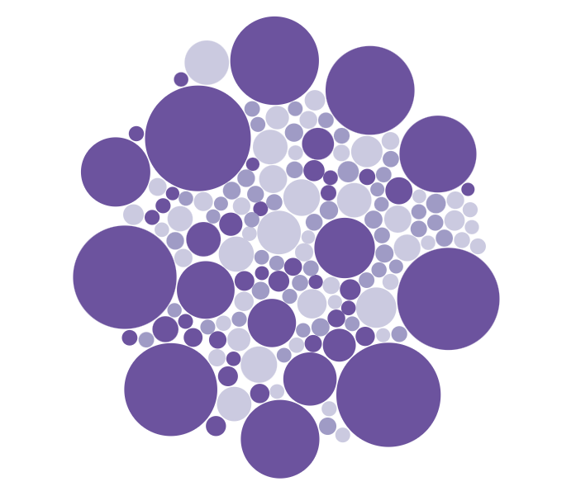
State Brewery Production by Type
D3.js Force is used to create the bubble graph!
Each circle’s radius is based on the size of its production value.
There are three production types
Bottles & Cans
Kegs & Barrels
On Premises
Force essentially allows you to apply a physical push/pull on the circles
Used in several physics papers!

Slide 4
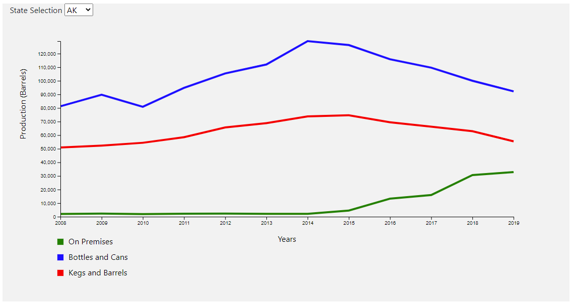
Brewery Production over Time
Effective visualization of production per state since 2008
By type of production
Drop down to select state
Axes and lines rescale on selection.
Trends

Slide 5
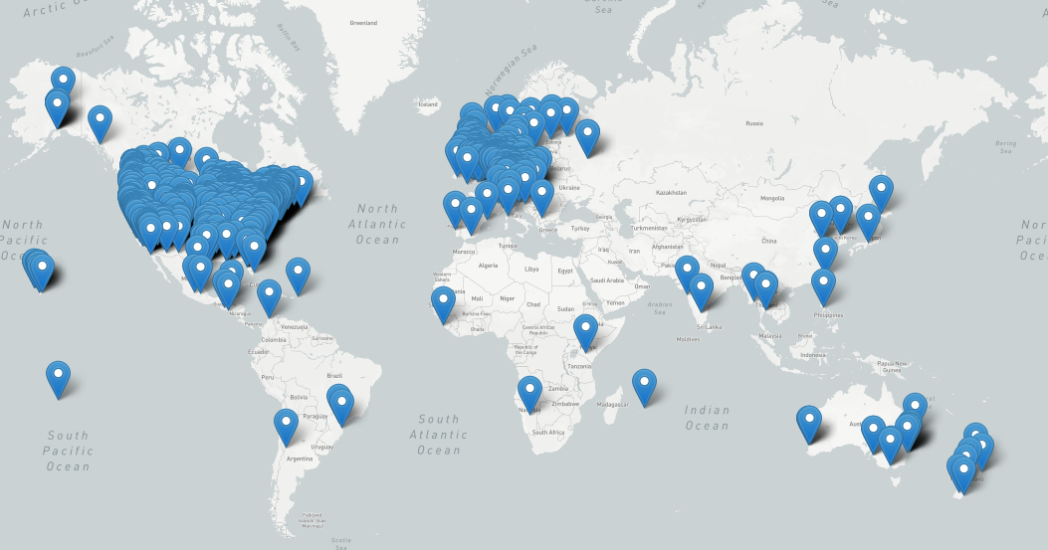
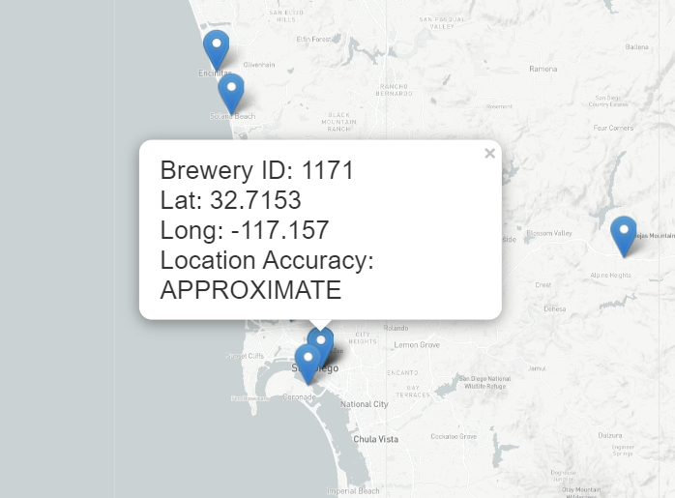
Where is the good beer at ? Lets use Leaflet !
How did we find the beer?
To create the tile layer for the background of our map, we used Lightmap.
With each marker, we added a pop-up of the Breweries ID and its location.
As you can see, the concentration of the markers is in the US and Europe.

Slide 6
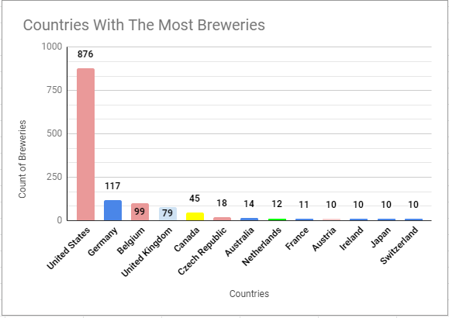
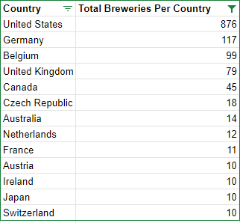
Countries With the Most Breweries : US #1
The US has 7.48x more breweries than Germany!

Slide 7
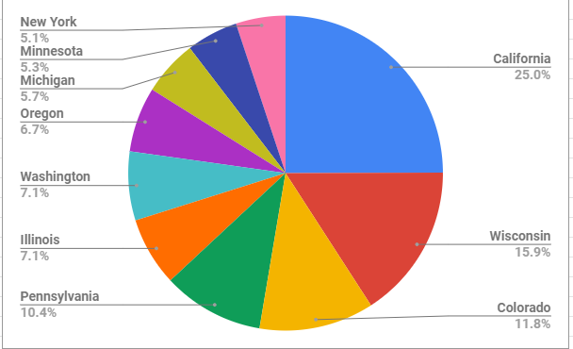
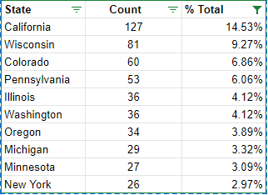
Top Ten States in the US that Have the Most Breweries !
California holds the highest proportion compared to other states. We really like our beer!

Slide 8
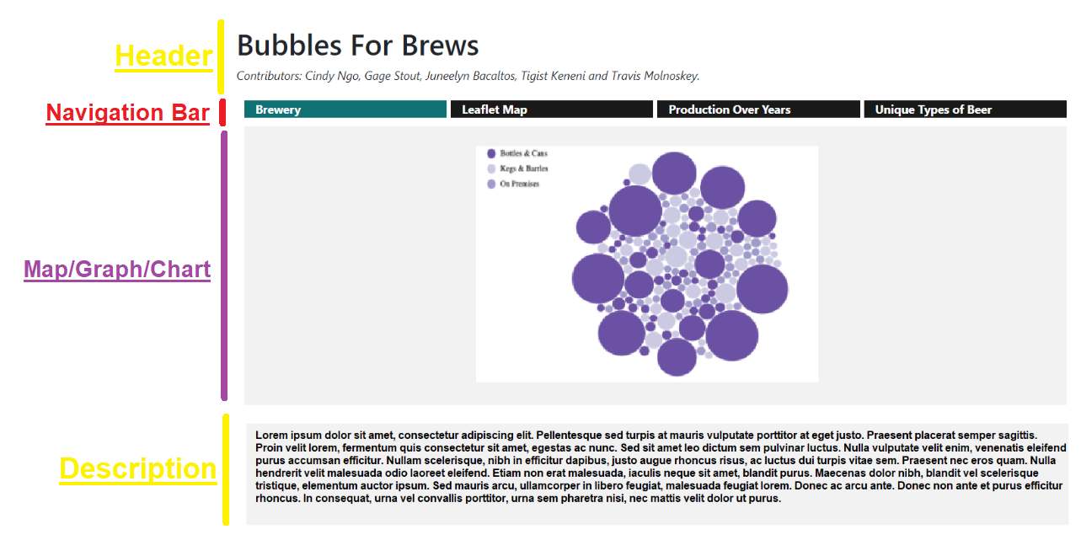
Website
We created a website to present the data to the public. The website is made with HTML and CSS. We also used Bootstrap’s Grid Layout System to give shape to our content. The website is divided into 4 parts:
Notes:
We created a website to present the data to the public. The website is made with HTML and CSS. We also used Bootstrap’s Grid Layout System to give shape to our content. The website is divided into 4 parts: Header, Navigation Bar, the Map/Graph/Chart and description.

Slide 9
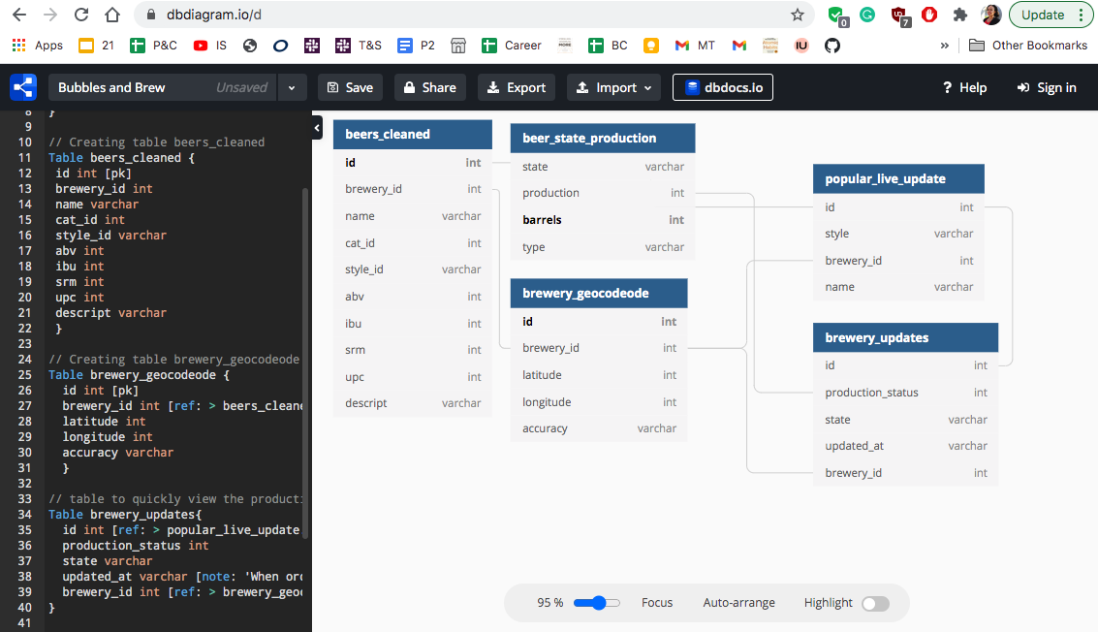
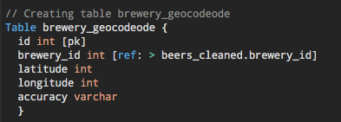
Database Model
Benefits
All data appears consistently across the database and data is the same for all the users viewing the database.
It was helpful to keep us organized and keep information easily accessible.
Creating DB model
Used https://dbdiagram.io/d
Keys for ID/Brewery
Data type int or varchar

Slide 10
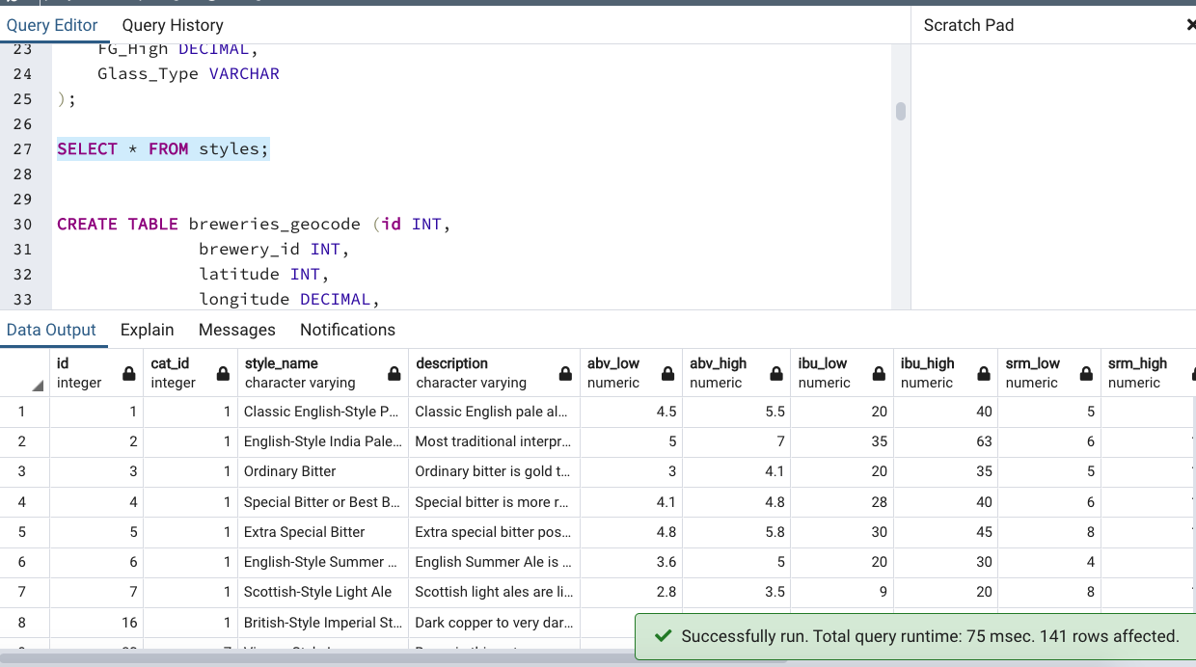
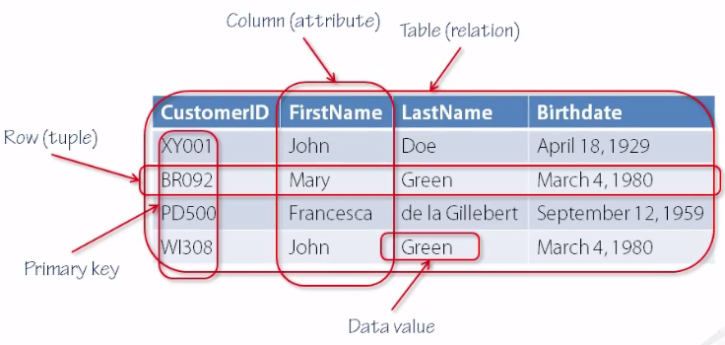

SQL
Created schema to importing csv files to relational database, pgAdmin
all the column/attributes must match the data type and name to quarry the data
Cleaned up data to make it reliable for our project
Quickly realized we had too much data and we dropped half the data to get specific about the results

Slide 11
Furthering the Analysis
As it stands, our project gives a quick, concise look at trends of beer production within the United States
The team thought of many more interesting analyses that could be conducted and visualized, but for brevity were cut out.
Unique types of beers produced within the U.S.
Top reviewed beer linked to every location on the leaflet map
Most produced category of beer across U.S.
Top 10 reviewed breweries by state
Highest reviewed beer type across nation

