Slide 1
Introduction to WebAR
Building an Image-Tracked Video Overlay Application
A Step-by-Step Educational Curriculum for Beginners

Slide 2
AR CONCEPTS
What is WebAR? Core Technologies
1. WEBRTC
Webcam Feed Access
The browser requests secure camera permissions from the mobile device using the 'getUserMedia' API to render a live camera stream on the page.
2. COMPUTER VISION
MindAR Engine
The tracking engine scans each frame of the webcam feed. It searches for high-contrast feature anchors matching the pre-compiled target signature (.mind file).
3. WEBGL / 3D RENDERING
A-Frame Graphics
A-Frame projects virtual 3D elements (like an overlay video plane) onto the tracked 3D space coordinates, matching its position and rotation in real time.

Slide 3
FILE SETUP
Project File Architecture
📁 assets/
Contains static tracking targets and video assets: • card.png: Printable physical target image. • card.mind: Compiled feature anchor signature. • video.mp4: Video plane overlay media file.
📄 index.html
The main WebAR application scanner file. Consolidates A-Frame configuration, HTML overlays, CSS styles, and tracking logic in a single readable document.
📄 preview.html
Utility target page display that lets students view and print the reference card for target tracking.
📄 server.js
Minimal local Node.js server. Configured to run secure local HTTPS (port 3030) allowing mobile camera access.
webar-video-demo/
├── assets/
│ ├── card.mind
│ ├── card.png
│ └── video.mp4
├── index.html
├── preview.html
├── server.js
├── package.json
├── cert.pem
└── key.pem

Slide 4
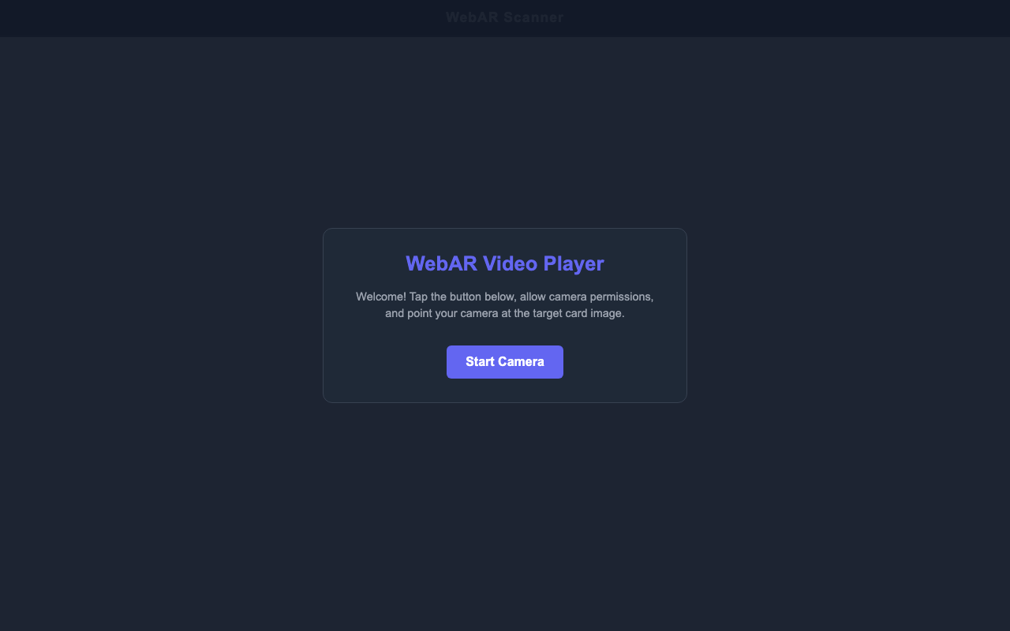
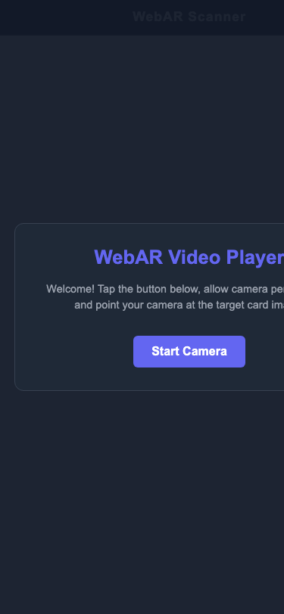
APPLICATION INTERFACE
WebAR App Onboarding & Start UI
• The Onboarding Overlay:
Since modern browsers restrict autoplaying media and camera feeds before a user gesture, we display an onboarding start screen first. Clicking 'Start Camera' triggers the permissions modal and primes the video player in the background.
• Clean UI Overlays:
All overlays (header status, visual dashed frame guides, status toast, and volume toggle buttons) are styled as floating absolute elements on top of the A-Frame camera canvas.
• Viewport-Relative Locking:
By positioning elements using CSS absolute/fixed layouts, the interface remains perfectly locked in place even when native scrolling is allowed.
Desktop Onboarding
Mobile Onboarding

Slide 5

APPLICATION INTERFACE
Active Tracking & Scanning Interface
• Live Camera Stream View:
Once permissions are granted, the active WebRTC camera feed starts streaming. The custom mock camera feed generates a rotating color wheel pattern in local simulated tests.
• Interactive Scanning Guide Frame:
A dashed rectangular container guides students where to align the target card. It uses fluid CSS parameters to scale dynamically on mobile screens.
• Status Toast Notification:
Floating dynamically at the top center of the viewport, a toast card reads 'Looking for target...' or displays tracking feedback context in real time.
• Fixed Volume Toggle Button:
Instagram-inspired floating volume indicators show whether the target video's audio track is currently muted or unmuted.
Mobile Camera Active

Slide 6
CODE WALKTHROUGH
Coding the AR Scene: Imports & Container
1. Importing Libraries:
We load A-Frame (3D positioning wrapper) and the MindAR image-tracking extension to enable browser-based AR processing.
2. Setting up the Scene Container:
The <a-scene> tag acts as the main 3D scene container. MindAR is attached as an attribute parameter.
3. Key Properties:
• imageTargetSrc: points to the compiled card.mind anchors. • autoStart: false (prevents camera from starting before click). • filterMinCF / filterBeta: configures tracking sensitivity to reduce video overlay jitter.
<!-- 1. Import Libraries -->
<script src="aframe.min.js"></script>
<script src="mindar-image-aframe.js"></script>
<!-- 2. Main AR Scene Container -->
<a-scene
id="ar-scene"
mindar-image="
imageTargetSrc: assets/card.mind;
autoStart: false;
filterMinCF: 0.0001;
filterBeta: 0.001;
uiScanning: no;"
embedded
vr-mode-ui="enabled: false">
...
</a-scene>

Slide 7
CODE WALKTHROUGH
Asset Preloading & Video Entities
1. Asset Preloading (<a-assets>):
Preloads large media assets in system memory before WebGL starts to guarantee lag-free insertion.
2. Crucial Autoplay Attributes:
• playsinline & webkit-playsinline: Force the video to render inside the page flow on iPhones, avoiding full-screen Apple media player takeovers. • loop muted: Necessary parameters to bypass browser autoplay blocks.
3. The Tracking Entity:
<a-entity mindar-image-target="targetIndex: 0"> anchors the overlay plane. When MindAR detects the card, this entity mirrors its coordinates dynamically.
<a-assets>
<!-- Muted video is preloaded -->
<video id="ar-video"
src="assets/video.mp4"
preload="auto" autoplay loop muted
playsinline webkit-playsinline></video>
</a-assets>
<!-- Camera viewport -->
<a-camera position="0 0 0"
look-controls="enabled: false">
</a-camera>
<!-- Target coordinates anchor index 0 -->
<a-entity mindar-image-target="targetIndex: 0">
<a-video src="#ar-video" width="1.4"
height="0.7875" scale="1.2 1.2 1"></a-video>
</a-entity>

Slide 8
TESTING & SECURITY
Mobile WebRTC: Secure Connections (HTTPS)
🛡️ WebRTC Security Model (getUserMedia)
Web browsers strictly block webcam streams from running unless the page is loaded over a fully secure HTTPS connection (or localhost on desktop).
📱 Connecting Your Phone to a Local Server
To test the application on your physical mobile device, the device must connect to your computer's local network server. The server runs a dual-port node instance printing the direct local IP URL, e.g. https://192.168.1.178:3030.
⚠️ Bypassing Self-Signed SSL Warnings
Because local HTTPS uses a self-signed developer certificate, mobile browsers display a warning page on load. This is safe to bypass: • iOS Safari: Tap 'Show Details' -> Tap 'visit this website' at the bottom -> Tap 'Visit Website'. • Android Chrome: Tap 'Advanced' -> Tap 'Proceed to <IP> (unsafe)'.

Slide 9
UX OPTIMIZATIONS
Tab Focus Recovery & Native Refresh Support
📲 Native Pull-to-Refresh on WebAR Pages
Usually, full-screen WebAR applications use 'overflow: hidden' to prevent scroll shifting, which blocks the mobile browser's native drag-down-to-reload gesture. By changing the CSS parameters to overflow-y: auto, we restore native browser reload support. Since our UI overlays are styled using fixed/absolute coordinates, the layout stays pinned, letting users refresh the camera feed without alignment glitches.
⚡ Solving Scene Race Conditions (A-Frame 'loaded' Event)
When refreshing the page, starting the camera tracker immediately can fail if the tracking engine is not fully loaded yet. By wrapping the autostart logic inside an A-Frame scene 'loaded' event listener, we guarantee the camera starts successfully every time on refresh.
🔄 Visibility Recovery (Tab Switching & Phone Sleep)
If you switch tabs or lock your phone, iOS and Android suspend active webcam capture streams. We add a listener to the 'visibilitychange' event. When the user returns to the tab, the system automatically shuts down the stalled stream and requests a fresh, active camera capture.

Slide 10
MEDIA CONTROLS
Autoplay Bypass & Instagram-Style Sound Controls
• Bypassing Autoplay Restrictions:
Mobile browsers block videos from playing automatically if they have sound. To build a seamless AR experience where the video starts immediately when the card is scanned, the video element MUST have the 'muted' attribute.
• Instagram-Style Screen Taps:
To let students unmute the video overlay easily, we attach a page-wide click listener. Clicking anywhere on the camera canvas toggles between muted and unmuted playback.
• Visual pop-up indicators:
When unmuting, a circular speaker status icon flashes in the center of the viewport for 600ms before fading away, matching Instagram's native video layout.
// Toggle mute state and center sound flash
const toggleMuteState = () => {
if (arVideo.muted) {
arVideo.muted = false;
muteIcon.innerHTML = SPEAKER_UNMUTED_SVG;
soundFlashIcon.innerHTML = SPEAKER_UNMUTED_SVG;
} else {
arVideo.muted = true;
muteIcon.innerHTML = SPEAKER_MUTED_SVG;
soundFlashIcon.innerHTML = SPEAKER_MUTED_SVG;
}
// Flash pop-up icon in center
soundFlash.classList.remove("show");
void soundFlash.offsetWidth; // force reflow
soundFlash.classList.add("show");
setTimeout(() => {
soundFlash.classList.remove("show");
}, 600);
};
// Tap screen background to toggle
document.body.addEventListener("click", (e) => {
if (e.target.closest("#start-screen") ||
e.target.closest(".header") ||
e.target.closest("#mute-button")) return;
toggleMuteState();
});

Slide 11
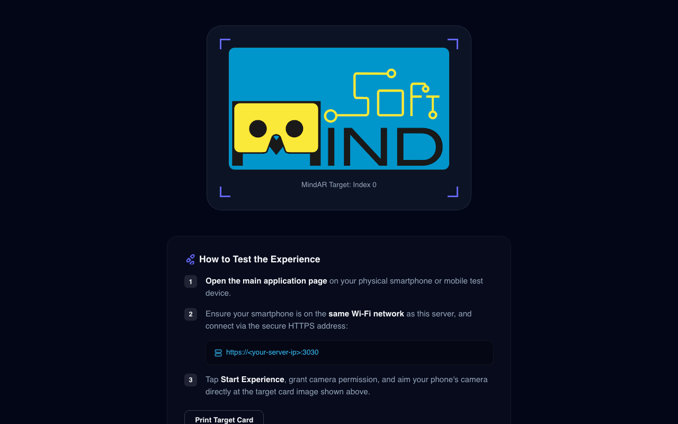
TESTING TARGETS
Target Anchor Cards: preview.html
• Target Cards Utility Page:
The preview.html page hosts the target card display and printing instructions so students can load it on their desktop monitor or print it out.
• CSS Print Stylesheets (@media print):
To ensure printer ink is not wasted on dark Web UI colors and instructions, preview.html contains a print media query that hides all descriptions, guide corners, and buttons when printing, leaving only the exact target card.
• Anchor Compilation:
Explain to students that standard images must be pre-compiled into a mathematical feature anchor mapping (.mind) using hiukim's tool before use.

