Slide 1





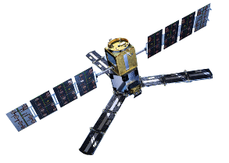
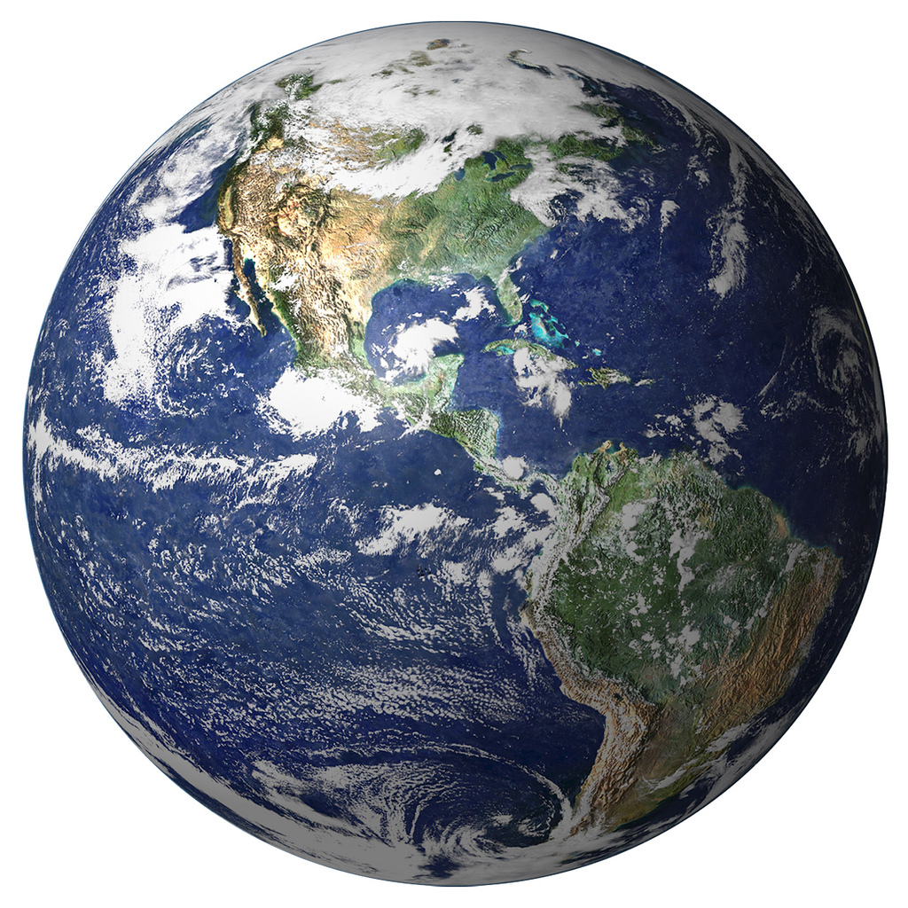
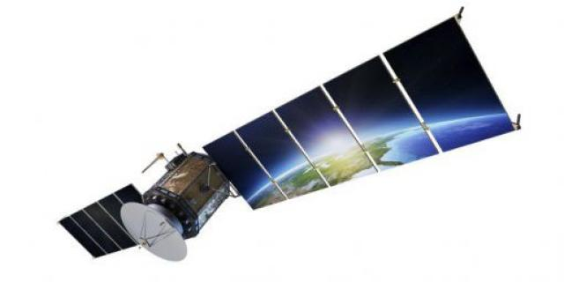
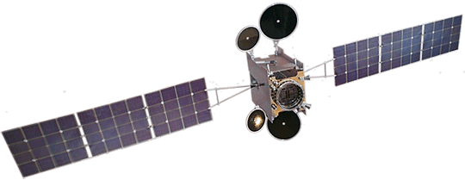
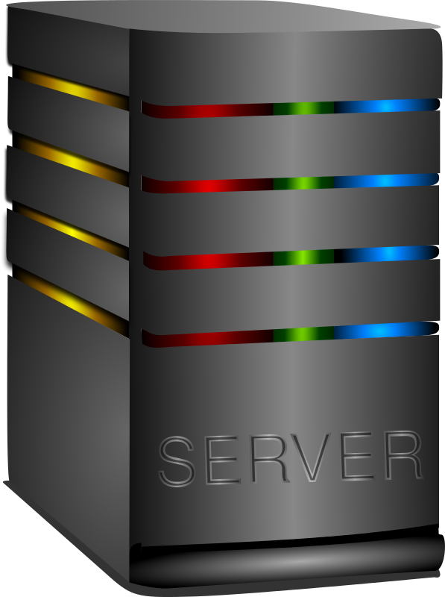
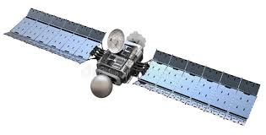

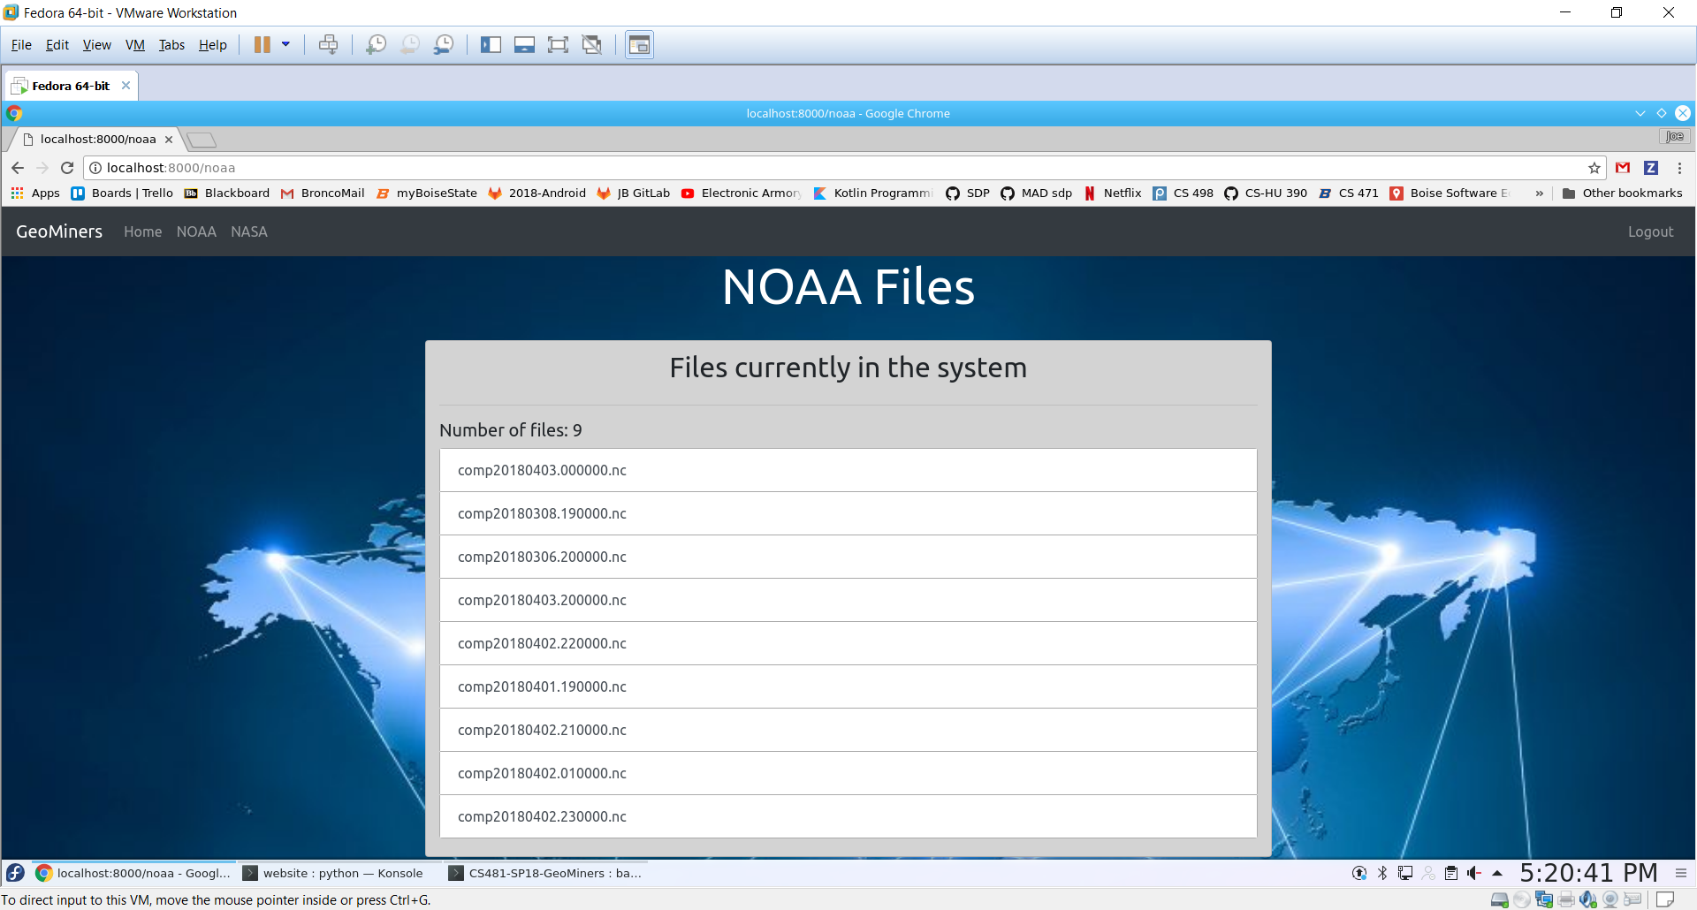



Logan Barclay
Joseph Bell
Patrick Cullings
Benjamin Hetz
Chris McLellen
Aaron Whetzel
Earth Data Solutions
Without reliable access to data, it is hard to be a data scientist.
Our application automatically downloads the desired data
Expandable to allow for easy addition of other data sources
Supports FTP and HTTP protocols
Each source will be checked for newly available data at desired intervals
Researchers get access to files through a web application using BSU credentials
The website displays locally available files and will allow researchers to download subsets
Earth Observation data is collected continuously from satellites, aircraft, and ground-based sensors.
NASA and NOAA collect more than 20TB of data per day.
(Twice the entire printed collection of the United States Library of Congress)
Because of the volume, access to this data via web services is available for only a short period of time, after which it is written to tape and must be obtained via special request.

