Slide 1
Data Driven Resource Allocation for Distributed Learning
Travis Dick, Mu Li, Venkata Krishna Pillutla,
Colin White, Maria-Florina Balcan, Alex Smola

Slide 2
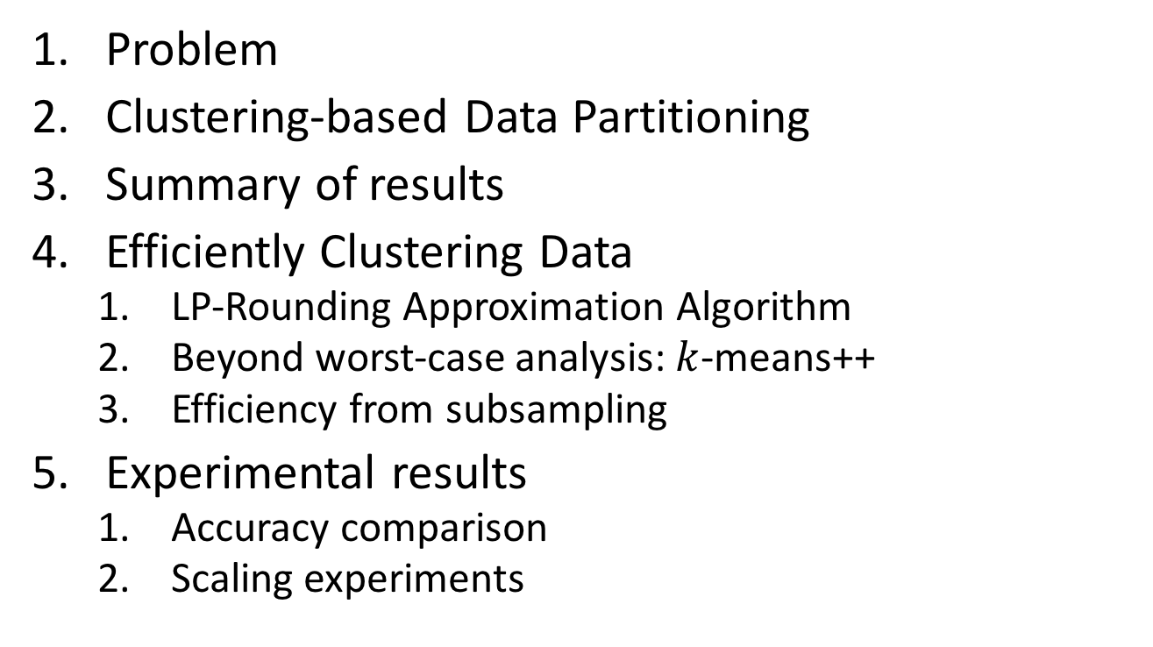
Outline
Problem
Clustering-based Data Partitioning
Summary of results
Efficiently Clustering Data
LP-Rounding Approximation Algorithm
Beyond worst-case analysis: $k$-means++
Efficiency from subsampling
Experimental results
Accuracy comparison
Scaling experiments

Slide 3
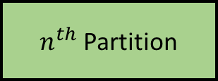
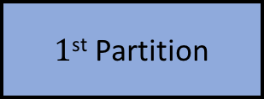

The problem
Want to distribute data to multiple machines for efficient machine learning.
How should we partition the data?
Data
$1$^{st} Partition
Machine 1
2nd Partition
Machine 2
…
…
$n^{th}$ Partition
Machine $n$
Common idea: randomly partition the data.
Clean both in theory and practice, but suboptimal.

Slide 4
Our approach
Cluster the data and send one cluster to each machine.
Accurate models tend to be locally simple but globally complex.

Slide 5
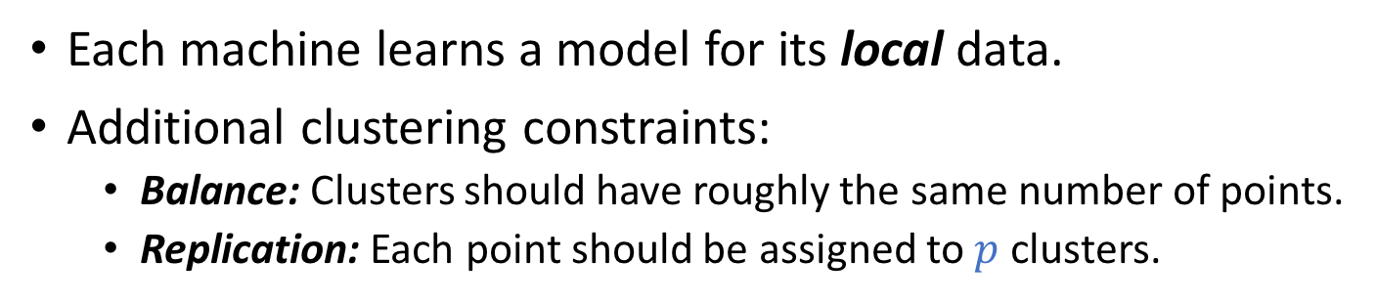
Our approach
Cluster the data and send one cluster to each machine.
Accurate models tend to be locally simple but globally complex.
Machine 2
Machine 1
Machine 3
Each machine learns a model for its local data.
Additional clustering constraints:
Balance: Clusters should have roughly the same number of points.
Replication: Each point should be assigned to $p$ clusters.

Slide 6
Summary of results
Efficient algorithms with provable worst-case guarantees for balanced clustering with replication.
For non-worst case data, we show that common clustering algorithms produce high-quality balanced clusterings.
We show how to efficiently partition a large dataset by clustering only a small sample.
We empirically show that our technique significantly outperforms baseline methods and strongly scales.

Slide 7
How can we efficiently compute balanced clusterings with replication?

Slide 8

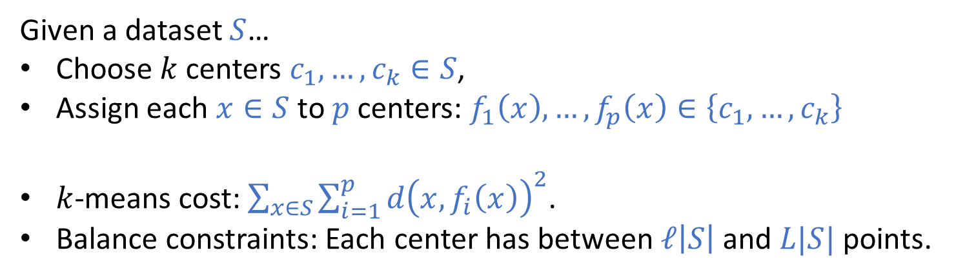
Balanced $k$-means with replication
Given a dataset $S$…
Choose $k$ centers $c_{1},…, c_{k}∈S$,
Assign each $x∈S$ to $p$ centers: $f_{1}\left(x\right),…,f_{p}\left(x\right)∈\left\{c_{1},…,c_{k}\right\}$
$k$-means cost: $\sum_{x∈S}{\sum_{i=1}^{p}{d{\left(x,f_{i}\left(x\right)\right)}^{2}}}$.
Balance constraints: Each center has between $ℓ\left|S\right|$ and $L|S|$ points.
x
x
x
x
x
x

Slide 9
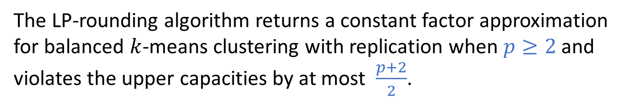
LP-Rounding Algorithm
Can formulate problem as an integer program (NP Hard to solve exactly).
The linear program relaxation can be solved efficiently…
but gives ”fractional” centers and “fractional” assignments.
Compute a coarse clustering of the data using a simple greedy procedure.
Combine centers within each coarse cluster to form “whole” centers.
Find optimal assignments by solving a min-cost flow problem.
Theorem
The LP-rounding algorithm returns a constant factor approximation for balanced $k$-means clustering with replication when $p≥2$ and violates the upper capacities by at most $\frac{p+2}{2}$.
* We have analogous results for $k$-median and $k$-center clustering as well.

Slide 10
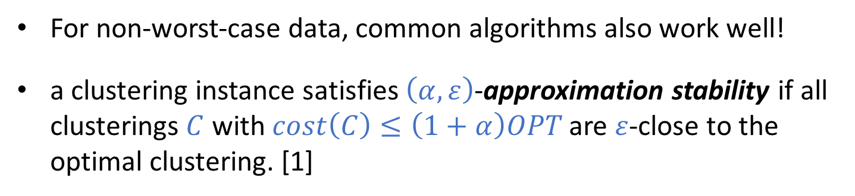
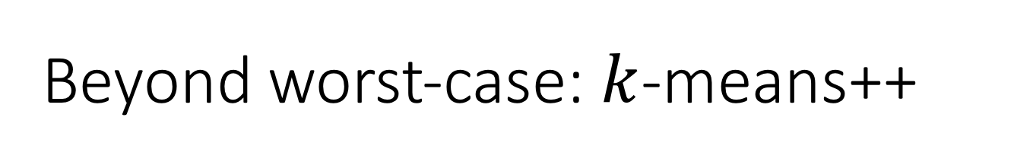
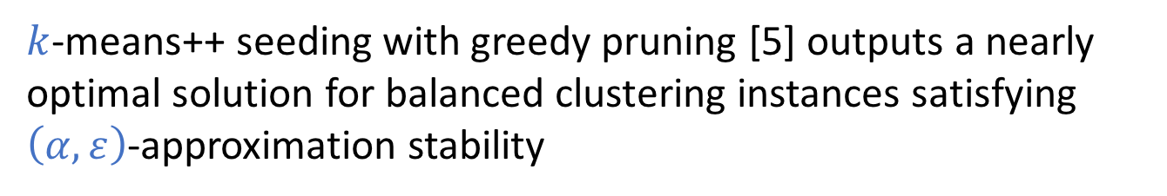
Beyond worst-case: $k$-means++
For non-worst-case data, common algorithms also work well!
a clustering instance satisfies $\left(α,ε\right)$-approximation stability if all clusterings $C$ with $cost\left(C\right)≤\left(1+α\right)OPT$ are $ε$-close to the optimal clustering. [1]
R
Q
Theorem
$k$-means++ seeding with greedy pruning [5] outputs a nearly optimal solution for balanced clustering instances satisfying $\left(α,ε\right)$-approximation stability

Slide 11
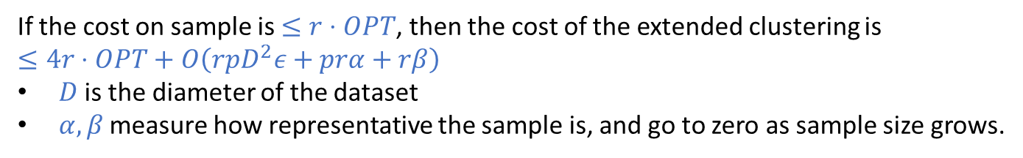
Efficiency from Subsampling
Goal: Cluster a small sample of data and use this to partition entire dataset with good guarantees.
Assign new point to the same clusters as its nearest neighbor.
x
Automatically handles balance constraints.
New point costs about the same as neighbor.
?
x
x
Theorem
If the cost on sample is $≤r⋅OPT$, then the cost of the extended clustering is
$≤4r⋅OPT+O\left(rpD^{2}ε+prα+rβ\right)$
$D$ is the diameter of the dataset
$α,β$ measure how representative the sample is, and go to zero as sample size grows.

Slide 12
How well does our method perform?

Slide 13
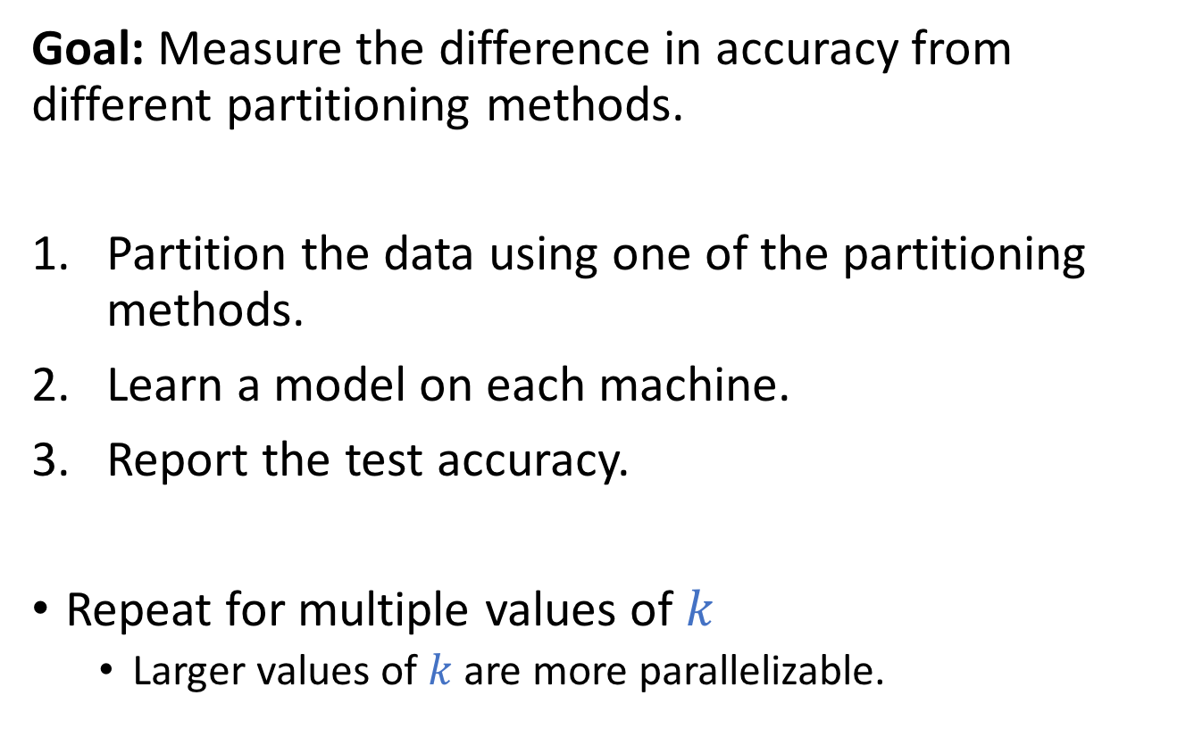
Experimental Setup
Goal: Measure the difference in accuracy from different partitioning methods.
Partition the data using one of the partitioning methods.
Learn a model on each machine.
Report the test accuracy.
Repeat for multiple values of $k$
Larger values of $k$ are more parallelizable.

Slide 14
Baseline Methods
Method | Fast? | Balanced? | Locality?
Random | ✔ | ✔ | 𝗫
Balanced Partition Tree (kd-tree) | ✔ | ✔ | 1/2
Locality Sensitive Hashing | ✔ | 𝗫 | ✔
Our Method | ✔ | ✔ | ✔

Slide 15
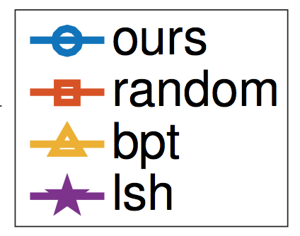
Experimental Evaluation
MNIST-8M
Synthetic
CIFAR10_IN3C
CIFAR10_IN4D
CTR

Slide 16
Strong Scaling
For a fixed dataset we evaluate the running time of our method using 8, 16, 32, or 64 machines.
We report the speedup over using 8 machines.
For all datasets, doubling the number of workers reduces running time by a constant fraction (i.e., our method strongly scales).

Slide 17
Conclusion
Propose using balanced clustering with replication for data partitioning in DML.
LP-Rounding algorithm with worst-case guarantees.
Beyond worst-case analysis for k-means++.
Efficiently partition large datasets by clustering a sample.
Empirical support for utility of clustering-based partitioning.
Empirically demonstrated strong scaling.

Slide 18
Thanks!

Slide 19
Extra Slides (You’ve gone too far!)

Slide 20
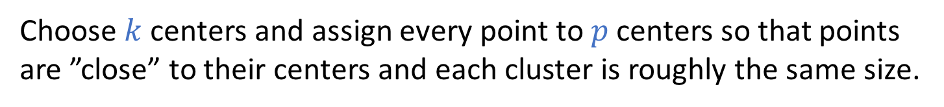
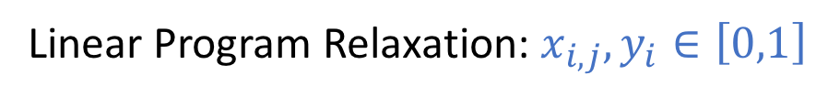

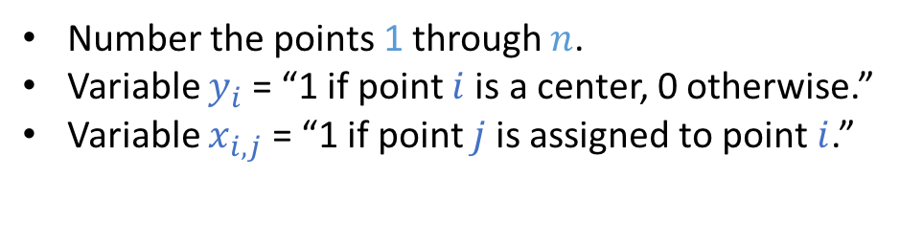
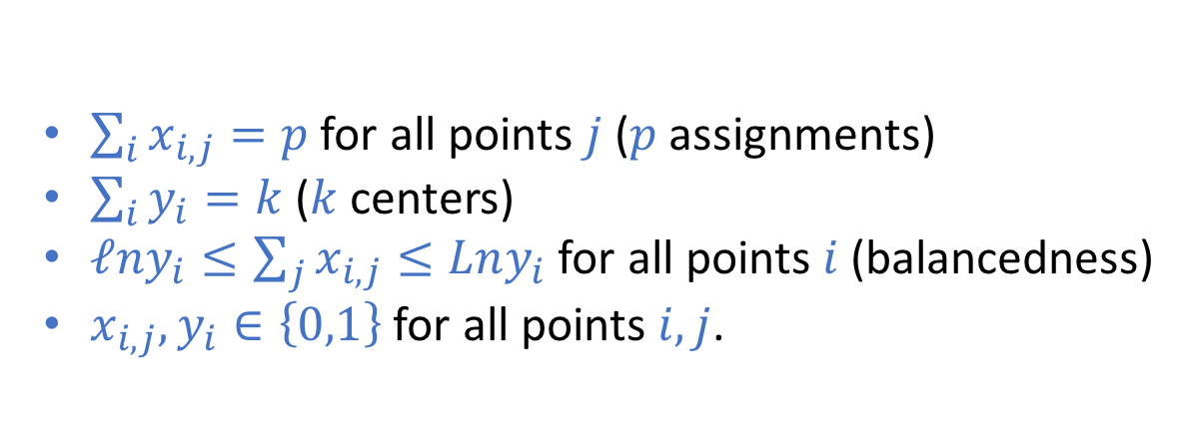
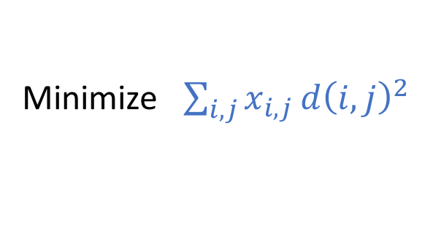
Capacitated $k$-means with replication
Choose $k$ centers and assign every point to $p$ centers so that points are ”close” to their centers and each cluster is roughly the same size.
As an Integer Program:
Number the points 1 through $n$.
Variable $y_{i}$ = “1 if point $i$ is a center, 0 otherwise.”
Variable $x_{i,j}$ = “1 if point $j$is assigned to point $i$.”
Minimize $\sum_{i,j}{x_{i,j}}d{\left(i,j\right)}^{2}$
Subject to:
$\sum_{i}{x_{i,j}=p}$ for all points $j$ ($p$ assignments)
$\sum_{i}{y_{i}}=k$ ($k$ centers)
$ℓny_{i}≤\sum_{j}{x_{i,j}≤Lny_{i}}$ for all points $i$ (balancedness)
$x_{i,j},y_{i}∈\left\{0,1\right\}$ for all points $i,j$.
Linear Program Relaxation: $x_{i,j},y_{i}∈\left[0,1\right]$
$x$s are “fractional assignment”, $y$s are “fractional centers”

Slide 21
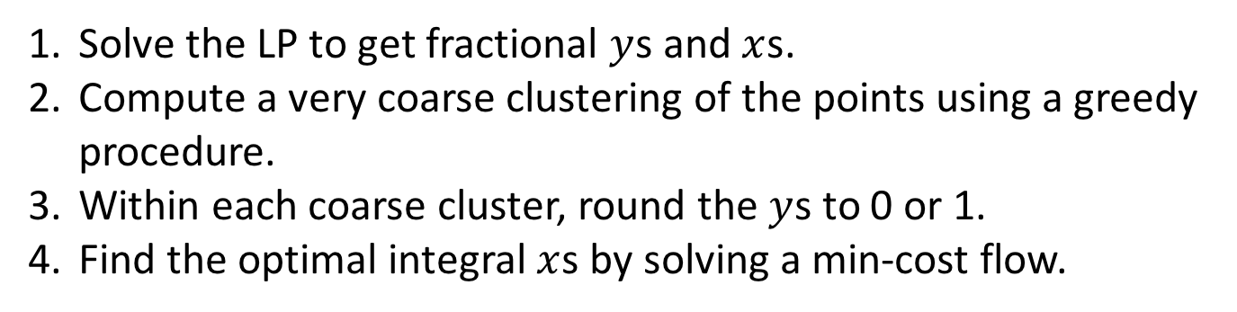
LP-Rounding algorithm
Solve the LP to get fractional $y$s and $x$s.
Compute a very coarse clustering of the points using a greedy procedure.
Within each coarse cluster, round the $y$s to 0 or 1.
Find the optimal integral $x$s by solving a min-cost flow.

Slide 22
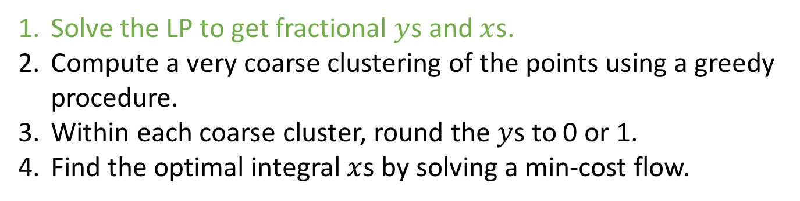
LP-Rounding algorithm
Solve the LP to get fractional $y$s and $x$s.
Compute a very coarse clustering of the points using a greedy procedure.
Within each coarse cluster, round the $y$s to 0 or 1.
Find the optimal integral $x$s by solving a min-cost flow.

Slide 23
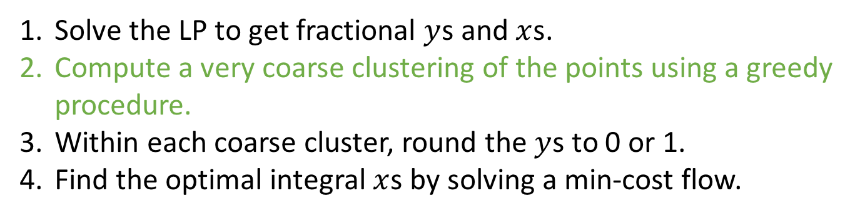
LP-Rounding algorithm
Solve the LP to get fractional $y$s and $x$s.
Compute a very coarse clustering of the points using a greedy procedure.
Within each coarse cluster, round the $y$s to 0 or 1.
Find the optimal integral $x$s by solving a min-cost flow.

Slide 24
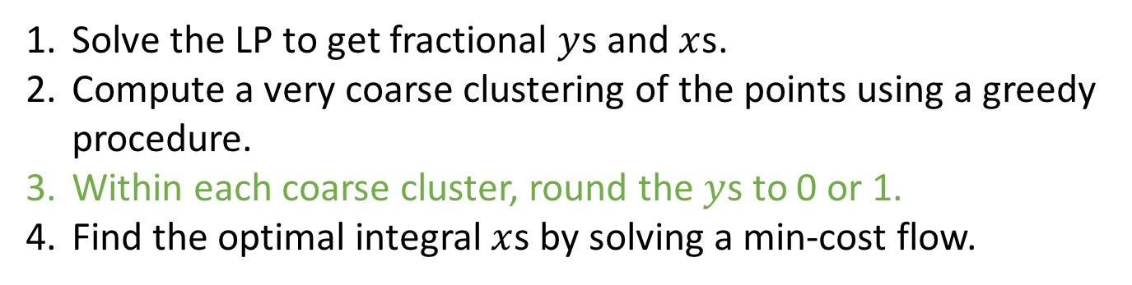
LP-Rounding algorithm
Solve the LP to get fractional $y$s and $x$s.
Compute a very coarse clustering of the points using a greedy procedure.
Within each coarse cluster, round the $y$s to 0 or 1.
Find the optimal integral $x$s by solving a min-cost flow.

Slide 25
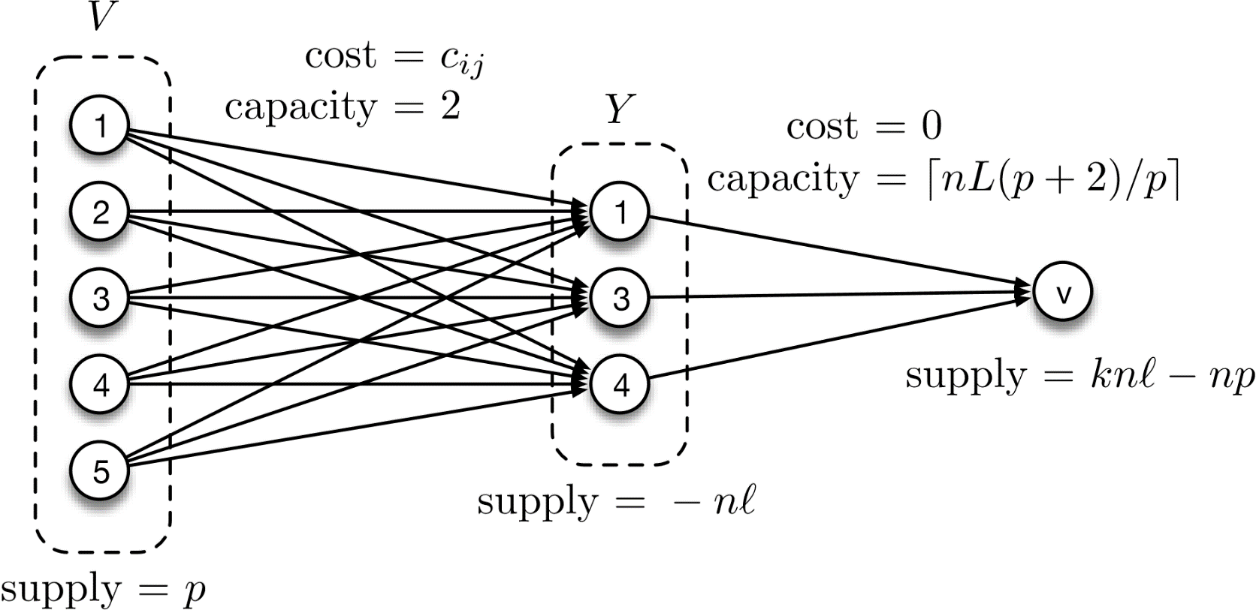
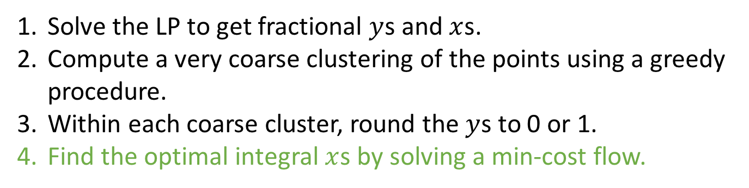
LP-Rounding algorithm
Solve the LP to get fractional $y$s and $x$s.
Compute a very coarse clustering of the points using a greedy procedure.
Within each coarse cluster, round the $y$s to 0 or 1.
Find the optimal integral $x$s by solving a min-cost flow.

Slide 26
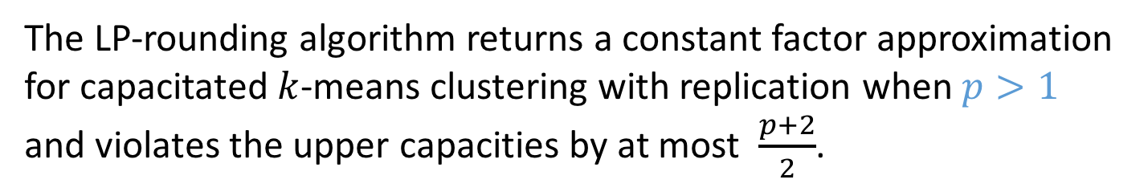
LP-Rounding Algorithm
Solve the LP to get fractional $y$s and $x$s.
Compute a very coarse clustering of the points using a greedy procedure.
Within each coarse cluster, round the $y$s to 0 or 1.
Find the optimal integral $x$s by solving a min-cost flow.
Theorem
The LP-rounding algorithm returns a constant factor approximation for capacitated $k$-means clustering with replication when $p>1$ and violates the upper capacities by at most $\frac{p+2}{2}$.
* We have analogous results for $k$-means and $k$-center clustering as well.

Slide 27
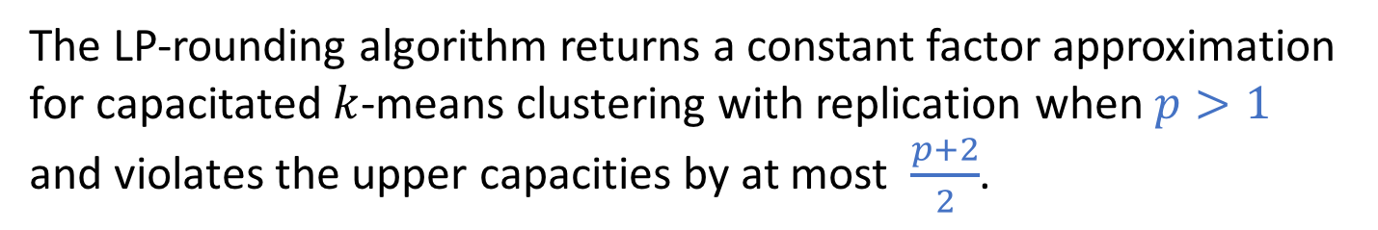
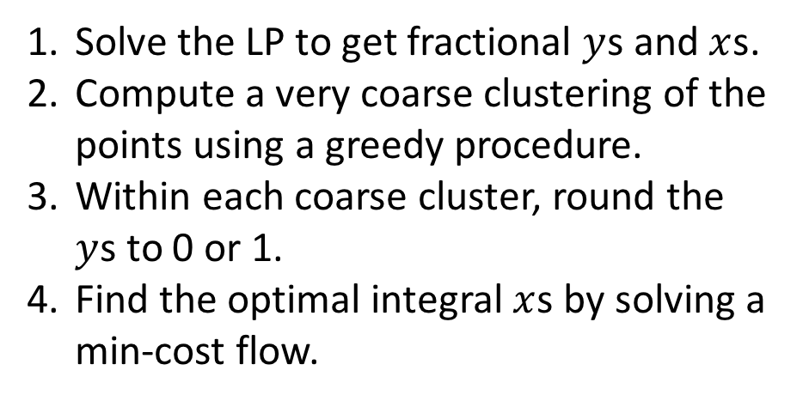
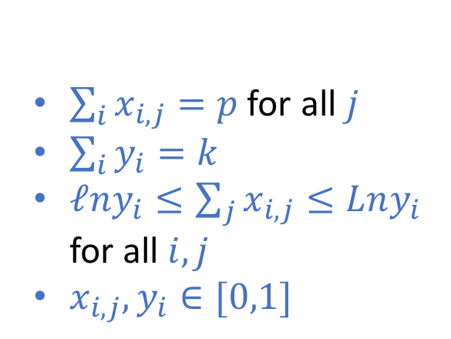

LP-Rounding Algorithm
Minimize $\sum_{i,j}{x_{i,j}}d{\left(i,j\right)}^{2}$
Solve the LP to get fractional $y$s and $x$s.
Compute a very coarse clustering of the points using a greedy procedure.
Within each coarse cluster, round the $y$s to 0 or 1.
Find the optimal integral $x$s by solving a min-cost flow.
Subject to:
$\sum_{i}{x_{i,j}=p}$ for all $j$
$\sum_{i}{y_{i}}=k$
$ℓny_{i}≤\sum_{j}{x_{i,j}≤Lny_{i}}$ for all $i,j$
$x_{i,j},y_{i}∈[0,1]$
$y$s indicate which points are centers, $x$s indicate center assignment.
Theorem
The LP-rounding algorithm returns a constant factor approximation for capacitated $k$-means clustering with replication when $p>1$ and violates the upper capacities by at most $\frac{p+2}{2}$.
* We have analogous results for $k$-means and $k$-center clustering as well.

Slide 28
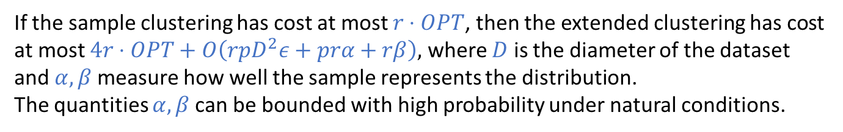
Efficiency from Subsampling
Goal: Cluster a small sample of data and use this to partition entire dataset with good guarantees.
First Idea: Assign new to nearest $p$ cluster centers.
Best cost for new points.
Severely violates balance constraints.
x
Better Idea: Assign new point to the same clusters as its nearest neighbor.
x
Automatically handles balance constraints.
New point costs about the same as neighbor.
x
(caveat: we use a second sample to estimate weights)
Theorem
If the sample clustering has cost at most $r⋅OPT$, then the extended clustering has cost at most $4r⋅OPT+O\left(rpD^{2}ε+prα+rβ\right),$ where $D$ is the diameter of the dataset and $α,β$ measure how well the sample represents the distribution.
The quantities $α,β$ can be bounded with high probability under natural conditions.

Slide 29
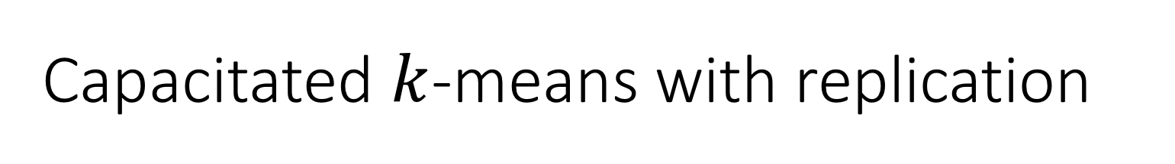
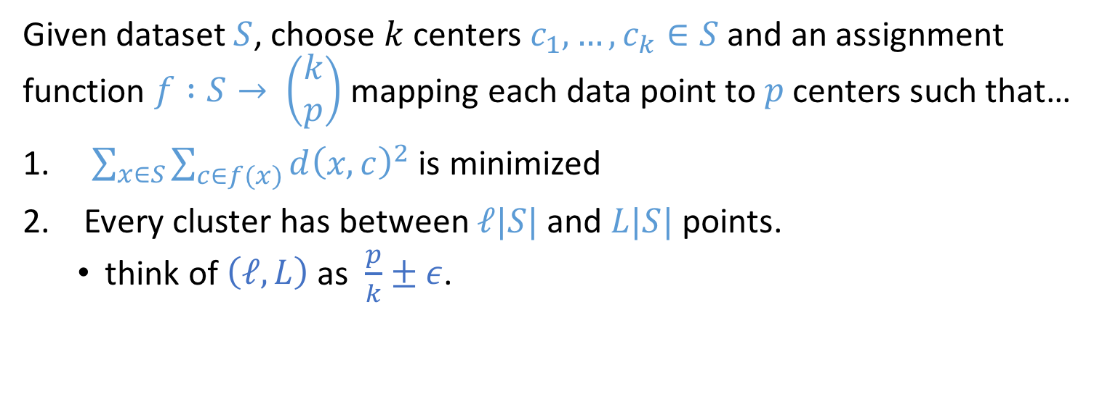
Capacitated $k$-means with replication
Given dataset $S$, choose $k$ centers $c_{1},…,c_{k}∈S$ and an assignment function $f :S→ \left(\begin{matrix}k \\ p\end{matrix}\right)$ mapping each data point to $p$ centers such that…
$\sum_{x∈S}{\sum_{c∈f(x)}{d{\left(x,c\right)}^{2}}}$ is minimized
Every cluster has between $ℓ|S|$ and $L|S|$ points.
think of $\left(ℓ, L\right)$ as $\frac{p}{k}±ε$.

Slide 30
Capacitated $k$-means with replication
Given dataset $S$, choose $k$ centers $c_{1},…,c_{k}∈S$ and an assignment function $f :S→ \left(\begin{matrix}k \\ p\end{matrix}\right)$ mapping each data point to $p$ centers such that…
$\sum_{x∈S}{\sum_{c∈f(x)}{d{\left(x,c\right)}^{2}}}$ is minimized
Every cluster has between $ℓ|S|$ and $L|S|$ points.
think of $\left(ℓ, L\right)$ as $\frac{p}{k}±ε$.
x
x
x

Slide 31
Capacitated $k$-means with replication
Given dataset $S$, choose $k$ centers $c_{1},…,c_{k}∈S$ and an assignment function $f :S→ \left(\begin{matrix}k \\ p\end{matrix}\right)$ mapping each data point to $p$ centers such that…
$\sum_{x∈S}{\sum_{c∈f(x)}{d{\left(x,c\right)}^{2}}}$ is minimized
Every cluster has between $ℓ|S|$ and $L|S|$ points.
think of $\left(ℓ, L\right)$ as $\frac{p}{k}±ε$.
x
x
x

Slide 32
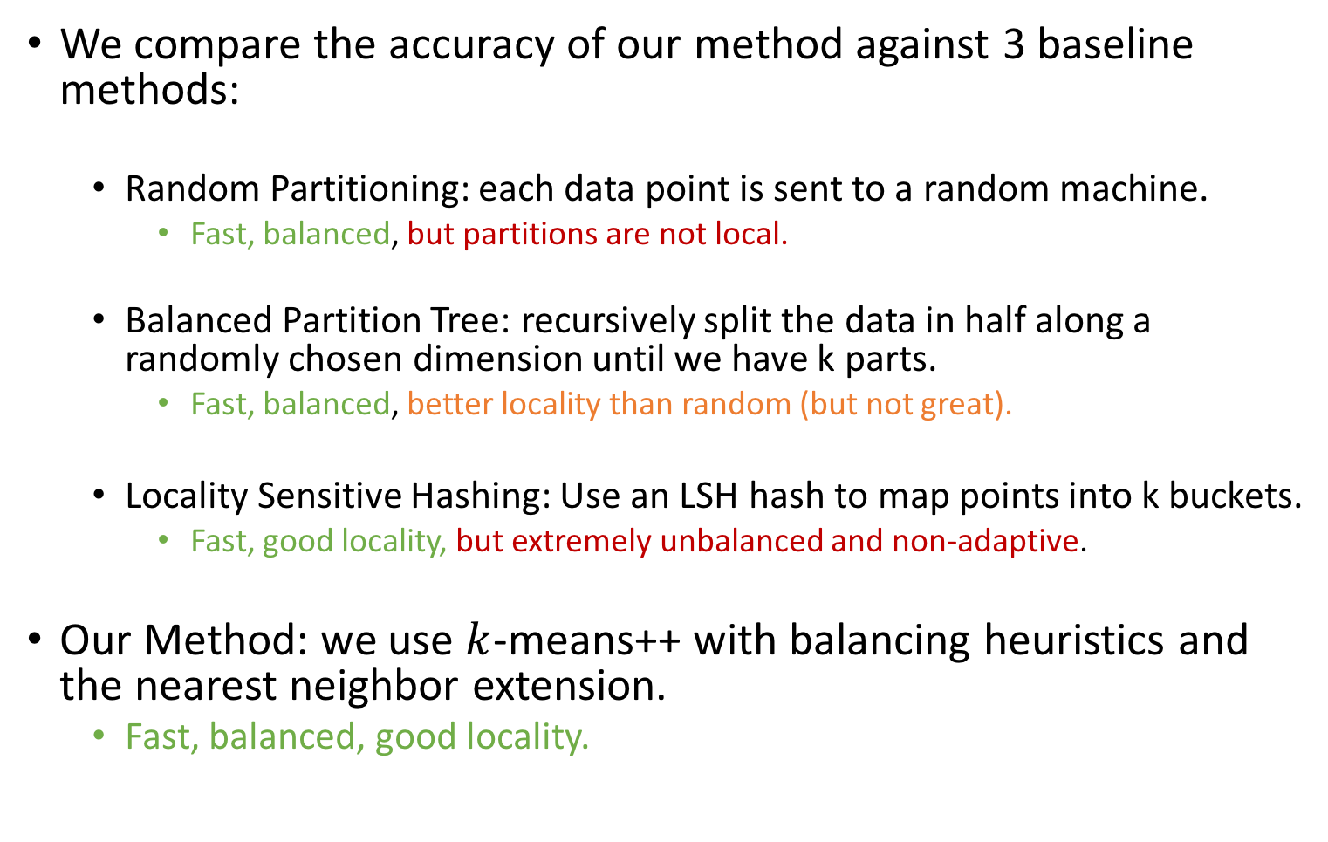
Baseline Methods
We compare the accuracy of our method against 3 baseline methods:
Random Partitioning: each data point is sent to a random machine.
Fast, balanced, but partitions are not local.
Balanced Partition Tree: recursively split the data in half along a randomly chosen dimension until we have k parts.
Fast, balanced, better locality than random (but not great).
Locality Sensitive Hashing: Use an LSH hash to map points into k buckets.
Fast, good locality, but extremely unbalanced and non-adaptive.
Our Method: we use $k$-means++ with balancing heuristics and the nearest neighbor extension.
Fast, balanced, good locality.

