Slide 1

Disease Prediction Using Machine Learning Algorithms
Travis Briffa
Institute of Information & Communication Technology
MCAST, Paola, Malta

Slide 2
Accurate Identification and Prediction of Diseases
The goal is to develop a predictive model using machine learning algorithms that can effectively learn the patterns and relationships between symptoms and diseases.
The research aims to investigate whether an automated system can outperform manual diagnosis in terms of accuracy and efficiency, potentially leading to improved healthcare professionals’ decision-making and patient care.
Can an algorithm learn the patterns and relationships between symptoms and diseases effectively?
Can an automated system prove to be better and more efficient than a manual diagnosis in terms of accuracy and efficiency?

Slide 3
Literature
Overview of Current Research: Review of existing literature on disease prediction using machine learning and key findings, methodologies, and knowledge gaps.
Significance of Automated Disease Prediction:
Automated prediction of diseases using machine learning is gaining attention and advancements in artificial intelligence along with the availability of medical data contribute to the need for accurate prediction systems.
Impact of Accurate Diagnosis and Timely Intervention: Incorrect diagnosis leads to worse health outcomes, increased cost of health-care and patient dissatisfaction, Machine learning-based disease prediction models can revolutionize health-care practices and improve patient care.

Slide 4
Literature
Research Findings:
Various machine learning algorithms have been studied for disease prediction. Chauhan (2020) achieved accuracies of 92.4% (Decision Tree), 95.7% (Random Forest) and 94.5% (Naïve Bayes).
Chen and Hwang (2017) achieved 94.5% accuracy using CNN-based multi-modal disease risk prediction.
Sharmila and Venkatesan (2017) achieved accuracies of 58.8% (Fuzzy Logic), 91% (Fuzzy Neural Networks), and 68.7% (Decision Tree).
Vijayarani and Dayananda (2015) achieved 79.66% (SVM) and 61.28% (Naive Bayes) accuracies.
Diverse Range of Algorithms: Different machine learning algorithms yield varying accuracies in disease prediction models. Historical Progression: Ongoing Extensive research in disease prediction using machine learning. Importance of Reviewing Historical Progression: Understanding strengths, limitations and gaps in existing research.

Slide 5
Methodology – Aim, Hypothesis, Questions
Developing a program for effective disease prediction based on given symptoms and medical data.
Machine learning algorithms and predictive modelling techniques can achieve accurate disease prediction by analysing symptoms and medical data.
How do different algorithms perform in predicting diseases based on symptoms and medical data? What is the impact of data size and diversity on the performance of different models? How efficient is the program compared to a human expert?

Slide 6
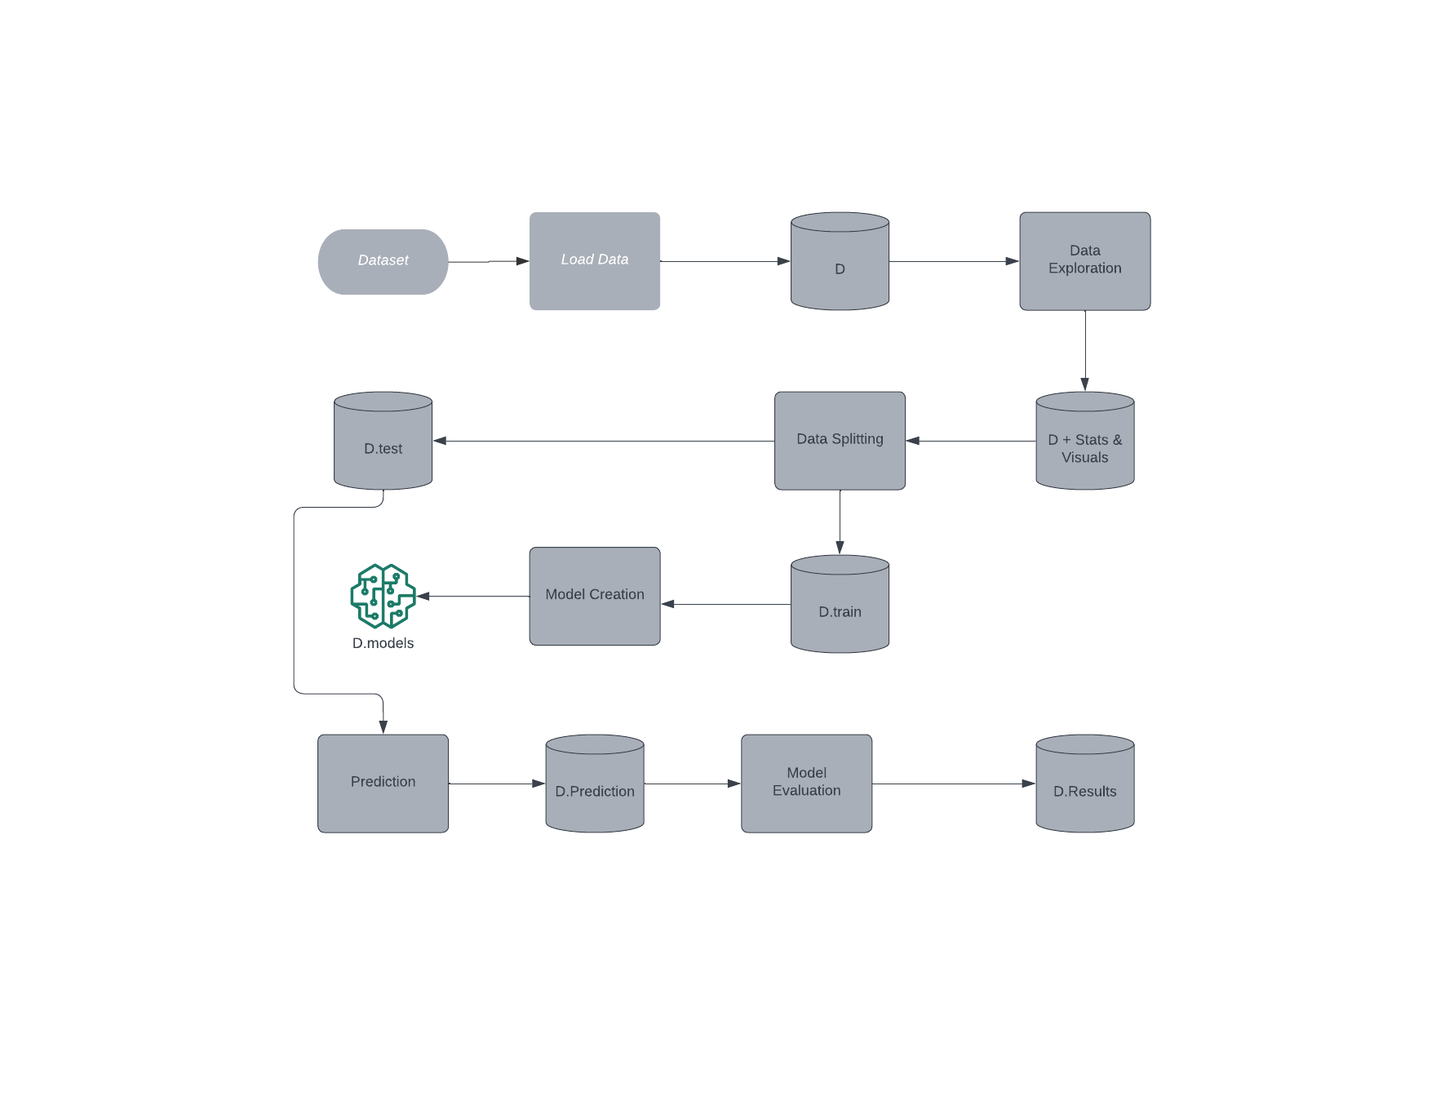
Methodology – Pipeline
Algorithms used:
K-Nearest neighbour
Support Vector Machine
Naïve Bayes
Random Forest
Logistic Regression

Slide 7
Methodology – Methods
Data Collection: Collected Diseases and symptoms data-set from Kaggle.
Data Pre-Processing: Removed missing values and unnecessary columns and Encoded the target variable (disease) using label encoding and split the data-set into training and testing sets.
Machine learning models: Employed KNN, SVM, Naive Bayes, Random Forest and Logistic Regression classifiers. Trained models using specific training steps for each algorithm.
Model Evaluation: Evaluated models on testing set using performance metrics (accuracy, precision, recall and F1-score), computed AUC-ROC to assess models’ performance.

Slide 8
Data Evaluation
Performance Metrics: Assessed models’ performance using metrics such as accuracy, precision, recall and F1-score, these metrics were calculated using the “sklearn.metrics” module.
Area Under the ROC Curve (AUC-ROC): Computed AUC-ROC to evaluate the trade-off between true positive rate and false positive rate. Utilised “roc_auc_score” and “roc_curve” functions from the “sklearn.metrics” module.
Model Comparison: Compared the performance of different machine learning models on the testing set. Analysed the strengths and weaknesses of each model in predicting diseases.

Slide 9
Prototype
Video Link: https://youtu.be/-nzUqLGHaxU
Limit to 2 minutes

Slide 10
Evaluation / Argumentation
Comparative Analysis: Conducted a comparative analysis of different machine learning algorithms in disease prediction. Evaluated the performance of each algorithm based on accuracy, precision, recall and F1-score metrics.
Robustness and Generalisation: Demonstrated the robustness and generalisation of the model by using a dataset containing prevalent diseases and symptoms. Ensured that the model can effectively predict diseases beyond the training data.
Performance Assessment: Assessed the practical applicability and accuracy of the program in a healthcare setting.
Advantages over Human Expertise: Highlighted the potential benefits of using automated systems, such as improved accuracy, timely intervention and cost-effectiveness.

Slide 11
3rd party comparison
Published Research was reviewed and findings were included from existing research studies on disease prediction using machine learning algorithms. Demonstrated the diverse range of algorithms employed in the models. Quantified the impact of accurate diagnosis and timely intervention in terms of improved health outcomes.

Slide 12
Pipeline evaluation
Methodology Overview: Provided an overview of the methodology employed for developing the prediction system using the machine learning techniques.
Data-set Collection and Pre-processing: Described the process of collecting a diverse data-set of diseases and symptoms from Kaggle.
Training and Evaluation of Models: Outlined the training process for each machine learning model, including SVM, Naive Bayes, Random Forest and Logistic Regression, all were evaluated based on the accuracy, precision, recall, F1-score and the Area Under the ROC Curve.
Objective Achievement and System Reliability: Conveyed that the proposed methodology aimed to develop a reliable and efficient system for disease diagnosis.

Slide 13
Research Question evaluation
Comparative Analysis of Algorithms: Explored how different algorithms perform in predicting diseases based on the symptoms, Addressed the impact of the size and diversity of the dataset on the performance of each algorithm.
Comparison with Human Expertise: Investigated how the developed program compares to a human expert in terms of disease prediction accuracy.
Importance of Data-set Characteristics: Explored the influence of data-set characteristics, such as size and diversity on the performance of disease models.
Practical Applicability and Accuracy: Assessed the accuracy of the program's disease prediction in real-world settings.

Slide 14
Conclusions - Achievements
Successful Disease Prediction: The study demonstrated that the developed predictive model accurately identifies and predicts diseases based on given symptoms.
Superiority Over Manual Diagnosis: When provided with a comprehensive data-set, the automated system proved to be accurate.
Potential for Improved Healthcare: Machine learning-based approaches have the potential to enhance disease diagnosis and health-care decision-making.
Future Implications: Further research and application of machine learning models can lead to improved health-care outcomes and enhanced patient care.

Slide 15
Conclusions - Recommendations
Promote Integration of Machine Learning in Health-Care: Encourage the adoption and integration of machine learning techniques in health-care settings to improve disease prediction and diagnosis.
Expand and Diversify Training Data: Include a diverse range of diseases and symptoms in the data-set to enhance the model’s robustness and effectiveness.
Collaborate with Domain Experts: By combining knowledge of both fields, more accurate and reliable disease prediction models can be developed.
Evaluate Real-World Implementation: Assess the practical applicability and effectiveness of the automated disease prediction system in real-world scenarios.

Slide 16
Conclusions - Limitations
Data Quality and Availability: The accuracy and reliability of the disease prediction models heavily depend on the quality and availability of the training data.
Interpretability and Explain ability: Machine learning models often lack interpretability, making it challenging to understand and explain the underlying reasons behind their predictions.
Ethical Considerations and Bias: Machine learning algorithms can inadvertently incorporate biases present in the training data, leading to unfair or discriminatory predictions.
Integration Challenges and Barriers: Integrating a machine learning model into existing healthcare systems may pose technical, logistical and financial challenges.

Slide 17
Future Recommendations
Data Enhancement and Standardisation: Improve the quality and diversity of available datasets by collaborating with health-care institutions and research ogranisations to collect comprehensive patient data.
Development of Explainable AI Models: Invest in research and development of machine learning models that provide transparent and interpretable explanations for their predictions.
Addressing Bias and Fairness: Develop robust techniques to identify and mitigate biases in disease prediction models.
Integration and Deployment Strategies: Collaborate with health-care providers and policy makers to develop strategies for the seamless integration of automated disease prediction systems into existing health-care workflows

Slide 18
References
Chauhan, “Disease prediction using machine learning,” IRJET, vol. 7, 2019
H. Chen and W. Hwang, “Disease prediction by machine learning over big data from healthcare communities,” IEEE access, vol. 5, pp. 8869–8879, 2017.

Slide 19
References
D. Sharmila and Venkatesan, “Disease classification using machine learning algorithms - a comparative study,” International Journal of Pure and Applied Mathematics, vol. 114, pp. 1–10, 2017.
Vijayarani and Dayananda, “Liver disease prediction using svm and naïve bayes algorithms,” International Journal of Science, Engineering and Technology Research, vol. 4, 2015.

Slide 20
Thank you Travis Briffa

