Slide 1

Learning Tech is Cool; Connecting Tech is Ice Cold!
Travis Bumgarner

Slide 2
I love learning new things…

Slide 3
I love connecting them even more.

Slide 4
Not All Connections Are Equal.

Slide 5




(In the same file)

Slide 6

(Via an API)

Slide 7

(Via Navigator.serial)
Notes:
Before we explore Navigator.serial let’s quickly talk about what is an arduino

Slide 8
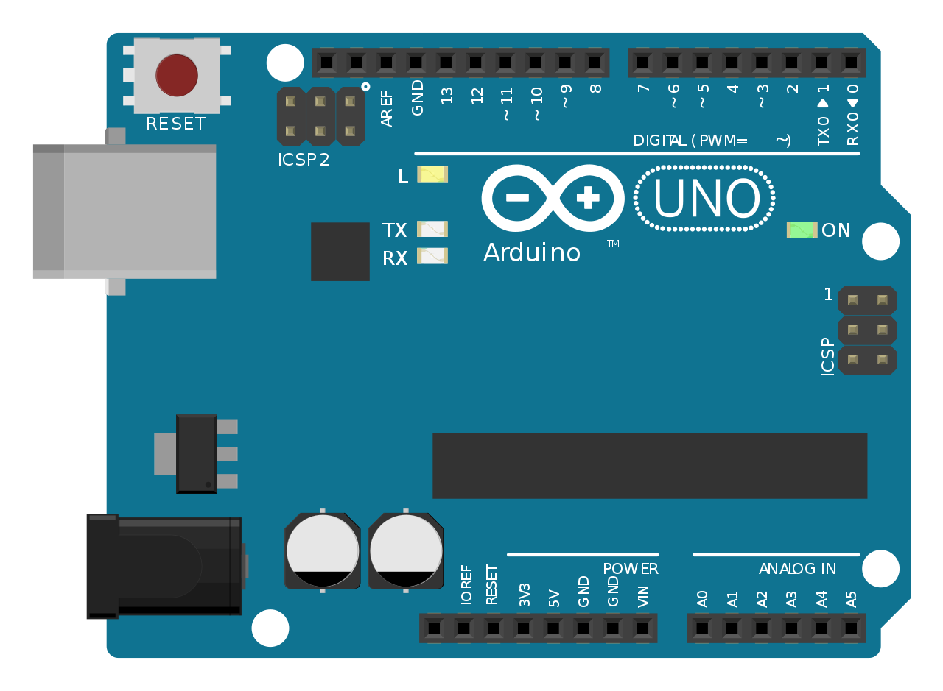

Slide 9
Hello World in HTML/CSS/JS
Notes:
Code sample is a bit weird but I picked it specifically for comparing arduno and front end dev

Slide 10
<div id="led">Here is a digital LED.</div>
<script>
let color = "black"
window.setInterval(function () {
document.getElementById("led").style.backgroundColor = color
color = color === "black" ? "white" : "black"
}, 1000)
</script>

Slide 11
Hello World in
Arduino

Slide 12
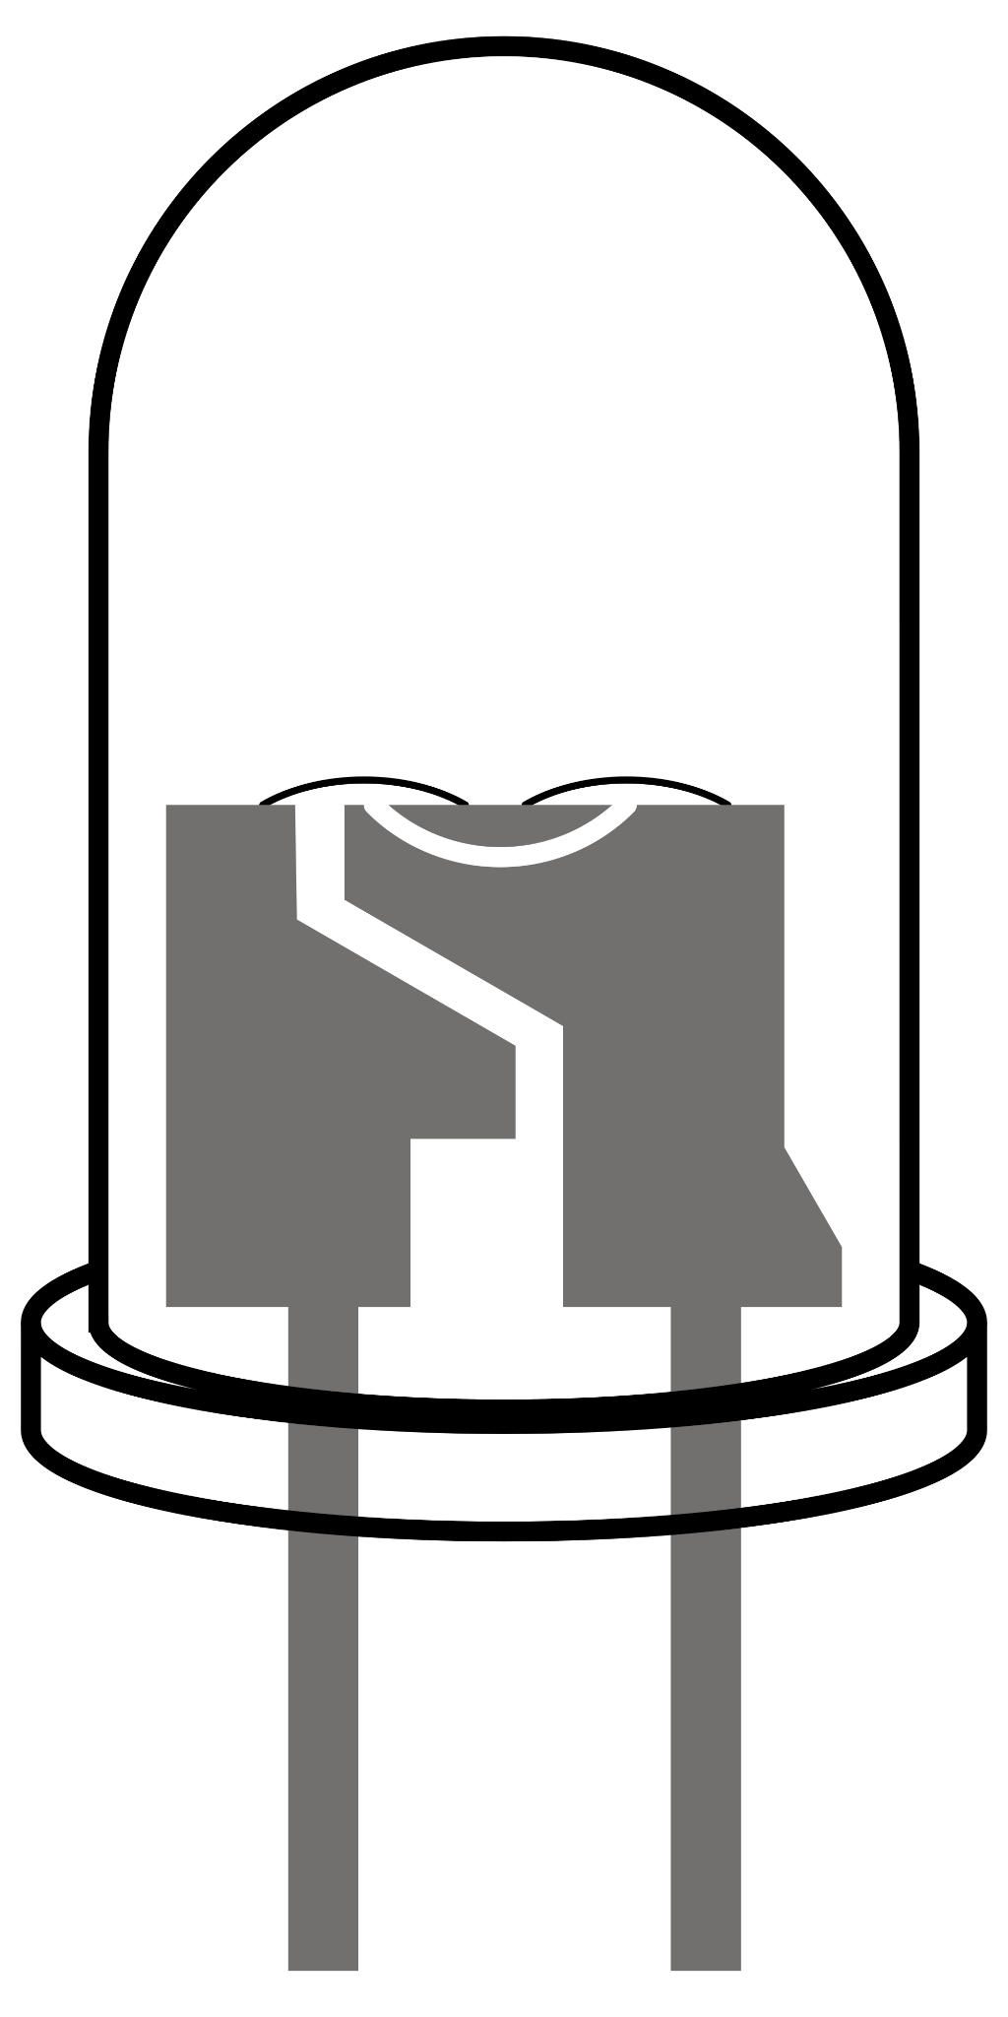
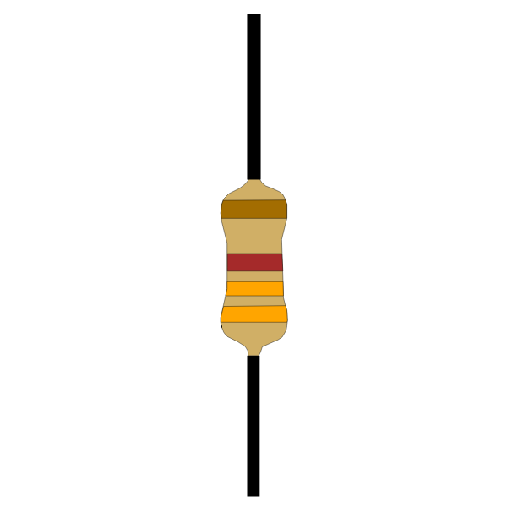
int LED_ID = 13;
void setup() {
pinMode(LED_ID, OUTPUT);
}
void loop() {
delay(1000);
digitalWrite(LED_ID, HIGH);
delay(1000);
digitalWrite(LED_ID, LOW);
}
Notes:
Three parts
Physical Setup
Physical to Code setup
Code Setup

Slide 13
What to do with it?
Get User Input
Pump Liquid
Control a Motor
Toggle Lights
Play Sound
Display Screen
Track Time

Slide 14
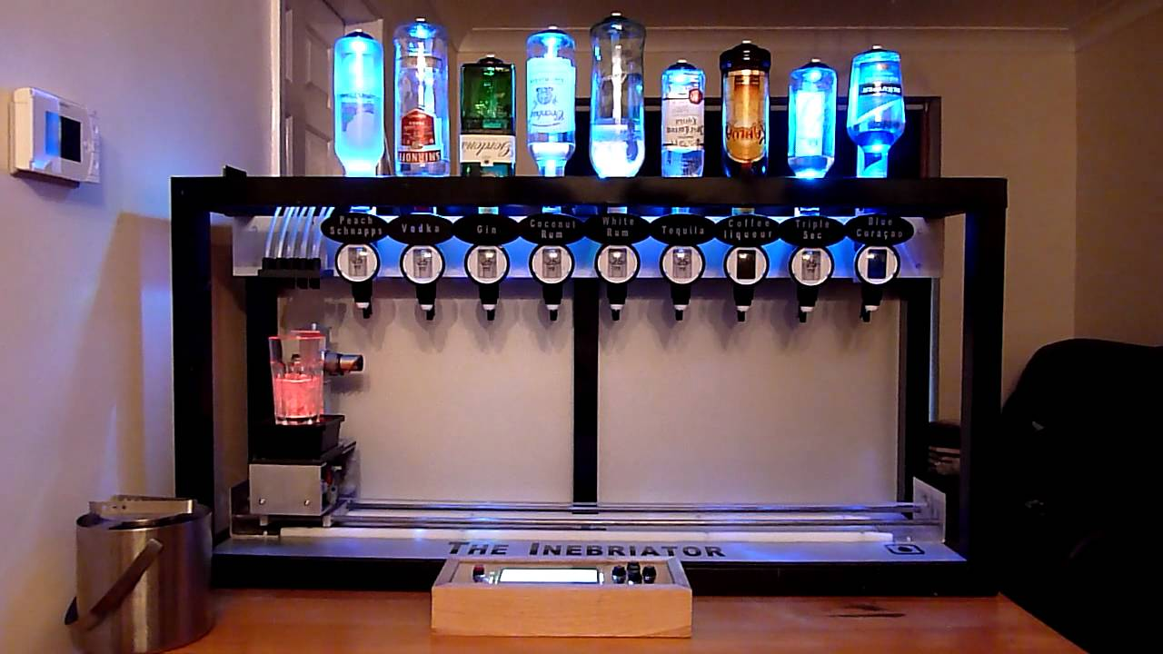
Source: TheInebriatorVideos on YouTube

Slide 15
Pros
Bridges Physical/Digital
Cons
No storage (~1KB)
No memory (~2KB)
Ugly GUIs
No Internet Connectivity

Slide 16
Pros
Lots of storage
Lots of memory
Pretty GUIs
Internet Connectivity
Cons
Doesn’t Bridge Physical/Digital

Slide 18
Pros
Lots of storage
Lots of memory
Pretty GUIs
Bridge Physical/Digital
Internet Connectivity
Cons
Literally None

Slide 19
Except One…

Slide 20
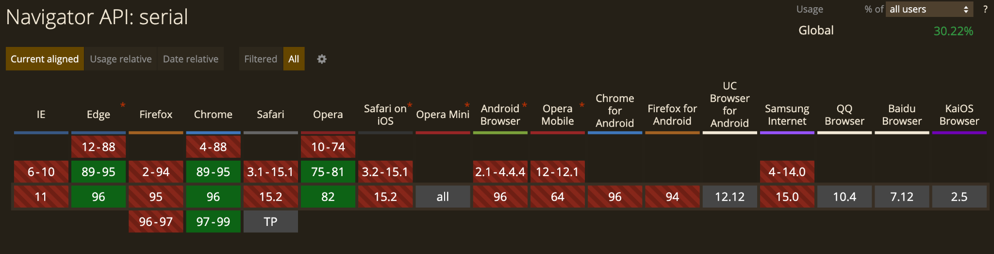

Slide 21
// ...
if(message){
if (message == "ping") {
Serial.print("pong");
} else if (message == "on"){
Serial.print("LED on");
digitalWrite(LED_ID, HIGH);
// ...

Slide 22
// ...
let sh = new SerialHandler();
const connect = async() => await sh.init(request)
// …
const talk = async (message) => {
await sh.write(message);
const response = await sh.read();
appendMessageToDOM(response);
};
// …
Notes:
SerialHandler little helper tool that wrapps navigator.serial

Slide 23
Live Demo??

Slide 24

Notes:
SerialHandler is a wrapper around Navigator.serial which exposes write and read messages.

Slide 25
Hey ya!(oh, oh)
Hey ya!(oh, oh)
That’s my talk.
https://github.com/TravisBumgarner/arduino_and_frontend

