Slide 1
Scammers At Work!
Travis Clark, Dhiraj Khanna, PhD; Tornia Lewis, PhD,
Clark Atlanta University, HBCU - UP

Slide 2
Abstract
Fraud and identity theft are ongoing issues in the United States. There has been a 38% increase from 2017 to 2018 with consumers reporting losses up to 1.4 billion dollars due to fraud. Identity theft and fraud have grown due to the advancement of technology and lack of progress in cybersecurity. Younger consumers are more targeted than older consumers. The older consumers that have reported complaints due to fraud or identity theft have lost more substantial amounts of money compared to younger consumers. Consumers are continually being targeted by scammers who use robocalls to attempt to collect an unrightfully-owed debt. Also, companies are have incorrectly reported information on consumer credit reports. An exploratory analysis of the data determines the major credit bureaus that have the most consumer credit reporting and debt collection complaints in Georgia, Florida, California, and Texas. The purpose of this research is to use machine learning techniques to predict if a consumer has a timely response to their complaint or not. It will also provide information to the consumers regarding the credit bureau that is most notorious for negatively reporting on a consumer’s credit profile. This study serves as a caution for any consumers dealing with credit disparity.

Slide 3
Research Questions
Which of the three major credit bureaus are statistically significant in predicting a consumer's interpretation of their response to complaints?
What company do consumers believe have a timely response rate to their complaints?

Slide 4
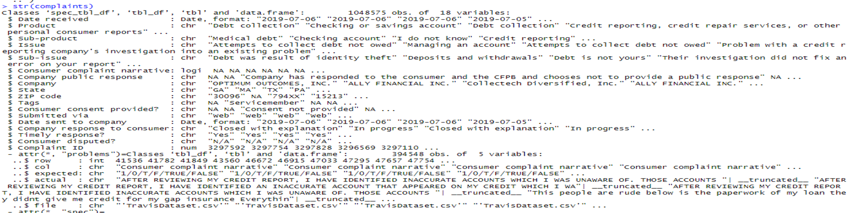

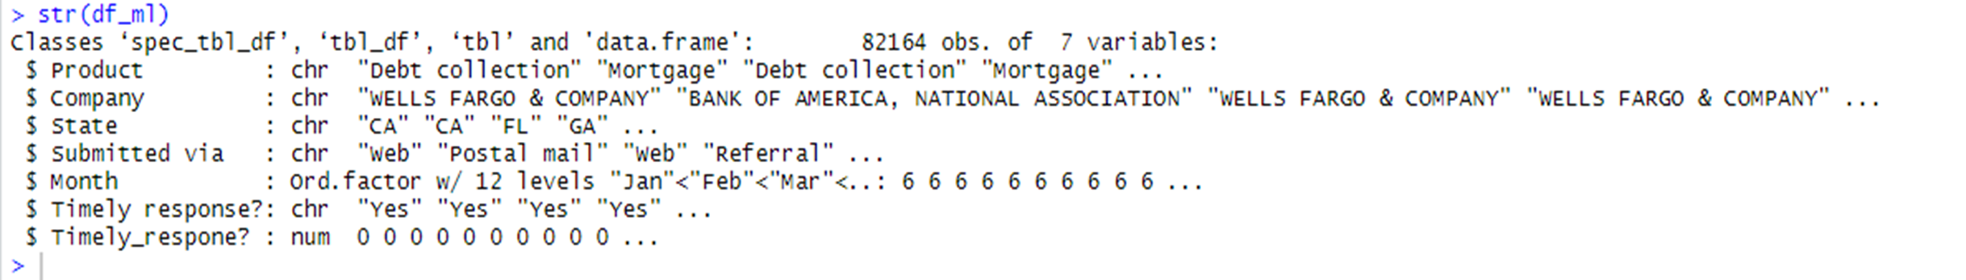

Data Set and Data Wrangling Technique
Figure 1 shows the original consumer complaint dataset that has 18 variables and 1,048,575 observations. Using data wrangling techniques, and an understanding of the research questions, the clean data set in Figure 2 included 7 variables and a little over 82,000 observations. The techniques utilized allowed me to focus on specific states, complaints, and companies.

Slide 5
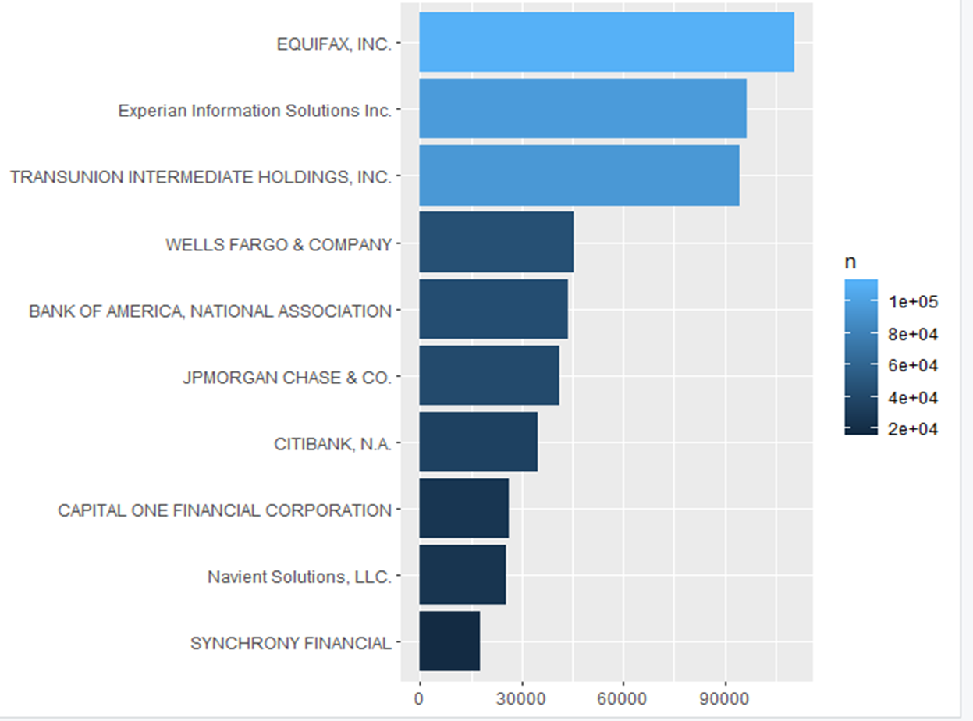
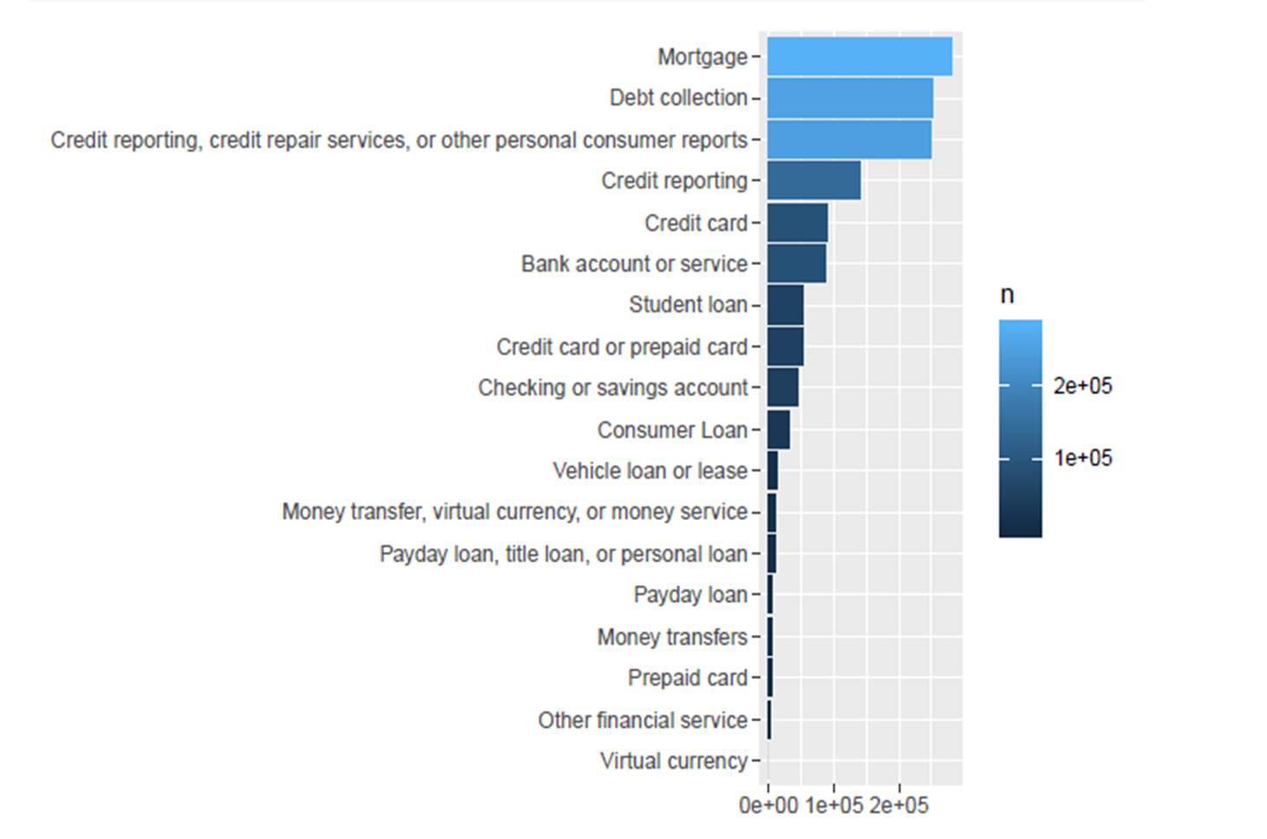


Statistical Analysis
Analyzing the consumer complaint dataset very thoroughly helped formulate the research questions. We filtered particular variables in the dataset to help make trends available. Figure 3 shows the companies that have the highest number of complaints. Figure 4 shows the number of consumers with a specific claim.

Slide 6
Logistic regression measures the relationship between a categorical dependent variable that is binary. The dependent variable is timely response, and 1 is the label for yes and 0 for no. Logistic regression was the best model for this research because of the binary dependent variable. The independent variables used in the model are categorical. The model is built to predict if a customer feels that their complaint was handled promptly. The independent variables are company, state, month, and product. Two models were developed to predicted timely response. The first model (Figure 5) was hard to interpret because of the number of attributes list in the categorical variables. The model in Figure 6 gave better results.
Machine Learning

Slide 7
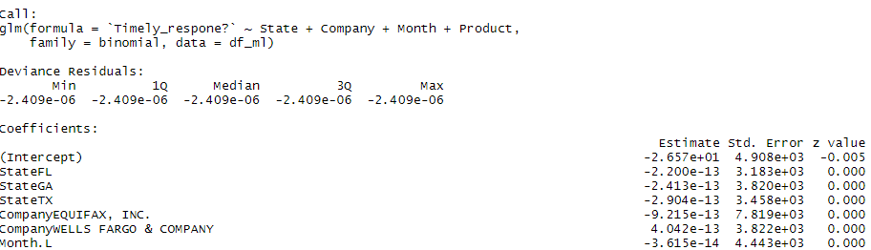
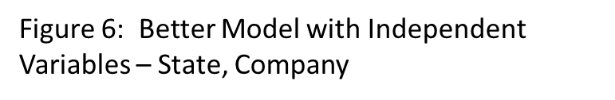
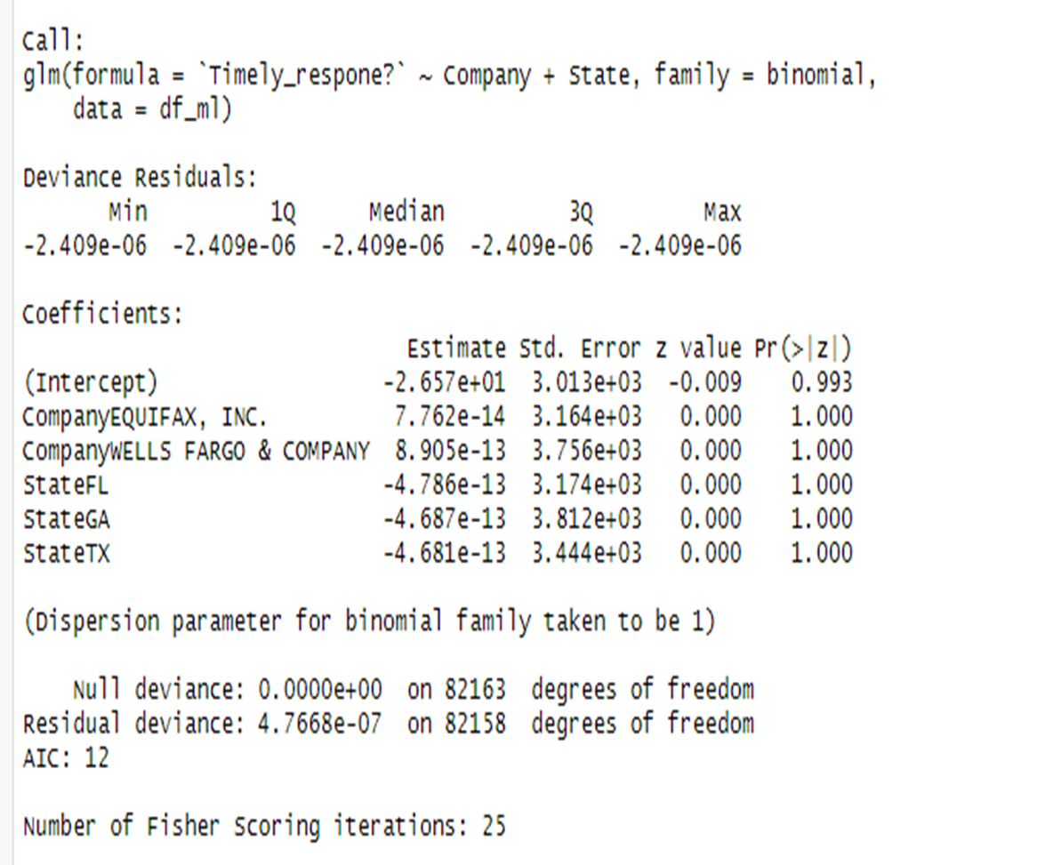
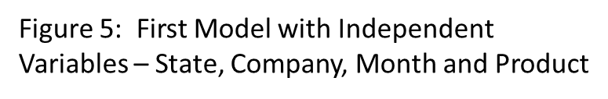

Slide 8
Results
The company with the highest number of complaints is Equifax, followed by Experian, then Transunion. It was not a shock that Wells Fargo came in at number four given their latest detrimental media debacle.
The model predicts the dependent variable, whether or not the consumer feels that there was a timely response to their complaint. The p-values show that the variables are not significant for predicting timely response. Residual deviance is related to our model because there are three independent variables. This metric indicates how plausible it is that we will see if the model has the independent variables that are in the model. The high level of degrees of freedom suggests that the data does not plausibly emanate from a logistic regression model that includes the independent variables selected. An evaluation of the model residuals explains that the model has room to achieve more significant results.

Slide 9
Future Work
In the future, we plan on building a better model and reducing the scope to include information regarding only college students. Natural language processing is a machine learning technique that analyzes text to determine the feelings and emotions of the consumer. We plan to expand the research to classify the sentiment of the consumer through their issues and sub-issues.

Slide 10
Acknowledgments
I give an exceptional thank you to my mentor Dhiraj Khanna and Dr. Torina Lewis for believing in me. Thanks to Dr. Mintz the principal investigator for the HBCU-UP project. A special thanks to the students in the program that helped and listened to me rant when the program crashed, causing me to lose my code. This research opportunity was sponsored by the National Science Foundation, award numbers 1700408 and 1818682.

Slide 11
Reference
Consumer Financial Protection Bureau, Consumer Complaint Database, https://www.consumerfinance.gov/data-research/consumer-complaints/, 2019.

