Slide 1
CERKL WORKSPACE · TRAVIS FOSTER
Folder Structure as Agentic Architecture
How plain markdown — routers, context, and skills — composes into a working multi-agent system. No code, no agent classes; English is the routing language.
GITHUB.COM/TRAVISDFOSTER/CERKL-CLAUDE

Slide 2
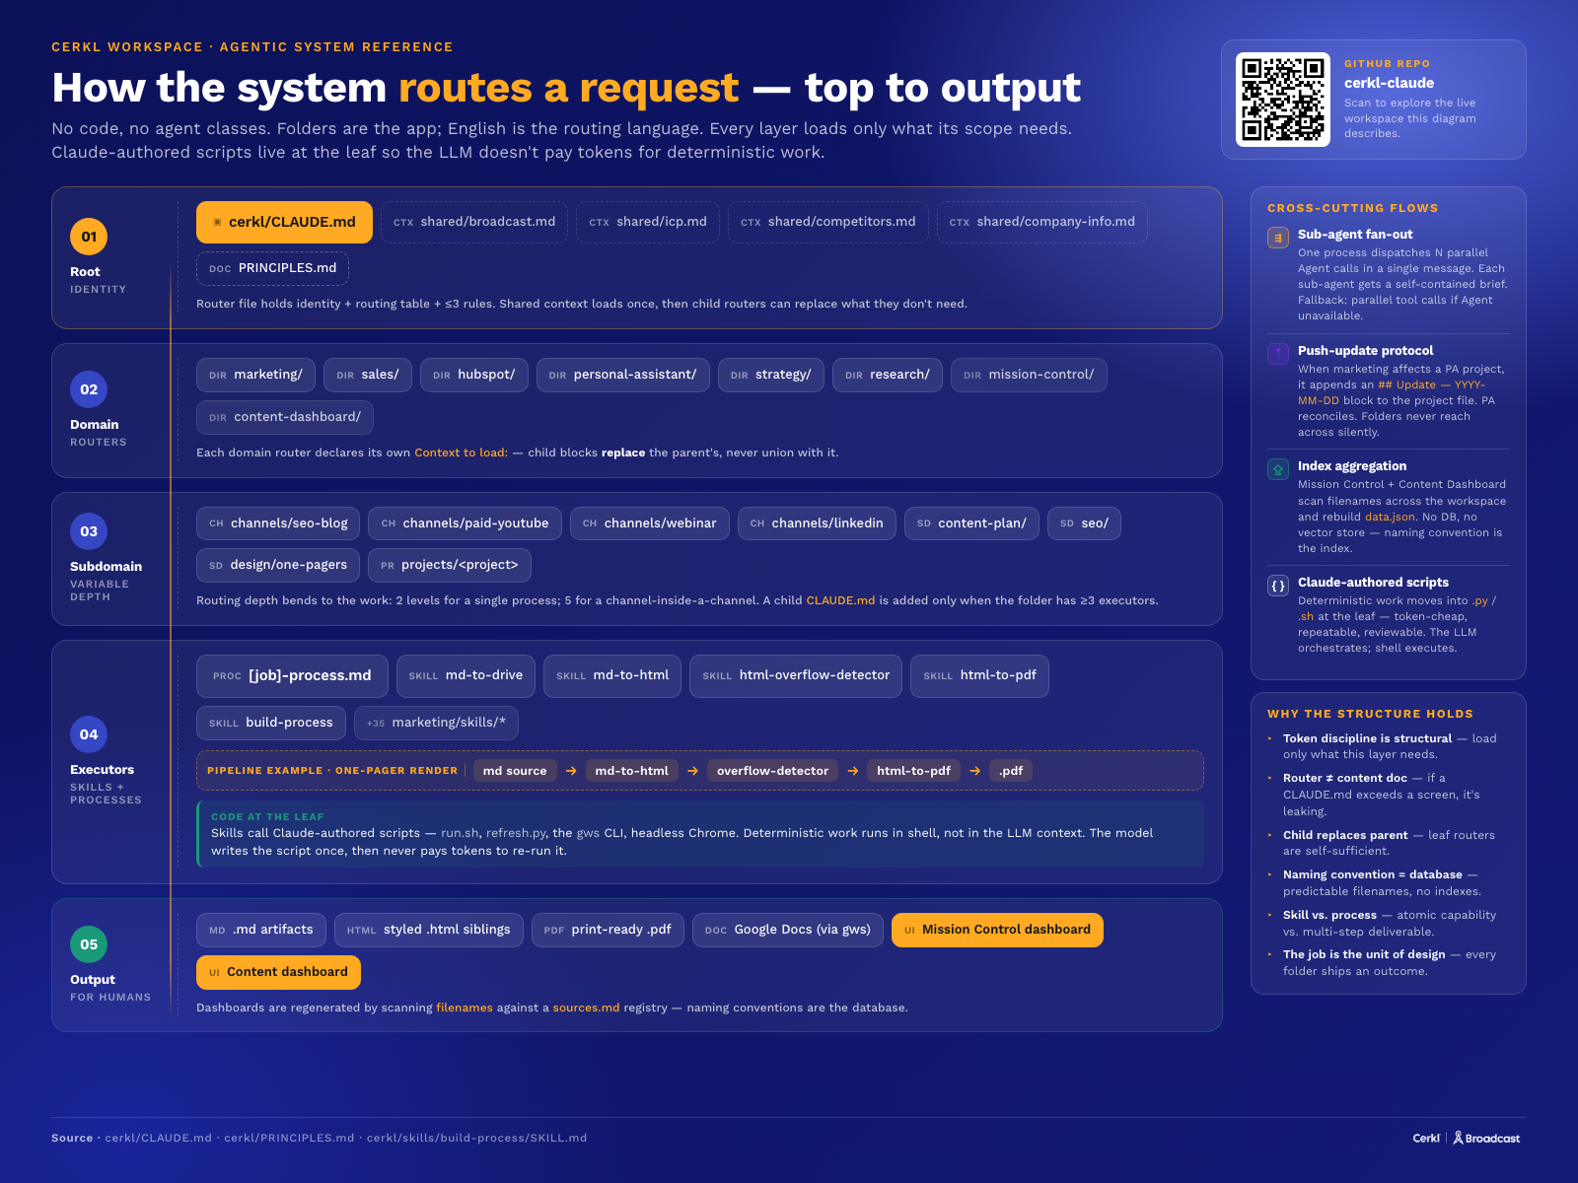
AGENTIC SYSTEM REFERENCE
How the system routes a request — top to output
ROOT → DOMAIN → SUBDOMAIN → EXECUTORS → OUTPUT

Slide 3
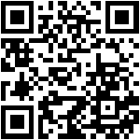

SCAN TO CONNECT
Take this home with you.
Explore the workspace, or stay in touch.
GITHUB REPO
LINKEDIN
cerkl-claude
Travis Foster
CERKL · HEAD OF MARKETING & GROWTH OPS

