Slide 1
INTRO TO RUBY ON RAILS
Lesson: My First Rails App
Travis Griffiths
Sr. Programmer, Quant5

Slide 2
Questions
Project Questions
Classes and Methods
Rails Scaffolding
Application Design

Slide 3
AGENDA
Modules
Browser and HTTP
Request Response Cycle
Rails Application File Structure
Thinking About My Final Project

Slide 4
USING MODULES, MIXINS, AND EXCEPTION HANDLING
MODULES

Slide 5
modules
USING MODULES, MIXINS AND EXCEPTION HANDLING
What is a module?
  A module is like a class, except
  You cannot create a new instance of a module
  You cannot extend a module to create a child module
  Collection of useful methods and constants
  Modules are defined using a module ... end block
    For example....(next slide)

Slide 6
modules - EXAMPLE
USING MODULES, MIXINS AND EXCEPTION HANDLING
module MyNeatMethods
def MyNeatMethods.neat_method
return "Oh so neat."
end
end
>> result = MyNeatMethods.neat_method
>> puts result
Oh so neat.

Slide 7
modules
USING MODULES, MIXINS AND EXCEPTION HANDLING
What are modules used for?
Why would you write code in modules?
    Good code should be reused
    Not all code logically groups together as a class
    Modules provide a namespace to keep names distinct

Slide 8
modules and constants
USING MODULES, MIXINS AND EXCEPTION HANDLING
Modules are commonly used to hold frequently used constants.
A constant is a value which does not change at runtime by convention, constants are named in all capital letters.
A warning given if you change a variable which starts with a capital letter.
>> APP_HOME = 127.0.0.1
>> APP_HOME = 229.42.8.16
>> puts APP_HOME
warning: already initialized constant APP_HOME

Slide 9
building modules - syntax
USING MODULES, MIXINS AND EXCEPTION HANDLING
module MyAppUtils
HOME_IP = "127.0.0.1"
def MyAppUtils.sentence_shuffler(sentence)
return sentence.split.shuffle!.to_s
end
end

Slide 10
Including Modules
USING MODULES, MIXINS AND EXCEPTION HANDLING
$LOAD_PATH.unshift(File.dirname(__FILE__))
require 'lib/my_app_utils'
include MyAppUtils
Let’s look at more examples in irb....

Slide 11
Built-in ruby modules
USING MODULES, MIXINS AND EXCEPTION HANDLING
Ruby exposes much core functionality through modules
A commonly used built in module is Math
The :: operator is used to refer to a constant set in a module
puts Math.sqrt(9)
>>3.0
puts Math::PI
>>3.1415926
Ruby docs has a full list of available modules.
Notes:
Array_math.rb example

Slide 12
USING MODULES, MIXINS AND EXCEPTION HANDLING
LAB TIME
Notes:
Suggested:
ex_module.rb

Slide 13
LESSON: MY FIRST RAILS APPLICATION
RAILS AND MY BROWSER

Slide 14


how does the internet works?
RAILS AND MY BROWSER

Slide 15
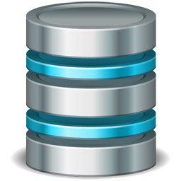
Introduction to the Request Response cycle
RAILS AND MY BROWSER
Rails Application
HTTP request GET
Dispatcher
Controller
Database
HTTP Response
<!DOCTYPE html>
View
Model

Slide 16
LESSON: MY FIRST RAILS APPLICATION
STRUCTURE OF A RAILS APP

Slide 17
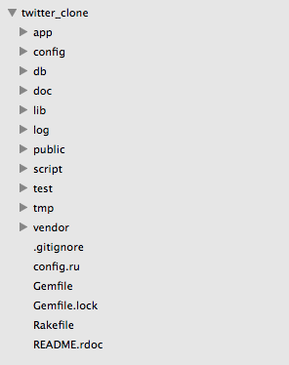
STRUCTURE OF A RAILS APP

Slide 18
STRUCTURE OF A RAILS APP
What is in the /app folder of a Rails application?
app/assets: images, JavaScripts, and stylesheets to be requested by RoR templates
app/controllers: switchboard classes which pass incoming data to models & providing outgoing data to views
app/helpers: utility classes which provide methods to be used across many views
app/mailers: support classes for sending email from the application
app/models: classes representing and providing access to database tables
app/views: ERB templates called to render data into pages
app/views/layouts: template "master pages" to consolidate common view code (e.g., site menus, etc.)

Slide 19
STRUCTURE OF A RAILS APP
What else is in the default folder structure of a Rails Application?
config: routing, database, and runtime environmental configuration files
db: scripts managing database tables
doc: location for auto-generated documentation created with RubyDoc
lib: developer-built code to be shared across the application, along with rake tasks
log: system and developer generated log files
public: static HTML, standard HTTP error pages, and favicon.ico files for the application
script: code used by command line tools to generate other code
test: code for mocks, unit tests, fixtures, and functional tests
tmp: location for session variables, temporary files, cached data, etc.
vendor: location for external third-party code added to the application as a plug-in

Slide 20
STRUCTURE OF A RAILS APP
Most of your application logic belongs to app/ (including css and javascript files)

Slide 21
STRUCTURE OF A RAILS APP
public/ contains static files that are directly available

Slide 22
LESSON: MY FIRST RAILS APPLICATION
DESIGNING A RAILS APP
Notes:
The purpose of this section is to introduce students to planning their rails final project.
We want students to begin to think about models and associations for their project even though they haven’t been formerly introduced to it.

Slide 23
How Do I start to plan my project?
DESIGNING A RAILS APP
Notes:
Provide students with a few tips on how they can start to plan their project.
They should provide a project proposal in a weeks times and it should have a list of classes they think their project will have.

Slide 24
LESSON: MY FIRST RAILS APPLICATION
LAB TIME
Notes:
Suggested:
Code Along Download Files From Public
Exercise Scaffolding

Slide 25
CODE ALONG - DOWNLOAD A TXT FILE
create a file hello.txt that a user can download by going to localhost:3000/hello.txt (using public/)

Slide 26
EXERCISE - SCAFFOLDING APP
Create a new scaffolding application with:
  users (first name, last name, age, email).
Bonus: Remove the ability to edit the user after they are created(hint: you can look at the files generated in app/views/)

Slide 27
LESSON: MY FIRST RAILS APPLICATION
BONUS: FILES GENERATED BY SCAFFOLDING

Slide 28
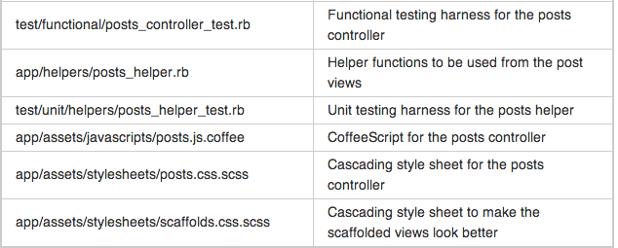
FILES GENERATED BY SCAFFOLDING

Slide 29
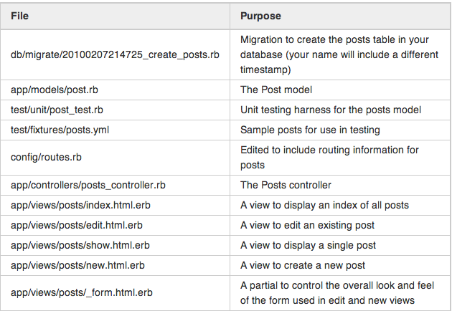
FILES GENERATED BY SCAFFOLDING

