Slide 1
INTRO TO RAILS (ITR)
Lesson 1: Intro To Programming
Travis Griffiths
Senior Programmer, Quant5

Slide 2
topics
LESSON 1: Introduction to Web Development and GitHub DEVELOPMENT AND BUILDING WEB PAGES
Class Information
What is Web Development
Command Line Review
Programming in the Ruby Shell
Using GitHub

Slide 3
What is web development?
LESSON 1: INTRODUCTION TO WEB DEVELOPMENT AND GITHUB

Slide 4
Web Development Roles
LESSON 1: Introduction to Web Development and GitHub
Back end
(server-side)
Ruby
PHP
Python
PERL
C++
Front-end
(client-side)
HTML
CSS
JavaScript

Slide 5
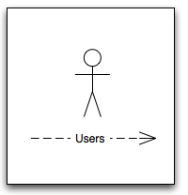
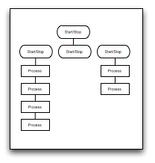
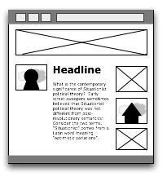
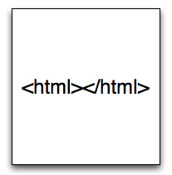
A Typical Web Development Cycle
LESSON 1: INTRODUCTION TO WEB DEVELOPMENT AND GITHUB
User-Experience
(UX)
Information
Architecture (IA)
Design
Development

Slide 6
Using the terminal
LESSON 1: INTRODUCTION TO WEB DEVELOPMENT AND GITHUB

Slide 7


Get to your terminal
LESSON 1: INTRODUCTION TO WEB DEVELOPMENT AND GITHUB
Click on the spotlight search (Glass on upper right)
Type terminal
Type WindowsKey + R
Type cmd in the dialog box
press Ok

Slide 8
Master your terminal
LESSON 1: INTRODUCTION TO WEB DEVELOPMENT AND GITHUB
Terminal is a representation of your files present on your computer.

Slide 9
Visit Directory
LESSON 1: INTRODUCTION TO WEB DEVELOPMENT AND GITHUB
cd (Change Directory)

Slide 10
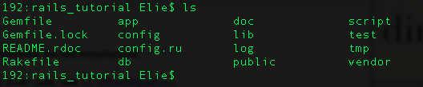
List file in a directory
LESSON 1: INTRODUCTION TO WEB DEVELOPMENT AND GITHUB
ls (list)

Slide 11
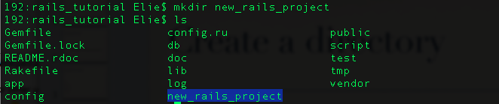
Create a directory
LESSON 1: INTRODUCTION TO WEB DEVELOPMENT AND GITHUB
mkdir (make directory)

Slide 12
Go back a directory
LESSON 1: INTRODUCTION TO WEB DEVELOPMENT AND GITHUB
cd ../ (.. represent the parent directory)

Slide 13
Open and edit a file/directory
LESSON 1: INTRODUCTION TO WEB DEVELOPMENT AND GITHUB
You need to have sublimeText command line tools installed:
  http://www.sublimetext.com/docs/2/osx_command_line.html
subl my_file.txt (open a file)
subl my_directory/ (open directory)

Slide 14
Ruby Programming language
LESSON 1: INTRODUCTION TO WEB DEVELOPMENT AND GITHUB
  Ruby was conceived in February 1993, by Yukihiro "Matz" Matsumoto
  This course is based on Ruby 1.9.3, originally released December 2007

Slide 15
WHY learn ruby
LESSON 1: INTRODUCTION TO WEB DEVELOPMENT AND GITHUB
Widely used, with the Rails framework.
Highly productive, enabling lots of functionality with less code.
Well documented, with many tutorials for all ability levels.
Notes:
\

Slide 16
Getting Ready
LESSON 1: INTRODUCTION TO WEB DEVELOPMENT AND GITHUB
http://railsinstaller.org/

Slide 17
Install Checklist
LESSON 1: INTRODUCTION TO WEB DEVELOPMENT AND GITHUB
Git
Ruby 1.9.3
Rails 3.2.11
Heroku

Slide 18
Configuring ruby development environment
LESSON 1: INTRODUCTION TO WEB DEVELOPMENT AND GITHUB

Slide 19
ruby shell
LESSON 1: INTRODUCTION TO WEB DEVELOPMENT AND GITHUB
A tool automatically installed with Ruby
Enables immediate excution of Ruby Code (useful for learning)
Launch by running irb from the command line
Quit by running exit from the IRB prompt.

Slide 20
ruby shell activity
LESSON 1: INTRODUCTION TO WEB DEVELOPMENT AND GITHUB

Slide 21

Using git and Github
LESSON 1: INTRODUCTION TO WEB DEVELOPMENT AND GITHUB

Slide 22
What is Git?
LESSON 1: INTRODUCTION TO WEB DEVELOPMENT AND GITHUB
Git is a version control system
It makes your code easy to share and to maintain!

Slide 23
Git -Setup (in the terminal)
LESSON 1: INTRODUCTION TO WEB DEVELOPMENT AND GITHUB
mkdir new_directory (we create a new directory)
cd new_directory (we go in it)
git init (starts git for this directory)
Now git is listening for any change.

Slide 24
Git commit
LESSON 1: INTRODUCTION TO WEB DEVELOPMENT AND GITHUB
git add .
git commit -m ‘my commit message goes here’
git log (shows your previous commit)

Slide 25
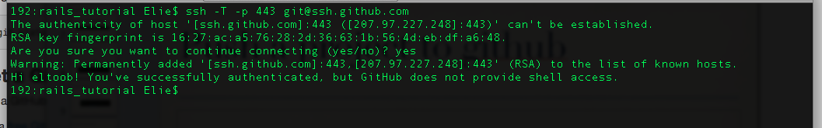
Push to Github
LESSON 1: INTRODUCTION TO WEB DEVELOPMENT AND GITHUB
Login on github.com
Set up your SSH keys (see github.com)
try it by typing: ssh -T -p 443 git@ssh.github.com

Slide 26
Push to Github
LESSON 1: INTRODUCTION TO WEB DEVELOPMENT AND GITHUB
Go to github and create a new repository (github.com/repositories/new)
$ git remote add origin: git@github.com:YOUR_GITHUB_ACCOUNT/YOUR_PROJECT_NAME.git
$ git push origin master (Pushes your code to github)

Slide 27
Push to Github
LESSON 1: INTRODUCTION TO WEB DEVELOPMENT AND GITHUB
Workflow:
1) Check your code at each stage of completion
  $ git commit -am "some helpful comment"
2) Push your code to github
  $ git push

Slide 28
Wanna learn more about git
LESSON 1: INTRODUCTION TO WEB DEVELOPMENT AND GITHUB
http://try.github.com/

Slide 29
Code along: Command Line
LESSON 1: INTRODUCTION TO WEB DEVELOPMENT AND GITHUB
Create a new folder
create a new file
Create a first commit in this directory
(Bonus) Push this directory to github

