Slide 1
INTRO TO RAILS
Lesson 2: Basics Of Computational Thinking (Variables and Conditionals)
Insert Instructor Name
Title, Company

Slide 2
AGENDA
Quiz
Homework ReviewIntroduction to Computational ThinkingArithmetic & Variables
Data Types Conditionals

Slide 3
Quiz
LESSON 2: BASICS OF COMPUTATIONAL THINKING
What tools are required to create a Ruby program?
What is irb?
How do you write and run a Ruby program?
Name and describe a command line flag
Notes:
5 min

Slide 4
Homework review
LESSON 2: BASICS OF COMPUTATIONAL THINKING
HW_01_solutions.rb
Notes:
15 min

Slide 5
LESSON 2: BASICS OF COMPUTATIONAL THINKING
INTRO TO PROGRAMMING

Slide 6
introduction to computational thinking
LESSON 2: BASICS OF COMPUTATIONAL THINKING
Get into groups of two or three
Create step by step instructions to provide a robot so that he can check your email.

Slide 7
introduction to computational thinking
LESSON 2: BASICS OF COMPUTATIONAL THINKING
What is Pseudo Code?
How is code read in a file (line by line)?
What is computational thinking?

Slide 8
LESSON 2: BASICS OF COMPUTATIONAL THINKING
VARIABLES AND DATA TYPES

Slide 9
variables, Arithmetic and data types
LESSON 2: BASICS OF COMPUTATIONAL THINKING
Available materials: variables_arithmetic.rb
What is a Variable?

Slide 10
ruby variables
LESSON 2: BASICS OF COMPUTATIONAL THINKING
How do you choose a variable name?

Slide 11
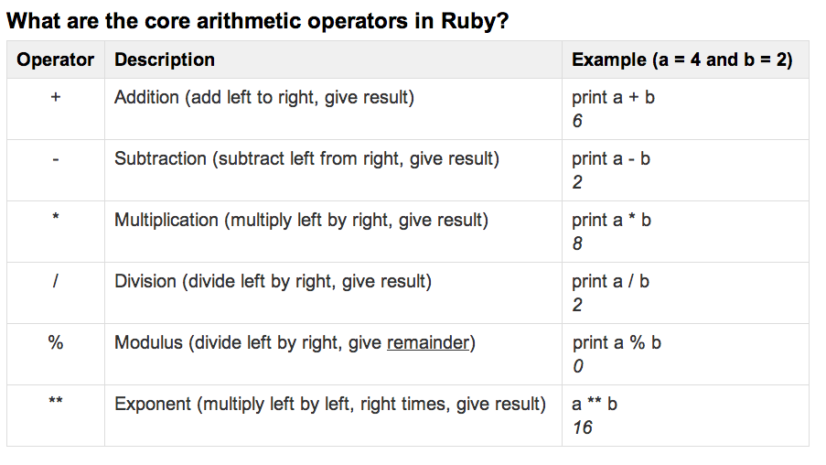
arithmetic IN ruby
LESSON 2: BASICS OF COMPUTATIONAL THINKING

Slide 12
arithmetic IN ruby
LESSON 2: BASICS OF COMPUTATIONAL THINKING
What is the order of precedence in operations?
unless otherwise specified by parentheses, * / and % take precedence over + and -.

Slide 13
data types
LESSON 2: BASICS OF COMPUTATIONAL THINKING
Available Materials:
data_types.rb
What is a data type?
  What are the basic data types in Ruby?

Slide 14
working with strings
LESSON 2: BASICS OF COMPUTATIONAL THINKING
Available Materials:
string.rb
What is a string?
What is a symbol?
Notes:
string.rb

Slide 15
INSERT CLASS TITLE
LAB TIME
dataTypes_Strings.rb

Slide 16
conditionals
LESSON 2: BASICS OF COMPUTATIONAL THINKING
What is a Conditional?
Why would we use it? (Remember your robot example)
Help students understand the concept by relating it to decisions in robot pseudo code example.
Available Materials:
conditionals.rb

Slide 17
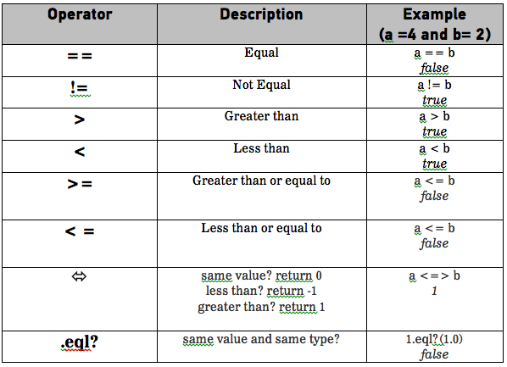
conditionals
LESSON 2: BASICS OF COMPUTATIONAL THINKING
Logical Operators

Slide 18
conditionals
LESSON 2: BASICS OF COMPUTATIONAL THINKING
Available Materials:
nested_conditionals.rb
Why would you use an if, else statement?
What is a nested conditional statement?

Slide 19


LESSON 2: MORE HTML/CSS BASICS

