Slide 1
INTRO TO RUBY ON RAILS
Lesson: My First Rails App
Insert Instructor Name
Title, Company

Slide 2
QUIZ
  Why would you include a module in a class?
  How do you implement the Enumerable module?
  What is a constant and how do you implement one?
  What is an exception?
  How do you prevent an exception from stopping program execution?
  How do you ensure certain code runs regardless of whether an exception is raised?
  What class would you commonly derive to define a custom exception?

Slide 3
AGENDA
Intro to Rails
My First Rails App
Request Response Cycle
Rails Application File Structure
Thinking About My Final Project

Slide 4

LESSON: MY FIRST RAILS APPLICATION
What you need to get started:
  Set up with ruby 1.9.3
  Rails 3.x
  git

Slide 5
LESSON: MY FIRST RAILS APPLICATION
Check if Rails is installed:
Terminal:
$rails -v
=> Rails 3.2.12

Slide 6
LESSON: MY FIRST RAILS APPLICATION
Sites you may have heard of that run on Rails:
Twitter
Groupon
GitHub
Basecamp
General Assembly!
Use the site http://builtwith.com to check if your favorite site was built on Rails.

Slide 7
LESSON: MY FIRST RAILS APPLICATION
What is Ruby on Rails?
What is a Framework?

Slide 8

LESSON: MY FIRST RAILS APPLICATION
Ruby on Rails is an open-source web framework
Built by @dhh in July 2004 extracted from his work on Basecamp
(a management tool by 37 signals)

Slide 9
LESSON: MY FIRST RAILS APPLICATION
MY FIRST RAILS APPLICATION

Slide 10
Creating a rails application
MY FIRST RAILS APP
$ rails new my_app_name
$ rails server
Go To: localhost:3000
Notes:
Instructor:
The purpose of this exercise is to give students a small win.
They create a rails application and it is rewarding.
You can use this application to explain how Rails works and the file structure.

Slide 11
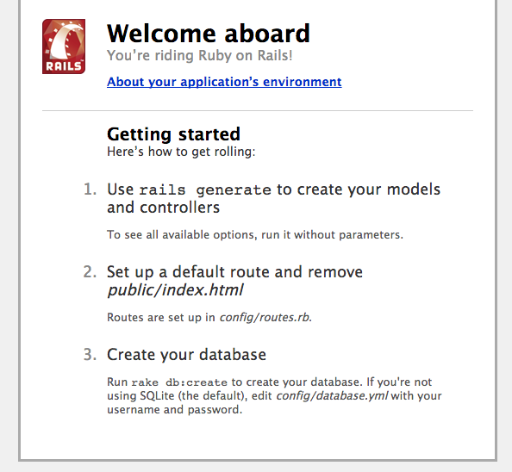
starting a rails application
MY FIRST RAILS APP

Slide 12
Creating a scaffolding application
MY FIRST RAILS APP
    $ rails generate scaffold Book author:string title:string abstract:text

Slide 13
create the tables in the database
MY FIRST RAILS APP
    $ rake db:migrate
Notes:
Instructor:
The purpose of this exercise is to give students a small win.
They create a rails application and it is rewarding.
You can use this application to explain how Rails works and the file structure.

Slide 14
Start the rails server
MY FIRST RAILS APP
    $ rails server
Notes:
Instructor:
The purpose of this exercise is to give students a small win.
They create a rails application and it is rewarding.
You can use this application to explain how Rails works and the file structure.

Slide 15
Be amazed
MY FIRST RAILS APP
    In your browser: localhost:3000/books
Notes:
Instructor:
The purpose of this exercise is to give students a small win.
They create a rails application and it is rewarding.
You can use this application to explain how Rails works and the file structure.

Slide 16
MY FIRST RAILS APP
Scaffolding posts will let you create, edit, delete and edit Books

Slide 17
MY FIRST RAILS APP
Scaffolding is very rarely used in production
websites but is a great way to get started with rails

Slide 18
LESSON: MY FIRST RAILS APPLICATION
RAILS AND MY BROWSER

Slide 19

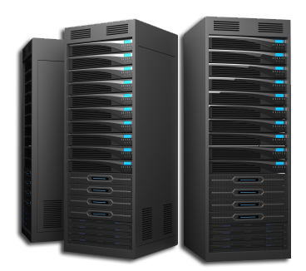
how does the internet works?
RAILS AND MY BROWSER

Slide 20
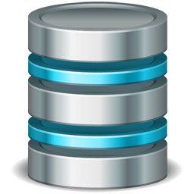
Introduction to the Request Response cycle
RAILS AND MY BROWSER
Rails Application
HTTP request GET
Dispatcher
Controller
Database
HTTP Response
<!DOCTYPE html>
View
Model

Slide 21
LESSON: MY FIRST RAILS APPLICATION
STRUCTURE OF A RAILS APP

Slide 22
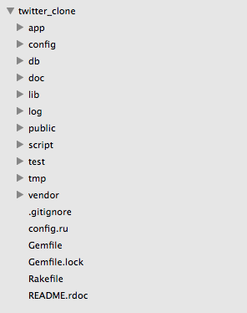
STRUCTURE OF A RAILS APP

Slide 23
STRUCTURE OF A RAILS APP
What is in the /app folder of a Rails application?
app/assets: images, JavaScripts, and stylesheets to be requested by RoR templates
app/controllers: switchboard classes which pass incoming data to models & providing outgoing data to views
app/helpers: utility classes which provide methods to be used across many views
app/mailers: support classes for sending email from the application
app/models: classes representing and providing access to database tables
app/views: ERB templates called to render data into pages
app/views/layouts: template "master pages" to consolidate common view code (e.g., site menus, etc.)

Slide 24
STRUCTURE OF A RAILS APP
What else is in the default folder structure of a Rails Application?
config: routing, database, and runtime environmental configuration files
db: scripts managing database tables
doc: location for auto-generated documentation created with RubyDoc
lib: developer-built code to be shared across the application, along with rake tasks
log: system and developer generated log files
public: static HTML, standard HTTP error pages, and favicon.ico files for the application
script: code used by command line tools to generate other code
test: code for mocks, unit tests, fixtures, and functional tests
tmp: location for session variables, temporary files, cached data, etc.
vendor: location for external third-party code added to the application as a plug-in

Slide 25
STRUCTURE OF A RAILS APP
Most of your application logic belongs to app/ (including css and javascript files)

Slide 26
STRUCTURE OF A RAILS APP
public/ contains static files that are directly available

Slide 27
LESSON: MY FIRST RAILS APPLICATION
DESIGNING A RAILS APP
Notes:
The purpose of this section is to introduce students to planning their rails final project.
We want students to begin to think about models and associations for their project even though they haven’t been formerly introduced to it.

Slide 28
How Do I start to plan my project?
DESIGNING A RAILS APP
Notes:
Provide students with a few tips on how they can start to plan their project.
They should provide a project proposal in a weeks times and it should have a list of classes they think their project will have.

Slide 29
LESSON: MY FIRST RAILS APPLICATION
LAB TIME
Suggested:
Code Along Download Files From Public
Exercise Scaffolding

Slide 30
CODE ALONG - DOWNLOAD A TXT FILE
create a file hello.txt that a user can download by going to localhost:3000/hello.txt (using public/)

Slide 31
EXERCISE - SCAFFOLDING APP
Create a new scaffolding application with:
  users (first name, last name, age, email).
Bonus: Remove the ability to edit the user after they are created(hint: you can look at the files generated in app/views/)

Slide 32
LESSON: MY FIRST RAILS APPLICATION
BONUS: FILES GENERATED BY SCAFFOLDING

Slide 33
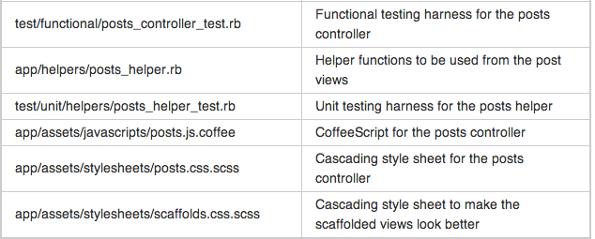
FILES GENERATED BY SCAFFOLDING

Slide 34
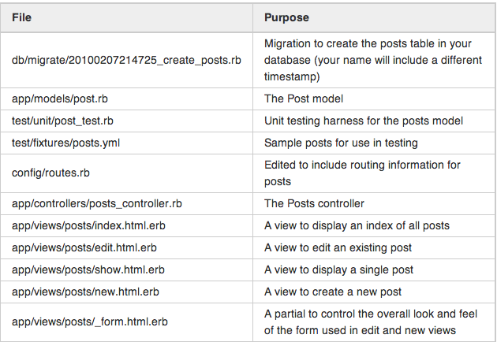
FILES GENERATED BY SCAFFOLDING

