Slide 1
INTRO TO RUBY ON RAILS
Lesson: Controllers and Views
Insert Instructor Name
Title, Company

Slide 2
Quiz
REVIEW FROM PREVIOUS CLASS
How do you create the foundation of a Ruby on Rails application?
What is the request response cycle?
What is WEBrick?
What is MVC?
How can you view your application in the browser (URL)?

Slide 3


Introduction to the Request Response cycle
REVIEW
Rails Application
HTTP request GET
Dispatcher
Controller
Database
HTTP Response
<!DOCTYPE html>
View
Model
Notes:
The next 3 lessons will include this diagram.
It is included so that students become comfortable and understand the flow of a Rails application.
We found that repetition while introducing new concepts / parts of the rails application works best.

Slide 4
AGENDA
MVC
The Dispatcher
Controllers
Views

Slide 5
LESSON: VIEWS AND CONTROLLERS
MODEL
VIEW
CONTROLLER

Slide 6
What is MVC?
MODEL VIEW CONTROLLER
Model View Controller
Rails follows the basic principles of MVC

Slide 7
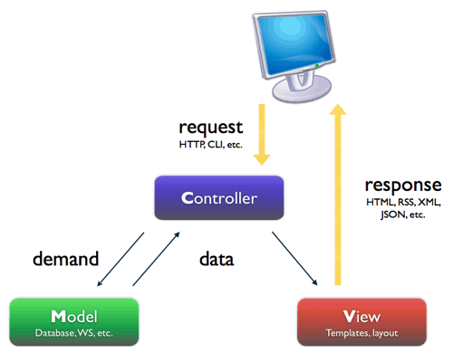
MODEL VIEW CONTROLLER
Image from: http://www.shopno-dinga.com/dustbin/mvc.png
Notes:
We talk about the models in the next class.

Slide 8
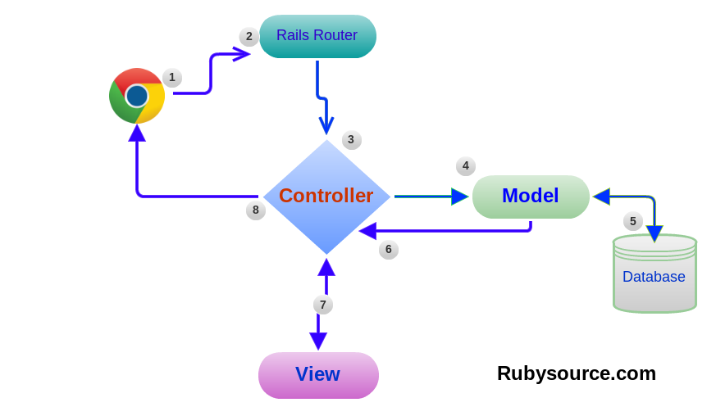
MODEL VIEW CONTROLLER
Notes:
We talk about the model in the next class.

Slide 9
LESSON: VIEWS AND CONTROLLERS
THE DISPATCHER

Slide 10
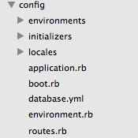
THE DISPATCHER

Slide 11
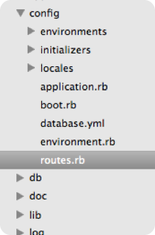
What is the Dispatcher?
THE DISPATCHER
Located: config/routes.rb
Role: Connects URLs to code
Current Routes: $ rake routes

Slide 12

What does the dispatcher do?
THE DISPATCHER
match "/users/:id" => "users#show"
Go to: UsersController
def show
Id =1

Slide 13
LESSON: VIEWS AND CONTROLLERS
LAB TIME
Discussion - Navigating My First Rails App

Slide 14
using resources
THE DISPATCHER
resources :books
HTTP Verb | Path | Action | User For
GET | /books | index | display all books
GET | /books/new | new | return an HTML form for creating a new book
POST | /books | create | create a new photo
GET | /books/:id | show | display a specific book
GET | /books/:id/edit | edit | return an HTML form for editing a book
PUT | /books/:id | update | update a specific book
DELETE | /books/:id | destroy | delete a specific book

Slide 15
LESSON: VIEWS AND CONTROLLERS
CONTROLLERS

Slide 16
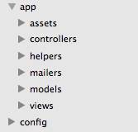
CONTROLLERS

Slide 17
what can a controller do?
CONTROLLERS
  Render a View
  Redirect to another view
Image from: http://www.shopno-dinga.com/dustbin/mvc.png

Slide 18
Controllers are ruby objects!
CONTROLLERS
Responsible for parsing user request
It can display some text to the browser, redirect to another path or send an error message.
Contains actions (aka functions)

Slide 19
Controllers
CONTROLLERS
  We are going to use the Post Scaffolding app from last class:

Slide 20
My First RAILS APP - Controller
CONTROLLERS
BooksController contains the index action that gets called when the user visits: localhost:3000/books/

Slide 21
My First RAILS APP - Controller
CONTROLLERS
app/controllers/books_controller.rb
def index @books = Book.all respond_to do |format| format.html # index.html.erb format.json { render json: @books } end end

Slide 22
generating a controller
CONTROLLERS
$ rails generate controller user index show
Creates UserController with action index and show
Adds entries to the routes file
Creates the view app/views/user/index.html.erb and show.html.erb

Slide 23
LESSON: VIEWS AND CONTROLLERS
LAB TIME
Code Along: Redirect to Google

Slide 24
LESSON: VIEWS AND CONTROLLERS
VIEWS

Slide 25
VIEWS

Slide 26
views and controllers
VIEWS
Views can be rendered directly by the controller
  Note: Not scalable when HTML file gets more complex
By default your controller renders the view named controller_name/action_name.html.erb

Slide 27
where are the views?
VIEWS
Views are available at app/views/

Slide 28
whats this .erb File?
VIEWS
Can write pure HTML or Ruby code
  <% These are ruby tags %>

Slide 29
Example: Conditions in a view
VIEWS
<% if user_signed_in? %>
    <h1> Hello User </h1>
<% end %>

Slide 30
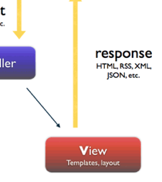
Application.html.erb
VIEWS
All views are wrapped inside application.html.erb
  It loads the assets
  sets up the meta tags, titles etc...
  You can render no layout
  Or a different layout

Slide 31
LESSON: VIEWS AND CONTROLLERS
ASSETS

Slide 32
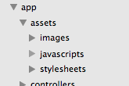
WHERE TO PUT THE CSS AND JS FILES
Put your javascript files here
Put your css files here

Slide 33
In application layout:
WHERE TO PUT THE CSS AND JS FILES
Including the stylesheets
app/views/layout/application.html.erb
<head> <title>BookReview</title> <%= stylesheet_link_tag "application", :media => "all" %> <%= javascript_include_tag "application" %> <%= csrf_meta_tags %></head>
Including javascript

Slide 34
LESSON: VIEWS AND CONTROLLERS
LAB TIME
Code Along - Creating an Index Page
Code Along - Sum of Parameters
Exercise - Hello GA

