Slide 1
INTRO TO RAILS
Insert Instructor Name
Title, Company

Slide 2
Quiz
REVIEW FROM PREVIOUS CLASS
What is the purpose of the app/assets directory?
How does a layout work in relation to a view?
What are three ways Rails may choose a layout for a requested view?
What is the difference between <% … %> and <%= … %> when used in a template?
What does using a content_for block in a template enable?

Slide 3
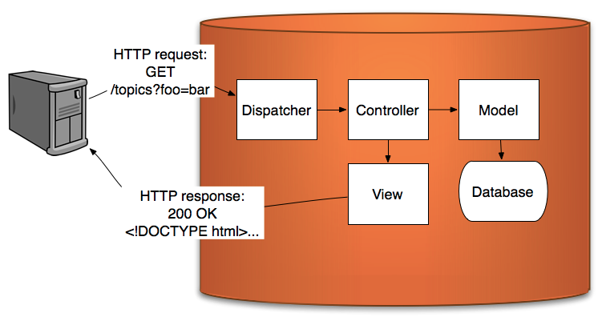
model view controller
Describe models and how they work in the request response cycle.
REVIEW

Slide 4
INSERT CLASS TITLE
MODELS & ACTIVE RECORD

Slide 5
Adding persistent data to a Rails app
MODELS
In your explanation of models, link to Ruby classes.
Model is a level of abstraction to interact with a database

Slide 6
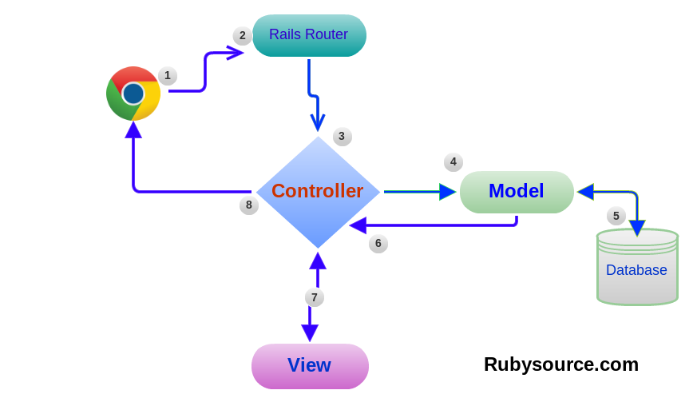
MVC
MVC

Slide 7
Code Along: generate your first model
LAB TIME: CODE ALONG
Note to students that data types are back.
Bring back the familiar by highlighting the data types mentioned here.
Create a rails application (My_Rails_App)
Create a user model:
  rails g model user name:string age:integer
  rake db:migrate

Slide 8
generating a model
GENERATING A MODEL
Generating a model creates a migration file (located in db/migrate/time_stamp_create_user.rb)
rake db:migrate creates a new table in your database.

Slide 9
What is Rake?
INSERT CHAPTER TITLE
Rake is Rails software task management tool, often used to automate moving, compiling, and deleting Ruby files
Rake executes tasks defined in rakefiles which describe tasks to be completed using Ruby anonymous function blocks
Introduction to using rake: http://guides.rubyonrails.org/command_line.html#rake
User guide to rake: http://docs.rubyrake.org/user_guide/index.html

Slide 10
generating a model
GENERATING A MODEL
The generator creates a model file in app/models/user.rb

Slide 11
Active record
INSERT CHAPTER TITLE
The Active Record pattern represents rows of data as objects, for example
  Review: a class whose objects representing one review in the Reviews table
All database interaction is managed through ActiveRecord objects, no SQL is required
ActiveRecord is built into Rails: http://ar.rubyonrails.org/
http://api.rubyonrails.org/classes/ActiveRecord/Base.html

Slide 12
Create a new User: My_Rails_App
MODELS
Let students know that a attr_accessor was created and that is why they have access to read and write to the User class/model.
Go in the rails console: $ rails c
Create a new instance user:
  me = User.new
  me.name = “Peter”
  me.age = 100
  me.save!

Slide 13
Create a new User
MODELS
Rails automatically assigns an id for the instance me
>me.id
->1
The id (or primary key) uniquely identifies this user

Slide 14
OR create a new instance
LAB TIME: CODE ALONG
me = User.create(name: “peter”, age: 100)

Slide 15
find a user w/ active record
MODEL
User.find_by_name(‘Peter’) --> returns the first user with name Peter
User.find_all_by_name(‘Peter’) --> returns an array of all the users named Peter

Slide 16
INSERT CLASS TITLE
LAB TIME
Exercise: Create a user model in shouter (email, password)
Create 4 users from the console

Slide 17
INSERT CLASS TITLE
ASSOCIATIONS

Slide 18
associations
INSERT CHAPTER TITLE
A database table is like a spreadsheet
Rails interacts with each table through a model
If the data in two tables is unrelated, write the code you need for each model

Slide 19
associations
INSERT CHAPTER TITLE
But, what if the data in two separate tables is related somehow? For example:
  one movie > many reviews
  one director > many movies
  many movies > many film festivals
  one movie > one production studio
When should data be separated? Should movies and reviews be separate models?

Slide 20
INSERT CLASS TITLE
LAB TIME
Lets discuss the associations for Shouter aka Twitter Clone.
Code Along: Shouter Associations
Exercise: My_Book_Review

Slide 21
Code Along
ASSOCIATION
using shouter as a code along.
create shout model needs attributes (content,user_id )
One to Many relationship
Create a shout (tweet) model
s User have many tweets : therefore tweet should have a user_id attributes (user_id is called foreign id)
User model should have : have_many :tweets
Tweet model should have : belongs_to :user
create a bunch of tweets from the console.

Slide 22
Code Along
ASSOCIATION
$ a_user.tweets : returns an array of tweets for the user a_user
$ a_tweet.user : returns the user who has tweeted a_tweet.

Slide 23
EXERCISES: MY BOOK REVIEW (BOOK_REVIEW.HTML)
Create a Book Review App that has users and books.
Users should have an age, first name, last name and email attributes.
Add a page that displays all the users name and age of the user you created
Create a is_teen? function that returns true if the user age is between 12 and 19 in app/model/user.rb
Create a function has_long_name? if the name is longer that 10 characters
Create a function all_long_name that returns an array of all the users with a long name
Add the associations so that users can give review for books.
Use active record to create a new review with a user from the console
Create the view to display each user and a list of his reviews

