Slide 1
SUBMITTING TO FORMS
LESSON 10

Slide 2
INTRO TO RAILS
MODEL VALIDATION

Slide 3
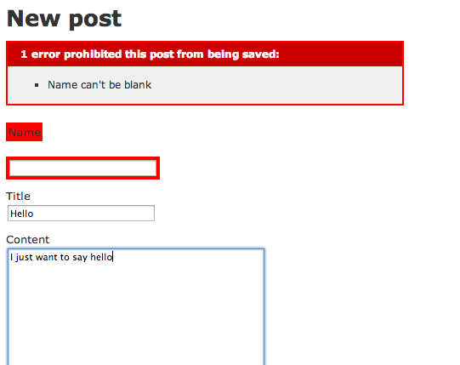
example with post scaffolding
MODEL VALIDATION
How can I enforce that the user enters a name in the name text box?

Slide 4

MODEL VALIDATION

Slide 5
OTHER VALIDATION
Here can show more examples if needed.
Maybe talk about validation messages etc...
validates :name, :length => { :minimum => 2 }
validates :bio, :length => { :maximum => 500 }
validates :password, :length => { :in => 6..20 }
validates :registration_number, :length => { :is => 6 }

Slide 6
VALIDATION
More about validation
http://guides.rubyonrails.org/active_record_validations_callbacks.html

Slide 7
INTRO TO RAILS
BUILD A FORM

Slide 8
Example of form
BUILDING A FORM
Documentation:
http://guides.rubyonrails.org/form_helpers.html

Slide 9
BASIC FORM
<form accept-charset="UTF-8" action="/home/index" method="post">
<div style="margin:0;padding:0">
<input name="utf8" type="hidden" value="&#x2713;" />
<input name="authenticity_token" type="hidden" value="f755bb0ed134b76c432144748a6d4b7a7ddf2b71" />
</div>
Form contents
</form>
<%= form_tag do %>
Form contents
<% end %>
Becomes

Slide 10

EXAMPLE A SEARCH FORM
<form accept-charset="UTF-8" action="/search" method="get">
<label for="q">Search for:</label>
<input id="q" name="q" type="text" />
<input name="commit" type="submit" value="Search" />
</form>
<%= form_tag("/search", :method => "get") do %>
<%= label_tag(:q, "Search for:") %>
<%= text_field_tag(:q) %>
<%= submit_tag("Search") %>
<% end %>

Slide 11

ADDING CHECKBOX
<%= check_box_tag(:pet_dog) %>
<%= label_tag(:pet_dog, "I own a dog") %>
<%= check_box_tag(:pet_cat) %>
<%= label_tag(:pet_cat, "I own a cat") %>
<input id="pet_dog" name="pet_dog" type="checkbox" value="1" />
<label for="pet_dog">I own a dog</label>
<input id="pet_cat" name="pet_cat" type="checkbox" value="1" />
<label for="pet_cat">I own a cat</label>

Slide 12
OTHER OPTIONS
<%= text_area_tag(:message, "Hi, nice site", :size => "24x6") %>
<%= password_field_tag(:password) %>
<%= hidden_field_tag(:parent_id, "5") %>
<%= search_field(:user, :name) %>
<%= telephone_field(:user, :phone) %>
<%= url_field(:user, :homepage) %>
<%= email_field(:user, :address) %>

Slide 13
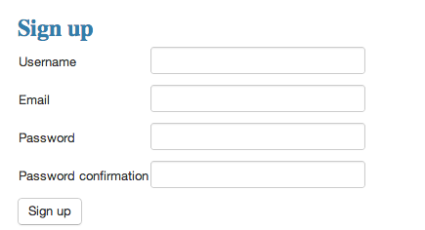
example
FORM BASED ON A MODEL
<%= form_for @user do |f| %>
<%= f.label :username %>
<%= f.text_field :username %>
<%= f.label :password %>
<%= f.text_field :email %>
<%= f.label :password %>
<%= f.text_field :password %>
<%= f.submit %>
<% end %>

Slide 14
INTRO TO RAILS
LAB

Slide 15
INTRO TO RAILS
EXERCICES

Slide 16
EXERCISES
  Create an application that has 2 input and on submit returns the sum of the 2 numbers
  Create a user model and a form to create users with a username and age
  Add validation:
    username needs to have between 5 and 20 characters
    age needs to be less more than 21
    Change custom validation message if the user is under aged : “sorry you are under aged”
Elie:
This will be done as a code along with instructors and then they work on Shouter by themselves.

