Slide 1
PROJECT LAB SESSION
LESSON 11

Slide 2
AGENDA
Building a web forum.
users and they post their questions / message to the forum.
slides are a resource for students.
Give the application a name. forum application for the class. post your rails questions.

Slide 3
CREATE A FORUM APPLICATION
First initiate the project
  rails new ga_forum
  cd ga_forum/
  git init
  git add .
  git commit -m ‘my first commit’
  add gem ‘simple_form’ to Gemfile
  bundle install
  rails generate simple_form:install

Slide 4
GENERATING THE MODEL
rails generate model message name:string content:text
rake db:migrate

Slide 5

CREATING THE CONTROLLER
the instructor can also speak about the resources routes
generating the controller message:
  rails g controller message create index
  routes file:

Slide 6
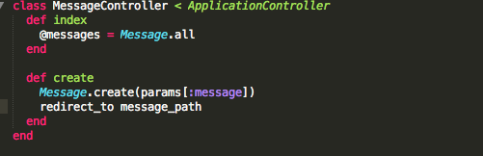
CREATING THE CONTROLLER
in app/controllers/message_controller.rb

Slide 7
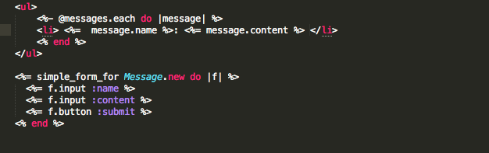
here using simple form,
More info in the session 13
CREATING THE VIEW
app/views/message/index.html.erb

Slide 8
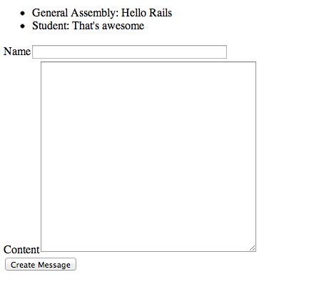
TEST THE APPLICATION
run: rails s
visit localhost:3000/message
application created and can be pushed to github for student review

