Slide 1
INTRO TO RAILS
Lesson: Testing and Debugging
Insert Instructor Name
Title, Company

Slide 2
INTRO TO RAILS
DEBUGGING IN RAILS

Slide 3
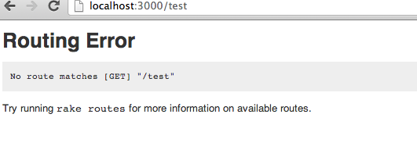
understanding an error
DEBUGGING
Routing error:

Slide 4
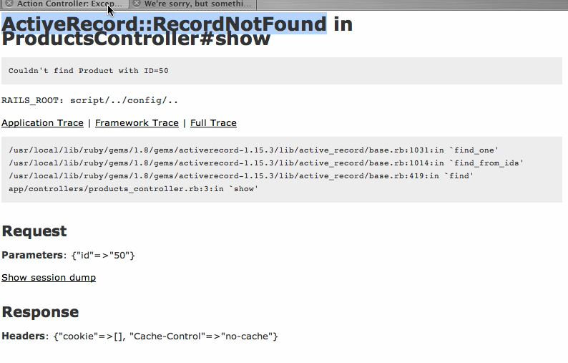
understanding an error
DEBUGGING
error type
error message
error trace

Slide 5
BETTER ERRORS
Install:
  In your Gemfile add:
group :development do
gem "better_errors"
end

Slide 6
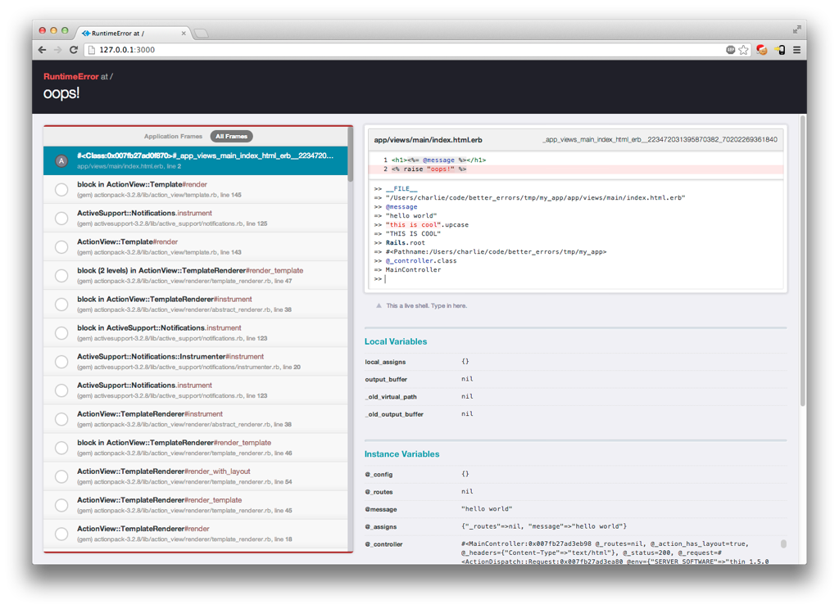
USING BETTER ERRORS
Error message
debugging console
Error trace

Slide 7
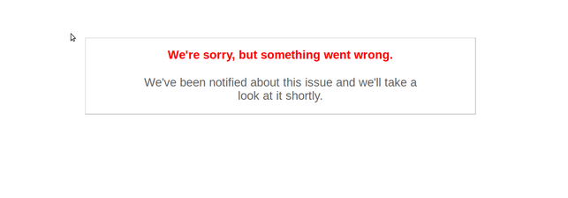
ERRORS IN PRODUCTION
true only when deploying to heroku
Debugging in production
Using a exceptional.io
-> Sends an email when new error are raised
using heroku console
-> heroku run console --app my_app

Slide 8
logging
DEBUGGING
logger.debug "Person attributes hash: #{@person.attributes.inspect}"
logger.info "Processing the request..."
logger.fatal "Terminating application, raised unrecoverable error!!!"

Slide 9
using ruby debugger
DEBUGGER
Install: $ sudo gem install ruby-debug
Example:
class PeopleController < ApplicationController
def new
debugger
@person = Person.new
end
end
More info: http://guides.rubyonrails.org/debugging_rails_applications.html

Slide 10
using the rails console
DEBUGGING
$ rails console
To run in sandbox mode
$ rails console --sandbox

Slide 11
INTRO TO RAILS
TESTING
UNIT TESTING

Slide 12
TESTING IN RAILS
“By simply running your Rails tests you can ensure your code adheres to the desired functionality even after some major code refactoring.”
Rails official documentation

Slide 13
INSTALLING RSPEC
In a rails project
  Add to your gemfile
group :test, :development do
gem "rspec-rails", "~> 2.0"
end
$ bundle install
$ rails generate rspec:install

Slide 14
INTRODUCTION TO UNIT TESTING
Red Green Refactor
Red: write a test for the function you want to create (the test fails)
Green: write a function to get the test to pass
Refactor: make sure you implemented the feature in the simplest way
maybe talk about test driven development as well

Slide 15
INTRODUCTION TO RSPEC EXAMPLE
require ‘spec_help’
describe Message do
describe “is_short?” do
  context “the message is short” do
    it “returns true” do
      m = Message.new(content: “Oops”)
      m.is_short.should be_true
    end
  end
  context “the message is long” do
    it “returns false”
      Message.new(content: “hello world”)
      m.is_short.should be_false

Slide 16
INTRO TO RAILS
LAB

Slide 17
LAB
Clone the failingApplication
Visit it on localhost:3000/messages
run rake db:migrate && rake db:test:prepare
Fix the failing tests

