Slide 1
INTRO TO RAILS
Lesson 2: Basics Of Computational Thinking (Variables and Conditionals)
Travis Griffiths
Sr. Programmer, Quant5

Slide 2
Questions?
Github
Schoology
Command Line

Slide 3
AGENDA
Quiz
Homework ReviewIntroduction to Computational ThinkingArithmetic & Variables
Data Types Conditionals

Slide 4
Quiz
LESSON 2: BASICS OF COMPUTATIONAL THINKING
What tools are required to create a Ruby program?
What is irb?
How do you write and run a Ruby program?
Name and describe a command line flag
Notes:
5 min

Slide 5
Homework review
LESSON 2: BASICS OF COMPUTATIONAL THINKING
HW_01_solutions.rb
Notes:
15 min

Slide 6
LESSON 2: BASICS OF COMPUTATIONAL THINKING
INTRO TO PROGRAMMING

Slide 7
introduction to computational thinking
LESSON 2: BASICS OF COMPUTATIONAL THINKING
Get into groups of two or three
Create step by step instructions to provide a robot so that he can check your email.

Slide 8
introduction to computational thinking
LESSON 2: BASICS OF COMPUTATIONAL THINKING
What is Pseudo Code?
How is code read in a file (line by line)?
What is computational thinking?

Slide 9
LESSON 2: BASICS OF COMPUTATIONAL THINKING
VARIABLES AND DATA TYPES

Slide 10
variables, Arithmetic and data types
LESSON 2: BASICS OF COMPUTATIONAL THINKING
What is a Variable?
Notes:
Variables_arithmetic.rb
################################################################################
#
# Introduction to Ruby on Rails
#
# Exercise variables_arithmetic
# Learning Objectives: Predict output of basic arithmetic on variables in Ruby.
# Use this example to further explain variables and arithmetic operators.
#
################################################################################
#
# Below are 3 variables that we will use in this exercise: a, b, and c
#
################################################################################
a = 4
b = 2
c = 5
# 1. Translate a^2 + c to Ruby code so that when printed, the result is 21
puts a**2 + c
# 2. Translate a x b + c into Ruby so that the result is 13
puts a * b + c
# 3. Change the code in #2 to display the result 28 by adding
# parenthesies
puts a * (b + c)
# 4. Display the result of 2 / 5
puts 2 / 5
# 5. Display the result of 2.0 / 5
puts 2.0 / 5
# 6. What are the differences between using an Integer versus a Float?
#
# When you divide by an Integer, you get an Integer back, when
# a Floating point, it will give the result as a Floating point.
# 7. Below are four expressions: two displaying even numbers modulus 2
# and two displaying odd numbers modules 2.
puts 4 % 2
puts 414 % 2
puts 9 % 2
puts 1311 % 2
# 8. Do you notice a pattern with modulus 2 when dealing with even versus
# odd numbers?
#
# If the number is even, when you use modulus 2, you will get 0. If it
# is odd, you will get 1. That is because even numbers are divisible by
# 2 and have no remainders. Odd numbers cannot be evenly divided and are
# left with 1 remainder.

Slide 11
ruby variables
LESSON 2: BASICS OF COMPUTATIONAL THINKING
How do you choose a variable name?

Slide 12
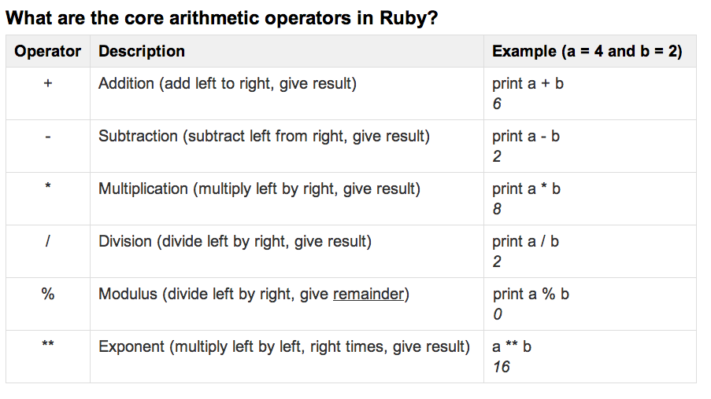
arithmetic IN ruby
LESSON 2: BASICS OF COMPUTATIONAL THINKING

Slide 13
arithmetic IN ruby
LESSON 2: BASICS OF COMPUTATIONAL THINKING
What is the order of precedence in operations?
unless otherwise specified by parentheses, * / and % take precedence over + and -.

Slide 14
data types
LESSON 2: BASICS OF COMPUTATIONAL THINKING
What is a data type?
  What are the basic data types in Ruby?
Notes:
Data_types.rb
################################################################################
#
# Introduction to Ruby on Rails
#
# Exercise data_types
# Learning Objectives: Describe what is a data type and dynamically change types in code.
# Topics covered: single expression declaration, type casting.
#
################################################################################
#
#
################################################################################
# 1. Create three variables, a, b, and c and assign each variable using
# parallel assignment so that a is 5, b is 7 and c is 9.
a, b, c = 5, 7, 9
# 2. Write an expression dividing a by b.
puts a / b
# 3. Overwrite variable b and convert the original value of b (5) to a float
# number.
b = b.to_f
# 3. Write the same expression again from problem 2.
puts a / b
# 4. What do you notice?
#
# Because we used the method .to_f, b is now a Float instead of an
# Integer. When we divide by a Float, we get a Floating number as
# a result.
# 5. Declare a new variable called `name` and assign it a String of your
# first name.
name = "Rachel"
# 6. Write an expression that adds the variables `name` and `a`
#
# puts name + a
# 7. What happened?
#
# Because a is an Integer, it cannot be simply concatenated to a String.
# We must first cast a into a String.
# 8. Comment out problem 6 and rewrite it below, casting a into a String.
puts name + a.to_s

Slide 15
working with strings
LESSON 2: BASICS OF COMPUTATIONAL THINKING
What is a string?
What is a symbol?
Notes:
string.rb, ex_data_Type_Strings.rb, symbol.rb
################################################################################
#
# Introduction to Ruby on Rails
#
# Exercise strings
# Learning Objectives: Assign and concatenate strings in Ruby and accept user input.
# Use this example to explain how to work with strings.
# Topics covered: String Declaration, concatenation, interpolation, input from user and modifying strings.
#
################################################################################
#
#
#
################################################################################
# 1. declare and assign variables named first and last, with string values and a variable named age with a number value
first = "Leo"
last = "Schuman"
age = 46
# 2. declare and display a variable named user containing the combined value of the Task # 1 variables
user = first + " " + last + " " + age.to_s
puts user
# 3. display the three variables using string interpolation
puts "#{first} #{last} was #{age} on his last birthday"
# 4. display the string "You typed X on the command line" where X is input by the user
print "Type your name:"
input = $stdin.gets.chomp
puts "You typed #{input} on the command line"
# 5. modify your Task # 4 code to display the input in all capital letters
print "Type your name:"
input = $stdin.gets.chomp
puts "You typed #{input.upcase} on the command line"
#mention that .downcase is also an option.

Slide 16
INSERT CLASS TITLE
LAB TIME
dataTypes_Strings.rb

Slide 17
conditionals
LESSON 2: BASICS OF COMPUTATIONAL THINKING
What is a Conditional?
Why would we use it? (Remember your robot example)
Notes:
Help students understand the concept by relating it to decisions in robot pseudo code example.
Available Materials:
conditionals.rb
Boolean.rb
################################################################################
#
# Introduction to Ruby on Rails
#
# Exercise conditionals
# Learning Objective: Describe what is a decision in programming and write a basic conditional statement
# Topics Covered: If statements, equality and conditional operators
#
################################################################################
#
# Below are variables that we will use in this exercise.
#
################################################################################
a = 3
b = 5
c = 7
# 1. Start off by determining if a is equal to 3 and printing "Yes!"
# with a multi-line logical expression using `if` and `end`.
if a == 3
puts "Yes!"
end
# 2. Translate Problem 1 to use a single-line logical expression instead
# using `if`, `then` and `end`.
if a == 3 then puts "Yes!" end
# 3. Write an expression to test if both a is equal to 3 and b is equal
# to 5 using `&&`. If so, print "Yes!"
if a == 3 && b == 5
puts "Yes!"
end
# 4. Now check to see if a is equal to 3 OR b is equal to 15 using `||`.
# Only one needs to be true for it to work! If so, print "At least one
# of them is true!"
if a == 3 || b == 15
puts "At least one of them is true!"
end
# 5. Lastly, let's get a little more complicated. Using parentheses,
# check to see if a is equal to 2 and b is equal to 11... OR c is
# equal to 7. Because c is equal to 7, the whole expression will
# evaluate to true!
if (a == 2 && b == 11) || c == 7
puts "c is 7, so my expression is true!"
end

Slide 18
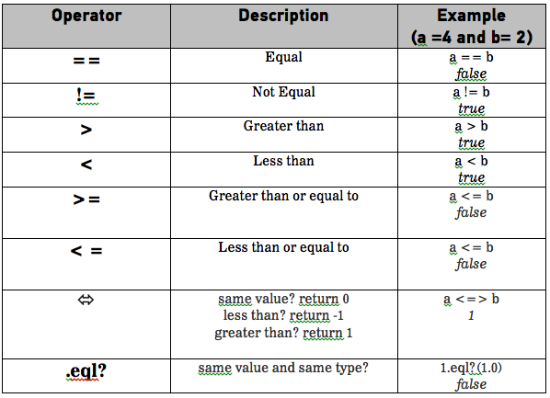
conditionals
LESSON 2: BASICS OF COMPUTATIONAL THINKING
Logical Operators

Slide 19
conditionals
LESSON 2: BASICS OF COMPUTATIONAL THINKING
Why would you use an if, else statement?
What is a nested conditional statement?
Notes:
Nested conditionals.rb
###############################################################################
#
# Introduction to Ruby on Rails
#
# Exercise nested_conditionals
#Learning Objectives: Describe what is a nested conditional statements and write am if else statement in Ruby.
################################################################################
#
# Below are variables that we will use in this exercise.
#
################################################################################
programs_day_of_week = "tuesday"
programs_number = 3
# 1. Let's get input from our User and see if they can guess which day
# of the week we are thinking of.
#
# Ask the User, "What day of the week am I thinking of?" and capture
# their input in the variable `guess`.
puts "What day of the week am I thinking of?"
guess = $stdin.gets.chomp.downcase
# 2. By default, `programs_day_of_week` is set to Tuesday. Let's compare
# our variable to what the User inputted. If they got it right, tell
# them "Correct!" otherwise tell them "Wrong!"
if programs_day_of_week == guess
puts "Correct!"
else
puts "Wrong!"
end
# 3. Now let's try seeing if two things are true at the same time.
#
# Ask your User for a day of the week and then for a number. Remember
# to cast your User's input appropriately when comparing values!
#
# Then use a conditional to see if both the number and the day of
# week are correct. If both are correct, tell the User "Correct!"
#
# If only the number is correct, tell them "Number Correct!"
#
# If only the day of the week is correct, tell them "Day of week
# Correct!"
#
# Otherwise, tell them "Wrong!"
puts "What day of the week am I thinking of?"
day_of_week_guess = $stdin.gets.chomp.downcase
puts "What number am I thinking of?"
number_guess = $stdin.gets.chomp.to_i
if programs_day_of_week == day_of_week_guess && programs_number == number_guess
puts "Correct!"
elsif programs_day_of_week == day_of_week_guess && programs_number != number_guess
puts "Number Correct!"
elsif programs_day_of_week != day_of_week_guess && programs_number == number_guess
puts "Day of week Correct!"
else
puts "Wrong!"
end
# 4. One last time, ask again for a day of the week and a number, except
# this time only one of them needs to be correct to "win"! But if
# they don't guess either correctly, they "lose"!
puts "What day of the week am I thinking of?"
day_of_week_guess = $stdin.gets.chomp.downcase
puts "What number am I thinking of?"
number_guess = $stdin.gets.chomp.to_i
if programs_day_of_week == day_of_week_guess && programs_number == number_guess
puts "Both Correct!"
elsif programs_day_of_week == day_of_week_guess || programs_number != number_guess
puts "One of them is Correct!"
else
puts "Wrong!"
end

Slide 20
Extra: Other Conditionals
LESSON 2: BASICS OF COMPUTATIONAL THINKING
Ruby supports the standard IF statement, plus a few others:
UNLESS, equivalent to IF(NOT(…)), use only if the IF version is harder to read.
Trinary statement, ? :, epression ? “true” :“false”

Slide 21
Extra: DeMorgan’s Law
LESSON 2: BASICS OF COMPUTATIONAL THINKING
For any boolean expression, if the entire expression is negated, do:
1) Toggle all negation: not a -> a, b -> not b
2) Change all AND’s to OR and all OR to AND: a and b -> not a or not b
This, allows us to use either if or unless when we have a particularly ugly expression
Notes:
Demorgan.rb

Slide 22


LESSON 2: MORE HTML/CSS BASICS

