Slide 1


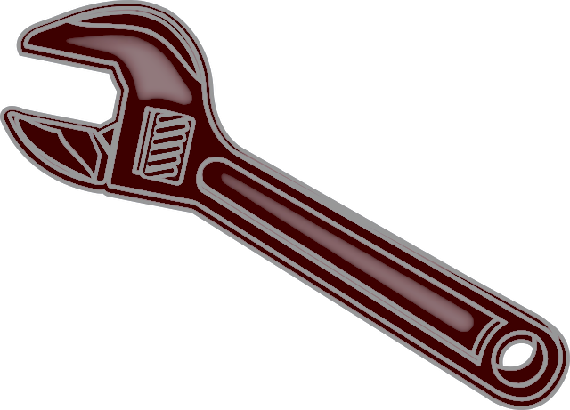
DrWrench
Dental Office Equipment CMMS
There are over 160k Dental offices in the US alone. Each office has at least 45 pieces of equipment to maintain, along with several regulatory requirements like shocking the water lines, testing the nitrous system, etc.. The average office spends $70k per year on equipment and supplies.
The Problem… Most offices, at best, keep some maintenance and regulatory reminders on sticky notes. Maintenance and regulatory requirements are rarely performed correctly, if at all. Random office checks are executed by OSHA, WISHA, DOSH, and other Regulatory departments. It is the office’s responsibility to stay current.
Office staff are extremely busy with little time to be properly educated on equipment maintenance, along with how and what to do to stay current on regulatory requirements. Turnover is high, re-training is seldom done.
The Result… Thousands of dollars are spent on unnecessary repairs and equipment downtime due to lack of maintenance. The office risks large fines and possible closure due to not following Regulatory requirements to ensure patients are safe.

Slide 2
DrWrench
Dental Office Equipment CMMS
DrWrench provides Doctors and Staff with all the necessary tools to execute adequate, timely maintenance and regulatory requirements with confidence. The stress, risk, and expense of not staying current with this ever-changing environment is diminished.
Dental sales reps and techs also benefit from having all equipment documentation accessible in one easy to search location.
Dr’s: Can now Verify staff is completing necessary and timely Maintenance and Regulatory requirements. Peace of Mind.
Staff: No more Headaches trying to stay current with Maintenance and Regulatory protocols. Ensured the right protocols are being performed.
Multi-site Offices: Can now verify and track Maintenance and Regulatory requirements across their
entire network of offices.
Sales reps and Techs: Can now access all equipment related documents in one place.

Slide 3

Features
Phase 1
Maintenance and Regulatory Notifications with how to and videos
Repair Tracking and Requests
Serial Number Decoder
Error Code Decoder
Documents and Videos – easy attach to email for sales and technicians
Dashboard: single and multi-location
Reward Program
Referral Program / Give Kids a Smile tracking
Phase 2
EquipFax – equipment history attach for used equipment sales
Equipment Reviews and voluntary Dr/staff reference linkup
Lead Generation
Maintenance parts ordering – send order to dealer of choice
Phase 3
IoT
Medical, Veterinary and Lab add
Connected Equipment Hub

Slide 4
Phase 1 1. Maintenance / Regulatory Notifications (very bad mockup on next slide, goal is simple app for the staff to navigate/follow)
App Pop-up reminders when equipment maintenance and regulatory tasks are due
Might need web-based here as well, some locations use a central computer
Most reminders are time based; monthly, every 6 months, annually, etc.
For cycle-based maintenance, IoT (phase 3) will link equipment with cycle counters. Will require manual entry until then
Simple app with following buttons
”completed”
“how do I do this?”
”schedule tech” - scheduling is hard? Maybe link to independent techs (fast growing segment)
“re-order air filter” link to dealers, office selects (maybe phase 2?)
“postpone”
Custom reminders- Dr and Staff can create custom reminders

Slide 5



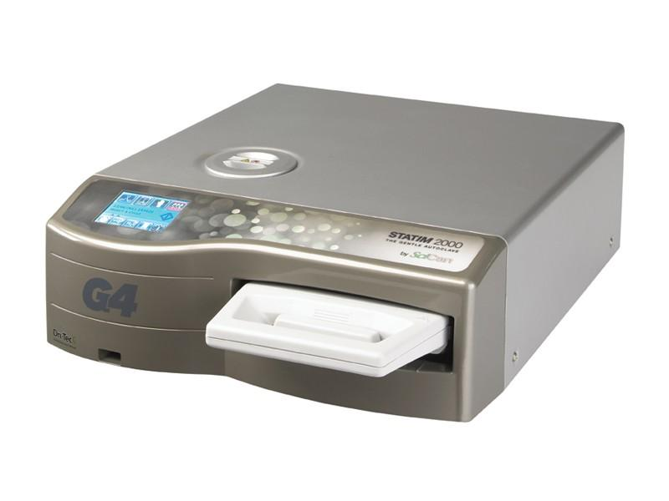


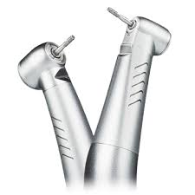
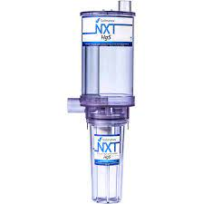

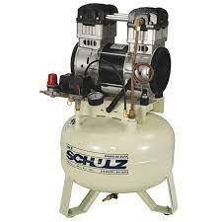
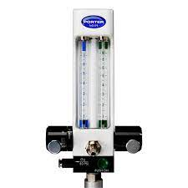
On-time Completion
96%
Awesome Job!
DrWrench
DrWrench
DrWrench
Hi Lindsay !
Due Today
Replace Statim Biological Filter
Order Statim Biological Filter
Replace Statim Biological Filter
>
Completed!
Henry Schein
Replace Handpiece O-rings
>
Re-order Filter
Patterson
Due Soon
How do I do this?
Burkhart
Replace Amalgam Separator Filter
>
Schedule Tech
Benco
Change Compressor Oil
>
Postpone
Check Nitrous for Gas Leaks
>

Slide 6
DrWrench
DrWrench
Replace Statim Biological Filter
How Do I Do This ?
Completed!
Step by Step
Re-order Filter
How-to Video
How do I do this?
Postpone

Slide 7
Phase 2 2. Repair upload and Requests (requests difficult?, maybe phase 2)
Upload repair invoice to pull pertinent info
Serial number
Date
Part used
Cost- part(s) and labor
Notes ?
Phase 2…. ?
User selects equipment needing repair and clicks “repair request”. Equipment info is auto populated and sent to desired tech company along with additional notes provided by user. Tech company calls office to arrange time.

Slide 8
Phase 1 3. Serial Number Decoder
Enter Serial Number to get Make, Model, Date of Manufacture
Assuming will be work in progress here as we likely won’t enter every single piece of equipment, just common items, off brand etc. can be added as we go

Slide 9
Phase 1 4. Error Code Decoder
Enter Error Code number to get manufacturer explanation and troubleshooting guide
Example:
https://drive.google.com/file/d/1pVjqM_sk1S2pX9UoDbk1WmPlxRZ10EAs/view?usp=sharing

Slide 10
Phase 1 1. Document and Video links, downloads and uploads
Users can access all documents and videos below
Sales reps and techs can attach documents to email
Equip reps spend a ton of time organizing new office build info for Dr’s, plumbers, electricians, etc. Make is easy for them to select equipment, select needed documents, and attach to email and/or label project name to come back to it?
Documents
Install guides / cut sheets
User manual
Tech manual
Error codes with troubleshooting
IFU’s -instruction for use
QRG -quick reference guide
Office extended shutdown- equipment preparation guide
Building codes/plumbing approvals, etc.
Studies
Equipment Reviews
Equipment rebates
Current Promos (updated by manufacturer?)
Videos
Install guide
In-service / training
Troubleshooting
Maintenance
Repair

Slide 11
Phase 1 2. Dashboard - Solo and Multi-Site
Make, model, age, serial number of each item
Repair records with pertinent info
Maintenance records
Areas of concern highlighted (ex. “Your dental drills turbines are failing 34% faster than your comps,” “your repair bill is higher than 28% of your comp offices; per repair, repairs to date, total office repairs, etc.)
Extended Shutdown procedure (covid) Hit ”shutdown” button and all equipment requiring attention populate
Capital Budgeting – equipment nearing end of life with approximate replacement costs ?
Best time to sell- based on end-of-life estimate, used equip value, projected future repair costs, new equip cost
Office equipment valuation (for whole practice purchase or sale)
Examples of data pulled across userbase
Avg repair costs for each piece of equipment
Most common parts replaced
Equipment Failure rate (especially important for new equipment, Dr’s always ask for referrals when looking at equipment that’s been in the field for less than two years)
Equipment Lifespan

Slide 12
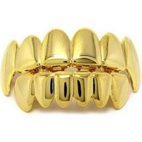
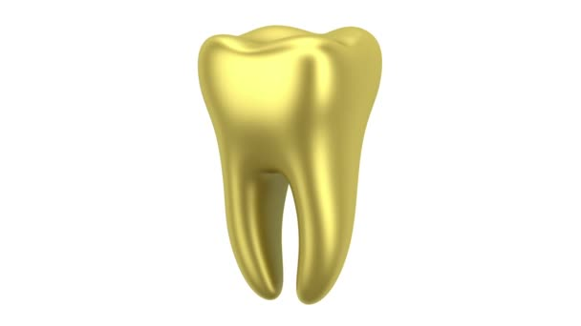

Phase 1 6. Reward System
Staff earns a gold tooth for completing certain tasks on time. Once the grill is full, they earn one entry into monthly/quarterly drawing for manufacturer sponsored item. Maybe winner get’s shoutout of some kind. Something to make it somewhat fun

Slide 13
Phase 1 7. Referral program / Give Kids A Smile
Partnership with ADA (American Dental Association)
Dentist and Staff Referral Program: each referral earns $ for Dentist or Staff member, and $ to Give Kids A Smile Foundation.

Slide 14
Phase 2 Features
Equipfax
Equipment Reviews
Lead Generation

Slide 15
Phase 2 3. Equipfax - Carfax for equipment
Maintenance Records
Repair Records
Equipment Health rating – number and cost of repair comps across userbase
Estimated individual equipment value for buying and selling used equipment
1) Web crawler to find used equipment value
2) Narrowed down by equipment health rating
Office Valuation assistance when buying/selling practice (costs the office $$$ to have someone come in and value equipment)

Slide 16
Phase 2 5. Equipment Reviews- hard ?
Equipment reviews - Categorize reviews based on user type
Tech
Dr
Staff
Sales Rep

Slide 17
Phase 2 6. Lead Gen- if possible
Lead generation tool. Select criteria to narrow sales and marketing focus
Criteria:
Location of office
Size of office
Type of equipment
Age of equipment
Repair dollars spent
Examples:
Target offices with autoclaves 7 years and older
Target offices with 8 operatories or more with only one autoclave

Slide 18
Phase 3 Features
IoT
Medical Veterinary and Lab
Internet connected equipment HUB

Slide 19
Phase 3 1. IoT
Sensors on Equipment with cycle/hr counter (autoclaves, washers, vacuum, compressor)
Cycle count
Diagnostics
Remote Login for troubleshooting
Error code
Remote Equipment Access Portal –some equipment allows remote access to remotely troubleshoot. Unique portal for each piece of equipment. There’s a need for a portal to bring all connected devices together to give access to all connected equipment in one place for remote monitoring and troubleshooting.

Slide 20
Phase 3
2. Medical Vet and Lab
Other professional offices

Slide 21
Phase 3
2. Connected equipment HUB
There’s a few pieces of equipment in the market that’s internet connected. You can diagnose and troubleshoot remotely, see cycle counts and error code history, monitor performance, etc. Very few are utilizing this technology yet as each piece of equipment has a different page and platform. If we can be a HUB that links up the different platforms in one place, we would see much more adoption in the market. More equipment will be connected down the road. This is big, just something to think about….
Examples:
Internet connected Dental air compressor
https://www.incisaledgemagazine.com/mag/article/connected-compressor-dentalez-aeras-leverages-iot-tech-to-stop-downtime-in-its-tracks/
SciCan’s G4 equipment can connect and send information to your smart devices so you can have cycle data, instructions, and maintenance notifications at your fingertips.
G4 Technology: https://www.scican.com/us/media/autoclaves/sd-563-us-en-r3-statclave-ss.pdf

Slide 22
Equipment data needed from user
Dental office staff enters the following information during onboarding or anytime new or used equipment is purchased
Eventually automate process with Equipment QR scan or alternate solution
Office information entered by user
Location
Number of Operatories
Number of Dr’s
Office Specialty
Equipment info entered by user
Make/Model
Serial Number /Decoder
Date of Install
Cost of Equip
Warranty length

Slide 23
7 Different User categories
Dentist
Dental Staff
Technician
Multi-site office
Manufacturing Rep
Retail Rep
Schools - Free for Dental, Assisting, and Hygiene Schools

Slide 24
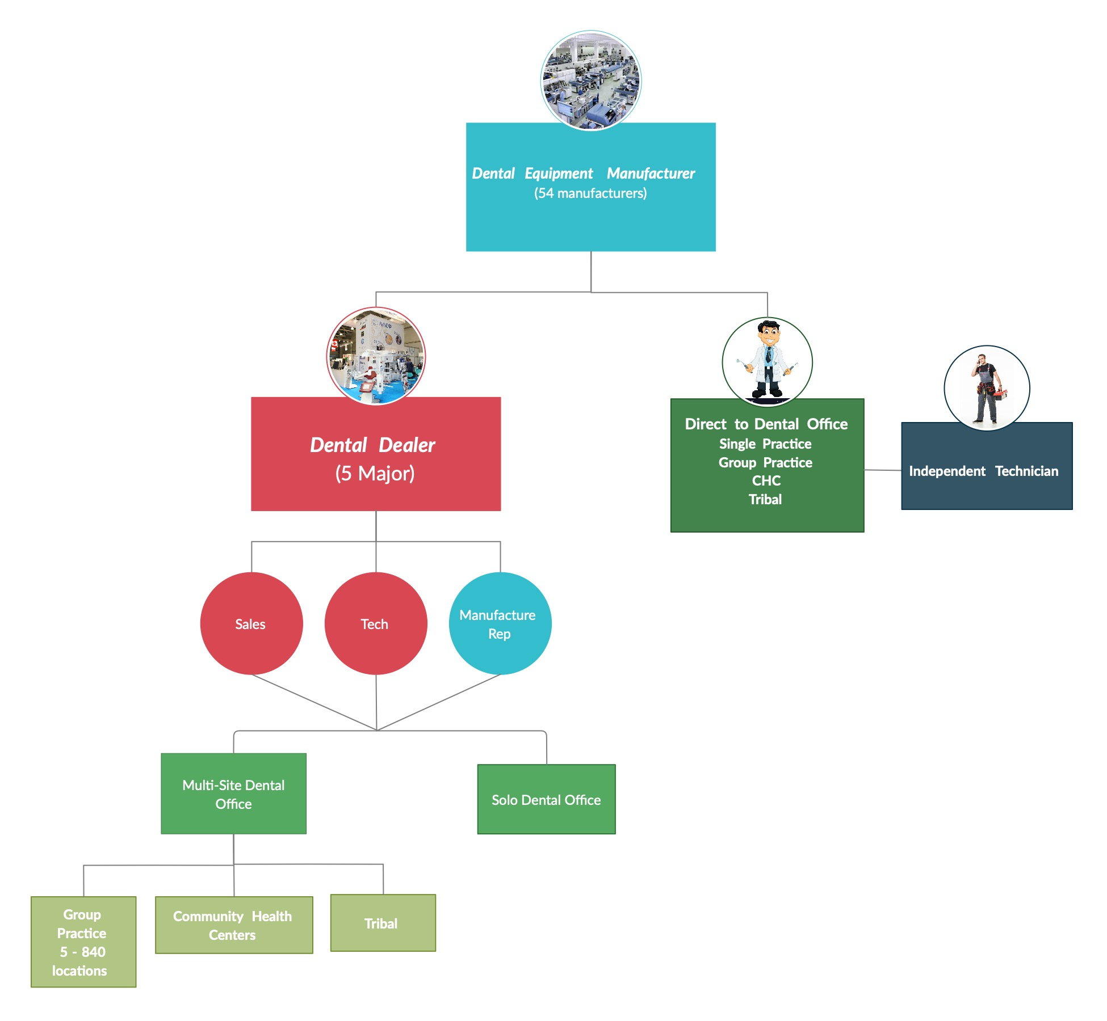
Dental Landscape with DrWrench Benefits
Manufacturers
Communicate directly with office
Maintenance changes/updates
Shutdown Procedures
Regulatory requirement updates
Operator Manual Updates
Lead generation
Dealers
Free up time for techs and sales reps, focus on installs and sales
Equipment maintenance and repair history easily accessible. Offices use multiple dealers for repairs- records near impossible to locate
Less time wasted constantly re-training staff on proper maintenance
All equipment documents in one easy to search location
Lead generation
Independent Techs
Equipment Maint. repair history
Error code lookup
Install guides and specs
Troubleshooting guides
Manufacturer contact info
Most common repair with how-to
Multi-Site Offices
Verify and Track maintenance and regulatory requirement completion
Removes maintenance guesswork
Save $$- avg tech visit $300
Maintenance repair history
Dashboard- bring it all together
Document lookup
Equipment info- age, s/n, health
Error code lookup
Budgeting- end of life estimate
Repair cost comps across user base
New Equipment transparency
Equipment valuations
Single Offices
Verify and Track maintenance and regulatory requirement completion
Save $$- avg tech visit is $300
Removes maintenance and regulatory guesswork
Dashboard- bring it all together
Install instructions
Document Lookup
Equip info- age, s/n, health
Error code lookup
Budgeting- end of life estimate
Repair cost comps across userbase
New Equip transparency
Equipment valuations

Slide 25
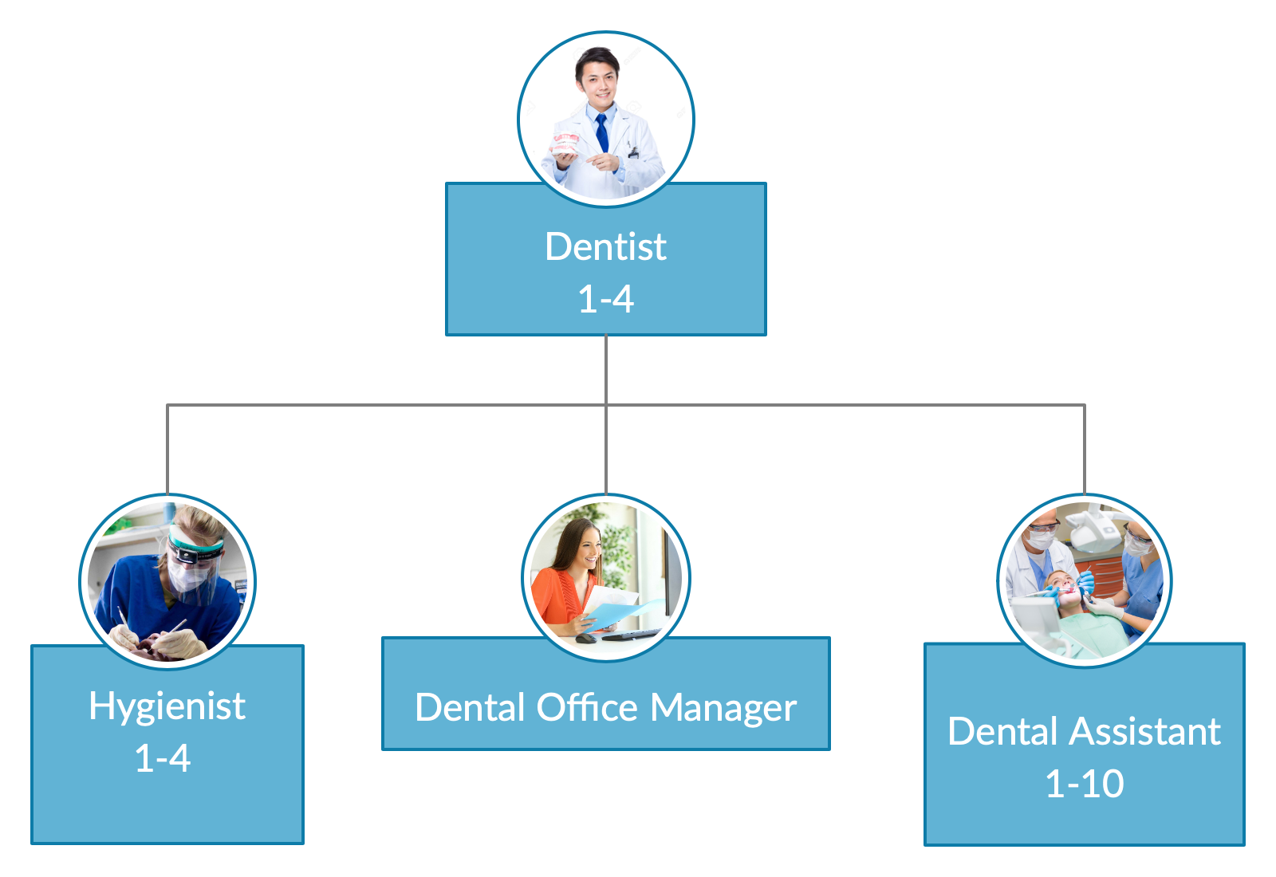
Single Office
Users keep profile. Keeps track of which equipment
and regulatory they have experience with

Slide 26
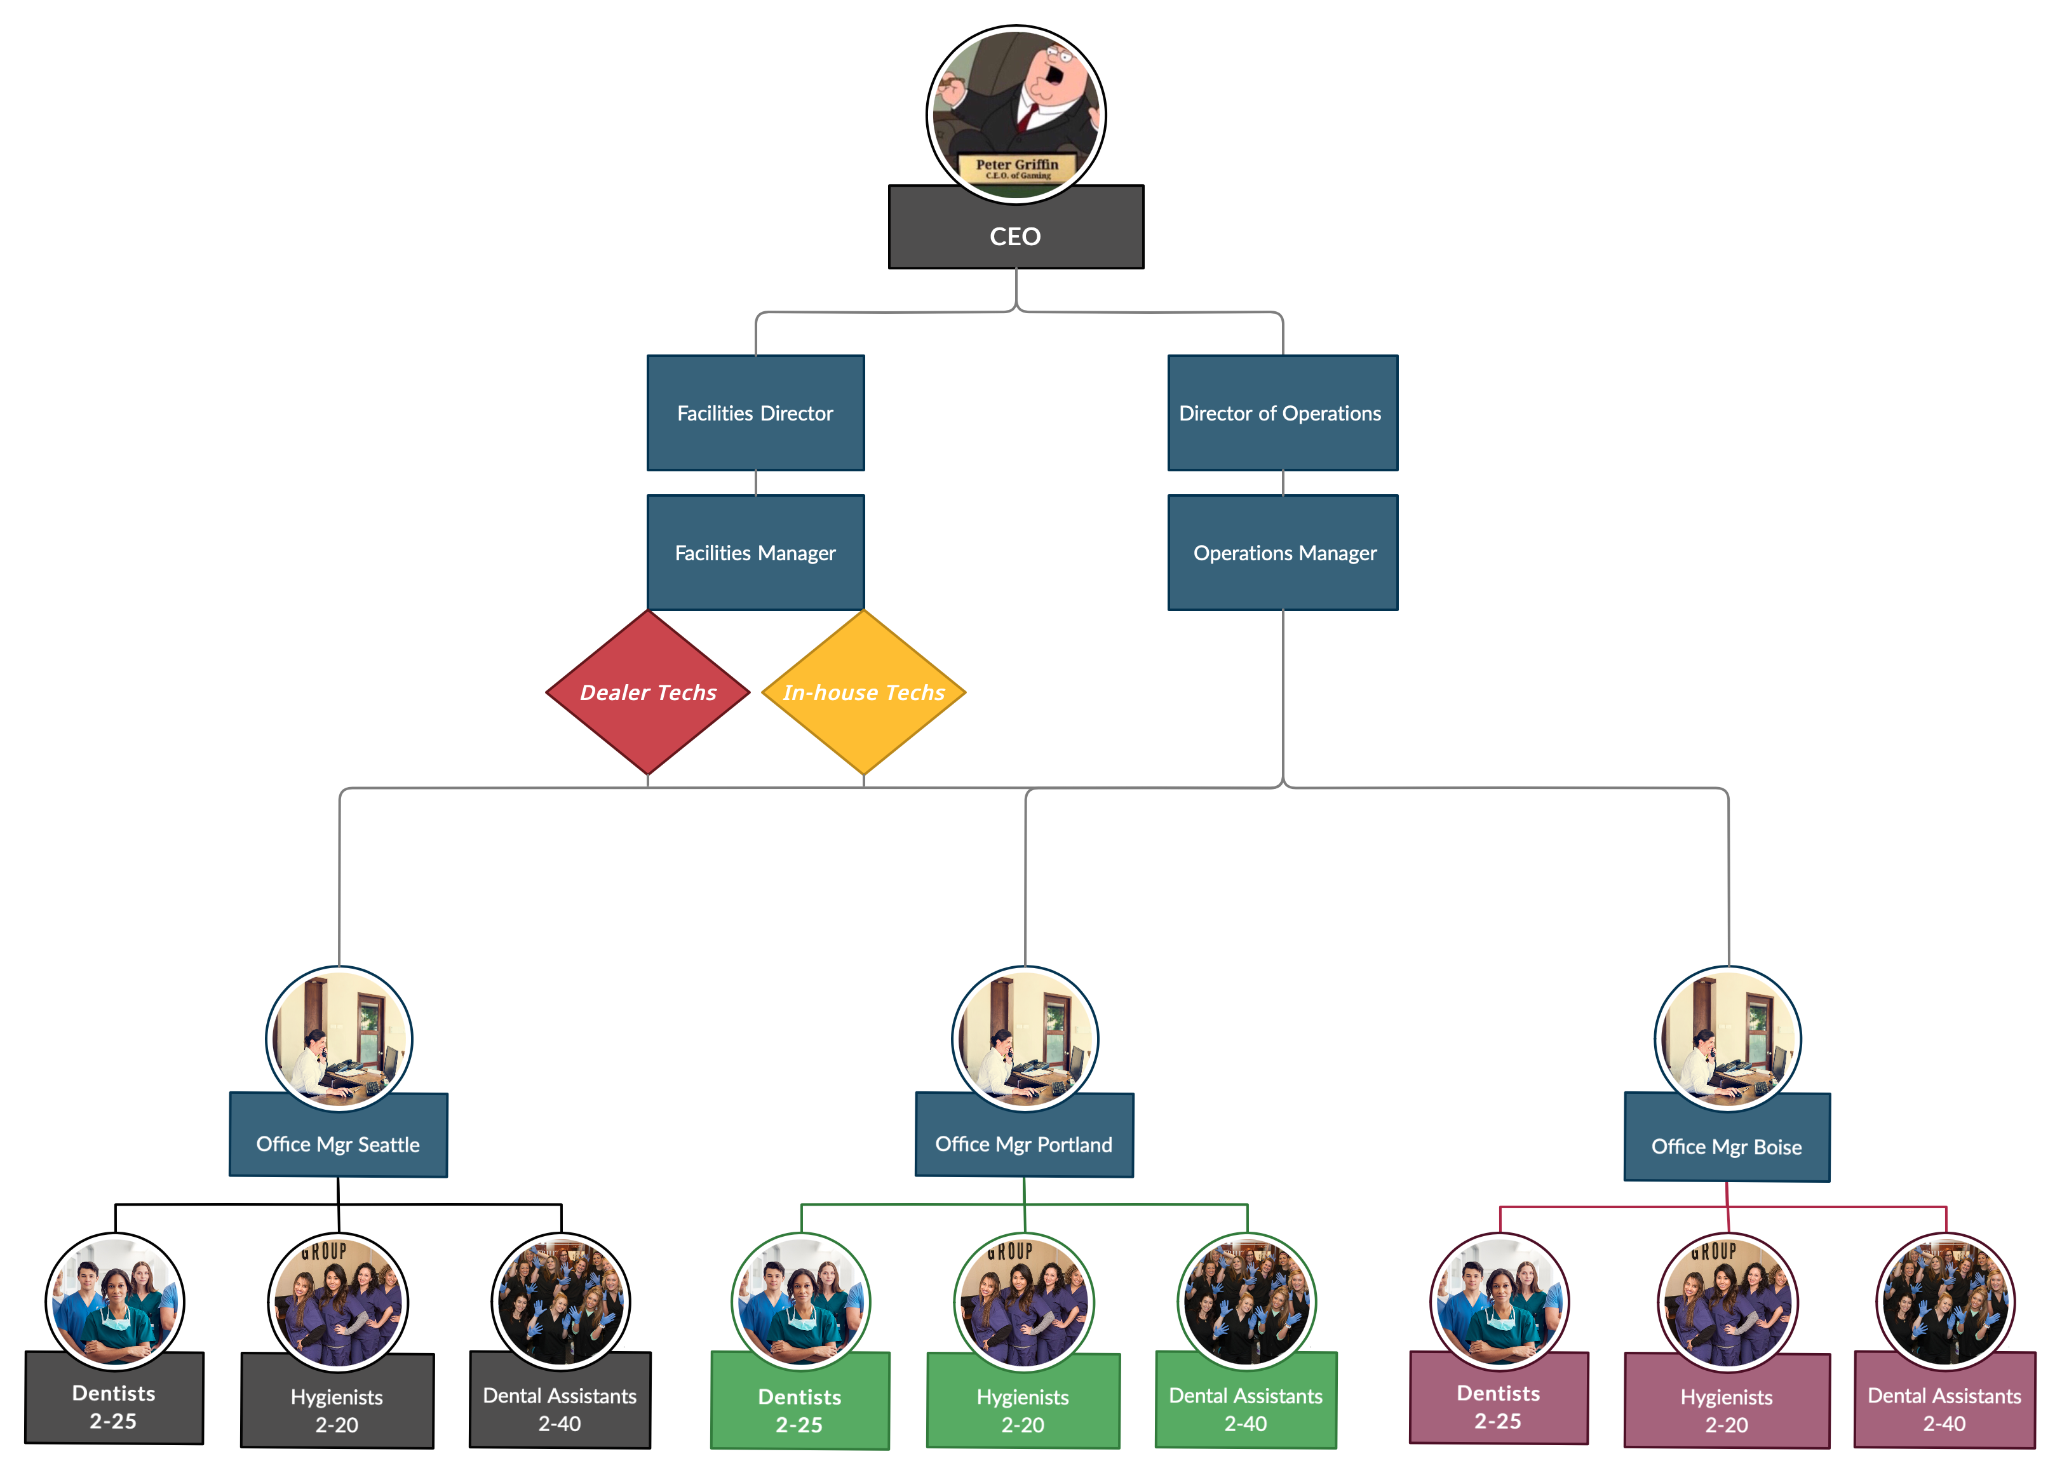
Group Practice
2 - 840 Locations
Security is priority

Slide 27
Dental Equipment Stats
Number of Manufacturers: 65
Equipment Categories: 31
Total Equipment: 480
Total Handpieces: 460
Equipment Requiring Maintenance: 162 ( several crossover equip with same maintenance. Not including handpieces)
160k Dental offices in US
62K Canada
163k Europe
700K Dentists worldwide

