Slide 1

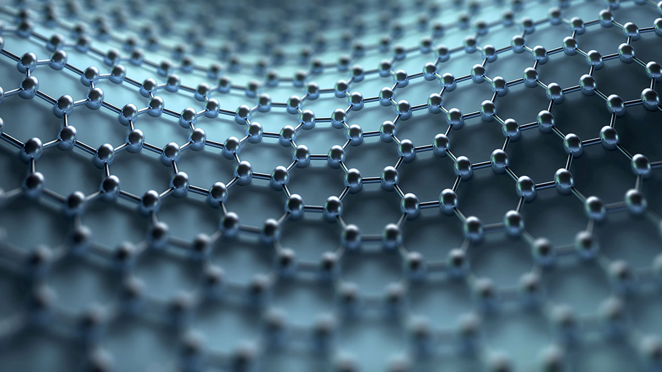
Digital Behavior vs. Mental Health
Evaluating the effects of Digital habits on Mental Health using Data Analysis and machine learning

Slide 2
Living in a Digital Age
Up
Device Usage
Down
Mental Health
Digital devices are used for school, work, and recreation
Hard to keep track of how long we are in front of a screen
Difficult to manage stress and mental health
Is there a correlation?

Slide 3
Dataset Used for Analysis and Model Training “Digital Lifestyle Benchmark” from Kaggle.com
23 synthetic features to reflect real world psychological data
17 numeric
6 categorical
Device Usage Metrics
Device hours per day
Phone unlocks
Mental Health Scores
Anxiety
Depression
Target: High Risk Flag

Slide 4
Methods
Preprocessing
Exploratory Data Analysis (EDA)
Machine Learning
Label encoding
Scaling
Visualization
Identifying relationships
Supervised
unsupervised

Slide 5
Preprocessing
Label Encoding
Ordered integer mapping for ordinal features
One-hot encoding for nominal features
Scaling
Applied standard scalar to numeric values for scaling sensitive models

Slide 6
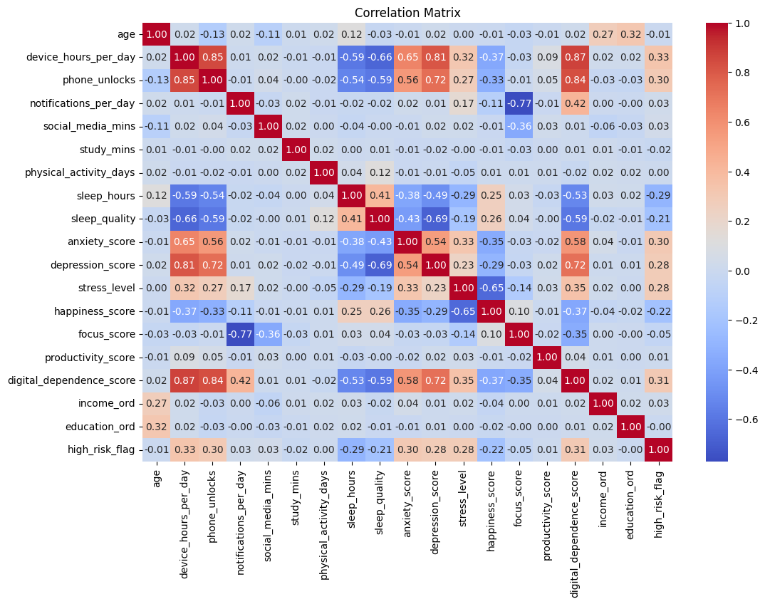
EDA
Approaches
Boxplots
Count plots
Histograms
Correlation Matrix
Results
Device use and sleep
Use and mental health scores
Identified significant features
Numeric Feature Correlation Matrix

Slide 7
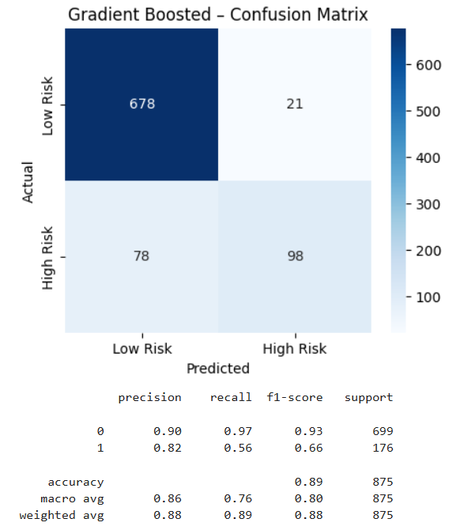
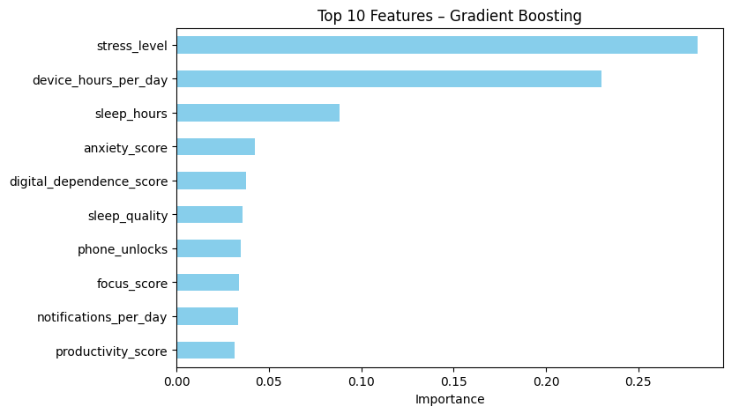
Trees
Decent, consistent performance
Able to ignore unimportant features
Gradient Boost yielded best results
Stress, device hours, and sleep hours were most important features for all tree models

Slide 8
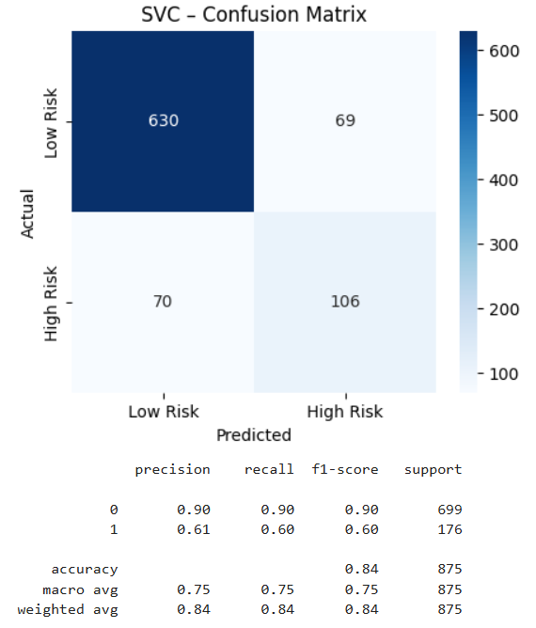
Linear
Poor initial performance due to noisy data
Performed better with fewer, more significant features
SVC with rbf kernel performed best

Slide 9
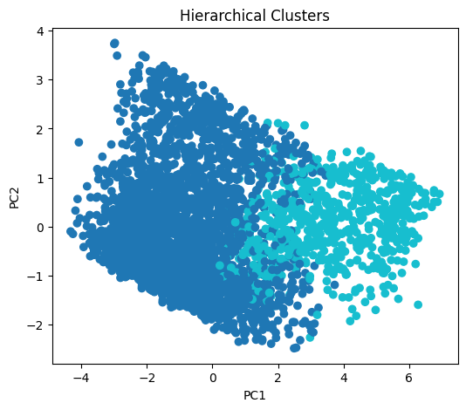
Clustering
Displayed natural separation of target classes exists in data
Performed best when set to 2 clusters
Both K-Means and hierarchical clustering yielded similar results
Hierarchical clustering slightly more insightful

Slide 10
Conclusion
Based on this dataset, device use does influence mental health markers
Strongest indicators were device use, sleep, and mental health scores
Further analysis can be done
Train more complex models
More robust feature engineering
More optimized tuning of model parameters and hyperparameters

Slide 11
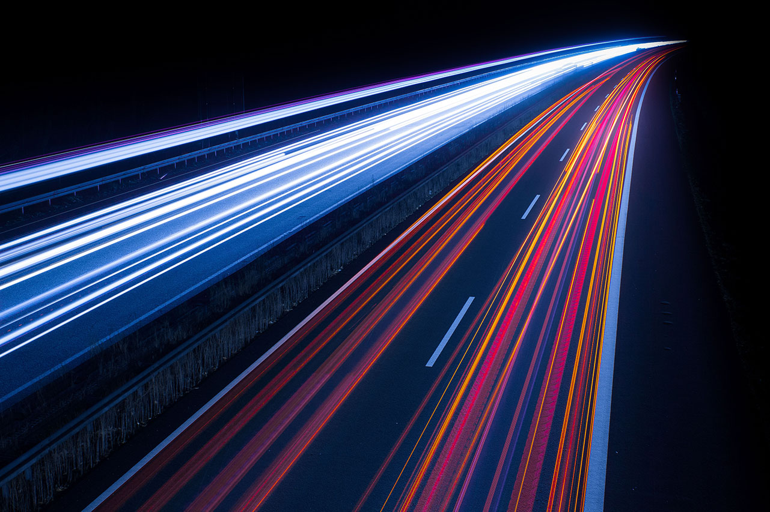
Thank You!

