Slide 1
Critical Path Analysis

Slide 2
Tasks, durations, and dependencies
Task | Effort (person-days) | Duration (days) | Dependencies
T1 | 15 | 10
T2 | 8 | 15
T3 | 20 | 15 | T1 (M1)
T4 | 5 | 10
T5 | 5 | 10 | T2, T4 (M3)
T6 | 10 | 5 | T1, T2 (M4)
T7 | 25 | 20 | T1 (M1)
T8 | 75 | 25 | T4 (M2)
T9 | 10 | 15 | T3, T6 (M5)
T10 | 20 | 15 | T7, T8 (M6)
T11 | 10 | 10 | T9 (M7)
T12 | 20 | 10 | T10, T11 (M8)

Slide 3
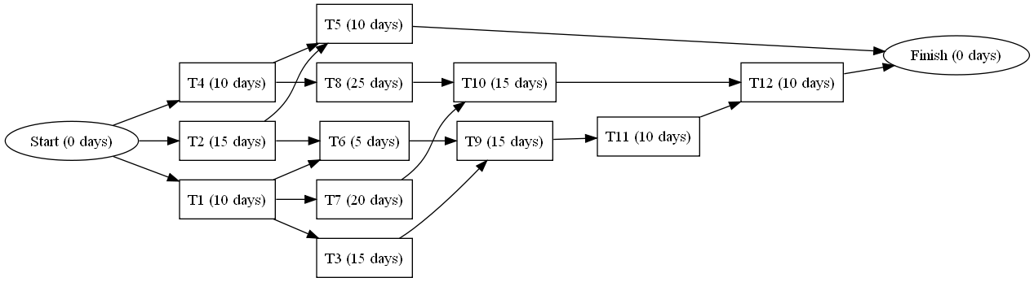
Graph representation of tasks and dependencies

Slide 4
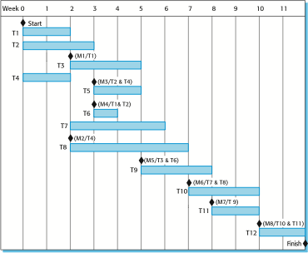
Activity bar chart

Slide 5
Critical path analysis
Given task durations and dependencies, critical path analysis computes the earliest time to complete a project.
Outputs of critical path analysis
Earliest time to completion.
Critical path(s).
Critical tasks – a set of tasks that, when delayed, will cause the entire project schedule to slip.
Two special critical tasks:
Start Task – milestone marking the beginning of the project.
Finish Task – milestone marking the end of the project.
Critical path – a sequence of critical tasks from Start and Finish.

Slide 6
Calculating the critical path
Initialize
Start Task’s earliest and latest starting times are set to 0
Forward Pass
Determine earliest starting times for all tasks beginning with Start Task
Compute candidate Earliest Times from the Earliest Times of each predecessor plus the duration from the predecessor
Pick the highest number
Initialize Finish Task
Finish Task’s Latest Time is set to its computed Earliest Time
Reverse Pass
Determine latest starting times for all tasks starting from Finish Task
Computer candidate Latest Times from the Latest Times of each successor minus the duration to the successor
Pick the lowest number
Critical Path
The nodes whose Earliest Times = Latest Times

Slide 7
Tasks, durations, and dependencies
Task | Duration (days) | Depen-dencies | Earliest Start | Successors | Latest Start
S | 0 |  | 0 | T1, T2, T4 | 0
T1 | 10 | S | 0 | T3, T6, T7 | 0
T2 | 15 | S | 0 | T5, T6 | 5
T3 | 15 | T1 | 10 | T9 | 10
T4 | 10 | S | 0 | T5, T8 | 0
T5 | 10 | T2, T4 | 15 | F | 50
T6 | 5 | T1, T2 | 15 | T9 | 20
T7 | 20 | T1 | 10 | T10 | 15
T8 | 25 | T4 | 10 | T10 | 10
T9 | 15 | T3, T6 | 25 | T11 | 25
T10 | 15 | T7, T8 | 35 | T12 | 35
T11 | 10 | T9 | 40 | T12 | 40
T12 | 10 | T10, T11 | 50 | F | 50
F | 0 | T5, T12 | 60 |  | 60
Project duration

Slide 8
Two critical paths

Slide 9
Two critical paths

