Slide 1



Empirical Research and Integration of Dual-Branch GCN-CNN Architecture
Facial Emotion Recognition (FER) App based on SOTA Models
Report 02

Slide 2




PROBLEM STATEMENT
Limitations of Pure CNNs Body Text: Facial Emotion Recognition (FER) traditionally relies entirely on 2D Convolutional Neural Networks to extract local textures. However, these pure CNN architectures exhibit significant limitations:
Pose Variations: They lack robustness against significant head rotations and spatial shifts.
Environmental Bias: They are highly susceptible to illumination variations and partial occlusions.
Information Loss: Subtle, complex expressions are often flattened or lost due to lighting biases.
Solution: A hybrid Dual-Branch GCN-CNN architecture.

Slide 3

The Architecture
The Dual-Branch Solution
Texture Branch (CNN): Analyzes standard grayscale face images to intelligently capture local skin wrinkles, complex mouth curves, and subtle eyebrow movements.
Geometric Branch (GCN): Interprets 468 precise facial landmarks as a biological graph to learn spatial deformability entirely independent of lighting and skin tone.
Target Classes: The system focuses strictly on four key emotions: Anger, Happiness, Neutral, and Sadness to establish a highly robust analytical baseline.

Slide 4
Data Source
Diverse Source Datasets
To ensure robust generalization across controlled and uncontrolled environments, we curated a pipeline combining three highly diverse data sources.
CK+ Dataset: High-resolution, lab-controlled portraits featuring exaggerated, front-facing expressions.
FER2013: Low-resolution (48x48) grayscale images from web searches with noise and occlusions.
RAF-DB: Highly diverse "in-the-wild" dataset containing natural expressions and complex lighting.

Slide 5

Data Processing
Data Formatting Pipeline
Block 1: Image Formatting
All images undergo strict standardization to 1-channel Grayscale and are resized using cubic interpolation to exactly 224x224 pixels.
Rationale: Resolves massive dimensional discrepancies across datasets, eliminates environment color biases, and reduces memory consumption by 3x.
Block 2: Landmark Extraction
We utilize the MediaPipe Tasks API to rapidly extract exactly 468 facial landmarks, saving coordinates as (468, 2) NumPy matrices.
Strict Protocol: If extreme pose or shadow prevents extraction, the corresponding source image is permanently deleted to maintain 1-to-1 matching cardinality.

Slide 6

Balancing Data
Dataset Balancing Strategy Key Metric/Statistic: 18,000 Total Training Samples
Combating Natural Class Imbalance:
Following a stratified split of 70% Train, 15% Val, and 15% Test, we identified heavy imbalances skewing towards "Happiness" and "Neutral".
To prevent model bias, the training set was rigidly balanced to exactly 4,500 samples per emotion class. This was achieved via controlled undersampling of majority classes and geometric-safe oversampling of minority classes.

Slide 7
Loading & Augmentation
DataLoader & Augmentation: Data loading is managed dynamically to feed the dual-branch architecture without breaking spatial coordinate relationships.
Custom tf.data.Dataset Loader: Streams nested inputs dynamically yielding both Image Tensors and Graph Tensors alongside One-Hot Labels, replicating grayscale channels to RGB on-the-fly for baseline backbone compatibility.
No Geometric Augmentation: Strictly prohibits rotational, shearing, or flipping transformations on images. Such operations would instantly desynchronize the facial landmarks stored in the graph branch.
Intensity Modulation: Applies Random Brightness scaling (pixel modulation between 0.8 and 1.2) within the loader. This safely simulates severe lighting variations without altering facial geometries.

Slide 8
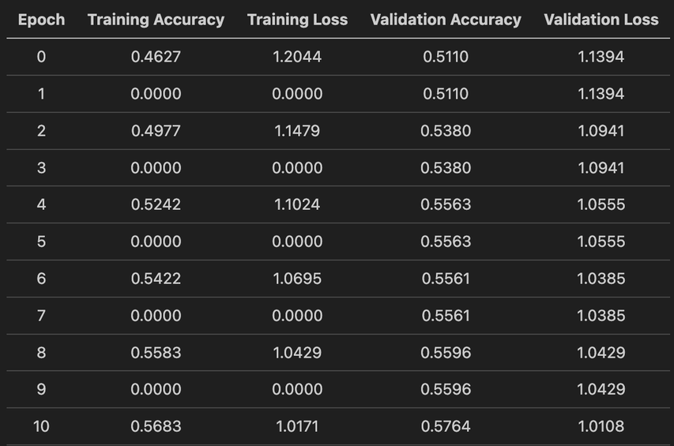
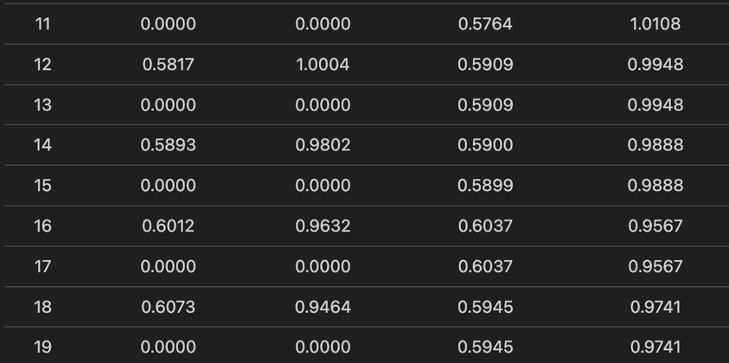
Phase 2 Baseline Results
Evaluating the Image-Only MobileNetV2 Architecture on the balanced 18,000-sample dataset to establish our core comparative benchmark.
Table showing Validation Accuracy climbing from 51% at Epoch 0 to 60.37% at Epoch 16

Slide 9

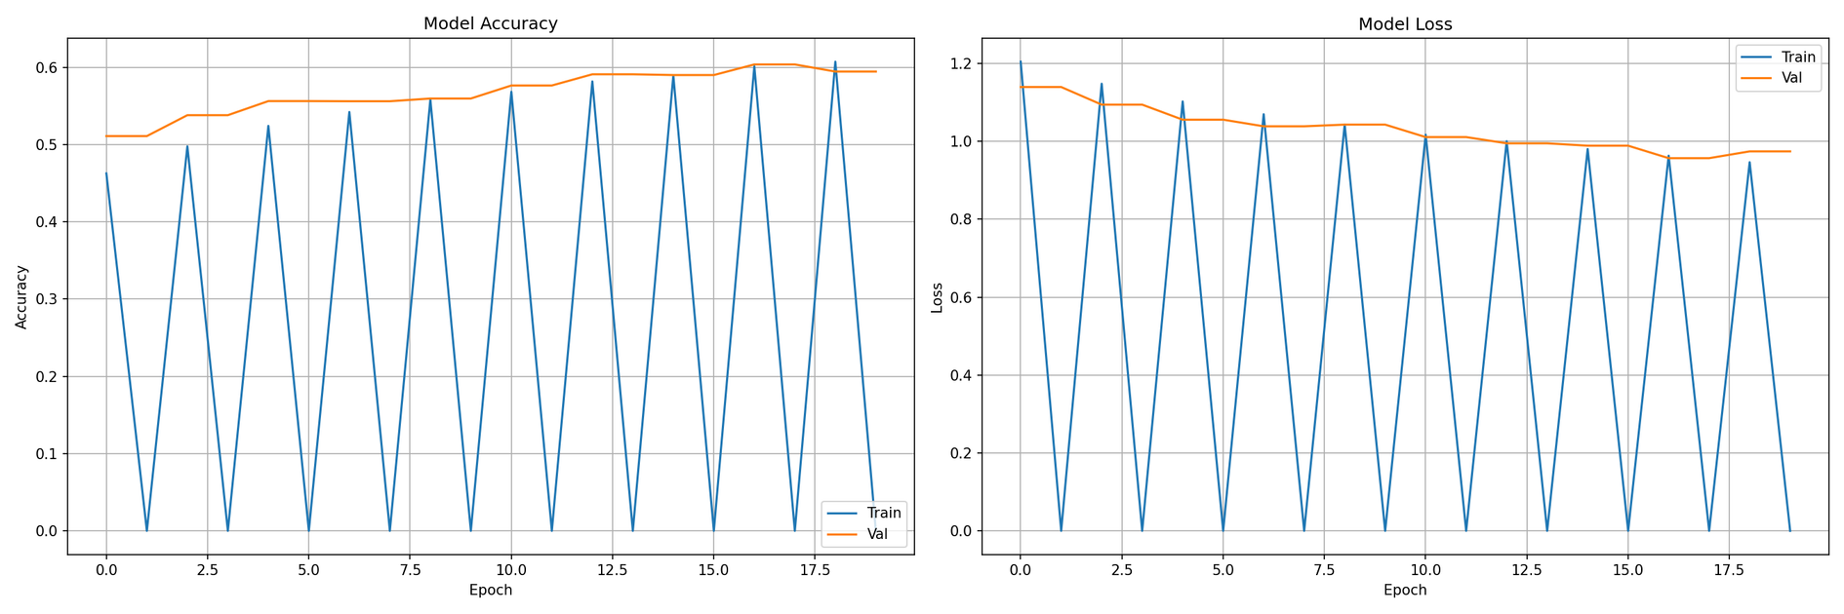
Baseline Training Convergence
The frozen ImageNet backbone shows steady convergence over 20 epochs. Strict dataset balancing prevented overfitting, achieving a peak validation accuracy of 60.37% at Epoch 16.
-

Slide 10
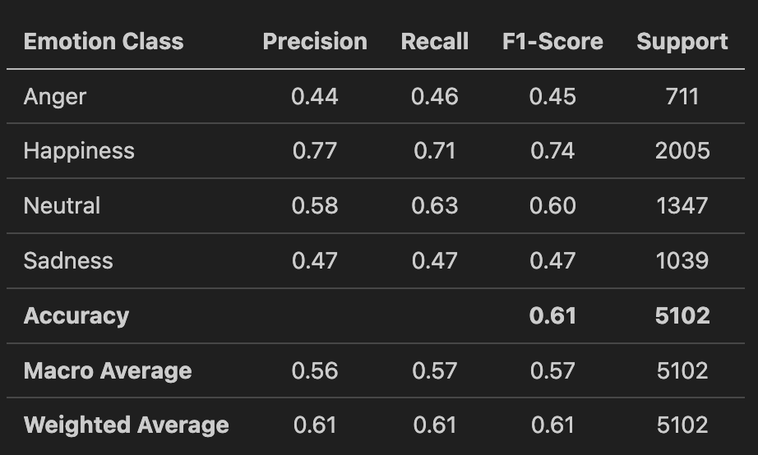
Test Set Performance
Evaluation metrics on the independent test dataset consisting of 5,102 samples representing natural real-world class distributions.
-

Slide 11
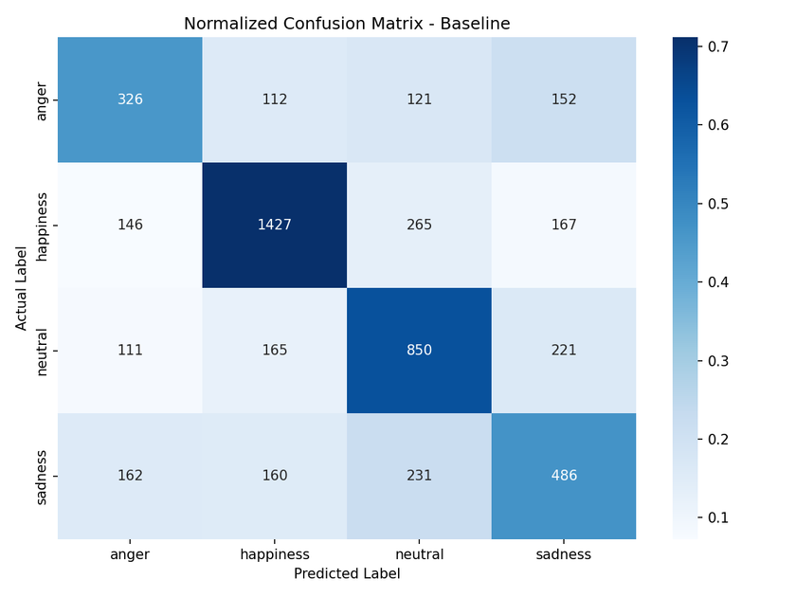
Confusion Matrix Insights
The baseline classification metrics reveal severe class-specific limitations within the 2D CNN texture branch:
Happiness Dominance: The model achieves a high F1-score (0.74) for happiness, driven by highly distinct visual textures (exposed teeth, raised cheeks).
Negative Emotion Failure: Performance drops sharply for negative expressions (Anger: 0.45, Sadness: 0.47).
The Neutral Overlap: In-the-wild negative expressions share subtle, highly overlapping textures with the "Neutral" class, creating a critical bottleneck for pure CNNs.
-

Slide 12
Conclusion
The Case for GCN Integration
Since GCN landmarks model topological distances rather than raw pixel intensities, the hybrid network will remain resilient to lighting variations and low image resolutions

