Slide 1

Finding root cause for
unexplained AG failover
PASS HA/DR Virtual Chapter
9/12/2017
Trayce Jordan MCM, MCA, CISSP
Senior Premier Field Engineer - SQL
Microsoft Corporation
Trayce.Jordan@Microsoft.com
Trayce@SeekWellAndProsper.com
@SeekWellDBA
http://seekwellandprosper.com

Slide 2
Do these quotes sound familiar?
“My AG just failed over – why?”
“My AG didn’t failover – why not?”
“I don’t know how to figure it out!”
“I know where to look, but it doesn’t make any sense!”

Slide 3
Our Agenda
Discuss most common issues for failover.
Review the SQL/Cluster components.
Share my root cause analysis (RCA) approach.
Look at logs!

Slide 4
Most common causes
for failover
Quorum loss
Lease timeout
HealthCheck timeout
SQL Dumps
User initiated
Notes:
QUORUM LOSS ==============
Database mirroring had Witness.
AG “replaced” the witness with WSFC.
It’s good at arbitration.
Because of SQL depends on QUORUM.
QUORUM is in the eye of the beholder.
LEASE TIMEOUT
==========
SQL Sets up a lease between the primary AG and the “cluster”.
If that lease is broken, the AG must go down.
HEALTH CHECK timeout
================
We replaced health checks of @@ServerName with sp_server_diagnostics.
If that “fails” or times out, we’ll shut down or failover.
SQL DUMPS
===========
During a memory dump, we freeze all of our threads.
The “lease renewal thread” will faile to respond and cause a lease timeout.
User Initiated
=========
Either from the WSFC Cluster Manager, or from SQL Server

Slide 5
Most common causes
for not failing over
One or more DBs not sync’d
Secondary not connected
WSFC cannot connect to SQL
AG set for manual failover
Exceeded failover thresholds
Notes:
Databases not sync’d
==============
Must be SYNCHRONIZED.
There are some conditions based on timing that can cause the databases not to be sync’d.
PG is working on trying to eliminate that condition. -- it is rare though.
SECONDARY not connected
==================
If the secondary is not connected to the primary prior to failover, we will not failover to it.
WSFC cannot connect to SQL
====================
In order to bring up the AG, the cluster must connect to SQL and have permissions to bring the AG online.
AG is set for manual failover
===================
if you try to use WSFC and set for manual failover, it won’t failover because we manage the possible ownerships.
A manual secondary will not have possible ownership set.
Exceeded Failover thresholds
====================
Cluster settings for failover attempts, failure threshold window, retry attempts – all can affect failover.
Example script that shows what has to be in order to auto failover (just from a SQL perspective):
IF (@ConnectedState = 1) BEGIN
IF (@SyncMode = 1) BEGIN
IF (@OperationalState = 2) BEGIN
IF (@ReplicaRole = 2) BEGIN
IF (@RecoveryHealth = 1) BEGIN
IF (@SyncState = 2) BEGIN
/* all conditions met, we can issue failover*/
ALTER AVAILABILITY GROUP [MyAG] FAILOVER

Slide 6

SQL/Cluster architecture
& interactions
AlwaysOn AGs requires & depends on WSFC.
Linux version will be different
In SQL v-next
The RHS.EXE process monitors SQL health.
The RHS.EXE process maintains a “lease” with SQL Server on the AG primary.
If the cluster service stops on the AG primary, the AG goes offline.
Notes:
A separate RHS.EXE process can be used for each resource in a cluster.
We recommend a separate RHS process for each availability group – if you have many AGs or many databases in AGs.
The lease process is explained in further detail on slide 10.
Reference:
http://blogs.msdn.com/b/psssql/archive/2012/09/07/how-it-works-sql-server-alwayson-lease-timeout.aspx

Slide 7
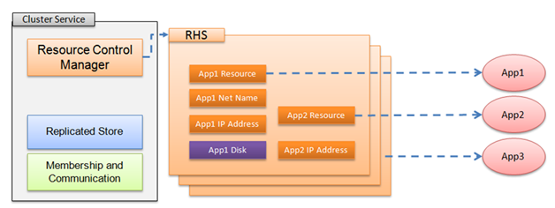
The Resource Control Manager
RCM is the thread within Cluster Service responsible for resources.
RHS.EXE is a separate process in charge of testing.
LooksAlive every 5 seconds
IsAlive every 60 seconds

Slide 8
RHS Interacts with SQL
SQL Server 2012/2014/2016
Resource DLL
Diagnostics
sp_server_diagnostics
SQL Server
Notes:
When the resource control monitor starts the AG resource, the SQL AG resource dll is loaded into RHS.EXE.
It then makes an ODBC connection to SQL Server and initiates a call to sp_server_diagnostics.
It is set to receive data every 1/3 of the “health check timeout” interval.
The RHS.EXE process (through the resource DLL), makes a persistent connection for each Availability Group.
It does not disconnect/reconnect normally –though if SQL Server kills its session or some other issue takes place – a new connection may be established.
The sp_server_diagnostics stored procedure is not actually called “multiple times” – it is called once – when the connection is made.
It is passed a parameter that specifies how often data should be returned to the RHS process for evaluation.
https://msdn.microsoft.com/en-us/library/hh710040.aspx

Slide 9
Flexible Failure Conditions
5 – Failover or restart on any qualified failure conditions
Query Processing errors
4 – Failover or restart on moderate SQL Server errors
Resource errors - OOM
3 – Failover or restart on critical SQL Server errors
System errors
2 – Failover or restart on server unresponsive
sp_server_diagnostics
failure or timeout
1 – Failover or restart on SQL service failure
Service down
Notes:
All levels are cumulative – meaning that level 2 includes all level 1 checks. Level 4 has all of Levels 3, 2, & 1 as well.
Level 1: Just checks to see if the SQL Server service is running. If so, it returns true for the “IsAlive” check.
Back in the SQL 2008R2 and earlier time frames the “LooksAlive” check just checked to see if the service was running.
If it was, then it did an “IsAlive” check to see if SQL could return data – that was the “IsAlive” check – and it sent a query of
SELECT @@SERVERNAME.
Beginning with SQL Server 2012, the “LooksAlive” and “IsAlive” both return TRUE if the SQL Service is running – when the flexible failure condition
is set at Level 1.
A true “IsAlive” check is not done until Level 2.
Level 2:
fails if the sp_server_diagnostics doesn’t return anything or if the data returned is corrupted somehow.
it does not “check the health” of what is returned – simply – “did I get data back?”
Essentially this is equivalent to the “IsAlive” check in the past for SQL FCIs – 2008R2 and earlier -→ SELECT @@SERVERNAME
Level 3:
“System Errors” are:
Check for too much dumping (>= 100 dumps & more recent interval check >= 2 more dumps)
Memory scribbler present (buffer overrun)
Orphaned spinlock
Level 4
“Resource Errors”
Essentially OOM – that we haven’t freed any memory in more than 2 minutes:
Level 5
“Query Processing” errors are:
Unresolved deadlocks
Deadlocked Schedulers

Slide 10
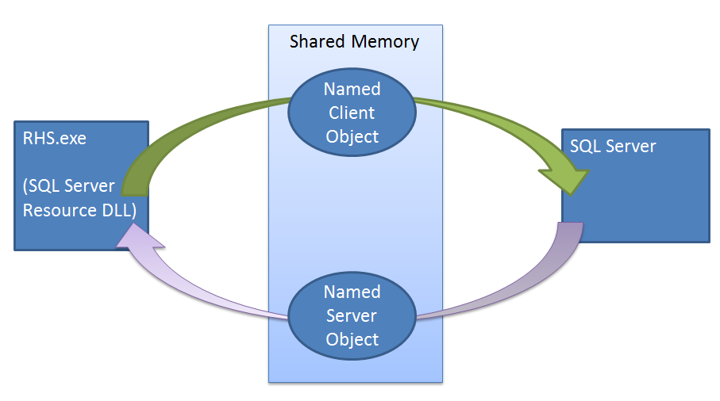
Two-way “Handshake lease”
Notes:
Both the RHS & SQL Server must respond to each other.
When one updates the Shared memory object, it triggers the other to ‘respond’.
The default lease timeout is 20 seconds.
Every 1/4th of the lease timeout setting, one process should be updating the shared memory triggering the other to respond.
If the other side responds, the lease timeout setting is reset and the process starts over.
So when things are working properly, by default, every 5 seconds a new 20 second countdown timer is started.
Reference:
http://blogs.msdn.com/b/psssql/archive/2012/09/07/how-it-works-sql-server-alwayson-lease-timeout.aspx

Slide 11
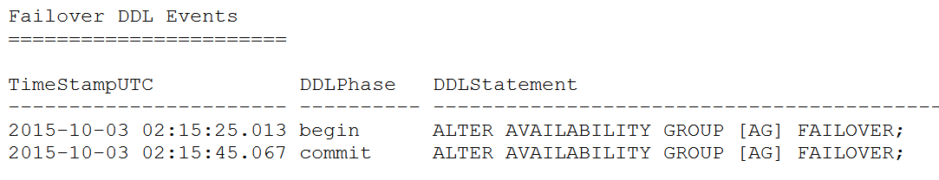
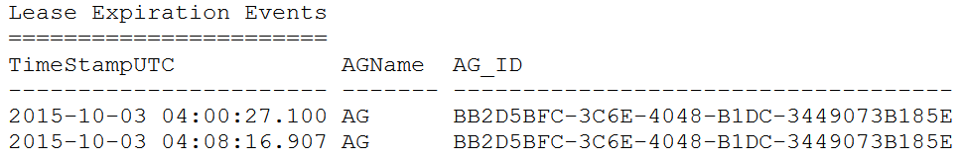
Review AlwaysOn Health *.XEL files
Look for failover DDL events
Look for lease timeout events

Slide 12
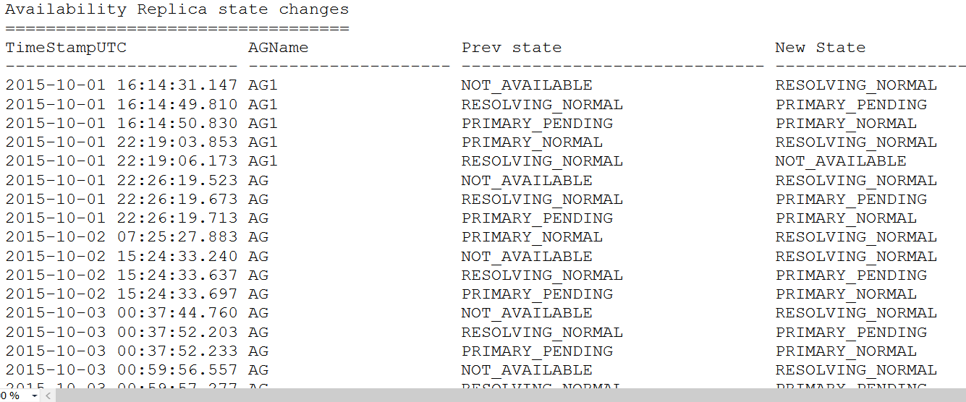
Review AlwaysOn Health *.XEL files
Look at all state changes to get timelines

Slide 13
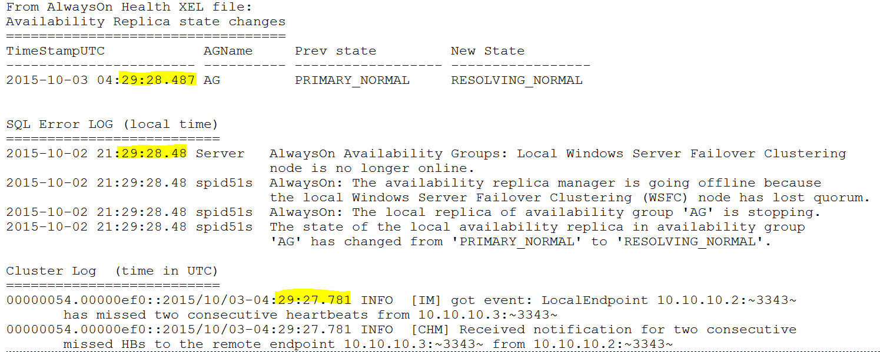
Correlate to SQL & Cluster Logs

Slide 14
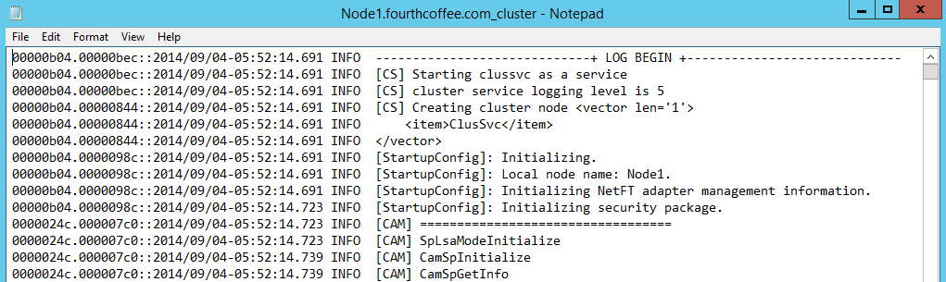
Cluster Log Anatomy

Slide 15
Demos

Slide 16
References
Appendix A: Details of How Quorum Works in a Failover Cluster
http://technet.microsoft.com/en-us/library/cc730649(v=ws.10).aspx
Force Quorum in a Single-Site or Multi-Site Failover Cluster
http://technet.microsoft.com/en-us/library/dd197500(v=WS.10).aspx
Tuning Failover Cluster Network Thresholds
http://blogs.msdn.com/b/clustering/archive/2012/11/21/10370765.aspx
Configure Heartbeat and DNS Settings in a Multi-Site Failover Cluster
http://technet.microsoft.com/en-us/library/dd197562(v=WS.10).aspx

Slide 17
References
LooksAlive and IsAlive Implementation of Availability Groups failure_condition_level
http://blogs.msdn.com/b/alwaysonpro/archive/2013/09/12/looksalive-and-isalive-implementation-of-availability-groups.aspx
Configure the Flexible Failover Policy to Control Conditions for Automatic Failover (AlwaysOn Availability Groups)
http://msdn.microsoft.com/en-us/library/hh710040(v=sql.120).aspx
How It Works: SQL Server AlwaysOn Lease Timeout
http://blogs.msdn.com/b/psssql/archive/2012/09/07/how-it-works-sql-server-alwayson-lease-timeout.aspx
Enhance AlwaysOn Failover Policy to Test SQL Server Responsiveness
http://blogs.msdn.com/b/alwaysonpro/archive/2014/10/13/enhance-alwayson-failover-policy-to-check-for-connection-and-availability-database-health.aspx

Slide 18
Thank you!
Questions?
Trayce.Jordan@microsoft.com
trayce@seekwellandprosper.com

