Slide 1
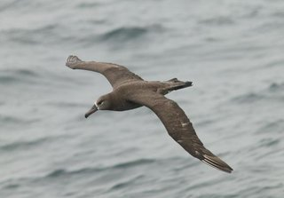



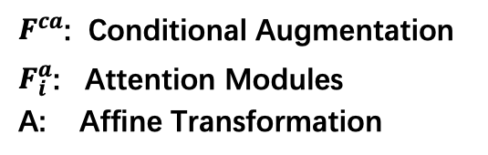






sentence feature
$$z\sim N(0, 1)$$
Mapping Network $f$
this bird has a dark brown overall body color, with a small white patch around the base of the bill.
$$F^{ca}$$
$$ω∈𝒲$$
BERT
Const 4x4x512
…
$$F_{1}^{a}$$
$$F_{2}^{a}$$
$$F_{3}^{a}$$
$$F_{4}^{a}$$
AdaIN
A
A
A
A
Style
Style
Conv
Style
Style
word features
AdaIN
…
Upsample
$F^{ca}$: Conditional Augmentation
$F_{i}^{a}$: Attention Modules
A: Affine Transformation
4x4
8x8
Conv
Attentional Style Generator $g$
Discriminator
AdaIN
Conv
AdaIN

