Slide 1
AI TRADING RESEARCH LAB
ATRL — AI-assisted research, automation and experimental validation
An engineering research environment for repeatable trading-system experiments.
Research loop
01
CONTROL
• 3 independent research bots with isolated experiment state
• Trade → Backtest → Lookahead → Hyperopt → A/B research
• 30-day primary validation windows with 7/14-day reliability checks
• Checkpoints, resume/recovery, diagnostics and run-state tracking
• Evidence-driven candidate selection instead of single-run optimization
02
RUN
03
MEASURE
04
COMPARE
05
VALIDATE
Public portfolio separates engineering evidence from proprietary strategy implementation.
ATRL | AI Trading Research Lab
1

Slide 2
What the system does
The screenshots show a controlled research environment rather than a single trading script.
ORCHESTRATE
EXPERIMENT
Start, inspect and coordinate multiple independent research stages.
Run repeatable backtests, lookahead checks, hyperparameter searches and A/B candidates.
VALIDATE
RECOVER
Compare base vs candidate runs using trades, profit, PF, drawdown and hold duration.
Persist state, checkpoints and diagnostics so long-running research can resume.
Observed UI vocabulary: RUNNING / DONE / SEARCH / REJECTED / BASE / PROSPECT / KEEP
ATRL | AI Trading Research Lab
2

Slide 3
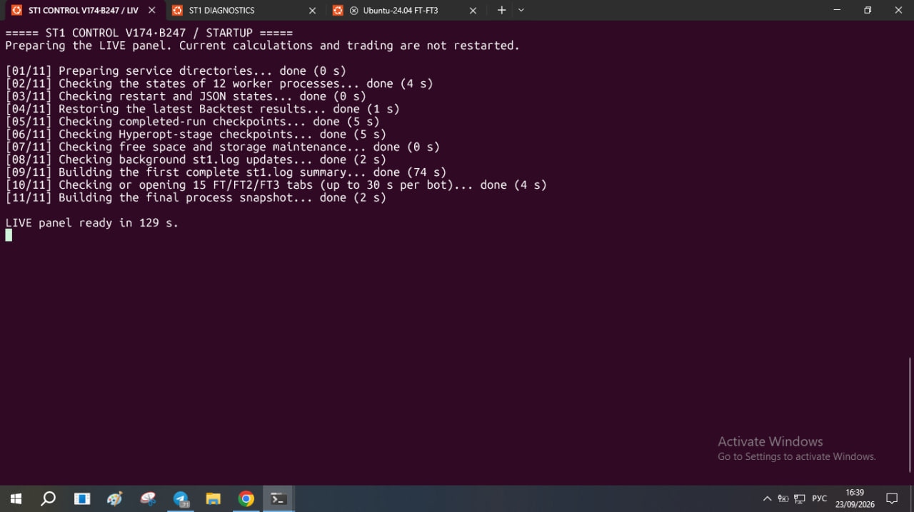
Startup
11-step startup prepares the live panel without restarting current calculations or trading.
What is visible
• Worker-process state checks
• Restart / JSON state checks
• Backtest and Hyperopt checkpoint restoration
• Storage / log maintenance
• Final process snapshot
ATRL | AI Trading Research Lab
3

Slide 4
Research execution pipeline
Each stage produces evidence consumed by the next stage.
01
02
03
04
05
TRADE
→
BACKTEST
→
LOOKAHEAD
→
HYPEROPT
→
A/B
Live/dry-run execution state
Historical performance + drawdown
Leakage / future-data validation
Parameter-space exploration
Controlled candidate comparison
Why this matters for QA / ML engineering
• The system separates generation of candidates from acceptance of candidates.
• Validation uses multiple windows and explicit baseline-vs-candidate evidence.
• Long-running research is treated as a stateful workflow with checkpoints and recovery.
ATRL | AI Trading Research Lab
4

Slide 5
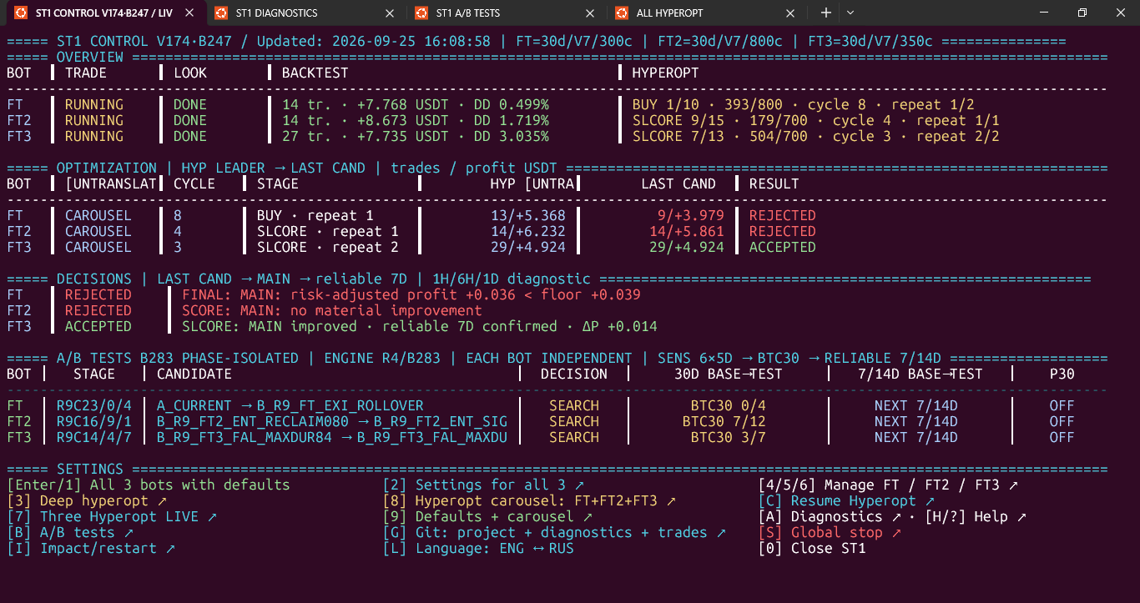
ST1 Control — English UI
Live overview for FT, FT2 and FT3; one control plane for research state.
Main functions
• Trade / Lookahead / Backtest / Hyperopt state
• Hyperopt cycle, stage, repeat and latest candidate
• 30D base→test and 7/14D reliability checks
• A/B candidate search and decision state
• Diagnostics, Help, Git, Restart and Language
ATRL | AI Trading Research Lab
5

Slide 6
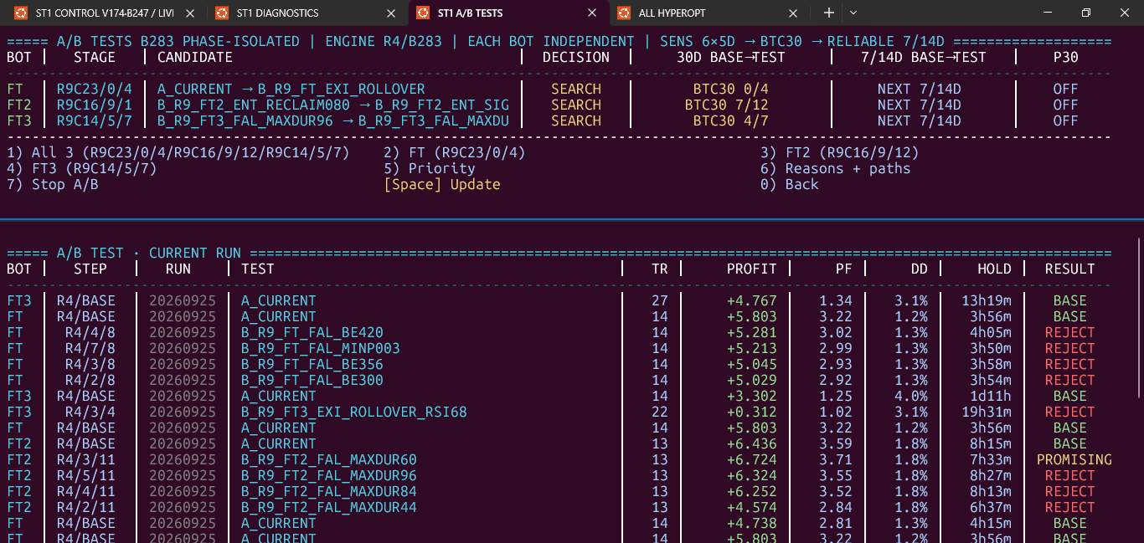
A/B Tests — isolated candidate research
Independent candidate comparison with baseline evidence and explicit decisions.
Evidence shown
• FT / FT2 / FT3 independently
• BASE and candidate runs
• Trades, profit, PF, DD and hold time
• KEEP / PROSPECT / REJECT / BASE outcomes
• Run and step traceability
ATRL | AI Trading Research Lab
6

Slide 7
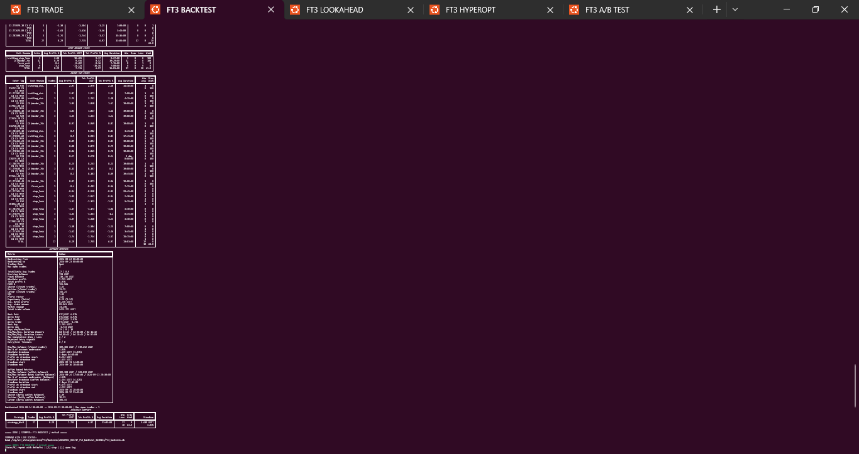
FT3 Backtest
Historical Freqtrade result used as one validation layer.
Observed output
• Backtest result table and summary
• Trade-level and aggregate metrics
• Profit / drawdown / duration fields
• Concrete historical validation evidence
ATRL | AI Trading Research Lab
7

Slide 8
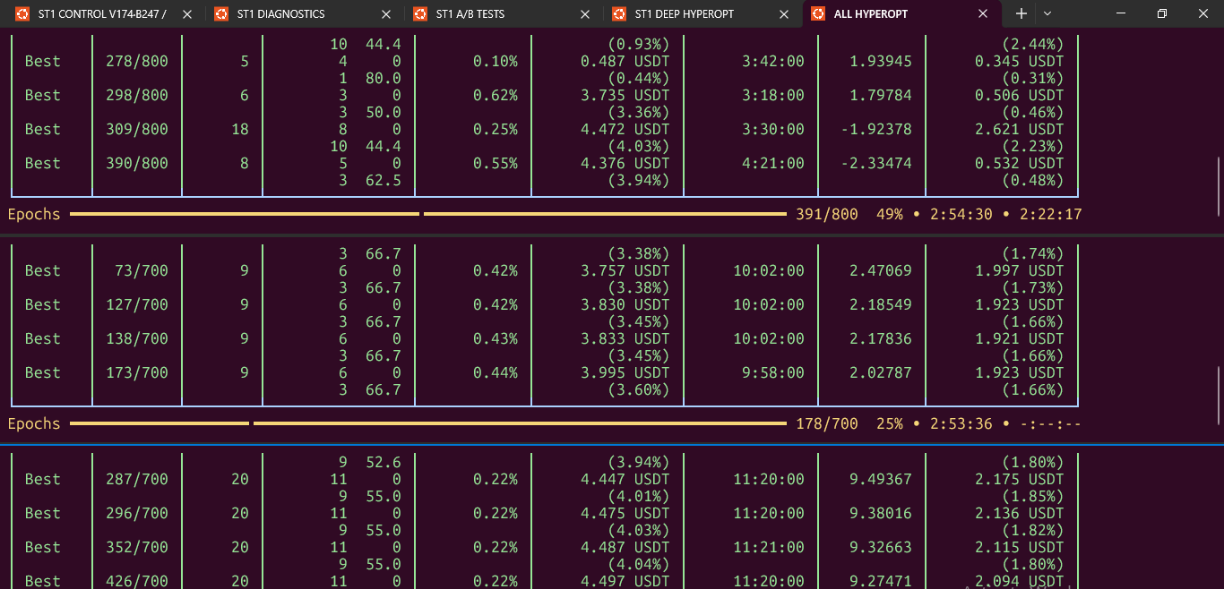
Hyperopt: all three bots
Parallel Hyperopt progress for FT, FT2 and FT3.
Research visibility
• Separate epoch streams
• Best candidates update during the run
• Trades, profit, objective and drawdown
• Long-running optimization remains observable
ATRL | AI Trading Research Lab
8

Slide 9
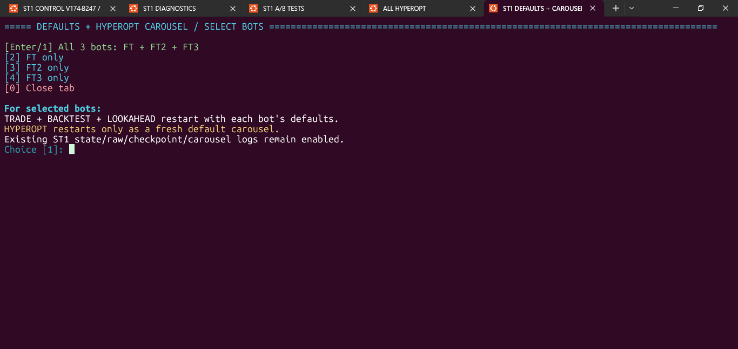
Defaults + Hyperopt Carousel
Select FT, FT2, FT3 or all three and restart research from bot defaults.
Operational control
• All 3 bots can be selected
• Trade + Backtest + Lookahead restart
• Hyperopt starts as a fresh default carousel
• Existing state / checkpoint logs remain enabled
ATRL | AI Trading Research Lab
9

Slide 10
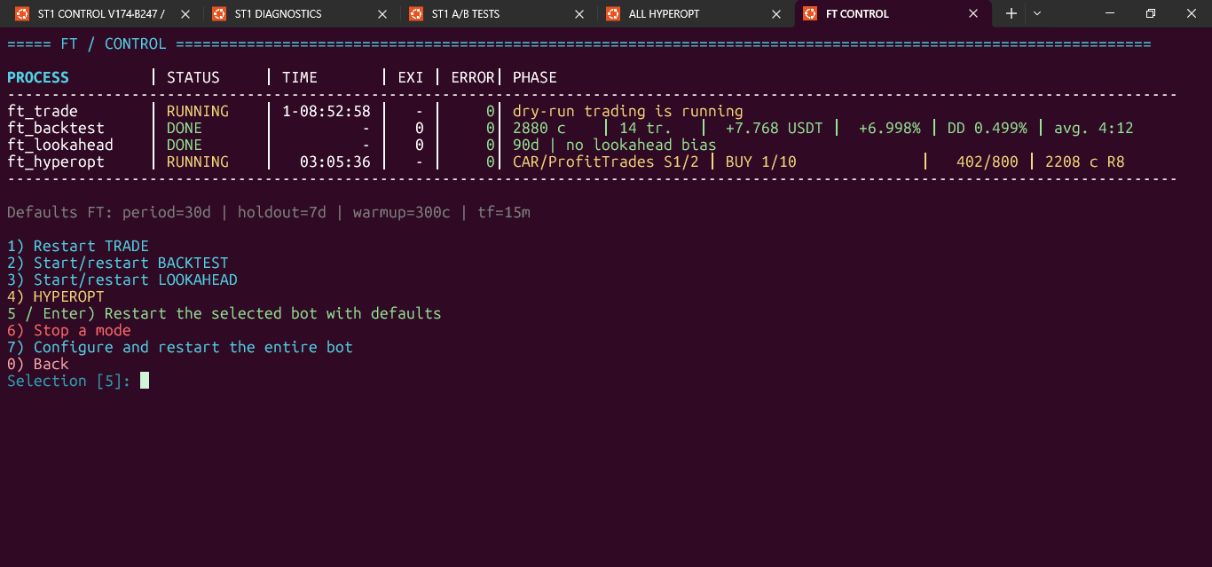
FT Control
Per-bot lifecycle control and current process state.
Available actions
• Restart Trade
• Start / restart Backtest
• Start / restart Lookahead
• Hyperopt
• Stop a mode
• Configure and restart the bot
ATRL | AI Trading Research Lab
10

Slide 11
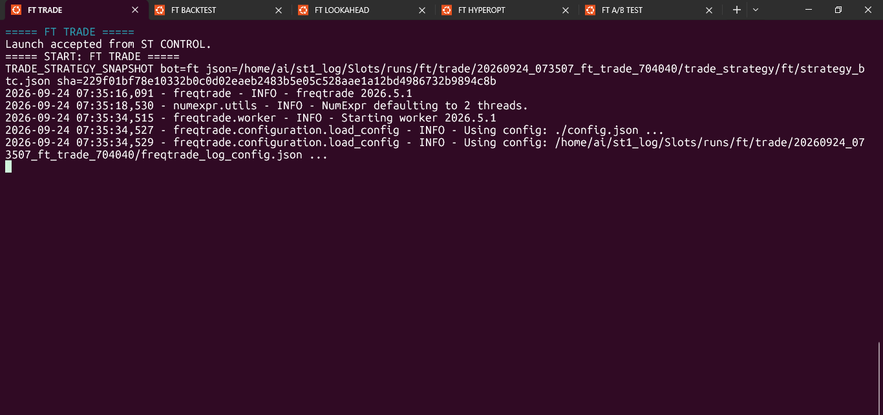
FT Trade
Real Freqtrade startup evidence from the FT Trade window.
Visible evidence
• ST Control launch accepted
• Strategy snapshot captured
• Freqtrade version shown
• Config and runtime log loaded
ATRL | AI Trading Research Lab
11

Slide 12
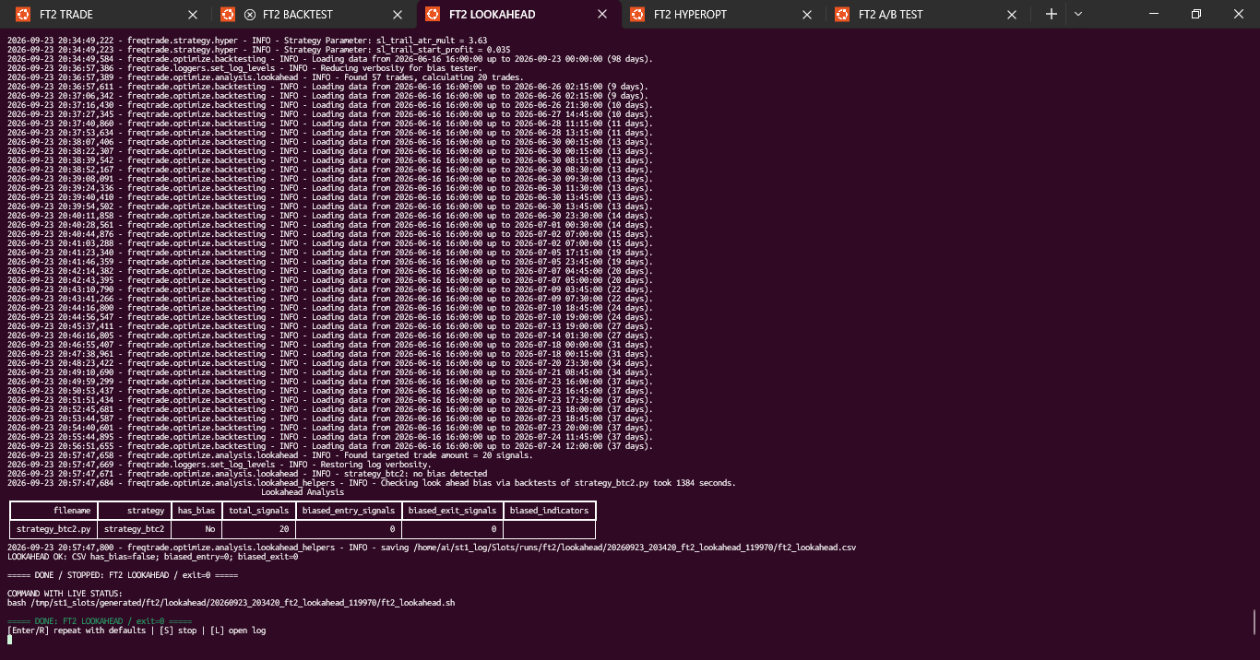
FT2 Lookahead
Lookahead Analysis result and bias check.
Validation purpose
• Historical data processed
• Lookahead analysis executed
• Bias result is explicit
• CSV evidence is saved
ATRL | AI Trading Research Lab
12

Slide 13
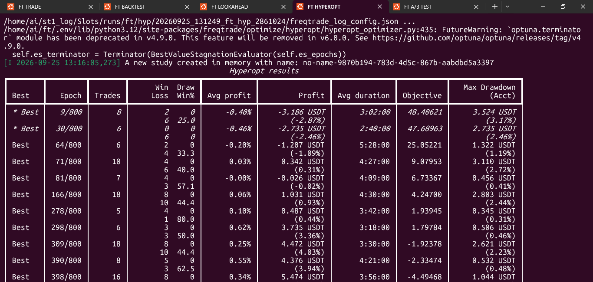
FT Hyperopt
Live Hyperopt result table for the FT research stream.
Visible metrics
• Epoch and best-so-far
• Trades and win/loss
• Average profit and total profit
• Objective and max drawdown
ATRL | AI Trading Research Lab
13

Slide 14
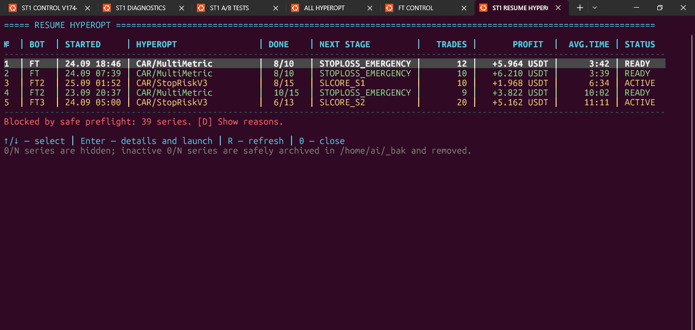
Resume Hyperopt
Saved Hyperopt series can be inspected and resumed after preflight.
Recovery capability
• Saved series and next stage
• Trades / profit / average time
• READY / ACTIVE state
• Safe preflight can block unsafe series
ATRL | AI Trading Research Lab
14

Slide 15
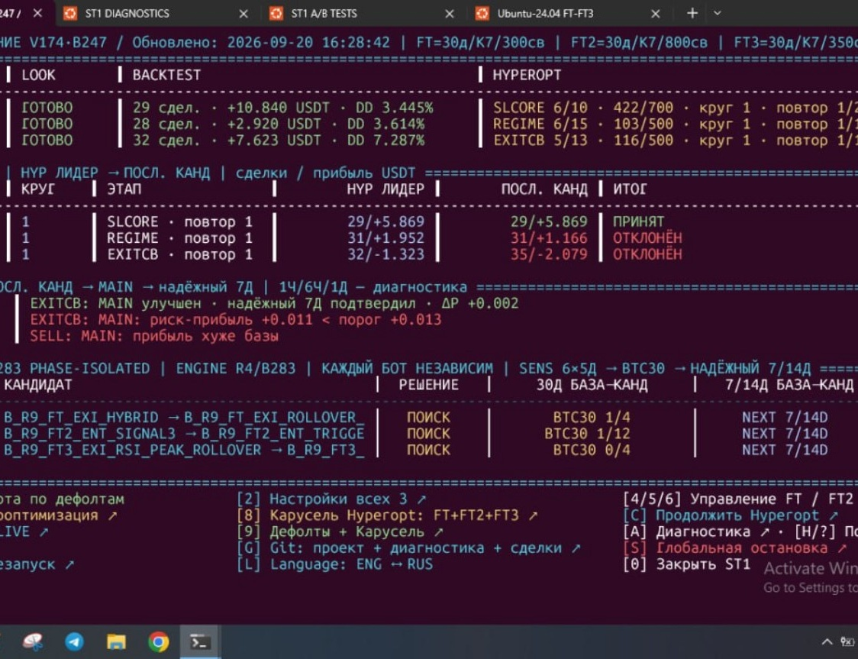
ST1 Control — Russian UI
The same live control plane in Russian; demonstrates ENG ↔ RUS localization.
User-facing support
• Same FT / FT2 / FT3 control model
• Russian operational labels
• Diagnostics / Help / Git / A/B controls
• Language switch is part of ST1
ATRL | AI Trading Research Lab
15

Slide 16
Three public-safe strategy profiles
15m LONG research strategies • high-level logic only • proprietary thresholds and scoring excluded
FT — strategy_btc
FT2 — strategy_btc2
FT3 — strategy_btc3
15m LONG
15m LONG
15m LONG
Extrema / rebound research
Multi-signal consensus
ZigZag + RSI
• EMA
• RSI
• RSI
• RSI
• EMA
• ATR
• StochRSI
• ATR
• Bollinger Bands
• Bollinger Bands
• ATR
• ZigZag / extrema
Trading logic — high level
Trading logic — high level
Trading logic — high level
Extrema/pivot context is combined with rebound and distance conditions. RSI, StochRSI and Bollinger provide confirmation; ATR supports protection / distance-aware logic.
Entry can combine extrema, RSI and EMA-stretch signals. Consensus controls independent signal agreement; reclaim paths use Bollinger, extrema distance and ATR gates.
ZigZag/extrema is a primary signal component. Entry combines RSI + extrema with ATR-aware gates; exits include peak / RSI-rollover style models.
No proprietary thresholds / weights / exact scoring.
No proprietary thresholds / weights / exact scoring.
No proprietary thresholds / weights / exact scoring.
ATRL | AI Trading Research Lab
16

Slide 17
QA / validation engineering
The research system applies QA principles to experimental ML/trading workflows.
REPRODUCIBILITY
REGRESSION CONTROL
OBSERVABILITY
Fixed periods, repeat/cycle tracking, explicit baselines and candidate identifiers.
Compare candidate outputs against a known baseline before progression.
Process snapshots, logs, diagnostics, stage state and measurable outcomes.
FAILURE ANALYSIS
RECOVERY
EVIDENCE
Inspect rejected candidates, risk-adjusted thresholds and diagnostic windows.
Checkpoints and resumable execution reduce loss of research progress.
Decisions are tied to measured results rather than a single optimization score.
ATRL | AI Trading Research Lab
17

Slide 18
Technology stack
Technologies directly reflected by the project workflow and public portfolio.
UBU
PLATFORM
PY
ENGINEERING
FT
TRADING
Ubuntu / Linux
WSL + Windows host
CLI / terminal workflows
Python
Bash
Git / GitHub
GitHub Actions / CI
Freqtrade
CCXT
Bybit dry-run
BTC/USDT research
NP
DATA / SCIENCE
SIG
INDICATORS / SIGNALS
QA
QA / RESEARCH
Pandas
NumPy
SciPy
Peak / extrema analysis
EMA • RSI • Bollinger Bands
ATR • ZigZag
find_peaks • EMD
Backtesting
Lookahead analysis
Hyperopt
A/B experiments
Holdout / reliability checks
ATRL | AI Trading Research Lab
18

Slide 19
Python / data / ML engineering
The portfolio emphasizes engineering around experiments, not only model or strategy code.
ORCHESTRATION
Python + Bash controllers • worker lifecycle • state machines • checkpoints
DATA PIPELINE
Pandas / NumPy • time-series transforms • feature and indicator computation
SIGNAL ANALYSIS
SciPy peak/extrema detection • ZigZag • EMD • EMA/RSI/BB/ATR-derived features
EXPERIMENT ENGINE
Hyperopt • deterministic runs • repeated candidates • isolated A/B tests
VALIDATION LAYER
Backtest • lookahead • holdout windows • drawdown / PF / duration metrics
ATRL | AI Trading Research Lab
19

Slide 20
System architecture
Conceptual architecture derived from the control workflow shown in the screenshots.
CONTROL PLANE
RESEARCH STAGES
A/B ENGINE
EVIDENCE
RECOVERY
→
→
→
→
BOT WORKERS
FT / FT2 / FT3
TRADE / BACKTEST / LOOK / HYP
CANDIDATES + DECISIONS
METRICS / LOGS / STATE
CHECKPOINTS / RESUME
The key engineering property is separation of control, execution, experiment state and evidence.
Public repository exposes the engineering story; proprietary strategy implementation and credentials remain private.
ATRL | AI Trading Research Lab
20

Slide 21
Continuous optimization loop
Cyclic Hyperopt + A/B validation refreshes candidates through repeated research cycles.
01
02
03
04
05
RUN
→
OPTIMIZE
→
COMPARE
→
VALIDATE
→
PROMOTE
Generate / refresh candidates
Hyperopt carousel explores parameters
Baseline vs candidate A/B
30D + reliable 7/14D checks
Explicit controlled promotion
ADAPTIVE RESEARCH LOOP
The carousel repeatedly evaluates candidates, compares them with the current baseline and carries validated candidates into the next research cycle. It is an automated, continuously refreshed research workflow — not a claim of autonomous machine learning.
ATRL | AI Trading Research Lab
21

Slide 22
Git, validation & controlled deployment
Version control, validation evidence and deployment lineage are integrated into the engineering lifecycle.
CODE
→
TEST
→
EVIDENCE
→
DEPLOY
Git repository + project synchronization
Regression / self-tests + deployment validation
State, manifests, checkpoints, diagnostics
Versioned deployment lineage + explicit promotion
Engineering controls
Public repository
• Git-based project synchronization and versioned research state.
• Regression/self-tests and deployment validation are part of the workflow.
• Deployment lineage preserves previous and selected states with evidence.
• Research candidates are not deployed implicitly: promotion remains controlled.
• Checkpoints and manifests provide traceability for long-running experiments.
Trd-cra / AI-Trading-Research-Lab
github.com/Trd-cra/AI-Trading-Research-Lab
Public: workflow, validation and selected evidence. Private: proprietary strategy implementation and credentials.
ATRL | AI Trading Research Lab
22

Slide 23
Contact & Portfolio
Senior QA Engineer | AI/ML QA & Automation | Web, API & Data
PUBLIC PORTFOLIO
LINKEDIN
AI Trading Research Lab (ATRL)
Professional profile
github.com/Trd-cra/AI-Trading-Research-Lab
linkedin.com/in/alex-k-46448175
Portfolio focus: AI-assisted QA • research automation • Hyperopt • A/B validation • reproducibility • diagnostics
ATRL | AI Trading Research Lab
23

