Slide 1
A method to do something

Slide 2
Basic information
Data1: Data2: Data3 |  |  | Data1: Data10: Data100:
ID | Inventor | Role | Contribute rate
1 | Tran Duc Huy
2

Slide 3
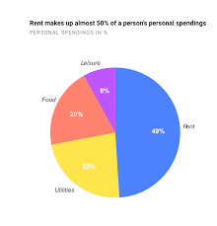
Content
This is some very long long long long long long very long long long long long long very long long long long long long very long long long long long long very long long long long long long text. Description 1. Description 2, very long long long long long long very long long long long long long very long long long long long long very long long long long long long very long long long long long long text.

