Slide 1
Prediction of Callbacks using Weather Data
8/11/2016 / Tré Watts
RIC ATLANTA

Slide 2
Introduction:
Elevator Service mechanics are typically assigned a collection of units (elevators, escalators, and moving walks) to be serviced.
"Callback” is the term used when referring to elevator maintenance calls made by the customer, which fall outside of the regular maintenance schedule.
Callbacks are generally unexpected, and can be costly during busy weeks and times when a branch is short-staffed.
GOAL
Identify a model which can predict an increase in the callback volume apriori to save money.

Slide 3
Hypothesis
There has long been a “gut feeling” within the industry that the weather can have an influence on callback volume
Potential causes:
Rapid changes in weather conditions could affect sensitive electronics
Temperature
Humidity
Air pressure
Lightning strikes can potentially overload some electronics
High humidity can cause corrosion on exposed mechanical assemblies

Slide 4
Data
To test the hypothesis, we will use maintenance data logged from the past three years, along with weather data sourced from www.wunderground.com for a major US city.
Maintenance Data Columns – Service Records
Time and date of service
Type of service performed
Reason for service (preventative maintenance, safety inspection, callback…)
Type of elevator unit
Roped
Hydraulic
Geared/Gearless
Machine Room/Machine Room-less
Weather Data – Daily Records of…
Temperature, Humidity, Air Pressure, Precipitation, etc.
“Events” – Snow, rain, thunderstorms, fog

Slide 5
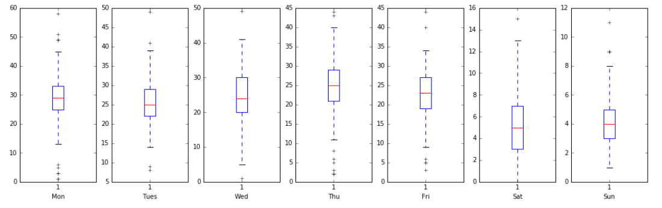
Exploratory Analysis
Plotting the data, we see that the number of callbacks per day is fairly normally distributed around each weekday.
Saturday and Sunday tend to have lower volumes. We may elect to treat weekends differently from weekdays.

Slide 6
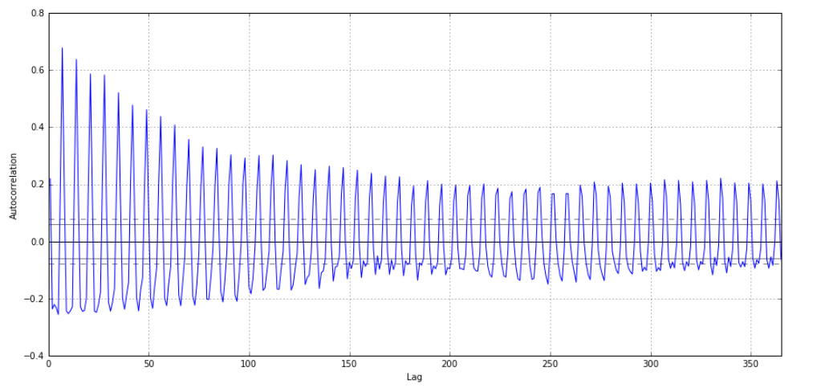
Exploratory Analysis
Plotting the autocorrelation function of the daily callback volume, we can see that the callback volume is somewhat periodic in nature
The consistent spacing of the spikes is likely due to the callback volume peaking during certain days of the week
Thursday seems to be the busiest, but also the most volatile
This is an indication that Autoregressive models may be a good fit for this problem.

Slide 7
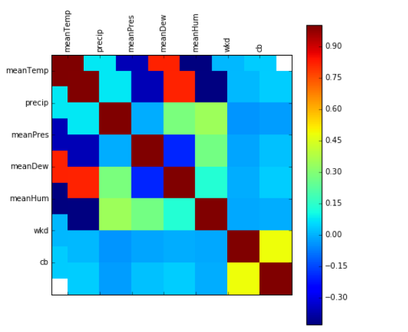
Exploratory Analysis
Correlating the callback volume with the last 30 days of weather conditions, we see that there is only mild correlation
Additionally, we see only mild correlation between the day of the week and the callback volume, though it seems much strong than that of the weather

Slide 8
Modeling
Given the findings from the exploratory analysis, we look at a few different options moving forward:
Treat this as a regression problem
Predict the number of callbacks on a particular day given the day of the week and the weather conditions of the previous month
Use Time-series modeling
Predict the number of callbacks by creating an autoregressive model, looking only at the callback volume of previous days

Slide 9
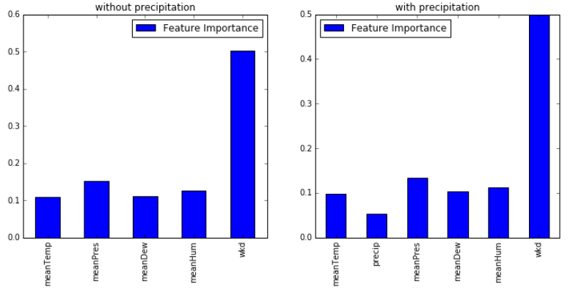
Regression – Random Forest Regressor
Before any additional modeling was done, we fit a random forest regressor to the training data and assessed feature importance
It was found that weekday was the most important feature by a long shot
All other features held roughly equal weight (with the exception of precipitation

Slide 10
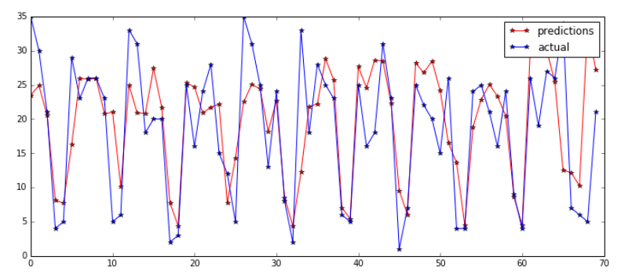
Regression – Random Forest Regressor
Continuing by after removing precipitation, we plotted the forecast for the last 70 days of our data
We see that while our model captures the general trend of the data, the error is a bit high.

Slide 11
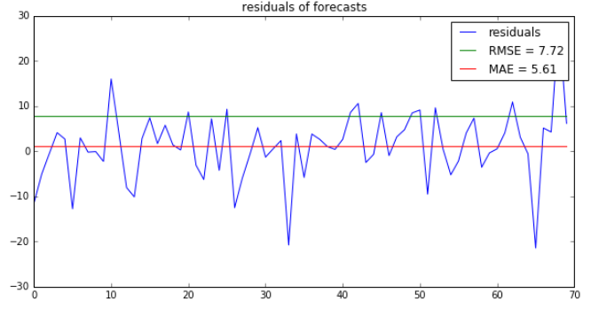
Regression – Random Forest Regressor

Slide 12
Conclusion
Final Remarks
Though it captures the general trend of our data, the Random Forest Regressor Model did not predict the callback volume sufficiently to rely on it as a business tool.
It is very likely that the weather is simply not correlated enough to callback volumes to use as a valid predictor. This could be investigated further through significance testing.
It is also very likely that we got almost all of our predictive power only from the day of the week, since its relative importance was roughly 5x that of the other features
NEXT STEPS
Generate a different set of weather statistics which more accurately capture extreme weather changes between service visits and treat the situation as a classification problem rather than a regression problem by predicting whether a given unit will experience a callback during a given week
Investigate time-series models

