Slide 1
CD/CI and monitoring
DevOps taks

Slide 2
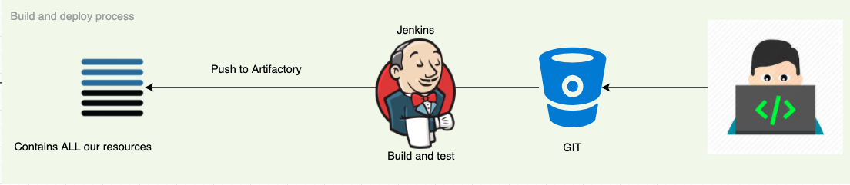
CD/CI Pipeline
Build process:
Developers push code to git
Jenkins build is triggered
Artifact is stored

Slide 3
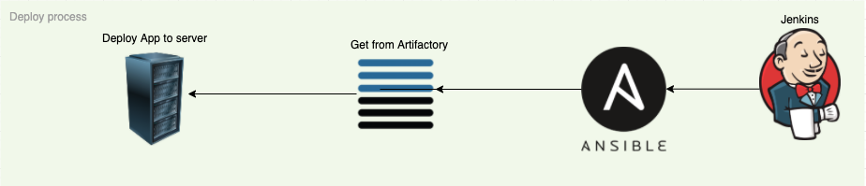
CD/CI Pipeline
Deploy process
Jenkins deploy is triggered (manual or automatic from git)
Ansible code is downloading already compiled resources from artifactory
The code and configuration is deployed to the server

Slide 4
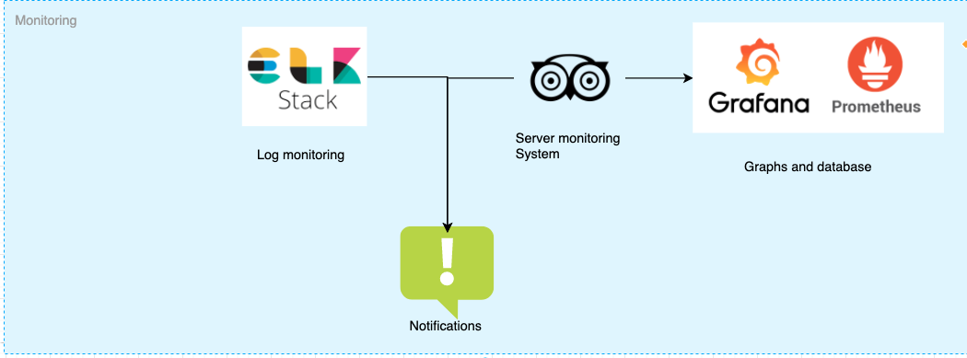
Monitoring solution
Installing and configuring different monitoring agents can happen with ansible
Creating dashboards and graphs is easy with grafana

