Slide 1

Soccernomics
Do Passion, GDP and Population Predict Soccer Success

Slide 2

Problem Statement
Soccernomics
Authored by Kuper & Szymanski
Postulates that soccer success is based on:
GDP (Wealth)
Population Size
Experience
ARE THEY CORRECT? Let the data speak.

Slide 3
Uniqueness of Problem/Approach
Model was based on:
National teams past performance (Experience)
Gross Domestic Production (Wealth)
The size of a country’s population (player pool)
Popularity of soccer in each country
Generational Player

Slide 4
Approach
Research
Model Selection
Results
Data Collection
Build several different models
Pick the top performer
Split the data into training and testing sets
Choose the final model
Train the model
Analyze the results
Determine if additional data points are required
Research previous similar work
Develop hypothesis
Scrape the data from the web sites
Transform the data

Slide 5
Expected Challenges
We’ll be working with disparate data sets
Soccer stats (Elo and FIFA)
Economic data (World Bank)
GDP data (World Bank)

Slide 6
Data Issues Encountered
The best source of game data was from www.elorating.net
There was no easy download option. Data needed to be scraped year by year
Scraped from web site and pasted it into Excel.
Because of the way the data was formatted it pasted vertically
Needed to transpose it into one single line
Wrote script to parse the ONE line and paste the selection into a new line
Found out that Excel has a limit of around 16,000 columns
Dates needed to be formatted because they all pasted in as 2018 dates
Minus signs needed to be converted for Excel to recognize negative numbers

Slide 7
Models Used

Slide 8
Model Tuning

Slide 9
Forecasting Accuracy

Slide 10
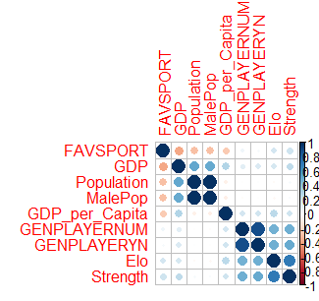
Correlation Amongs Predictors

Slide 11
10,000 Hour Rule - $15,000 Rule
10,000 hours – Practice makes perfect
Small apartments force poorer kids to spend more time outdoors
They don’t have funds to have expensive hobbies
Soccer is cheap – you need a ball
$15,000
Having a lot of free time won’t help if you are undernourished
Caveat: Poor means an annual income of at least $15,000

Slide 12
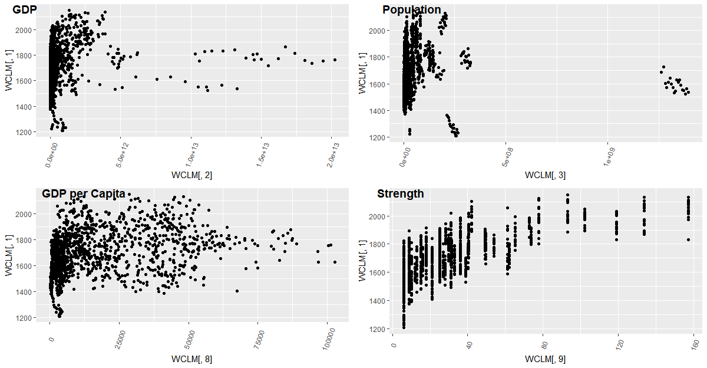
Correlation

