Slide 1
Web APIs

Slide 2
What is an API?
It stands for “Application Programming Interface”
That sounds pretty generic...
it is! (on purpose)

Slide 3
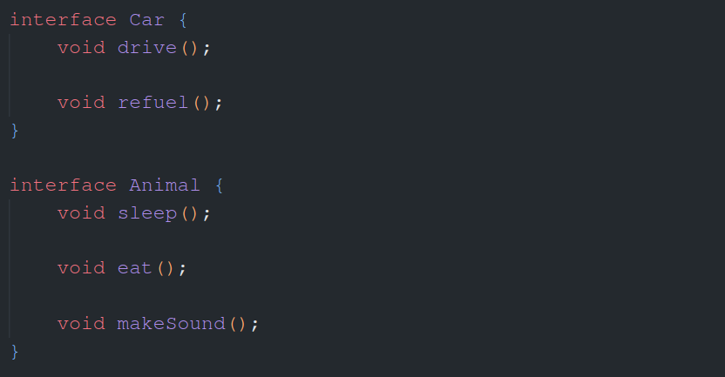
Remember these?
An interface is just a set of rules that we make as a programmer

Slide 4
Curl Example
curl http://localhost:3000/ -vv

