Slide 1
TASK-3

Slide 2
TITLE- Cross Site Scripting(XSS)
Domain- vulnweb.com Subdomain- testasp.vulnweb.com STEPS TO REPRODUCE
1. Go to website http://testasp.vulnweb.com/ 2. Then click on search option in the top menu. 3. Type <script src=1 href=1 onerror="javascript:alert(1)"></script> in the search box. 4. A prompt screen will appear with an error of 1.
IMPACT The impact of XSS vulnerability on a web application can vary depending on the specific attack. By executing script code, attacker’s can steal session cookies and perform session hijacking to impersonate the victim or take over their account. It can lead to the disclosure of sensitive data, CSRF () attacks or even malware installation.
PREVENTION Utilization of Content Security Policy provides additional levels of protection and mitigation against XSS attempts and encoding output to prevent potentially malicious user-provided data from triggering automatic load and execute behaviour by a browser.

Slide 3
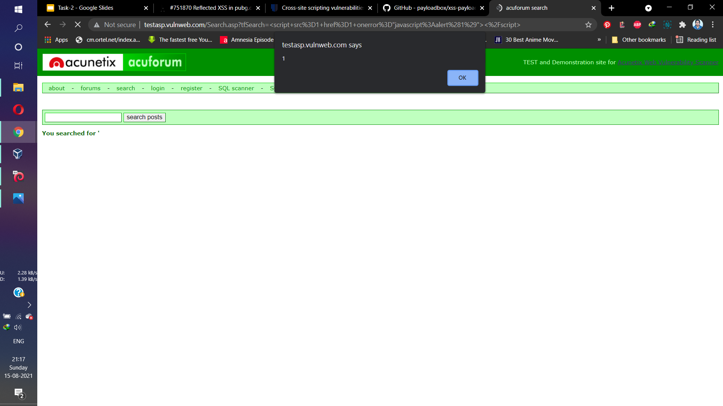
PoC

Slide 4

Video Demonstration

