Slide 1
Task-2

Slide 2
Steps to reproduce
1. Open Netsparker 2. Add http://zero.webappsecurity.com/ to the dialogue box and select the default security checks in the options part. Then start the scan. 3. It will automatically start scanning and show all the vulnerabilities according to the most critical and then in decreasing order.

Slide 3
TITLE-Found an old version of Apache in http://zero.webappsecurity.com/
Impact An out-of-date version of Apache 2.2.6 can lead to many vulnerabilities. (a)Cross Site Scripting- It can allow remote attackers to insert arbitrary HTML via the URL. (b)Cross-site Request Forgery- It can allow attackers to gain privileges via undefined vectors. (c)Code Injection- The existence of code syntax in the users data increases attacker's possibility to change the planned control conduct and execute arbitrary code. These are some of the vulnerabilities that can happen because of the old version.
Remedy Updation of database Apache to 2.4.48 can solve this vulnerability.

Slide 4
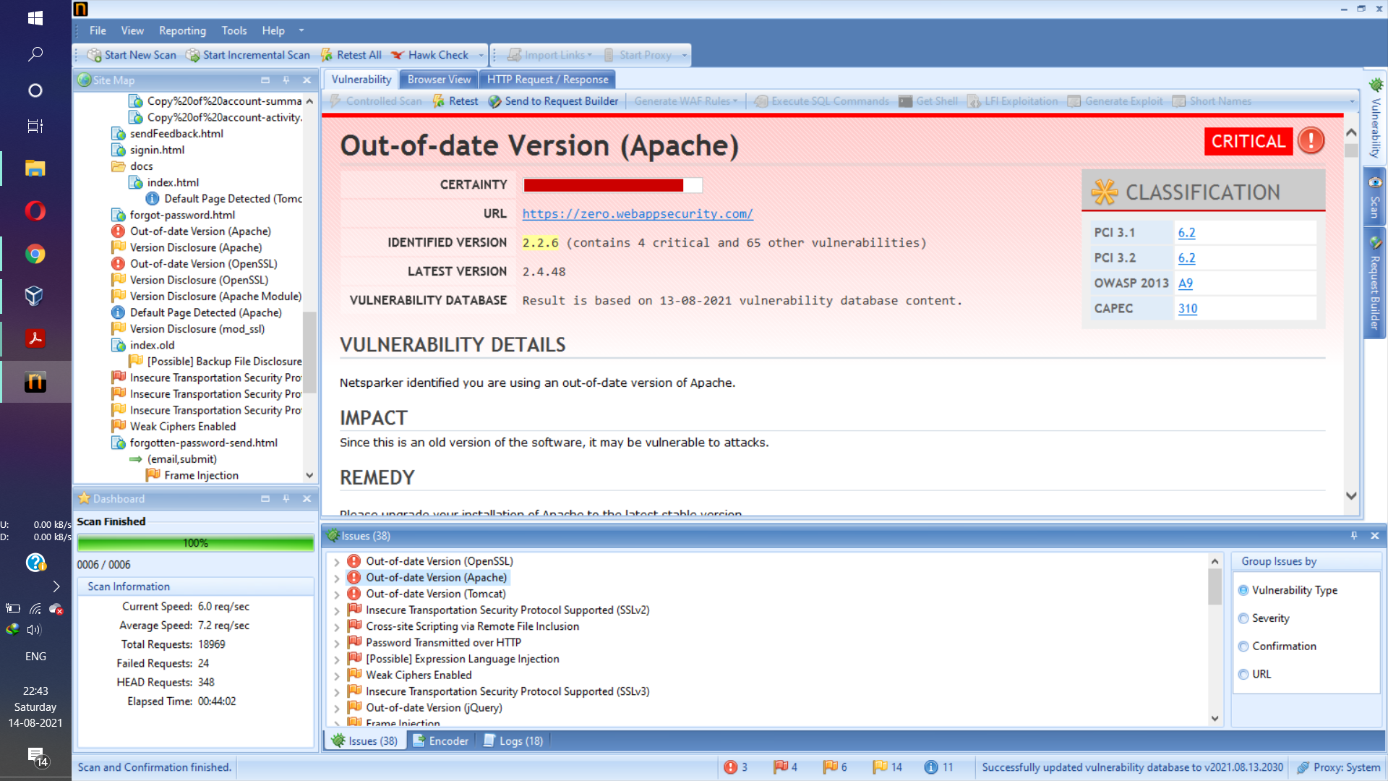

Slide 5


Slide 6


