Slide 1
Comparing Neural Networks for NHL Performance Forecasting
Group ID: 44
Trevor Lee - 100751771
Notes:
My name is Trevor Lee and this is my project presentation for comparing Neural Networks for NHL Performance Forecasting

Slide 2
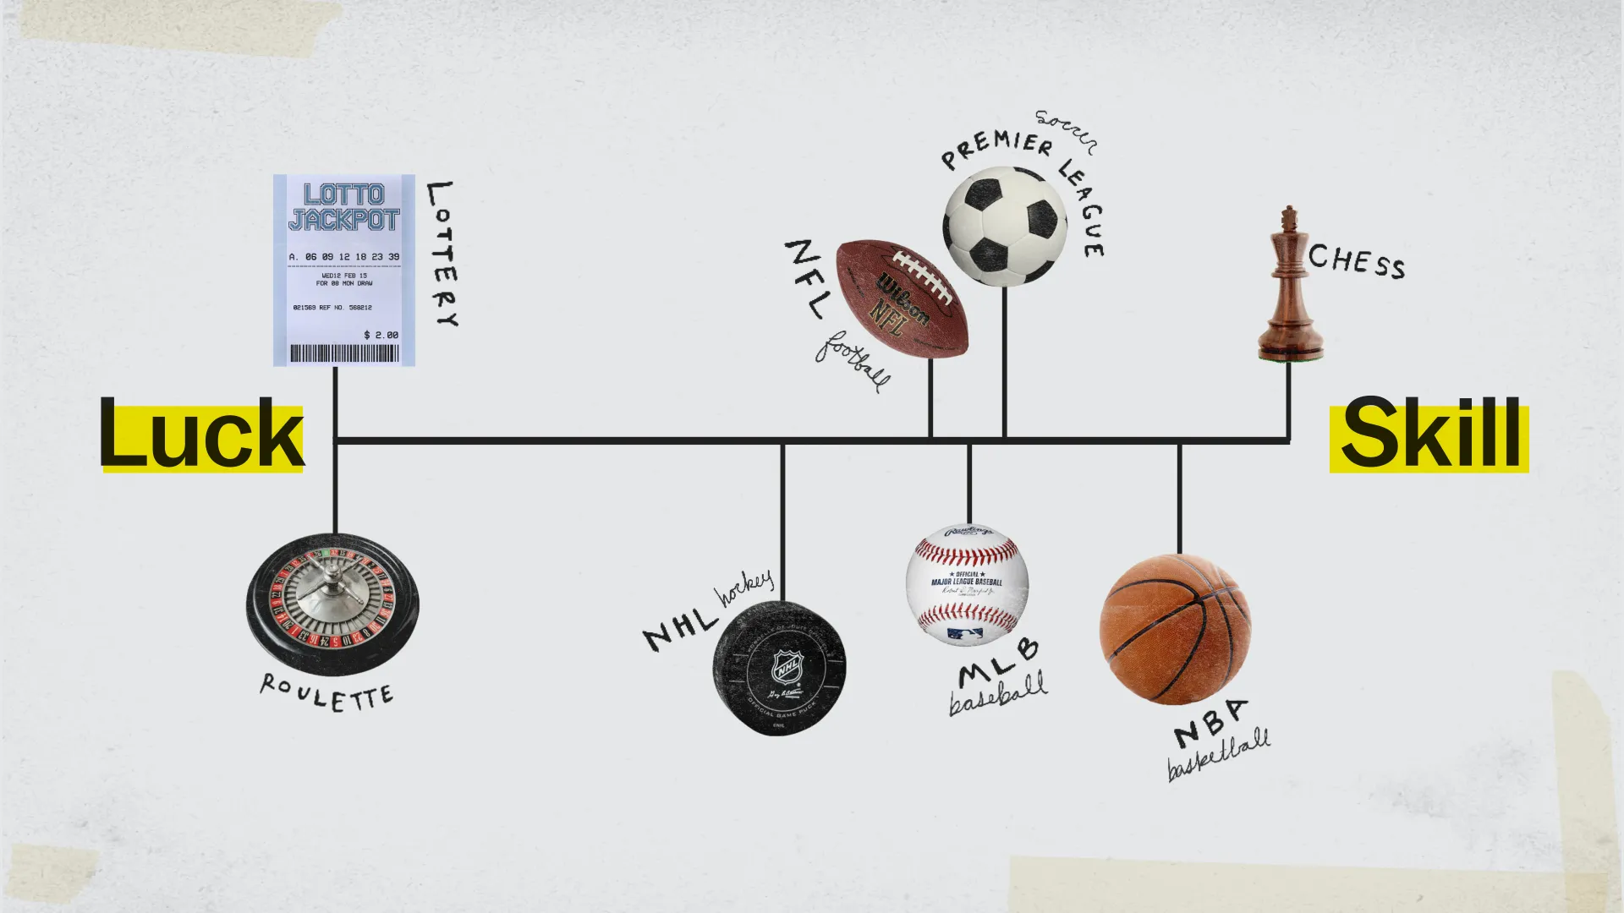
The Problem
Objective: predict next-season NHL player performance based on their prior 3 seasons
  Stats in sports can be volatile, especially hockey
  Want to see if we can make a viable solution
Method: use MLP, RNN, LSTM, and a LSTM-MLP hybrid
Michael Mauboussin’s skill-luck continuum https://www.vox.com/videos/2017/6/5/15740632/luck-skill-sports
Notes:
The objective of this project is to predict an NHL player’s performance next season given their past 3 seasons.
Stats in sports are hard to predict, especially hockey.
Players are prone to injury due to being a high contact sport, and it widely considered more luck-based than the other major sports.
To perform these predictions, I used MLP, RNN, LSTM, and a mix of LSTM and MLP

Slide 3
Dataset
Source: Kaggle – NHL Player Statistics by Benzik
Spans roughly 1979-80 to 2019-20
Contains rows of box score stats, player details, and more per player-season
Processed:
  Removed goalies
  Trimmed columns
  Merge season stats when player was on multiple teams
  Flattened 3-year stat lines
Notes:
A quick overview of the dataset her.
It spans the 1979-80 season to the 2019-20 season, containing box score stats and player info among other things for each player’s season.
The data was processed prior to use so it was easier to input into the models.
Goalies were removed because they use different stats than skaters which are not comparable.
Incomplete data or info deemed irrelevant or redundant was trimmed away.
Players would appear twice per season if they switched teams for any reason mid-season. These lines were merged, and then the data was flattened to lines that contain 3 years of box score stats rather than one.

Slide 4
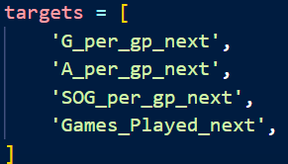
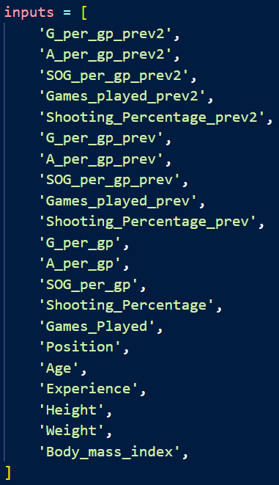
Training Features
Targets (y):
  Per game rates of goals, assists, shots on goal (SOG) for the next season and total games played
Inputs (x):
  Per game rates of goals, assists, shots on goal (SOG), as well as the shooting percentage and games played for the current season and previous 2 seasons
  Player info (position, age, experience, height, weight, BMI)
Notes:
The target stats were goals, assists, and shots on goal, all on a per game basis as well as total games played.
The inputs to predict the targets are the aforementioned stats for the current season and the previous 2 seasons as well as some relevant player info.

Slide 5
Training
Nearly identical functions to assignment 3
  Modified to record error instead of accuracy
  Learning rate of 1e-3
  100 epochs
Notes:
The functions used in training the models are nearly identical to those used in assignment 3 with some from assignment 2.
These were just modified to record error instead of accuracy since we are predicting numerical values instead of classifying.

Slide 6

Models
MLP
  Connected layers on a flattened input
RNN
  3 season sequence
LSTM
  Same as RNN but with LSTM instead
LSTM + MLP
  LSTM but passed through an MLP head instead of a single Linear Layer
Notes:
A reminder of the models I used.
MLP, , RNN, LSTM, and an LSTM MLP hybrid

Slide 7
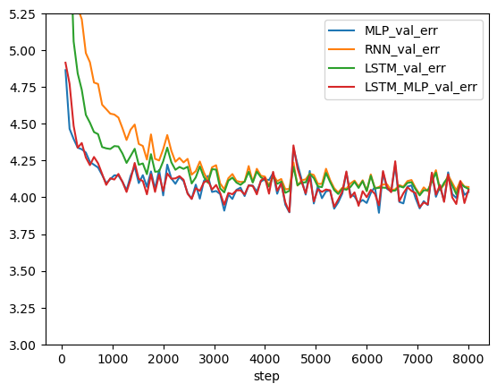
Comparison
MLP models converge faster
MLP models spike more
Notes:
The models utilizing MLP seemed to converge lower and faster than RNN and LSTM.
The spikes on the graph are due to the model architecture with RNN and LSTM learning less heavily from one sample.

Slide 8
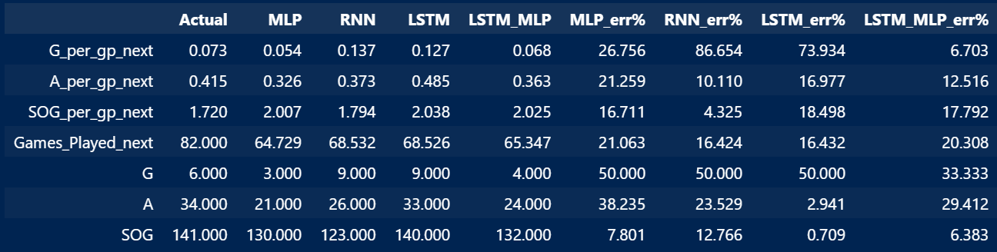
Application – Duncan Keith – 2018-19
Aging case – age 35
Inaccurate goal rates – small denominator
LSTM + MLP preformed best
Notes:
We will quickly run through the results of our practical application.
Duncan Keith was used as a case of an aging player.
The inaccurate goal rates are largely due to the initial prediction having a very small value, giving us a small denominator for calculation.
Here, our hybrid model performed best.

Slide 9
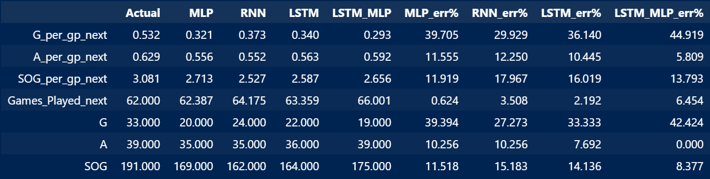
Application – Evgeni Malkin – 2016-17
Injury history case – consistently fewer than 70 GP
Poor goal rate prediction
Good GP predictions
No clear winner
Notes:
Malkin was chosen as a case of a frequently injured player.
The goal rate prediction was poor. It predicted a regression from the sample despite him being in his prime years.
But the models seemed to take injury history into account based on the Games Played prediction,

Slide 10
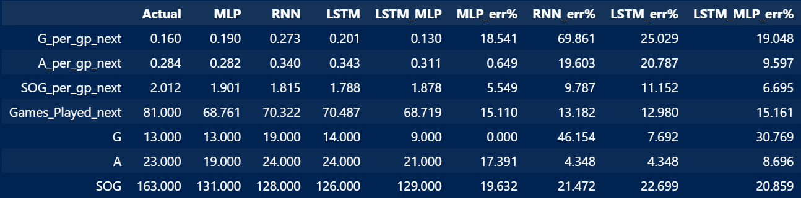
Application – Lars Eller – 2017-18
Depth player example
Poor goal predictions again
Poor GP prediction
MLP wins
Notes:
Eller was an example of a depth player.
The goal prediction was bad again and his games played prediction was poor too for a player who is historically durable.

Slide 11
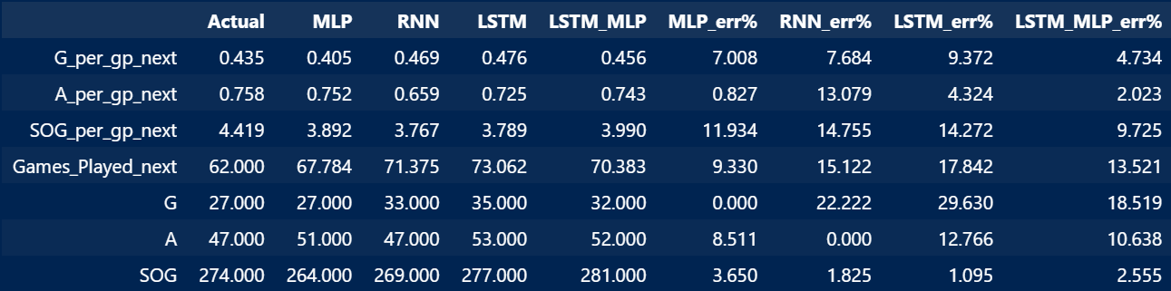
Application – Jack Hughes – 2024-25
Emerging star
Injury history
More accurate – larger denominators
MLP models performed best
Notes:
Hughes is an example of an emerging star who also had an injury history.
The larger numbers make the predictions look more accurate for the opposite reason compared to Keith, giving larger denominators.

Slide 12
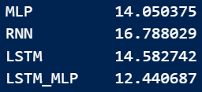
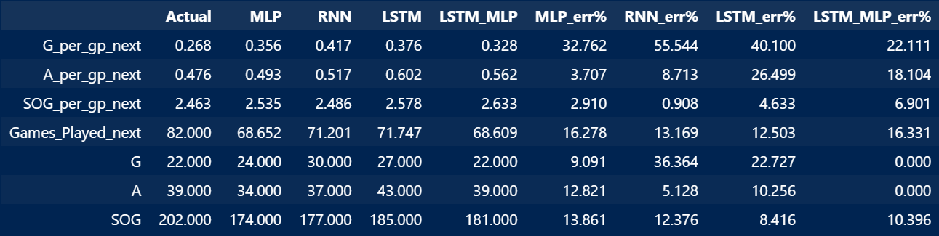
Application – Jared McCann – 2024-45
Outlier shooting percentage
Goals look off – look back at shooting percentage
GP not good
MLP clear best
Notes:
McCann is an example of a player who had a high shooting percentage.
The goals look off but in actuality, the model predicted close to his career norm of 13% and he had a down year shooting 10%.

Slide 13
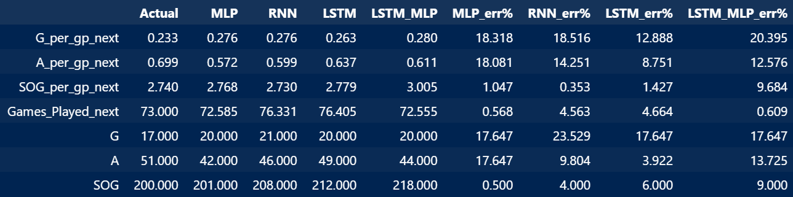
Application – Rasmus Dahlin – 2024-25
Prime-aged star defender
Very accurate
No clear winner
Notes:
Dahlin was a sample of a prime-aged star defender.
All the models did fairly well with him.

Slide 14
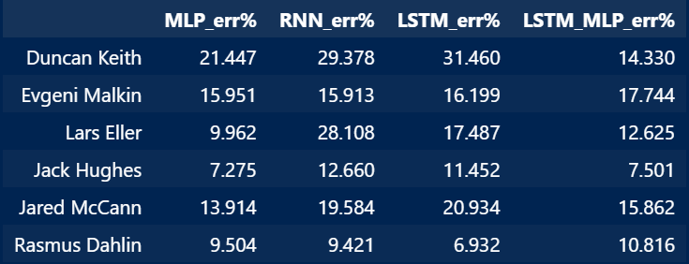

Analysis
MLP performed best on half the players
LSTM + MLP most consistent
MLP performed best in test
  LSTM + MLP close behind
Notes:
Overall, MLP performed best on half of our sample and was best overall with 13% average error.
Our hybrid model was more consistent than accurate and not far behind in the results.

Slide 15
Discussion
RNN and LSTM didn’t have enough data to shine
  Only 3 seasons
  Conditioned data
  Small dataset
Improvements
  Context
  Flags
  Details
  More data
Notes:
This is likely because RNN and LSTM didn’t have enough data over this small sample to really shine.
Not all players over the span appear to have been recorded in the dataset and we only took 3-season sample instead of a whole career.
Looking back, most of the improvement to be made boils down to adding more data, whether through volume or detail.

