Slide 1
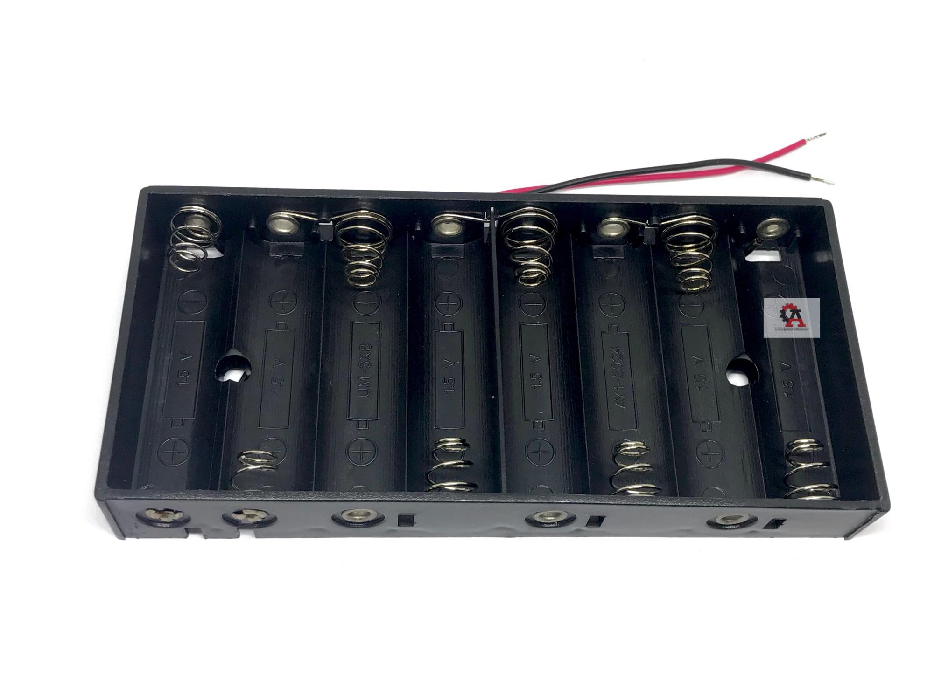
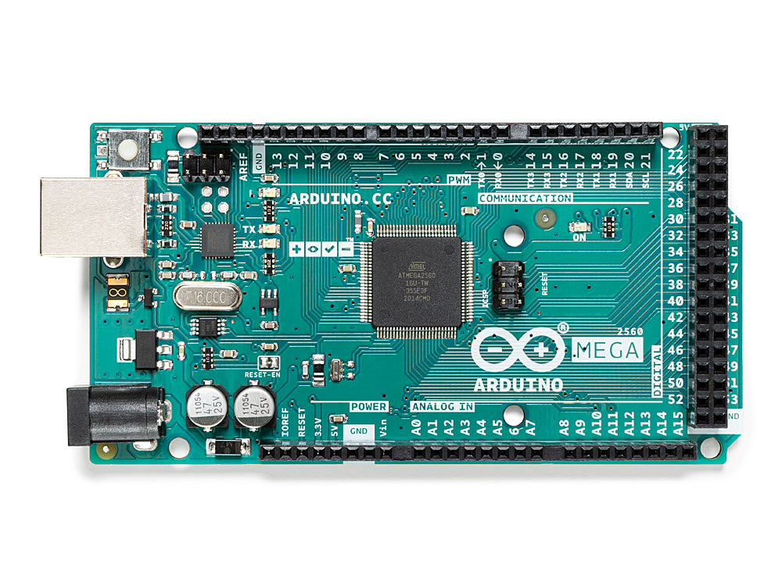
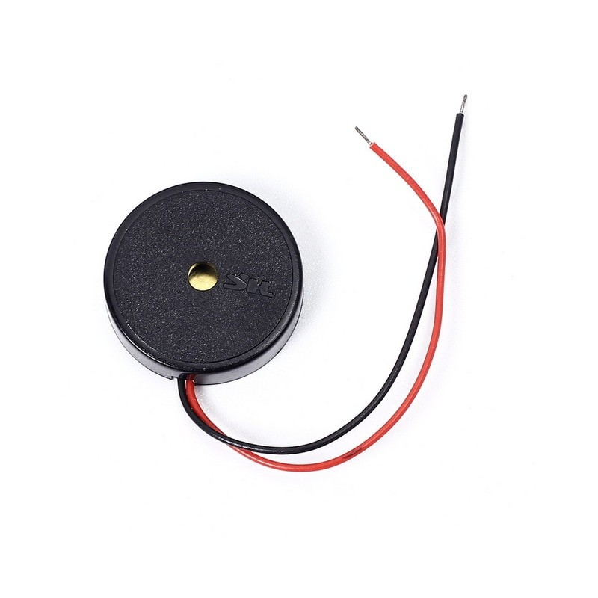
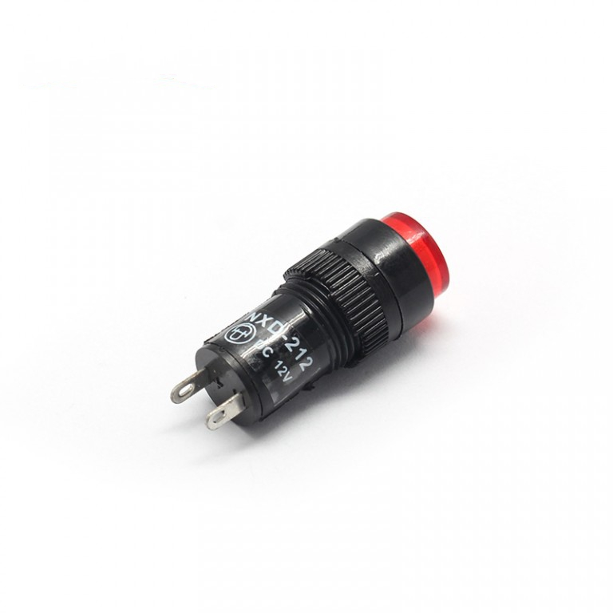
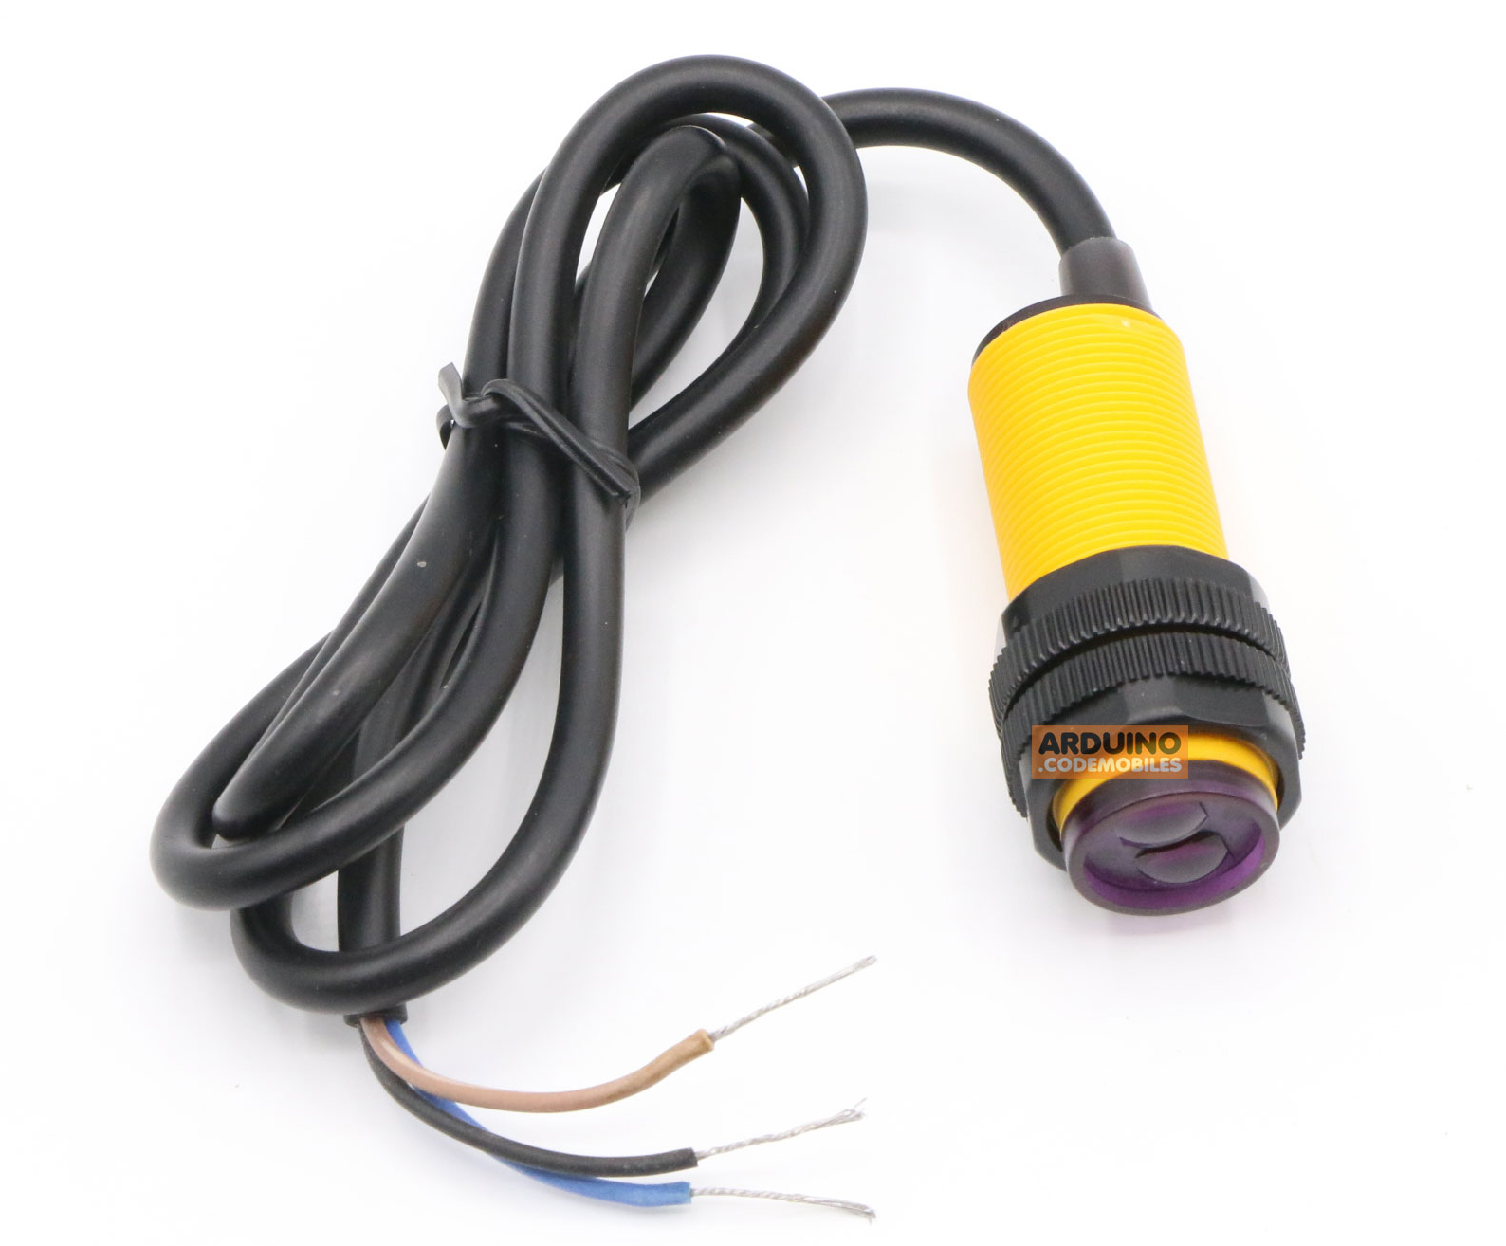
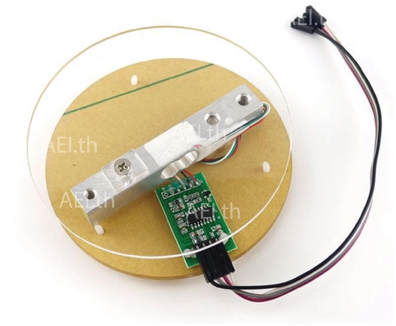
Battery Box AA x8
VCC (+12V)
GND
Arduino Mega 2560
Buzzer
Signal
Pilot lamb
VCC
GND
GND
VCC (+12V)
GND
Battery Box AA x8
Photoelectric switch sensor
GND
GND
Photoelectric switch sensor
OUT
VCC
VCC
OUT
Load cell
Load cell
VCC
VCC
GND
GND
SCK
DT
SCK
DT
Load cell
VCC
VCC
Load cell
GND
GND
SCK
SCK
DT
DT
Load cell
VCC
Load cell
GND
VCC
SCK
GND
DT
SCK
DT

Slide 2
Battery Box AA x8
VCC (+12V)
GND
Arduino Mega 2560
VCC (+12V)
GND
Battery Box AA x8
Photoelectric switch sensor
GND
GND
Photoelectric switch sensor
OUT
VCC
VCC
OUT

Slide 3
Battery Box AA x8
VCC (+12V)
GND
Arduino Mega 2560
Pilot lamb
VCC
GND
VCC (+12V)
GND
Battery Box AA x8

Slide 4
Battery Box AA x8
VCC (+12V)
GND
Arduino Mega 2560
VCC (+12V)
GND
Battery Box AA x8
Load cell
Load cell
VCC
VCC
GND
GND
SCK
DT
SCK
DT
Load cell
VCC
VCC
Load cell
GND
GND
SCK
SCK
DT
DT
Load cell
VCC
Load cell
GND
VCC
SCK
GND
DT
SCK
DT

