Slide 1
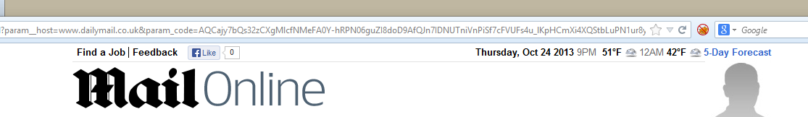
GET http://tags.crwdcntrl.net/c/991/cc.js?ns=_cc991 HTTP/1.1
…
Referer: http://www.dailymail.co.uk/registration/social/register.html?param__host=www.dailymail.co.uk&param_code=AQCajy7bQs32zCXgMlcfNMeFA0Y-hRPN06guZI8doD9AfQJn7IDNUTniVnPiSf7cFVUFs4u_lKpHCmXi4XQStbLuPN1ur8ynzVY8zqENn3NK3UEK1S0AXeExzlRfUVCbilOler5YImj2HGak86kGzZcfuby3ATyJsEQTdc1fXmnw_nruVXj-jSiNiEKYuyOXQNfAYGDezZZkQe_81agmv7FxcgS9mUspWrnnHLi1nP_9ZpyBU5dUeMTsPV9qXbp3Vs2_3CcMVzd7Sma0s8A1xR-IH-D_Y9E96mdT_LKKU8lV_T-ZrphLCwYmj9PXXGZ9wrI

