Slide 1
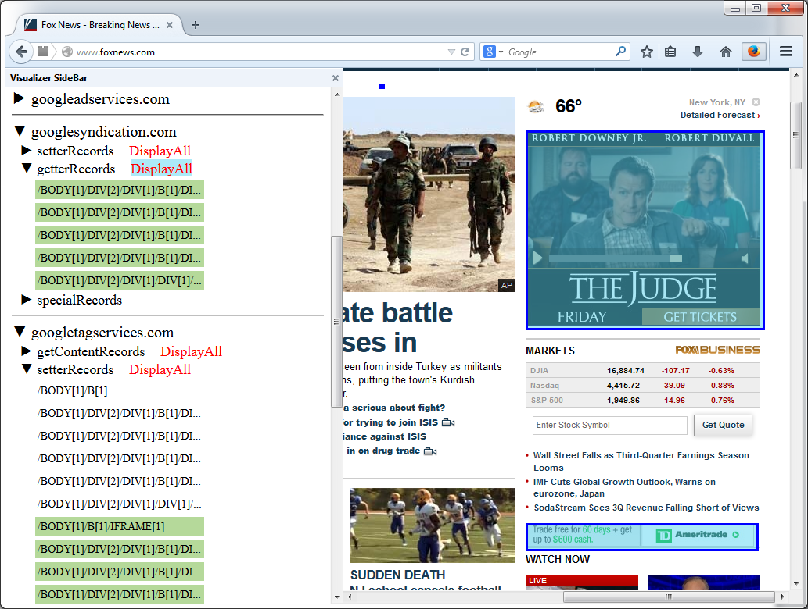
Owned nodes
Displaying entries/nodes

Slide 2
3P Owned ([o]) nodes
Displaying nodes

Slide 3
3P Owned ([o]) nodes
Displaying nodes

