Slide 1
Queen – The Rock Band
History , Members and Albums

Slide 2
Lunguleasa Eugen Alexandru
A presentation by

Slide 3
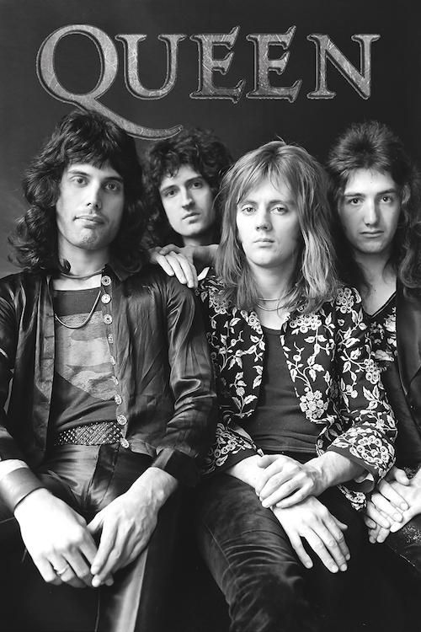
History of Queen
Queen are a British rock band formed in London in 1970.
- Their classic line-up was Freddie Mercury , Brian May , Roger Taylor and John Deacon
Their earliest works were influenced by progressive rock, hard rock and heavy metal, but the band gradually ventured into more conventional and radio-friendly works by incorporating further styles, such as arena rock and pop rock.

Slide 4
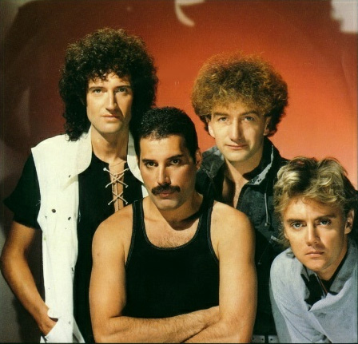
The Members
Freddie Mercury :
- lead vocals
- piano
Brian May :
- guitar
- vocals
Roger Taylor :
- drums
- vocals
John Deacon :
- bass

Slide 5
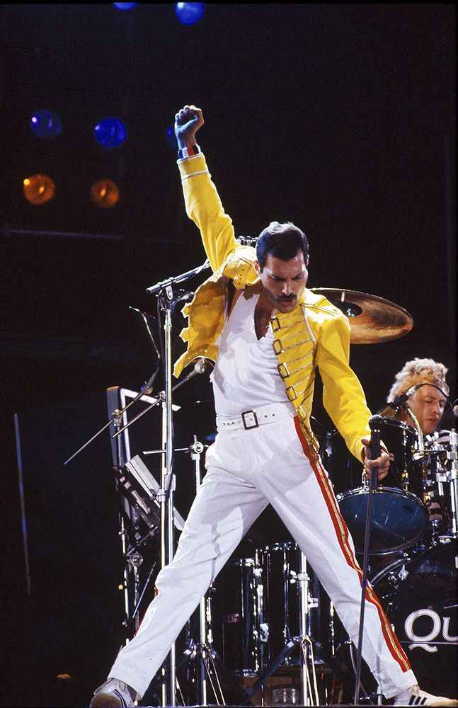
Freddie Mercury
- Freddie Mercury was born on 5th September 1946 as Farrokh Bulsara in Zanzibar to Parsi-Indian parents, he attended English-style boarding schools in India from the age of eight and returned to Zanzibar after secondary school. In 1964, his family fled the Zanzibar Revolution, moving to Middlesex, England. Having studied and written music for years, he formed Queen in 1970 with guitarist Brian May and drummer Roger Taylor. Mercury wrote numerous hits for Queen, including "Killer Queen“ , "Bohemian Rhapsody“ , "Somebody to Love“ , "We Are the Champions“ , "Don't Stop Me Now“ , and "Crazy Little Thing Called Love“ .
His charismatic stage performances often saw him interact with the audience, as displayed at the 1985 Live Aid concert. He also led a solo career and served as a producer and guest musician for other artists.
He was known for his flamboyant stage personality and four-octave vocal range.
Mercury died in 1991 at the age of 45 due to complications from AIDS. He confirmed the day before his death that he had contracted the disease, having been diagnosed in 1987. Mercury had continued to record with Queen following his diagnosis, and he was posthumously featured on the band’s final album, Made in Heaven (1995). In 1992, his tribute concert was held at Wembley Stadium. His career with Queen was dramatised in the 2018 biopic Bohemian Rhapsody.

Slide 6
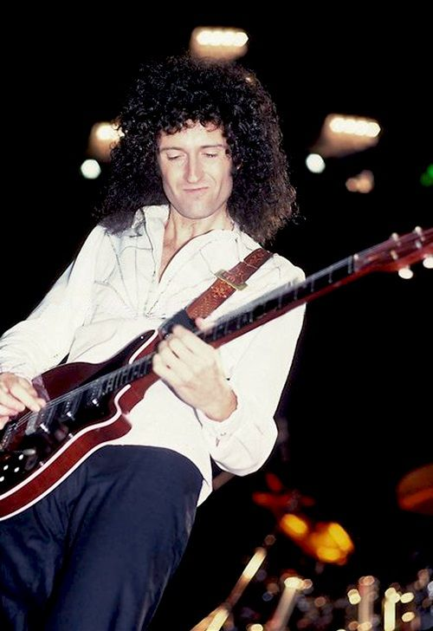
Brian May
- Brian Harold May was born on 19 July 1947 in a nursing home at Hampton Hill, Twickenham.
- May was a co-founder of Queen with lead singer Freddie Mercury and drummer Roger Taylor, having previously performed with Taylor in the band Smile, which he had joined while he was at university
As a member of Queen, May became regarded as a virtuoso musician and he was identified with a distinctive sound created through his layered guitar work, often using a home-built electric guitar called the Red Special. May wrote numerous hits for Queen, including "We Will Rock You", "I Want It All“ , "Fat Bottomed Girls“ , "Flash“ , "Hammer to Fall“ , "Save Me“ , "Who Wants to Live Forever“ , "Too Much Love” , Will Kill You“ and "The Show Must Go On".
May was appointed a CBE by Queen Elizabeth II in 2005 for "services to the music industry and for charity work". May earned a PhD in astrophysics from Imperial College London in 2007, and was Chancellor of Liverpool John Moores University from 2008 to 2013. He was a "science team collaborator" with NASA's New Horizons Pluto mission. He is also a co-founder of the awareness campaign Asteroid Day. Asteroid 52665 Brianmay was named after him. May is also an animal rights activist, campaigning against the hunting of foxes and the culling of badgers in the UK.

Slide 7
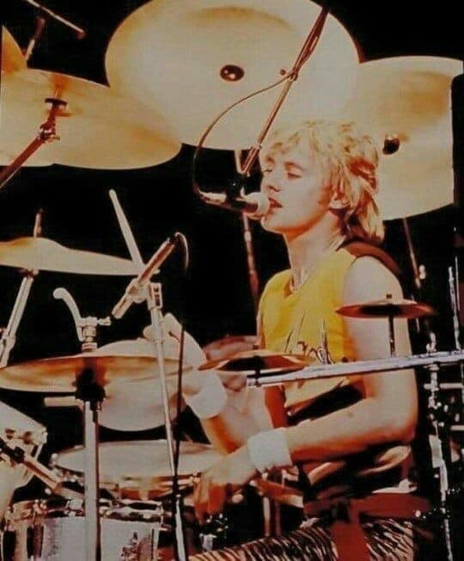
Roger Taylor
- Roger Taylor was born on 26 July 1949 at West Norfolk & Lynn Hospital in King's Lynn, Norfolk.
When he was seven years old, he and some friends formed his first band, the Bubblingover Boys, in which he played the ukulele.
At the age of 15, Taylor became a member of the Reaction, a semi-professional rock band formed mainly of boys from Truro School.
As a drummer, Taylor was recognised early in his career for his unique sound. He was voted by radio listeners as the eighth-greatest drummer in classic rock music history.
As a songwriter, Taylor contributed songs to Queen's albums from the beginning, composing at least one track on every album, and often singing lead vocals on his own compositions. He wrote or co-wrote three UK number ones ("These Are the Days of Our Lives", "Innuendo" and "Under Pressure") and contributed to a further five major hits ("Radio Ga Ga“ , "A Kind of Magic“ , "Heaven for Everyone“ , "Breakthru", and "The Invisible Man").
In addition to his drum work, Taylor is well known for his falsetto vocal range. He sometimes played keyboards, guitars and bass on his own songs.

Slide 8
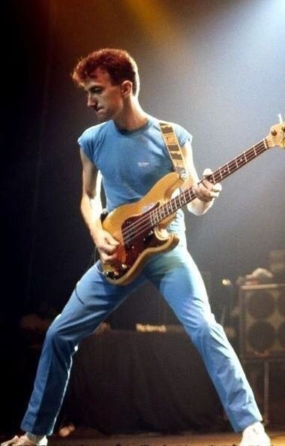
John Deacon
- John Richard Deacon was born on 19 August 1951 at St. Francis Private Hospital, London Road, Leicester to Arthur Henry and Lilian Mollie Deacon.
Deacon joined his first band, The Opposition, in 1965 at the age of 14. The band played covers of chart hits; Deacon played rhythm guitar using an instrument he had bought with money borrowed from the group's founder, Richard Young. He switched to bass the following year after the original bassist was fired for not improving his playing as much as the other members.
In early 1971, Deacon was introduced to Taylor and May by a friend at a disco who told him that they were in a band that had just lost its bassist. A couple of days later he auditioned in a lecture room at Imperial College London and became the last member of Queen to join
On Queen's first album (1973) he was credited as "Deacon John",in order to make him "sound more interesting". He asked to be credited under his real name, which was done on all albums from Queen II (1974) onwards
He composed several songs for the group—including Top 10 hits "You're My Best Friend“ , "Another One Bites the Dust“ and "I Want to Break Free“ ; co-wrote "Under Pressure“ , "Friends Will Be Friends" and "One Vision” —and was involved in the band's financial management.

Slide 9
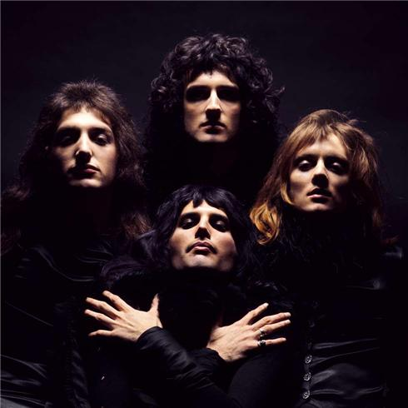
Career and Albums
In 1973, the band began to concentrate on their career, releasing their debut album, Queen, that year and setting out on their first tour. Produced by the band, along with Roy Thomas Baker and John Anthony, Queen was more or less a straight metal album and drew favorable comparisons to Led Zeppelin.
However, it was with their sophomore album, Queen II, that the band unexpectedly broke through in Britain in early 1974. Before its release, the band played on Top of the Pops, performing "Seven Seas of Rhye" . Both the song and the performance were smash successes, and single rocketed into the Top Ten, setting the stage for Queen II to reach number five. Following its release, the group embarked on its first American tour, supporting Mott the Hoople. On the strength of their campily dramatic performances, the album climbed to number 43 in the States.
Queen released their third album, ”Sheer Heart Attack” , before the end of 1974. The song "Killer Queen" climbed to number two on the U.K. charts, taking the album to number two as well. Sheer Heart Attack made some inroads in America, setting the stage for the breakthrough of 1975's ”A Night at the Opera”. Queen labored long and hard over the record; according to many reports, it was the most expensive rock record ever made at the time of its release. The first single from the record, "Bohemian Rhapsody," became Queen's signature song.
Queen were at the height of their popularity as they entered the '80s, releasing ”The Game” , their most diverse album to date, in 1980. On the strength of two number one singles -- the rockabilly-inspired "Crazy Little Thing Called Love" and the disco-fied "Another One Bites the Dust" -- The Game became the group's first American number one album.

Slide 10
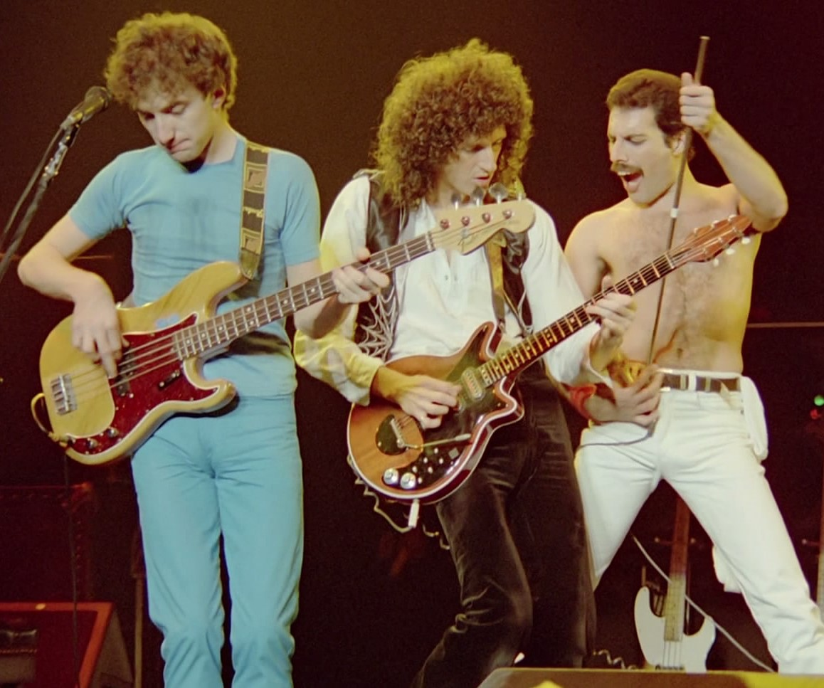
Important Concerts
1 – Live Aid, Wembley, London, July 13th, 1985, “The Works Tour”
2 – Rock In Rio, Rio De Janeiro, January 12th, 1985, “The Works Tour”
3 – Morumbi Stadium, São Paulo, Brazil, March 20th, 1981, “The Game Tour”
4 -Hyde Park, London , September 18th, 1976, “A Day At The Races Tour”
5 – Estadio José Amalfitani, Buenos Aires, Argentina, February18th,1981, “The Game Tour”
6 – Wembley, London, July 12th, 1986, “Live Magic Tour”
7 – Nepstadium, Budapest, Hungary July 27th, 1986, “Live Magic Tour”
8 – National Bowl, Milton Keynes, June 5th, 1982, “Hot Space Tour”
9 – Rainbow Theatre, London, March 31st 1974, “Queen II Tour”
10 – Madison Square Garden, New York, May 2nd 1977, “A Day At The Races Tour”

Slide 11
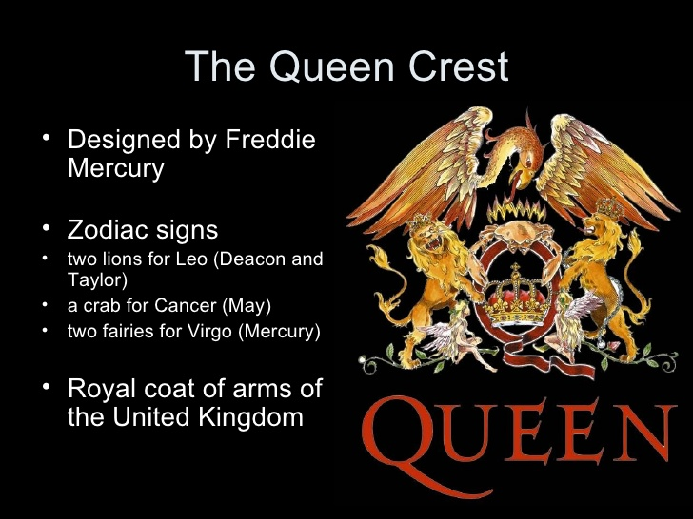
Slide Title

Slide 12
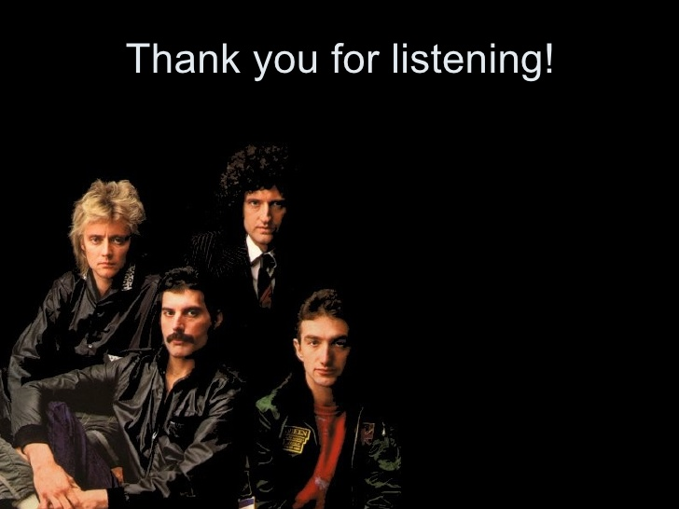
Slide Title

