Slide 1
Software development
Lunguleasa Eugen Alexandru

Slide 2
TABLE OF CONTENTS
01
02
03
Introduction
What is A Software
What is a Software developer

Slide 3
TABLE OF CONTENTS
04
05
06
Importance of Software Development
History of software
Conclusion & Resources

Slide 4
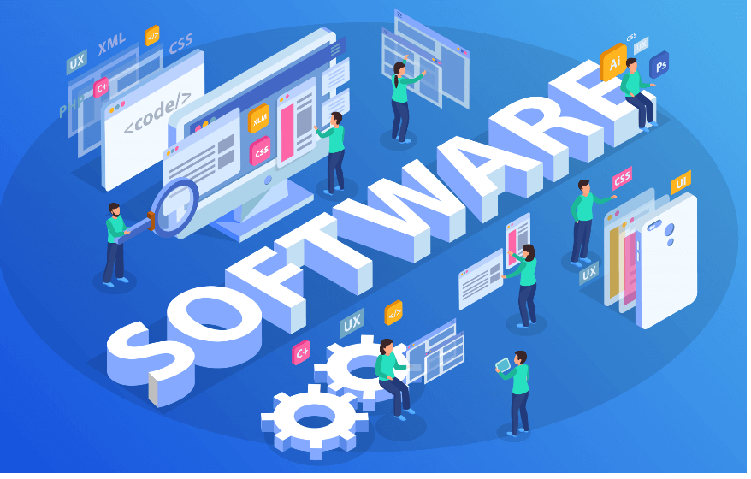
1.Introduction
Software development is the process of conceiving, specifying, designing, programming, documenting, testing, and bug fixing involved in creating and maintaining applications, frameworks, or other software components.

Slide 5
PROJECT GOALS
developer
software
The person that writes a code and creates programms
The code, application or programm

Slide 6
2.What is a SoftAware
Software is a collection of instructions that tell a computer how to work. This is in contrast to hardware, from which the system is built and actually performs the work.

Slide 7
At the lowest programming level, executable code consists of machine language instructions supported by an individual processor—typically a central processing unit (CPU) or a graphics processing unit (GPU). Machine language consists of groups of binary values signifying processor instructions that change the state of the computer from its preceding state. For example, an instruction may change the value stored in a particular storage location in the computer—an effect that is not directly observable to the user. An instruction may also invoke one of many input or output operations, for example displaying some text on a computer screen; causing state changes which should be visible to the user.
The majority of software is written in high-level programming languages. They are easier and more efficient for programmers because they are closer to natural languages than machine languages. High-level languages are translated into machine language using a compiler or an interpreter or a combination of the two. Software may also be written in a low-level assembly language, which has a strong correspondence to the computer's machine language instructions and is translated into machine language using an assembler.

Slide 8
3.What is a Software Developer
Software development involves writing and maintaining the source code, but in a broader sense, it includes all processes from the conception of the desired software through to the final manifestation of the software, typically in a planned and structured process .Software development also includes research, new development, prototyping, modification, reuse, re-engineering, maintenance, or any other activities that result in software products.

Slide 9
Software can be developed for a variety of purposes. The three most common purposes are:
to meet specific needs of a specific client or organization (known as custom software)
to meet a perceived need of some set of potential users (known as commercial software )
for personal use (e.g. a scientist may write software to automate a mundane task)
A software development process (also known as a software development methodology, model, or life cycle) is a framework that is used to structure, plan, and control the process of developing information systems. A wide variety of such frameworks has evolved over the years, each with its own recognized strengths and weaknesses. There are several different approaches to software development: some take a structured, engineering-based approach to developing software, whereas others may take an incremental approach, where software evolves as it is developed piece-by-piece. One system development methodology is not necessarily suitable for use by all projects. Each of the available methodologies are best suited to specific kinds of projects, based on various technical, organizational, project, and team considerations.

Slide 10
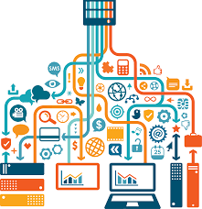
4.History of Software
An algorithm for what would have been the first piece of software was written by Ada Lovelace in the 19th century, for the planned Analytical Engine. She created proofs to show how the engine would calculate Bernoulli numbers.Because of the proofs and the algorithm, she is considered the first computer programmer.

Slide 11
The first theory about software, prior to the creation of computers as we know them today, was proposed by Alan Turing in his 1935 essay, on Computable Numbers, with an Application to the Entscheidungsproblem (decision problem).This eventually led to the creation of the academic fields of computer science and software engineering; both fields study software and its creation. Computer science is the theoretical study of computer and software (Turing's essay is an example of computer science), whereas software engineering is the application of engineering principles to development of software. Prior to 1946, software was not yet the programs stored in the memory of stored-program digital computers, as we now understand it; the first electronic computing devices were instead rewired in order to "reprogram" them.
In 2000, Fred Shapiro, a librarian at the Yale Law School, published a letter revealing that John Wilder Tukey's 1958 paper "The Teaching of Concrete Mathematics" contained the earliest known usage of the term "software" found in a search of JSTOR's electronic archives, predating the OED's citation by two years. This led many to credit Tukey with coining the term, particularly in obituaries published that same year, although Tukey never claimed credit for any such coinage. In 1995, Paul Niquette claimed he had originally coined the term in October 1953, although he could not find any documents supporting his claim. The earliest known publication of the term "software" in an engineering context was in August 1953 by Richard R. Carhart, in a Rand Corporation Research Memorandum.

Slide 12
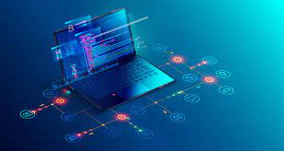
5.Importance of Software Development
Today, it is difficult to imagine a successful business model without online marketing. In the next few years, it will be one of the top ways that determines how well your business grows. Businesses need online platforms and mobile apps because they impact how customers reach you and shop for your products and services.
Using a well-built platform can result in a huge increase in revenue. Here are some of the most crucial benefits your business can get from proper software development.

Slide 13
1. Promote your business:
Software development takes your business to new heights incorporation. It helps promote and spread your business as it enables your brand to be visible for everyone and almost anywhere through a computer or smartphone.
2. Improves sales and service:
It is important to know how your customers think about your brand and products. If you want to know their opinion and want them to give a positive comment, then you must have an online platform to let customers reach out to you easily and share their opinion about your products and services.
3. Direct communication:
Software development is the only thing that can help you have direct communication with the clients. No other strategy can help you do direct communication with your customers. It is the fastest way to increase your brand awareness.
4. Increases customers’ engagement
Every business wants to increase its list of loyal customers. But how a business can increase its number of customers? The answer is online marketing. Businesses need to implement online marketing strategies. You can boost the customers’ engagement with the help of a mobile app or website and make them come back to you and not to your rival.
5. Helps in marketing your business
Software development helps to apply on-the-go marketing of your business thus promoting your products and services at any place without any additional money spent or extra time required. Your customers can reach you from anywhere throughout the world.

Slide 14
6.Conclusion
Software development is the process programmers use to build computer programs. The process, also known as the Software Development Life Cycle (SDLC), includes several phases that provide a method for building products that meet technical specifications and user requirements.
The SDLC provides an international standard that software companies can use to build and improve their computer programs.
The aim of the IT software development process is to build effective products within a defined budget and timeline..

Slide 15
RESOURCES
Links:
https://en.wikipedia.org/wiki/Software
https://www.indeed.com/career-advice/career-development/what-is-software-development
https://en.wikipedia.org/wiki/Software_development
https://www.javatpoint.com/what-is-software
PHOTOS
https://www.javatpoint.com/what-is-software
https://dailytechtime.com/latest-software-development-trends-that-works-in-2021/
https://www.alibaba.com/product-detail/CryptoCurrency-Buy-Sell-and-Trading-Software_62441404842.html

Slide 16
THANKS!
Do you have any questions?
eugen.lunguleasa@student.upt.ro

