Slide 1
REVIEW 1 · PROBLEM & SOLUTION PROPOSAL
CAPSTONE PROJECT
TrekLink Operations Platform
Off-grid trekking safety and operations over a LoRa mesh · Presenter: Đỗ Đăng Khoa
TEAM MEMBERS
MENTOR(S)
Đỗ Đăng Khoa, Team Leader
Lâm Phi Long, Member
Trần Khải Hoàng, Member
Nguyễn Ngọc Long, Member
Nguyễn Bá Tân, Member
Mentor: Đặng Ngọc Minh Đức
FA26SE159 · GFA26SE55

Slide 2
2
Context
WHY IT MATTERS
The situation
A system, with platform seams
Trekking agencies run multi-day routes through Vietnam's cellular dead zones.
Affected: operators at base, guides in the field, customers on the trail.
Summer 2026: our LoRa mesh firmware sends SOS, fall alerts and positions without coverage.
Nothing yet carries that data to the people who must act on it.
Scope: web system, gateway, targeted firmware work.
We build one operations system for one agency.
Beyond that, four seams:
· new field transports plug in (D-007)
· every business rule is configuration (D-015)
· stock Meshtastic devices and apps keep working (D-019)
· staff roles extend as data
Presenter: Đỗ Đăng Khoa
TrekLink · Capstone Project, Review 1 · GFA26SE55

Slide 3
3
Existing Situation & Problems
PAIN POINTS
1
Field events are lost
2
An SOS goes nowhere
The node's queue holds 16 events in RAM and drops the oldest: in an outage the SOS goes first (MQTT.cpp:821).
A device SOS raises a local radio alarm. No one is assigned, nothing is recorded.
3
No operational records
4
Impact
Devices, rentals and trips are tracked in no system; coordination is by phone.
Response depends on who notices; no audit trail after an emergency; custody disputed by memory.
Presenter: Lâm Phi Long
TrekLink · Capstone Project, Review 1 · GFA26SE55

Slide 4
4
Proposed Solution
OUR APPROACH
In one sentence
Approach and boundary
A web operations system plus gateway that delivers every field event exactly once, turns each SOS into one owned incident, and runs the fleet, rentals and trips.
Lost events: durable priority queues, SOS first, eventId deduplication.
SOS goes nowhere: one incident per episode, alert in 2 s, full audit trail.
No records: booking, rental, 7-state device lifecycle, sandbox billing.
React web app · NestJS backend · Node.js gateway · MQTT · PostgreSQL · MapLibre on Goong Maps.
Out of scope: mesh-stack rearchitecture, native apps, real payments, route recommendation, localization, hardware certification, multi-tenancy.
Presenter: Đỗ Đăng Khoa
TrekLink · Capstone Project, Review 1 · GFA26SE55

Slide 5
5
Key Features
PRODUCT SCOPE
1
Offline-safe sync
2
SOS to incident
3
Live monitoring
Every event arrives exactly once, SOS first after an outage.
One episode, one incident: owned, acknowledged, closed, audited.
One map of trips, devices and incidents, scoped by role.
4
Booking and rental
5
Return and billing
6
Rules as configuration
From a booking to a provisioned device in the Guide's hands.
Inspection, itemized fees, deposit first, sandbox payment.
Every fee, threshold and window changeable live.
Presenter: Trần Khải Hoàng
TrekLink · Capstone Project, Review 1 · GFA26SE55

Slide 6
6
Actors & Their Functions
WHO USES THE SYSTEM
Actor | Key Functions
Guest | Browse packages · Register
Customer | Book · Pay · Sign agreement · View own history
Operator (Staff) | Confirm bookings · Allocate and provision devices · Check out and in · Inspect · Coordinate incidents
Guide (Staff) | Confirm handover · Start and end trip · Acknowledge incidents · Report from the field · Own trips only
Admin (Staff) | Users and roles · Pricing and parameters · Device catalogue · Audit and health
Device, Gateway, Scheduler | Emit SOS and positions · Buffer and deliver events · Expire holds, flag stale, escalate
Presenter: Nguyễn Ngọc Long
TrekLink · Capstone Project, Review 1 · GFA26SE55

Slide 7
7
Main Flow 1: Booking to Rental to Trip Preparation
CORE SCENARIO
1
2
3
4
5
Book
Confirm
Allocate
Sign and pay
Check out
Customer books a package; one device is held for 10 minutes.
Operator confirms, seeing device and Guide conflicts first.
Operator allocates devices, loads the fleet key, generates the agreement.
Customer signs; deposit paid; Guide confirms handover and checklist.
Devices move to Rented; the trip is ready to start.
Exception: Two customers take the last device at once: one is told it is no longer available.
Presenter: Nguyễn Bá Tân
TrekLink · Capstone Project, Review 1 · GFA26SE55

Slide 8
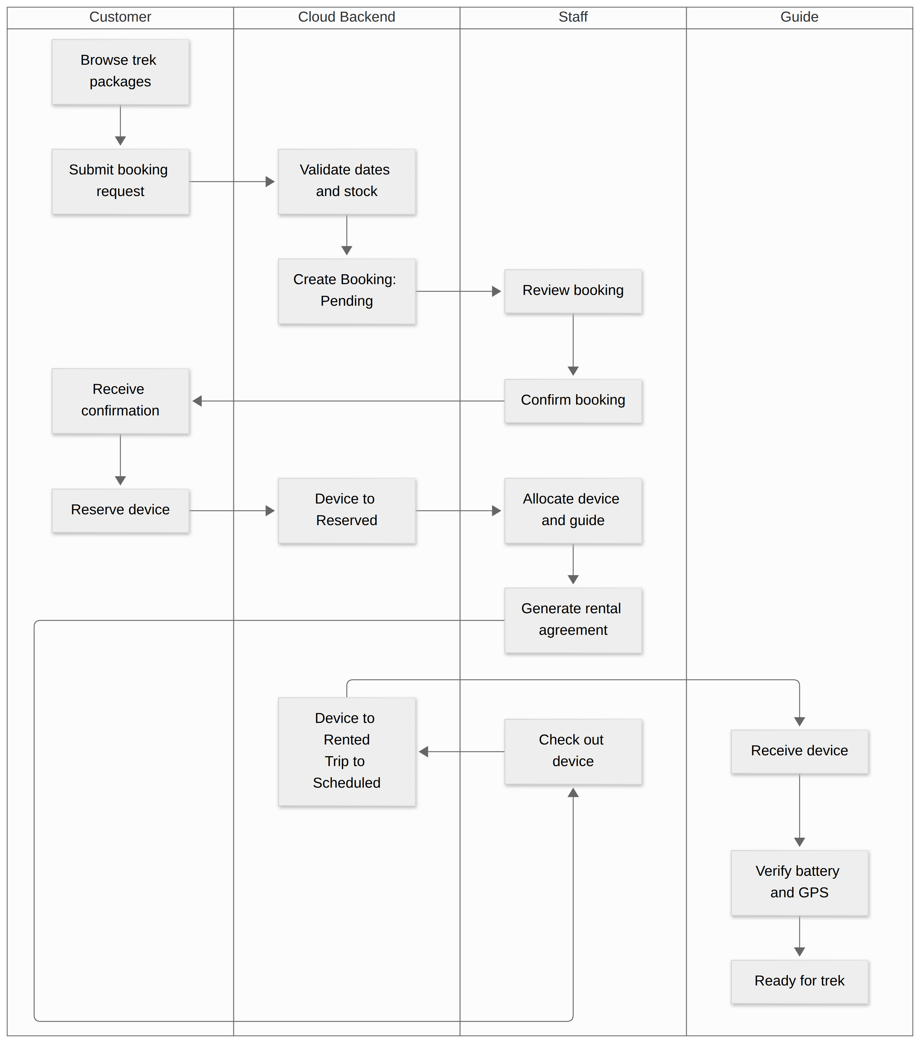
8
Main Flow 1 swimlane
MAIN FLOW DIAGRAM
Presenter: Đỗ Đăng Khoa
TrekLink · Capstone Project, Review 1 · GFA26SE55

Slide 9
9
Main Flow 2: Field Data to Offline Gateway to Cloud Sync
CORE SCENARIO
1
2
3
4
5
Broadcast
Classify
Hold
Flush
Deduplicate
Device sends SOS, position or telemetry over the LoRa mesh.
Event tagged P0 to P3 and queued durably before any send.
Uplink down: held on the device (Stage B) and at basecamp (Stage C).
Uplink back: strict priority order, SOS first.
Backend keys it by eventId; a replay is a no-op.
Exception: The same packet delivered 10 times creates 0 duplicate incidents.
Presenter: Đỗ Đăng Khoa
TrekLink · Capstone Project, Review 1 · GFA26SE55

Slide 10
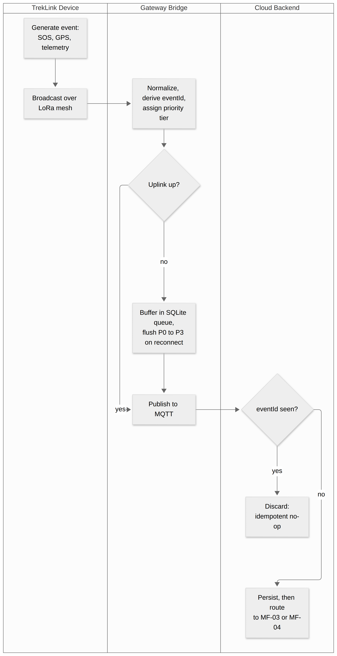
10
Main Flow 2 swimlane
MAIN FLOW DIAGRAM
Presenter: Đỗ Đăng Khoa
TrekLink · Capstone Project, Review 1 · GFA26SE55

Slide 11
11
Main Flow 3: SOS to Incident to Emergency Response
CORE SCENARIO
1
2
3
4
5
SOS
One incident
Alert
Acknowledge
Resolve
Button, gesture or fall detection triggers the SOS.
Backend opens one incident per episode, or appends to it.
Guide and Operators alerted within 2 seconds.
First acknowledgement takes ownership and starts the clock.
In Progress, Resolved, Closed: each with actor, time and note.
Exception: The SOS text frame is lost: beacon cadence raises a Suspected incident.
Presenter: Trần Khải Hoàng
TrekLink · Capstone Project, Review 1 · GFA26SE55

Slide 12
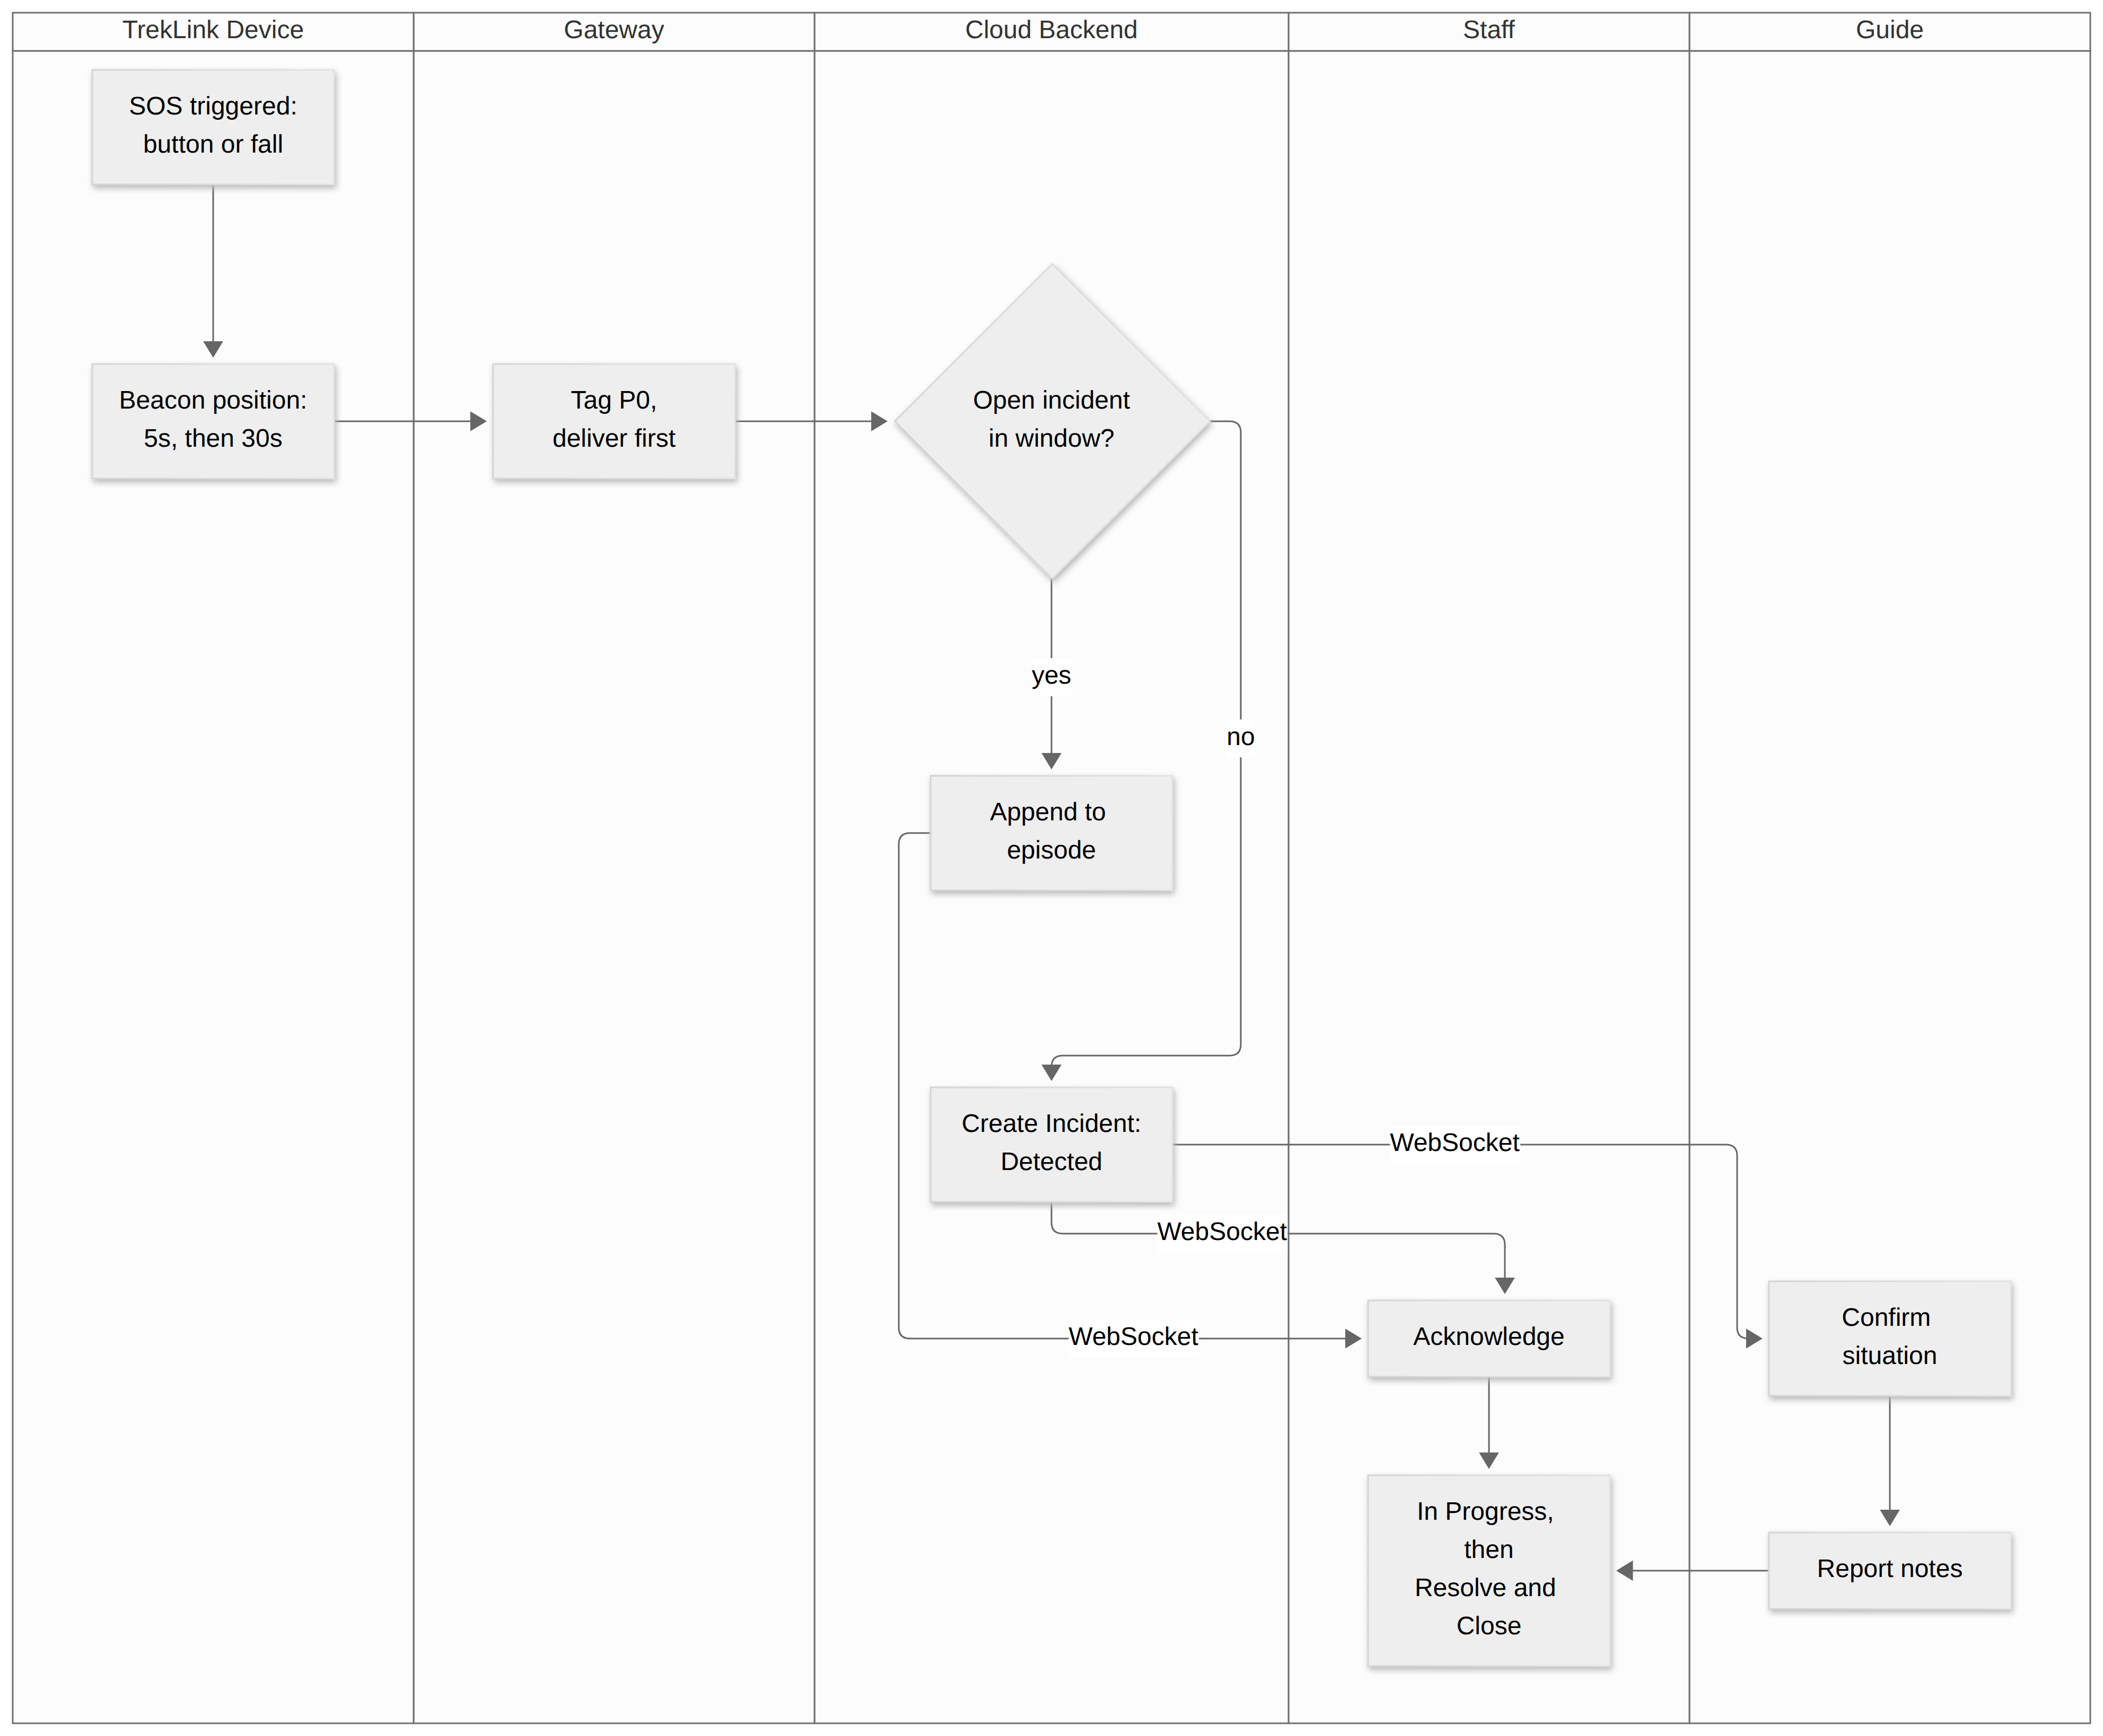
12
Main Flow 3 swimlane
MAIN FLOW DIAGRAM
Presenter: Đỗ Đăng Khoa
TrekLink · Capstone Project, Review 1 · GFA26SE55

Slide 13
13
Main Flow 4: Real-Time Trip Monitoring
CORE SCENARIO
1
2
3
4
5
Ingest
Update
Scope
Show
Age
Positions and telemetry arrive through Main Flow 2.
Backend updates position, battery and last-seen.
Server pushes only what each role may see.
Map shows status, battery, last-seen and incidents.
Silent devices and gateways turn visibly stale.
Exception: A Guide asks for another Guide's trip and is refused on the server.
Presenter: Nguyễn Ngọc Long
TrekLink · Capstone Project, Review 1 · GFA26SE55

Slide 14
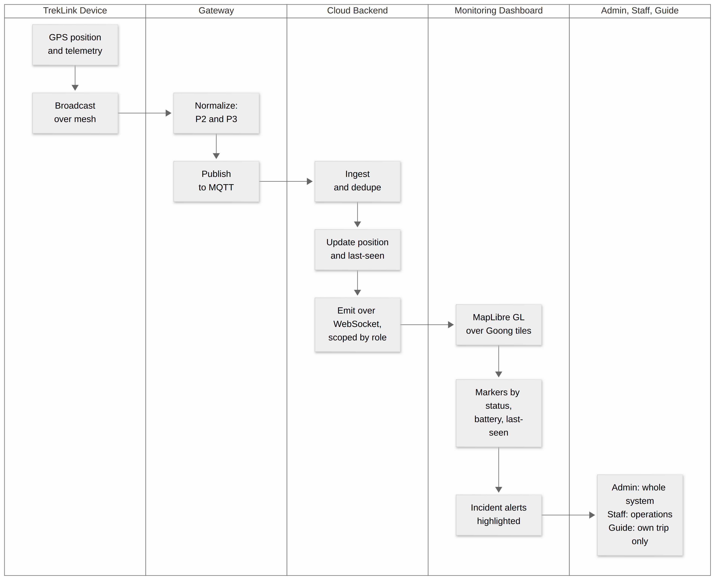
14
Main Flow 4 swimlane
MAIN FLOW DIAGRAM
Presenter: Đỗ Đăng Khoa
TrekLink · Capstone Project, Review 1 · GFA26SE55

Slide 15
15
Main Flow 5: Return to Inspection to Billing to Maintenance
CORE SCENARIO
1
2
3
4
5
Collect
Check in
Charge
Settle
Dispose
Guide collects every device and ends the trip.
Operator checks devices in and inspects them.
Base, late and damage fees computed; deposit applied first.
Balance paid or refunded in sandbox; rental closes.
Device back to Available, to Maintenance, or Retired.
Exception: Payment fails: the rental stays open with the balance visible.
Presenter: Lâm Phi Long
TrekLink · Capstone Project, Review 1 · GFA26SE55

Slide 16
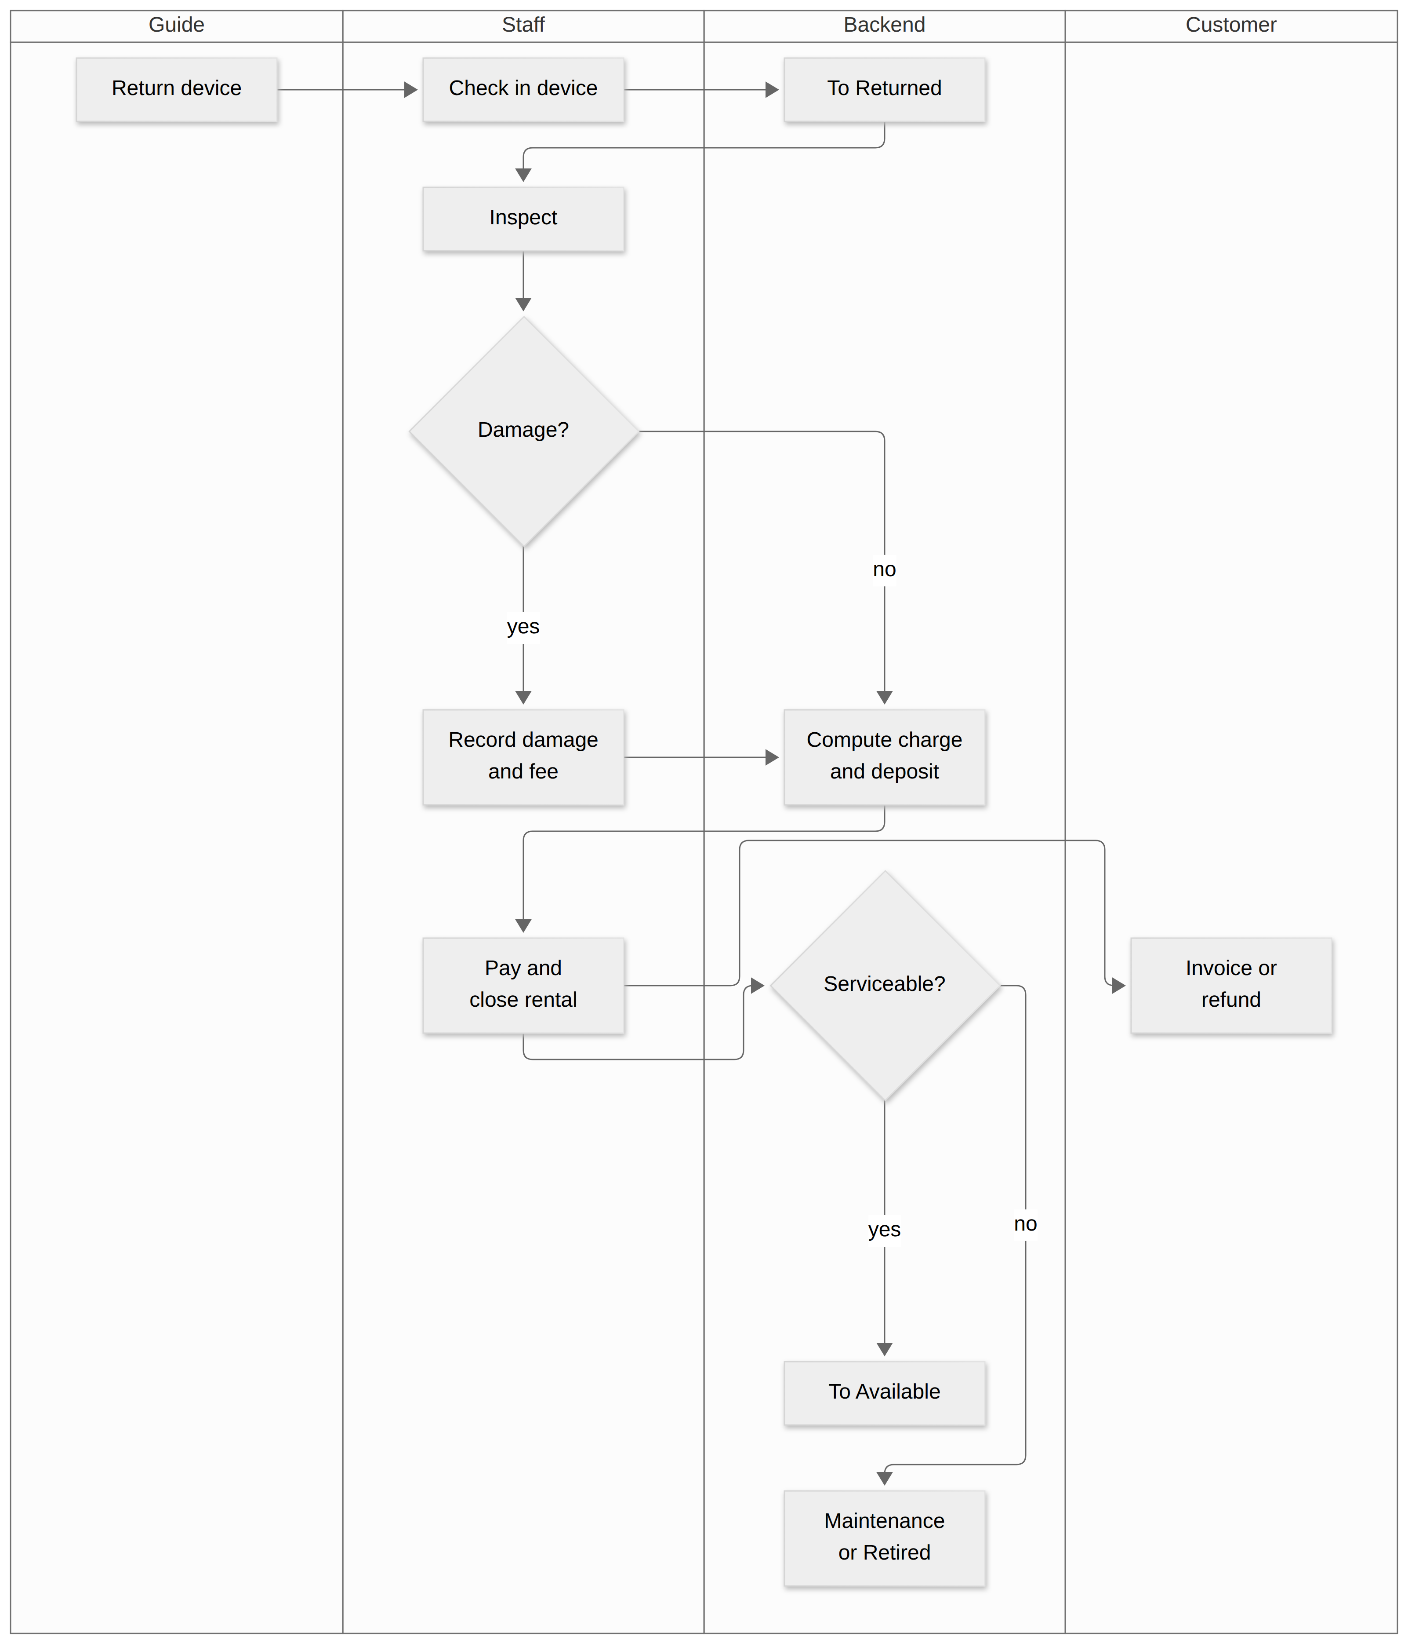
16
Main Flow 5 swimlane
MAIN FLOW DIAGRAM
Presenter: Đỗ Đăng Khoa
TrekLink · Capstone Project, Review 1 · GFA26SE55

Slide 17
17
Scope, stated now
BOUNDARY
In scope
Out of scope
Five Main Flows.
58 use cases, 112 functional requirements (SRS §2, §3).
Gateway with offline queue.
Targeted firmware work: on-device queue, fleet channel key.
Mesh-stack rearchitecture
Native mobile apps
Production payment
Route recommendation
Localization of the system
Hardware certification
Multi-tenancy
Presenter: Đỗ Đăng Khoa
TrekLink · Capstone Project, Review 1 · GFA26SE55

Slide 18
18
How we will know it works
MEASURED TARGETS
Property | Target
Gateway to cloud sync | ≤ 5 s when the uplink is available
Offline recovery | ≥ 99 % delivered after a 30 s to 30 min loss
Duplicate prevention | 0 duplicate incidents across a 10× replay
Priority ordering | ≥ 99 %: all P0 before any P2 or P3
Incident alert | ≤ 2 s from creation to connected clients
API latency | ≤ 300 ms at p95, 50 concurrent users
Presenter: Nguyễn Ngọc Long
TrekLink · Capstone Project, Review 1 · GFA26SE55

Slide 19
19
Top risks
RISK AND MITIGATION
Risk (impact) | Mitigation
SOS announced by one unacknowledged radio frame (Critical) | Cadence-anomaly detection now; firmware marker on every beacon
Node queue drops the SOS first in an outage (Critical) | On-device durable priority queue, Stage B
Map tiles misrepresenting national sovereignty (Critical) | Goong Maps held in configuration; sovereignty screenshots to file
Few physical devices for radio testing (High) | Simulation supplements, never presented as radio evidence
Presenter: Nguyễn Ngọc Long
TrekLink · Capstone Project, Review 1 · GFA26SE55

Slide 20
20
Plan to Review 2
GATES
Gate | Assessed
Review 1, W4 | Problem, scope, requirement baseline
Review 2, W8 | Design baseline; MF-01 and MF-02 demonstrated
Faculty Council, W13 | Final product, main flows and 85 % of use cases
Submission and defence, W15 | Complete package
Presenter: Nguyễn Ngọc Long
TrekLink · Capstone Project, Review 1 · GFA26SE55

Slide 21
21
What we ask
FEEDBACK
We ask the committee to
Thank you
1. Confirm the five Main Flows are the right scope for the term.
2. Confirm the requirement baseline is clear and verifiable.
3. Record feedback against an owner and a deadline; we close it with evidence at Review 2.
Questions.
Presenter: Đỗ Đăng Khoa
TrekLink · Capstone Project, Review 1 · GFA26SE55

