Slide 1
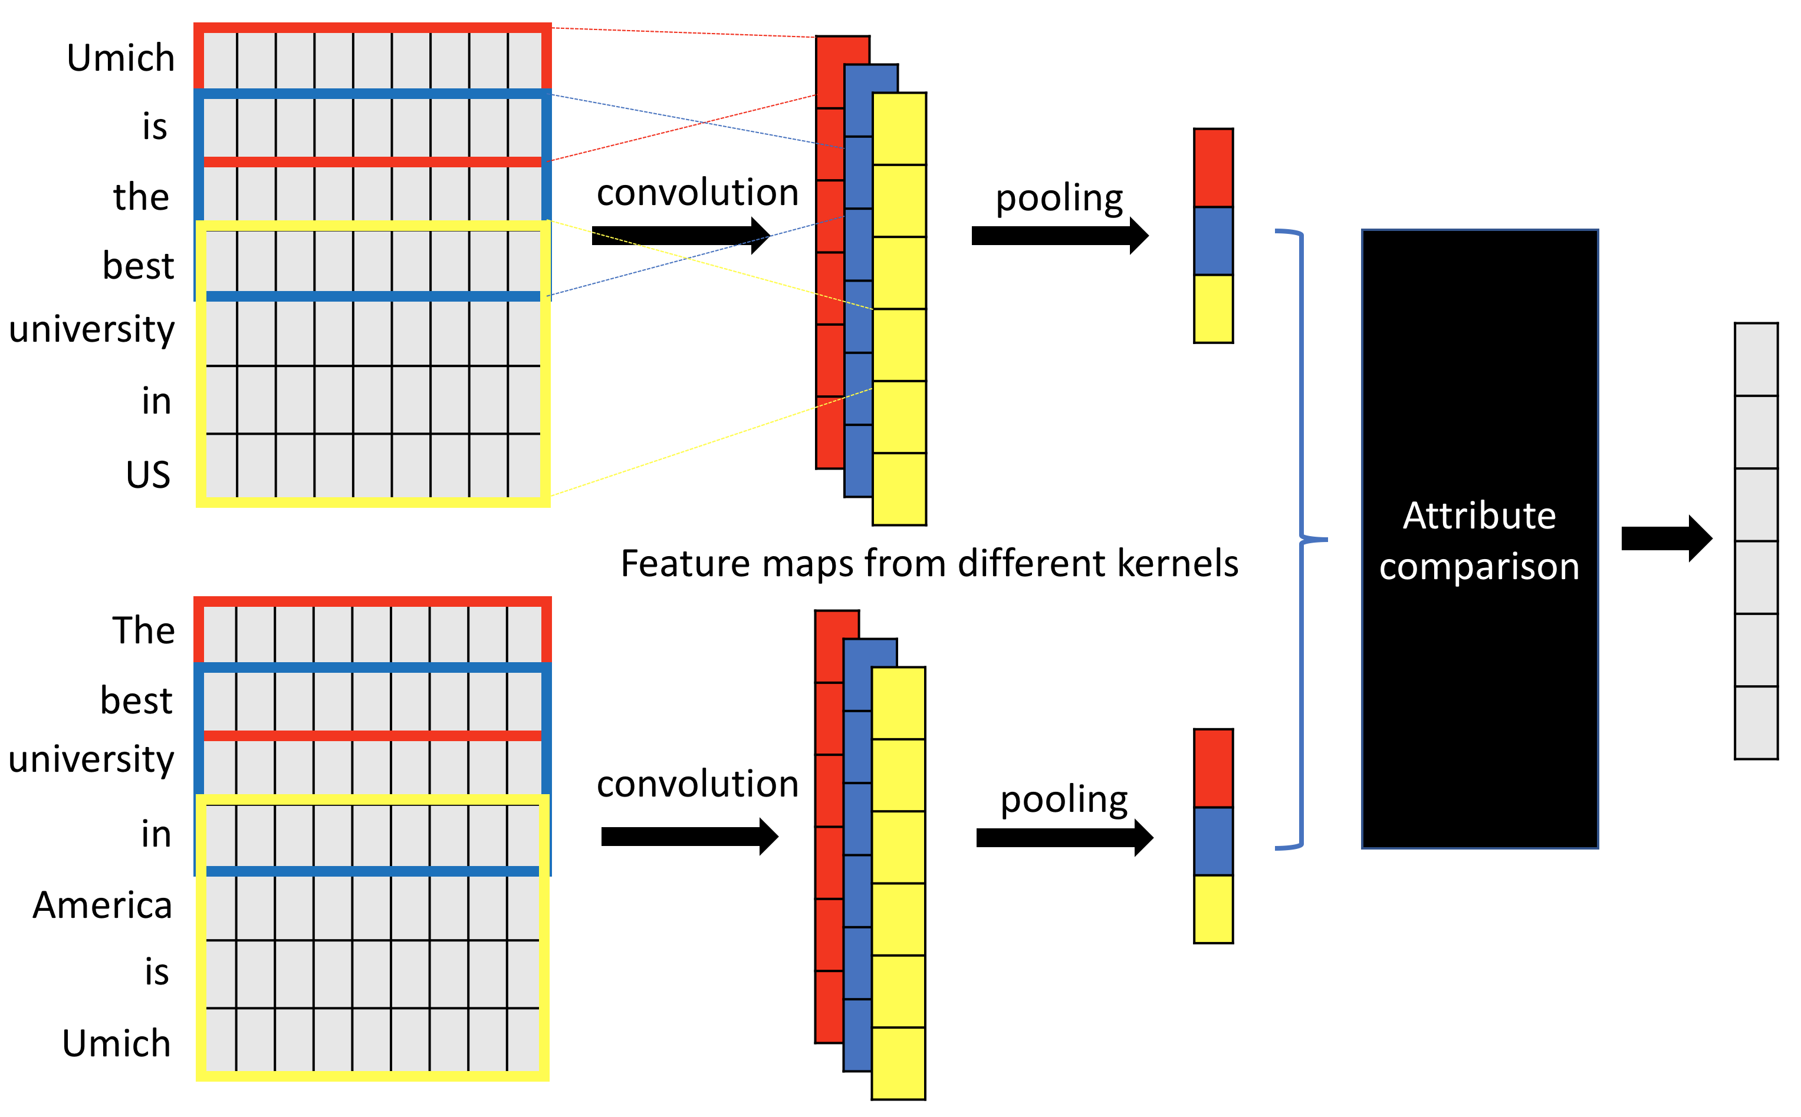
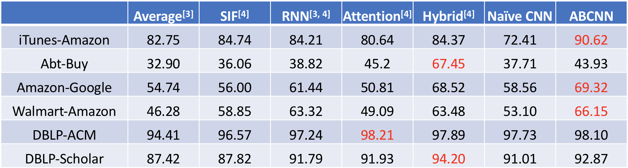
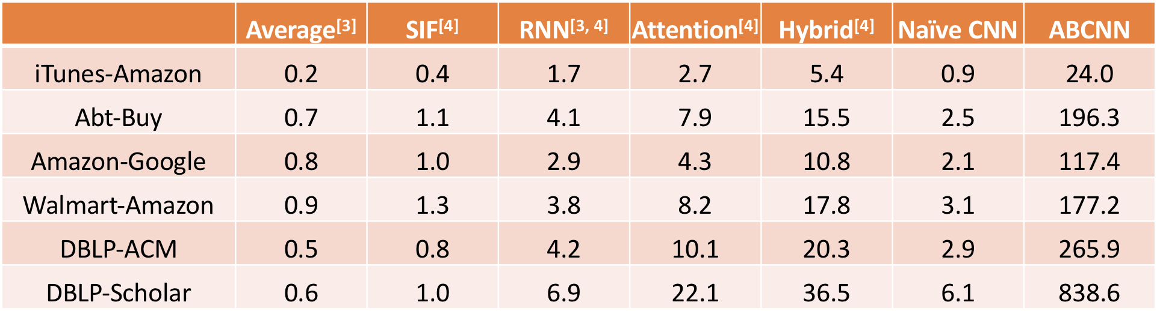
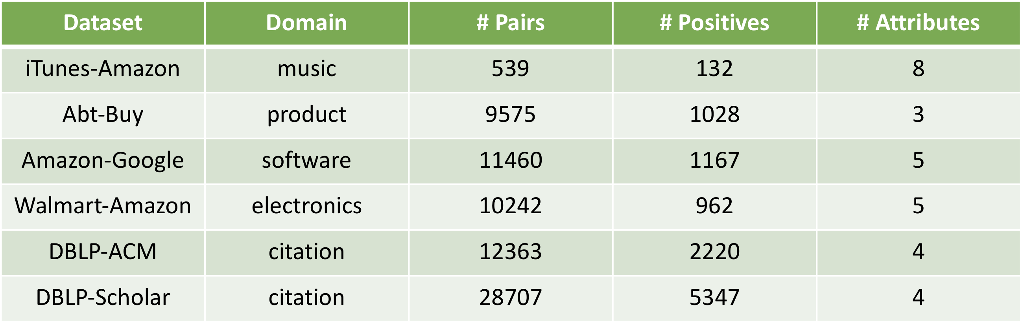
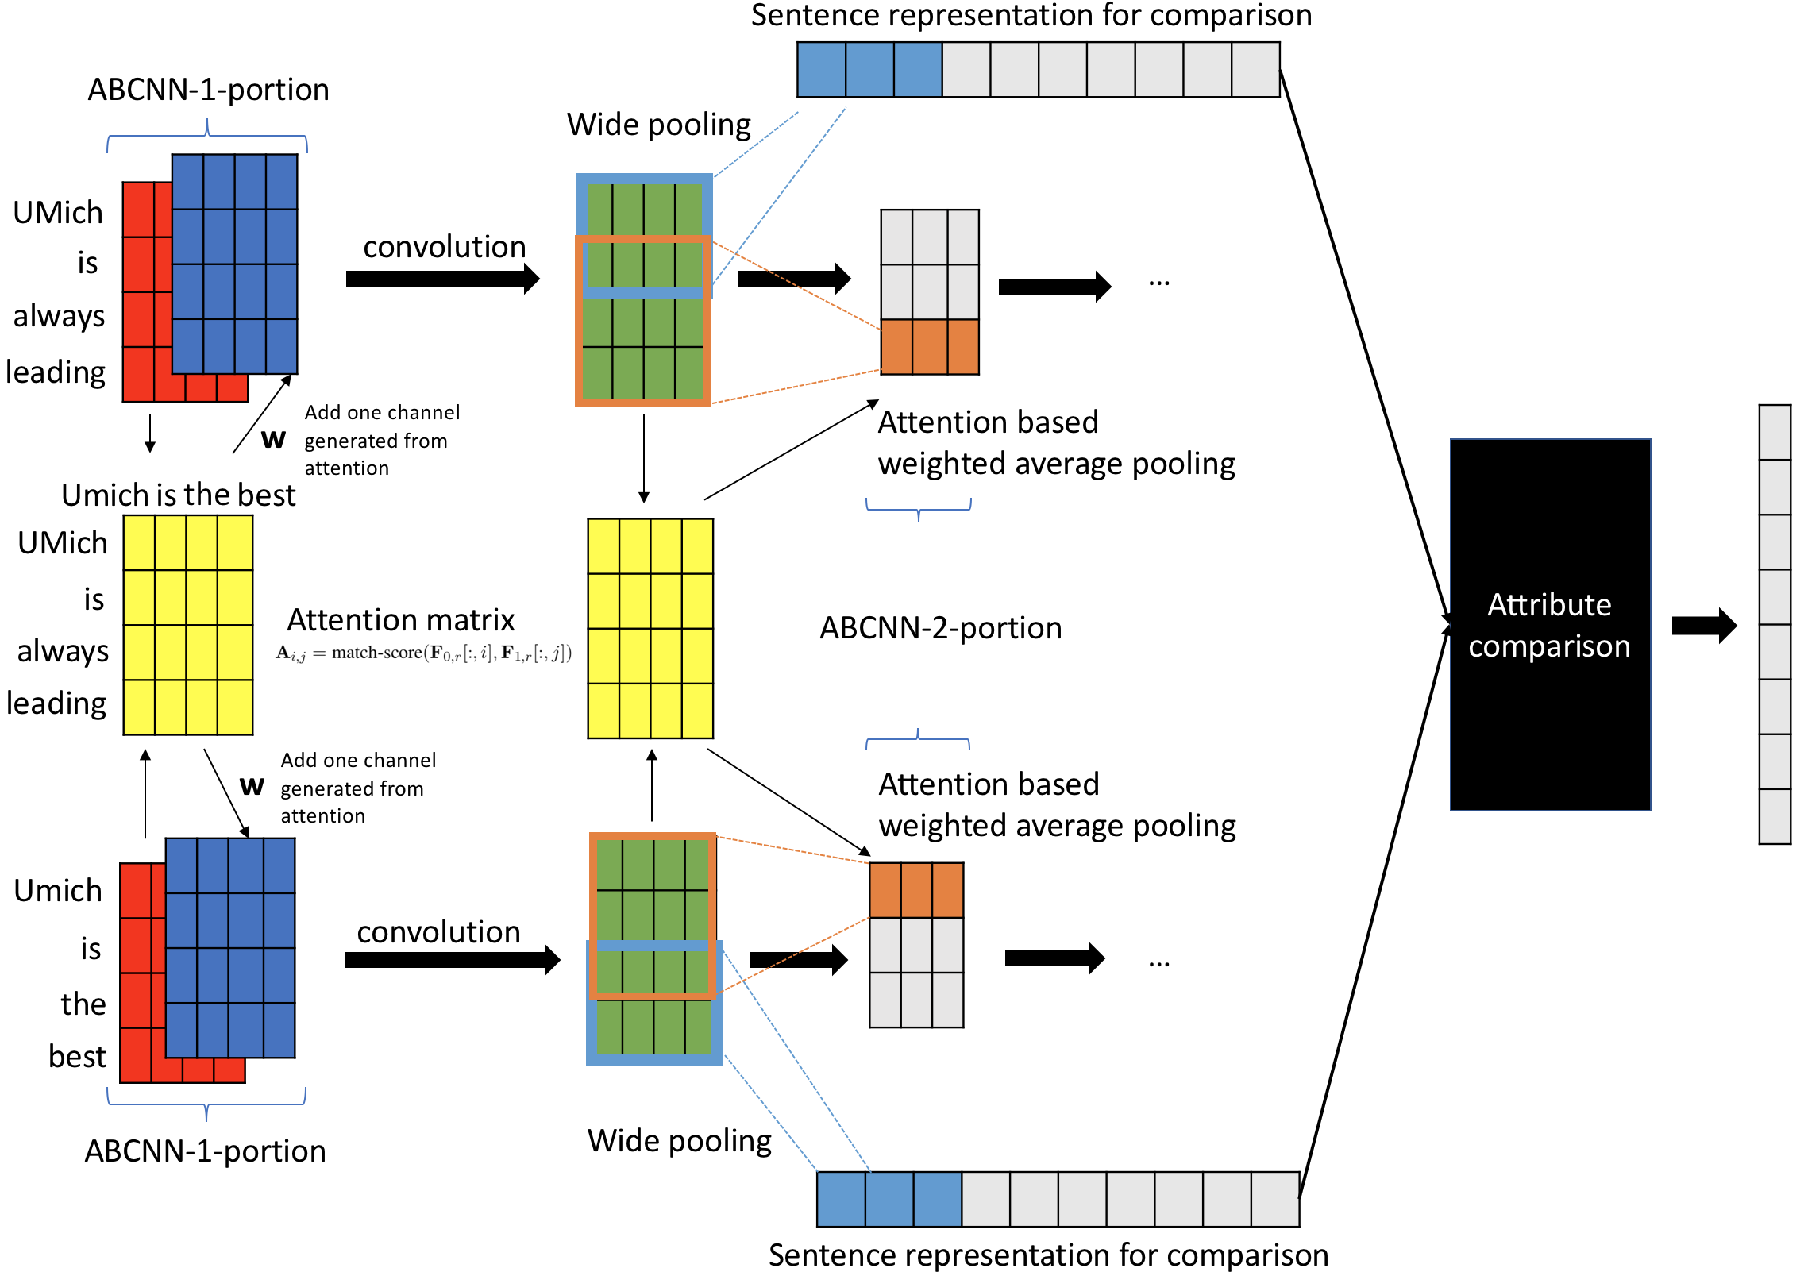
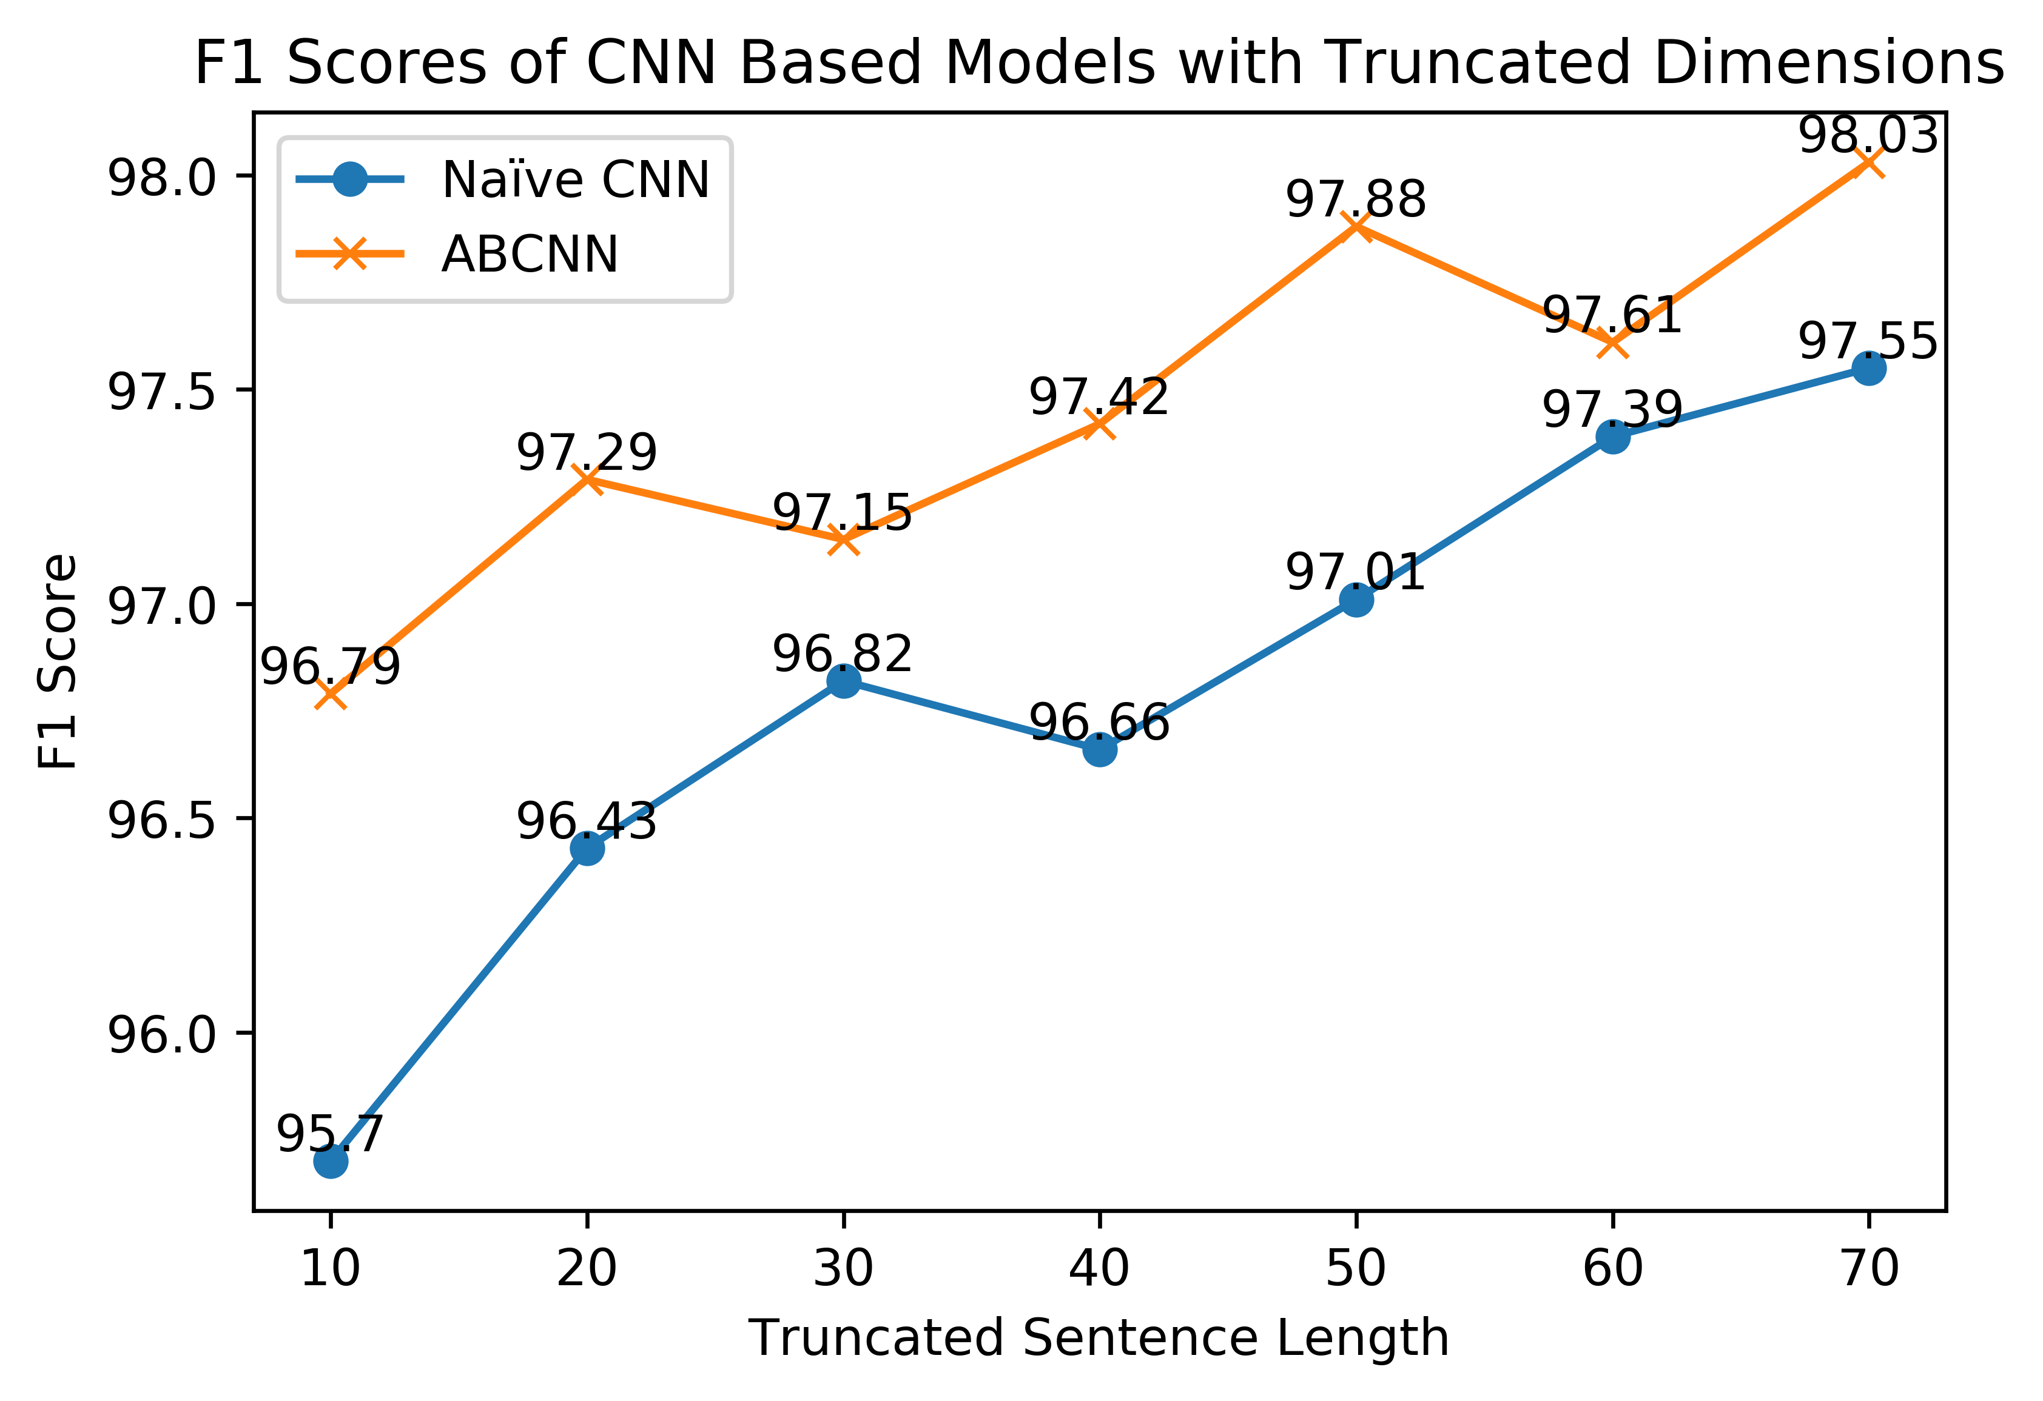
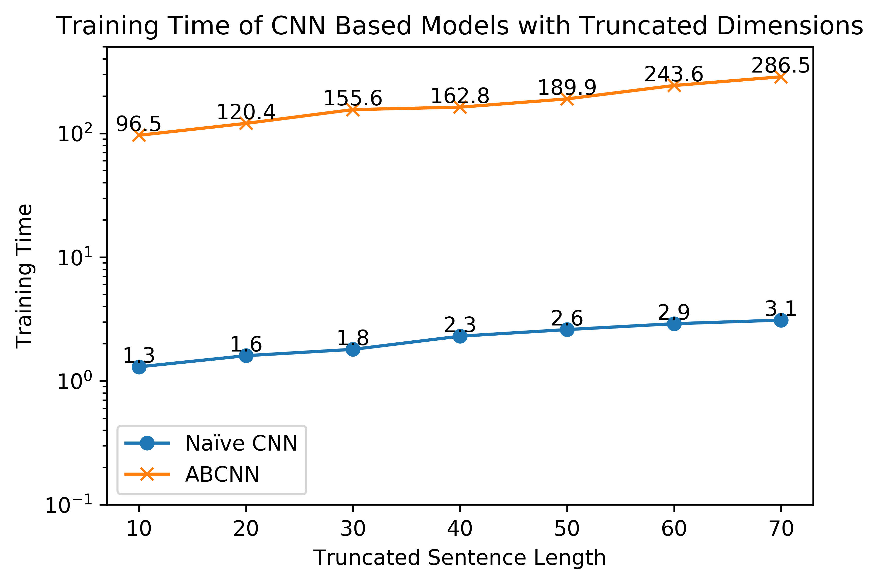
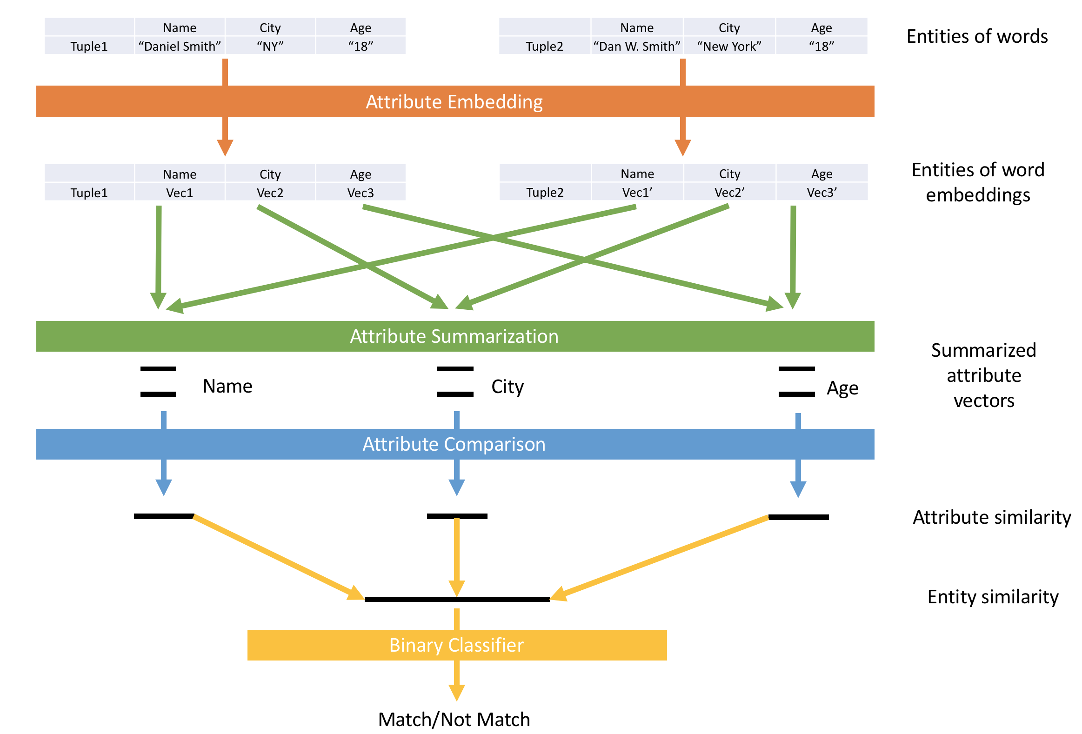
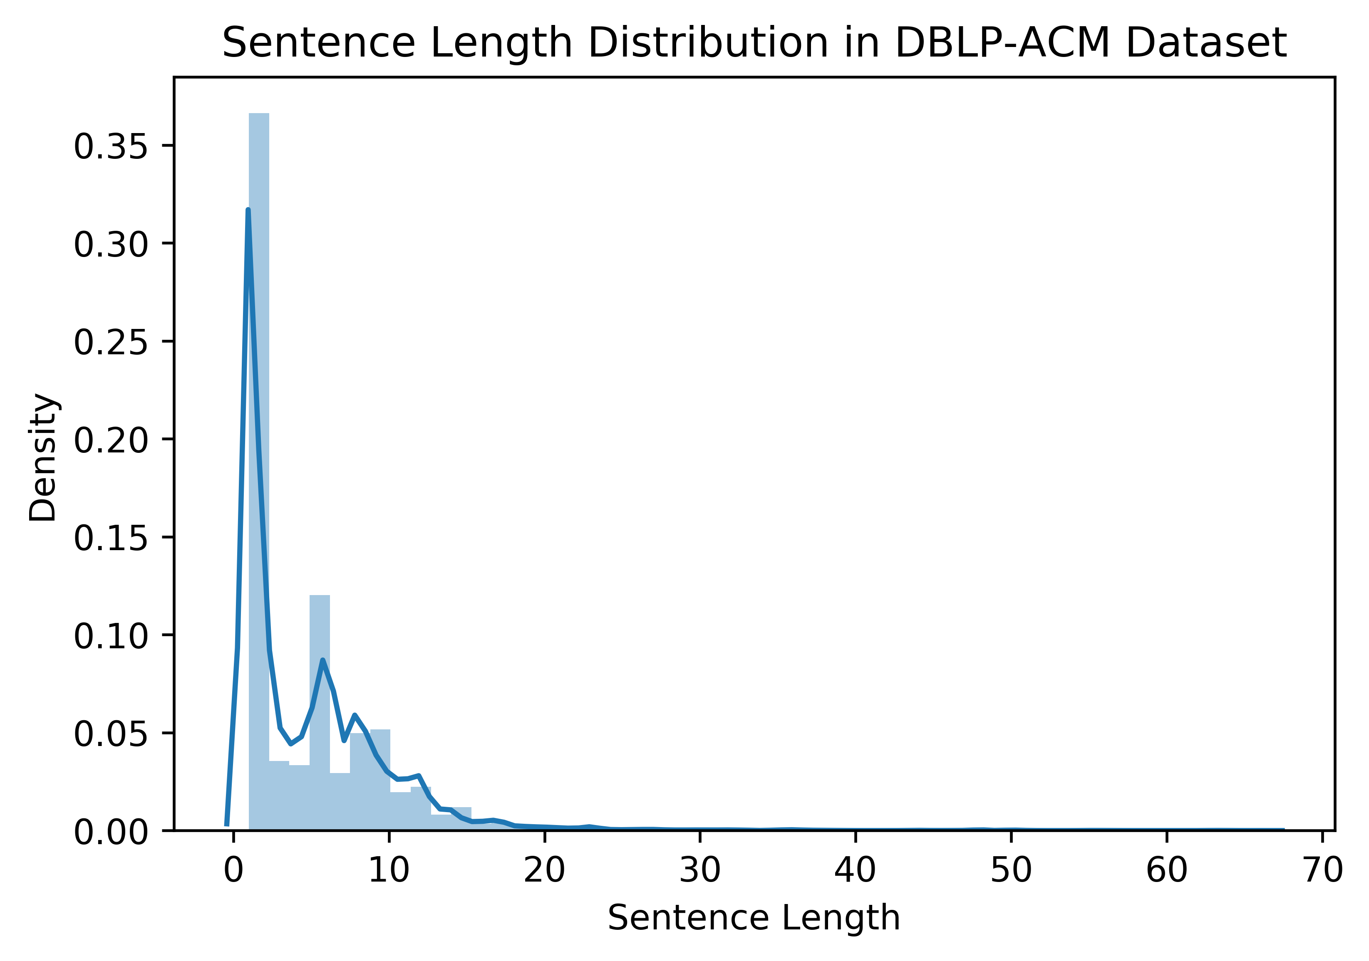
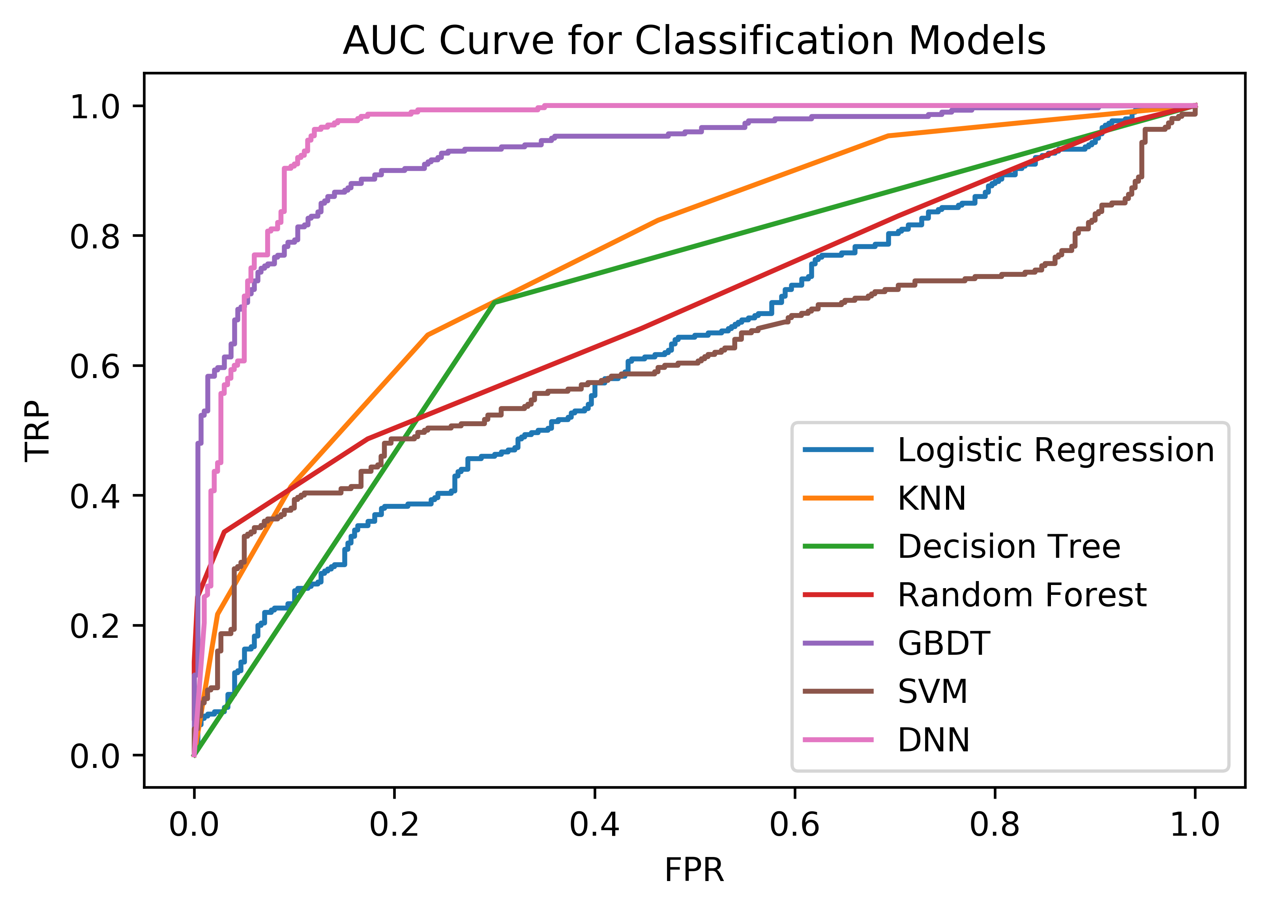
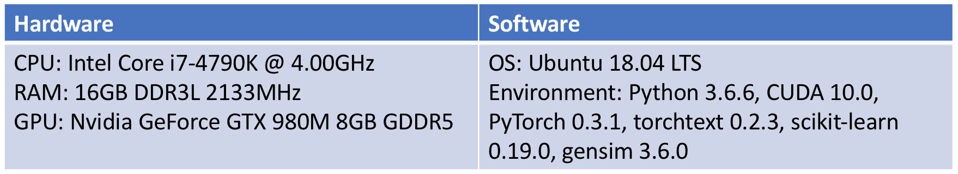
Entity Resolution with Attention Based Convolutional Neural Network
EECS 584, F18 Advanced Database Management Systems
Siyuan Xie¹ Kailin Tang¹
¹ Department of Electrical Engineering and Computer Science, University of Michigan, MI, USA
Problem Definition
Our Approach
Experimental Results
Input: Pairs of tuples from two different datasets
Output: Pairs of matched tuples
Goal: Explore traditional CNN and attention-based CNN in entity resolution
Naïve CNN for Attribute Representation
F1 Scores of Baselines and CNN Based Models
Dataset
Training Time of Baselines and CNN Based Models per Epoch in Seconds
We use the dataset provided in [4] for model evaluation, we split the set of labeled tuple pairs into 3 subsets (train, validation, test) with ratio 3:1:1
Attention Based CNN for Attribute Representation
Performance of CNN Based Models with Truncated Dimensions
System Architecture
Sentence Length Distribution in DBLP-ACM Dataset
AUC Curve for Different Classification Models
References
[1] Y Kim, et al. Convolutional neural networks for sentence classification (2014)
[2] W Yin, et al. ABCNN: Attention-Based Convolutional Neural Network for Modeling Sentence Pairs (TACL 2016)
[3] M Ebraheem, et al. Distributed Representations of Tuples for Entity Resolution (VLDB 2018)
[4] S Mudgal, et al. Deep Learning for Entity Matching: A Design Space Exploration (SIGMOD 2018)
Experimental Setup
Conclusions
ABCNN-based attribute summarization achieves the state-of-art performance for entity resolution
Dimension truncation for tuple representation is helpful for reducing the training time without sacrificing too much performance
Notes:
1

