Slide 1
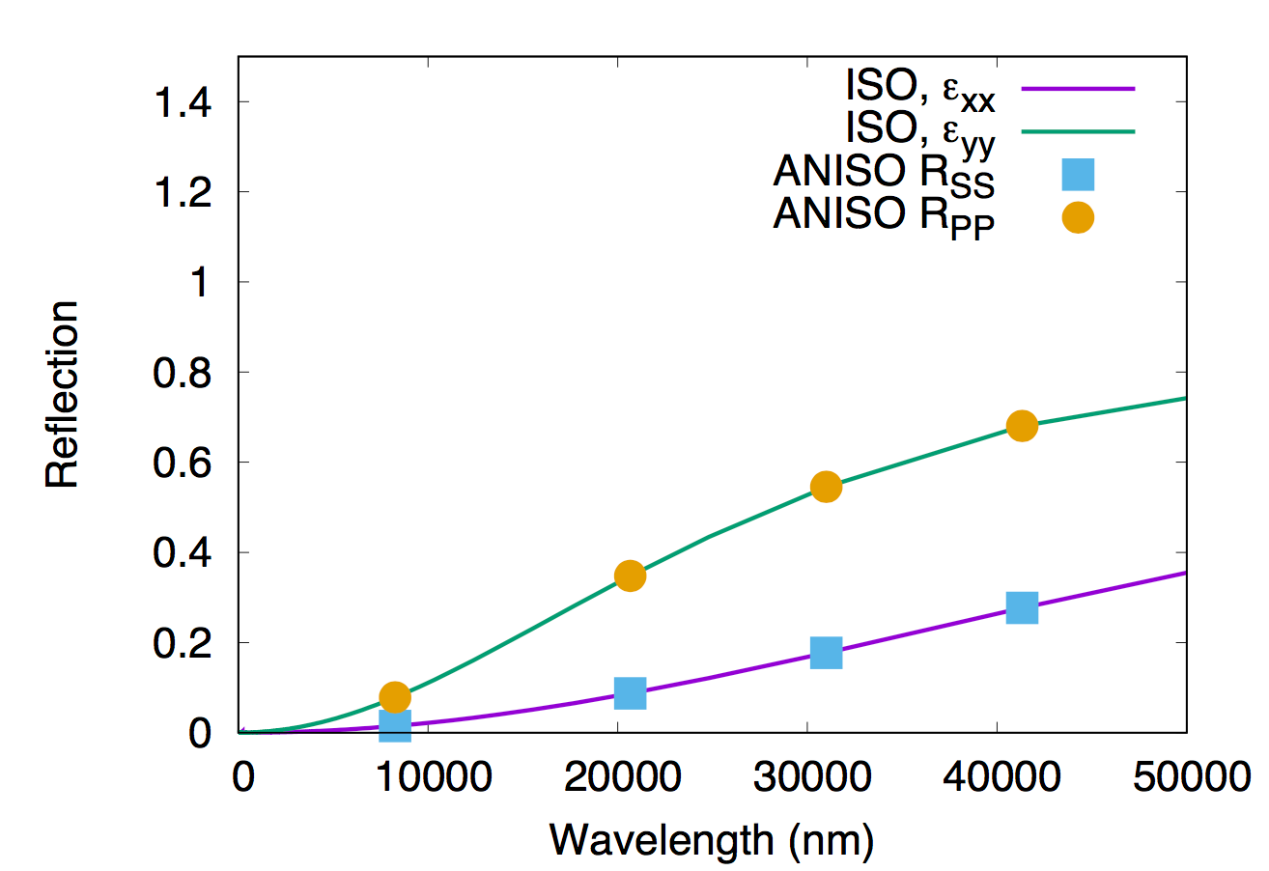
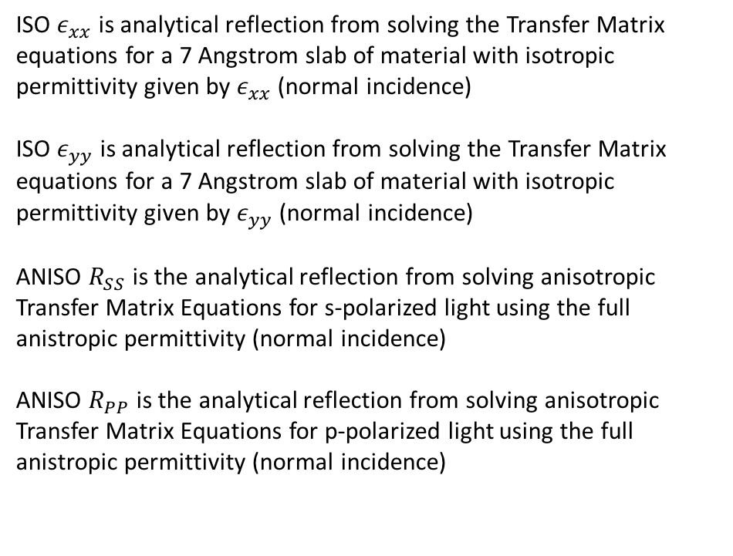
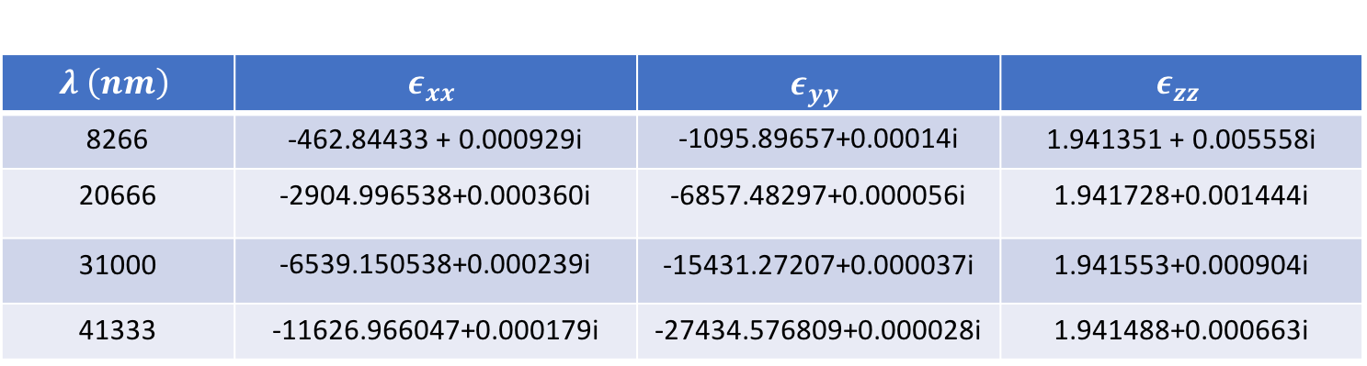
Anisotropic Permittivity Tensor at select wavelengths plotted below
$$λ \left(nm\right)$$ | $$ε_{xx}$$ | $$ε_{yy}$$ | $$ε_{zz}$$
8266 | -462.84433 + 0.000929i | -1095.89657+0.00014i | 1.941351 + 0.005558i
20666 | -2904.996538+0.000360i | -6857.48297+0.000056i | 1.941728+0.001444i
31000 | -6539.150538+0.000239i | -15431.27207+0.000037i | 1.941553+0.000904i
41333 | -11626.966047+0.000179i | -27434.576809+0.000028i | 1.941488+0.000663i
ISO $ε_{xx}$ is analytical reflection from solving the Transfer Matrix equations for a 7 Angstrom slab of material with isotropic permittivity given by $ε_{xx}$ (normal incidence)
ISO $ε_{yy}$ is analytical reflection from solving the Transfer Matrix equations for a 7 Angstrom slab of material with isotropic permittivity given by $ε_{yy}$ (normal incidence)
ANISO $R_{SS}$ is the analytical reflection from solving anisotropic Transfer Matrix Equations for s-polarized light using the full anistropic permittivity (normal incidence)
ANISO $R_{PP}$ is the analytical reflection from solving anisotropic Transfer Matrix Equations for p-polarized light using the full anistropic permittivity (normal incidence)

Slide 2
Air (semi-infinite)
Borophene (7 Angstroms)
Air (semi-infinite)

Slide 3
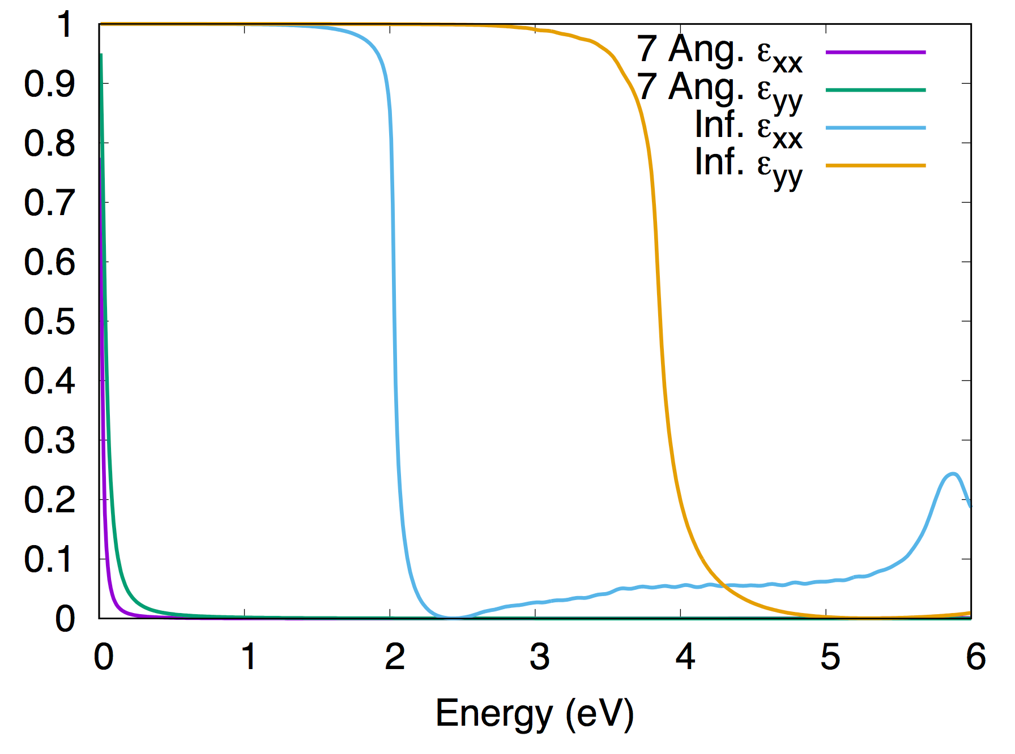

Slide 4
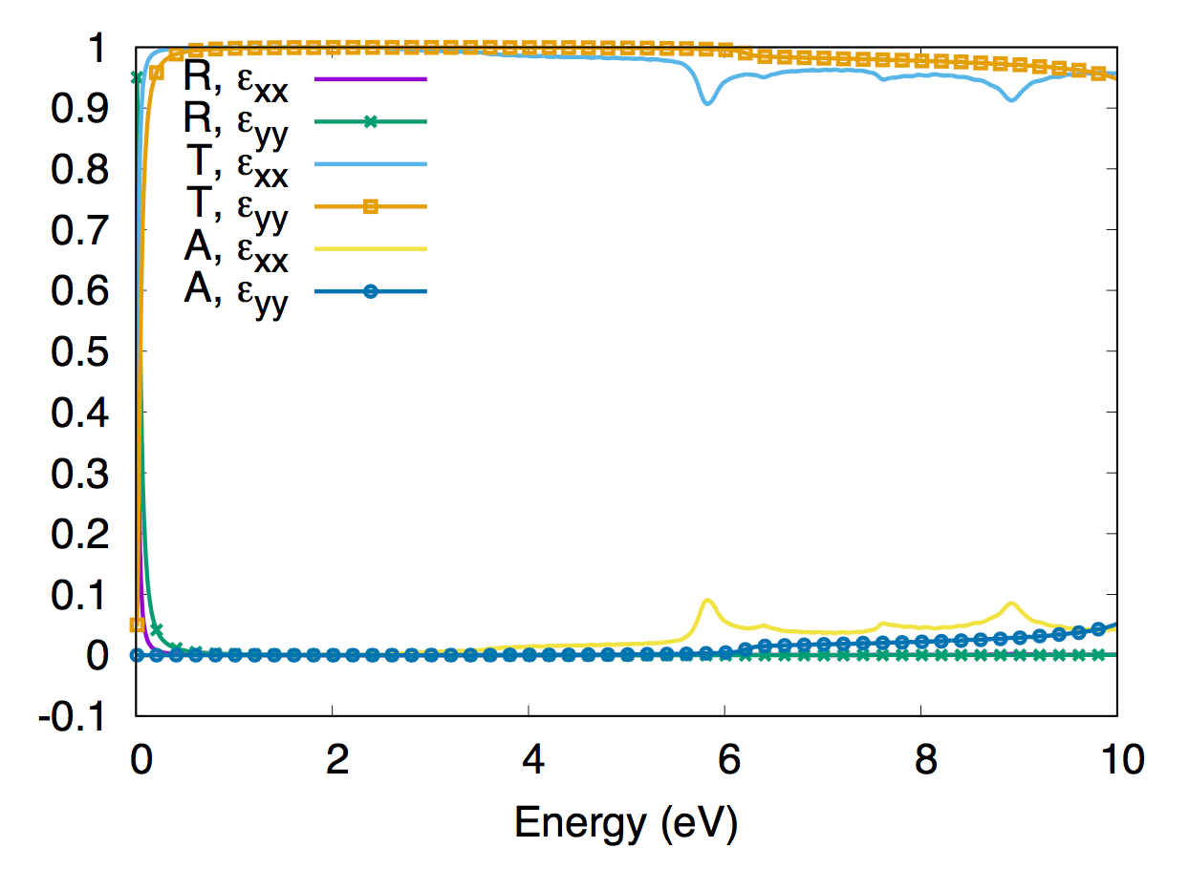

Slide 5
Comparison of Reflection and Transmission using 2-atom epsilon and 10-atom epsilon

Slide 6
Comparison of Absorption and Transmission using 2-atom epsilon and 10-atom epsilon

